Slide 1
Log Based Query Recommendation
Speaker: Rui-Rui Li
Supervisor: Prof. Ben Kao

Slide 2
Outline
Introduction
Motivation
Methods
-using click-through data
-using session data
-context aware query suggestion
-other methods
Conclusion

Slide 3
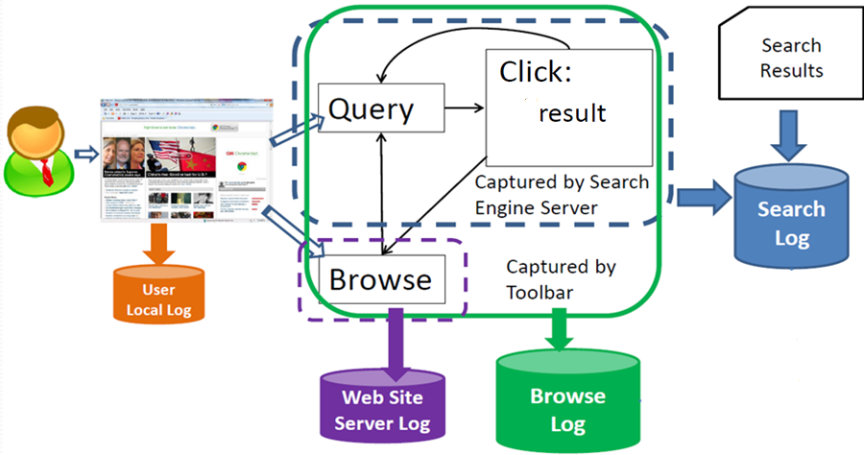
Different Types of Log Data

Slide 4
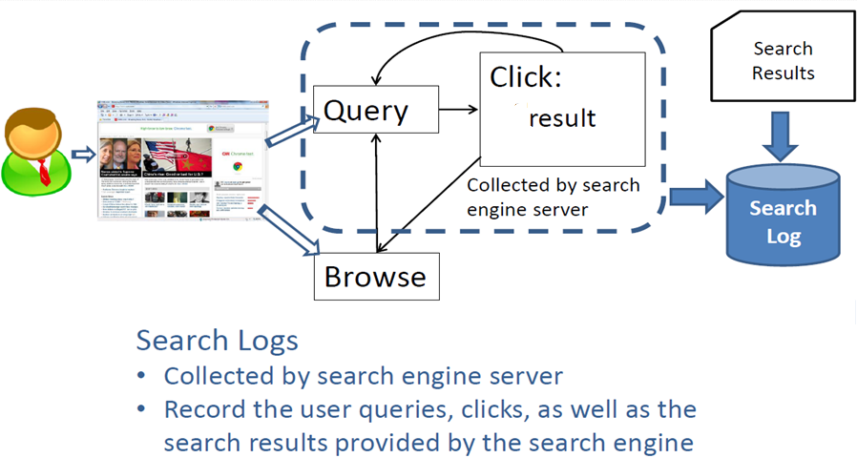
Different Types of Log Data :Search Log

Slide 5
Major Information in Search Logs
Four categories information
-User info: user ID & IP
-Query info: query text, time stamp, location, search device, etc
-Click info: URL, time stamp ,etc
-Search results:
Query suggestions, deep links, etc

Slide 6
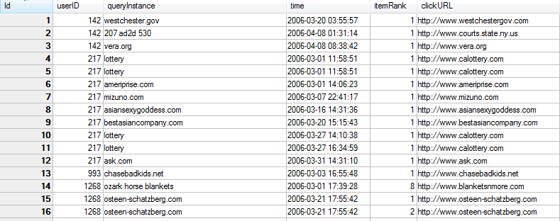
AOL search log

Slide 7
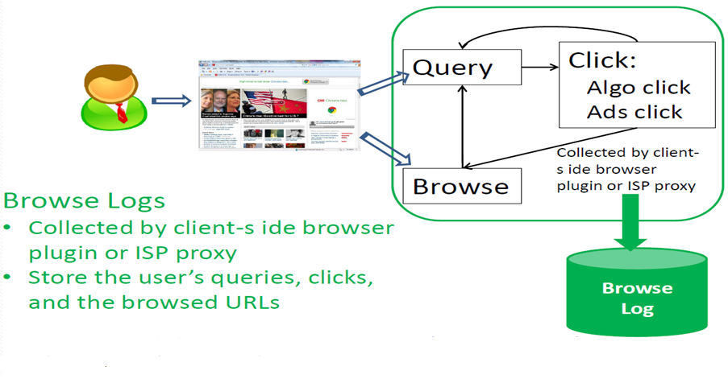
Different Types of Log Data :Browse Log

Slide 8
Major Information in Browse Logs
Not only the search requests from the clients but also all of the HTTP requests pass through the proxy server.
Compared with search engine logs, a proxy server’s log can record richer information, the recorded search requests are not limited to certain search engines.

Slide 9
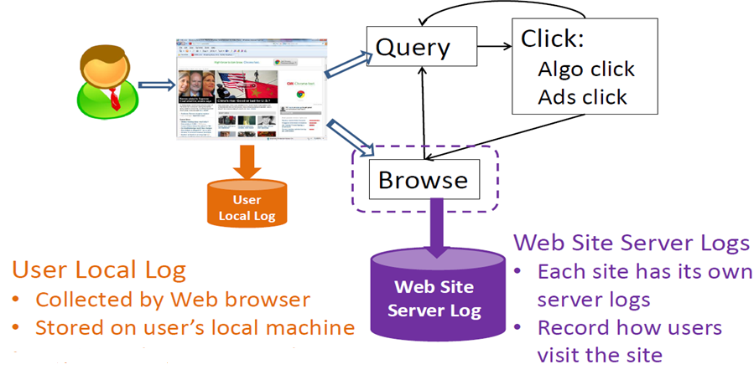
Different Types of Log Data :Other Logs

Slide 10
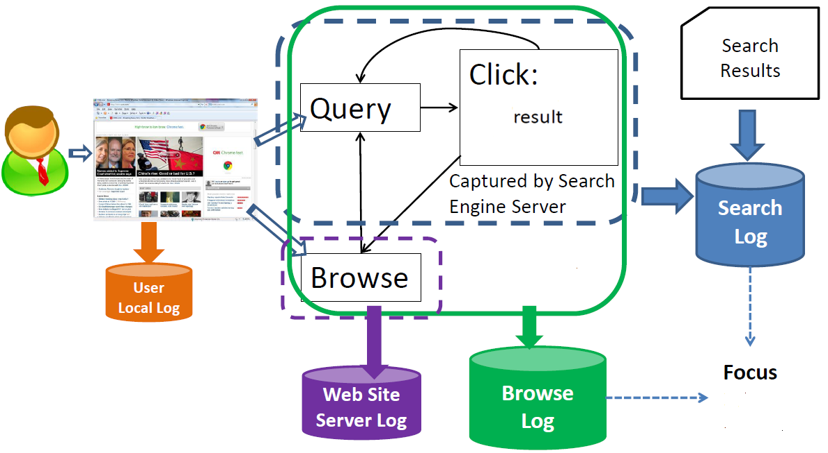
Different Types of Log Data

Slide 11
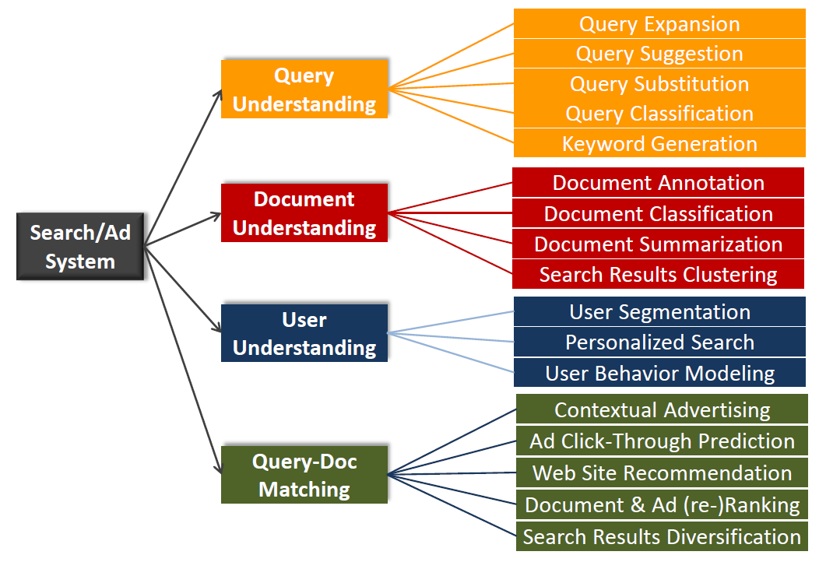
Log mining applications

Slide 12
Motivation
People may not know what they really want at the first beginning.
-hoping the search engine may aid them to explore the query poll and find their desire target.
Even though they are aware of the target they really want.
- expressing their information need is always difficult for casual users.

Slide 13
Query Recommendation
Suggest queries in two types
-Related searches.
-Same search intent, better form.

Slide 14
Complex Objects

Slide 15
Methods
Using click-through data
Using session data
Context aware query suggestion
Others

Slide 16
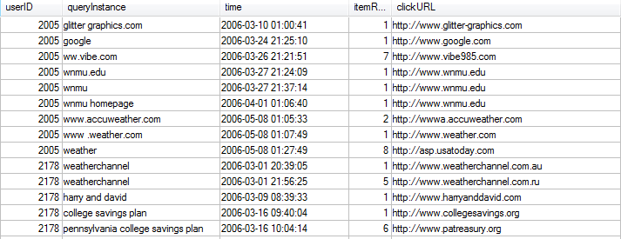
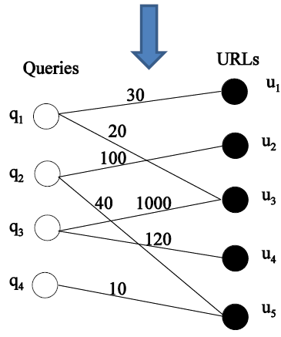
Methods Using Click-Through Data
Search log
Click-through bipartite

Slide 17
Methods Using Click-Through Data
Use similar queries as suggestions for each other.
Measure similarity of queries
-Overlap of clicked URLs
-Similarity of category or content of clicked documents
Cluster queries
-Agglomerative hierarchical method
-DBScan
-K-means
[Agglomerative clustering of a search engine query log ]KDD’00
[Query clustering using user logs]TOIS’01
[Query recommendation using query logs in search engines]EDBT’04
[A structured approach to query recommendation with social annotation data]CIKM’10

Slide 18
Methods Using Click-Through Data
Use similar queries as suggestions for each other.
Measure similarity of queries
-Overlap of clicked URLs
-Similarity of category or content of clicked documents
Cluster queries
-Agglomerative hierarchical method
-DBScan
-K-means
[Agglomerative clustering of a search engine query log ]KDD’00
[Query clustering using user logs]TOIS’01
[Query recommendation using query logs in search engines]EDBT’04
[A structured approach to query recommendation with social annotation data]CIKM’10

Slide 19
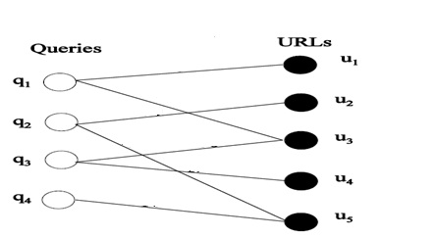
Methods Using Click-Through Data
similarity between vertices x and y
-straightforward, intuitive, convenient to work with
-Suffer from not distinguishing between two vertices which each have the same neighbor and two vertices which each have the same two neighbors

Slide 20
Methods Using Click-Through Data
Use similar queries as suggestions for each other.
Measure similarity of queries
-Overlap of clicked URLs
-Similarity of category or content of clicked documents
Cluster queries
-Agglomerative hierarchical method
-DBScan
-K-means
[Agglomerative clustering of a search engine query log ]KDD’00
[Query clustering using user logs]TOIS’01
[Query recommendation using query logs in search engines]EDBT’04
[A structured approach to query recommendation with social annotation data]CIKM’10

Slide 21
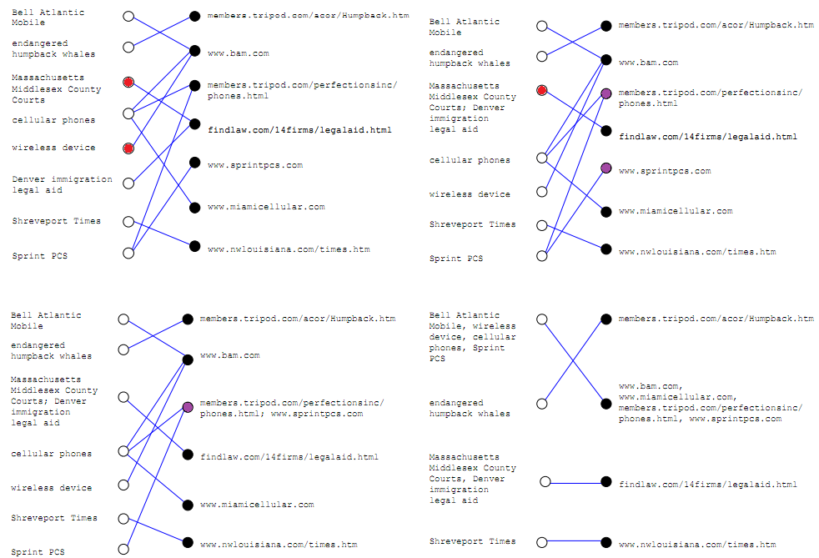
Methods Using Click-Through Data

Slide 22
Methods Using Click-Through Data
Use similar queries as suggestions for each other.
Measure similarity of queries
-Overlap of clicked URLs
-Similarity of category or content of clicked documents
Cluster queries
-Agglomerative hierarchical method
-DBScan
-K-means
[Agglomerative clustering of a search engine query log ]KDD’00
[Query clustering using user logs]TOIS’01
[Query recommendation using query logs in search engines]EDBT’04
[A structured approach to query recommendation with social annotation data]CIKM’10

Slide 23
Methods Using Click-Through Data
Similarity based on keywords or phases
Query terms are weighted, cosine similarity
Extend to phrases
“history of China”, “history of the United States”
Similarity Keywords=0.33 similarity Phrases=0.5

Slide 24
Methods Using Click-Through Data
Similarity based on string matching
Edit distance is a measure based on the number of edit operations(insertion, deletion, or substitution of a word)necessary to unify two queries.
-query1: Where does silk come from
-query2: Where does lead come from
-query3: Where does dew come from

Slide 25
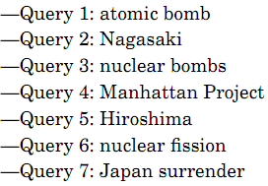
Methods Using Click-Through Data
Similarity through a single Document(URL)
Cluster semantically related queries containing different words
Distinguish between queries that happen to be worded similarly but stem from different information needs.
-”law”------>articles about legal problems
-”law” ------>articles about the order of nature

Slide 26
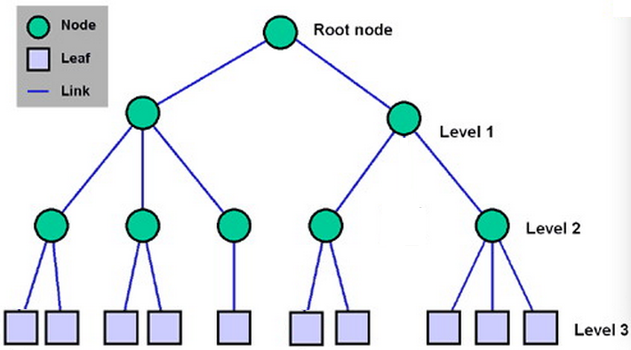
Methods Using Click-Through Data
Similarity through document hierarchy
; and if
Let and be the clicked documents of queries p and q.

Slide 27
Methods Using Click-Through Data
Content based measures tend to cluster queries with the same or similar terms.
Cross-references based measures tend to cluster queries related to the same or similar topics.

Slide 28
Methods Using Click-Through Data
Use similar queries as suggestions for each other.
Measure similarity of queries
-Overlap of clicked URLs
-Similarity of category or content of clicked documents
Cluster queries
-Agglomerative hierarchical method
-DBScan
-K-means
[Agglomerative clustering of a search engine query log ]KDD’00
[Query clustering using user logs]TOIS’01
[Query recommendation using query logs in search engines]EDBT’04
[A structured approach to query recommendation with social annotation data]CIKM’10

Slide 29
Methods Using Click-Through Data
DBSCAN
-A cluster consists of at least the minimum number of points-MinPts (to eliminate very small clusters as noise)
-for every point in the cluster, there exists another point in the same cluster whose distance is less than the distance threshold Eps (points are densely located)

Slide 30
Methods Using Click-Through Data
Use similar queries as suggestions for each other.
Measure similarity of queries
-Overlap of clicked URLs
-Similarity of category or content of clicked documents
Cluster queries
-Agglomerative hierarchical method
-DBScan
-K-means
[Agglomerative clustering of a search engine query log ]KDD’00
[Query clustering using user logs]TOIS’01
[Query recommendation using query logs in search engines]EDBT’04
[A structured approach to query recommendation with social annotation data]CIKM’10

Slide 31
Methods Using Session Data
Session Segmentation Problem: given a sequence of user queries, where to cut the session boundary.
Features for session segmentation
-Timeout threshold
-Common words or edit distance between queries
-Adjacency of two queries in user input sequences
-similarity between the top K search results of two queries

Slide 32
Methods Using Session Data
Co-occurrence or adjacency in sessions
-If qa and qb often co-occur in the same session, they can be suggestions for each other
-If qb often appear immediately after qa in the same session, qb is a suggestion for qa
Measures to represent correlation between qa and qb
-Number of sessions where qa and qb co-occur(or are adjacent)
-Jaccard similarity, dependency, cosine similarity
[How are we searching the World Wide Web? A comparison of nine search engine transaction logs]Information Processing and Management’04
[Relevant term suggestion in interactive web search based on contextual information in query session logs]Journal of the American society for information science and technology’03
[Generating Query Substitutions]WWW’06

Slide 33
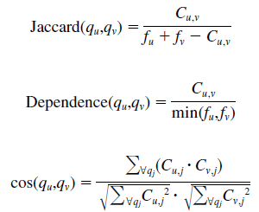
Methods Using Session Data
Co-occurrence matrix C(n by n):
Cij= the number of query sessions containing both query qi and qj.
Let fi=CiJ, which denotes the number of query sessions containing qi.

Slide 34
Context-Aware Query Suggestion
User raises query “gladiator”
If user raises query “beautiful mind” before “gladiator”
Then user is likely to be interested in the film

Slide 35
Context-Aware Query Suggestion
A naïve formulation
-Given user query qn
-Find sequence of queries q1…qn-1 submitted by users immediately before qn
-Scan log data and find out that in the same context q1…qn-1,what queries people often ask after qn
-Output results as query suggestion
[Context-aware query suggestion by mining click-through and session data]KDD’08

Slide 36
Conclusion
Background knowledge about web log mining
Motivation
Methods
- using click-through data
-using session data
-context aware query recommendation

