Slide 1
ACM-HK Local Contest 2010
Special trainings:
6:30 - 9pm @ HW311
May 27, 2010 (Thur)
June 3, 2010 (Thur)
June 10, 2010 (Thur)
Competition date:
June 12, 2010 (Sat)

Slide 2
What is ACM-HK local?
A local competition for university students
About 30 teams from local universities like UST, CUHK + some Macau or China teams
Time to practice + Win honor and prize
Winner usually gets a few thousand
More important competition: Regional Contest
Usually overseas, e.g., Manila, Jakarta, Taipei, Tokyo
No prize, but win tickets to world final
Most important competition: World Final
World cup for computer programming
Canada, Czech, China, USA, Japan, Finland

Slide 3
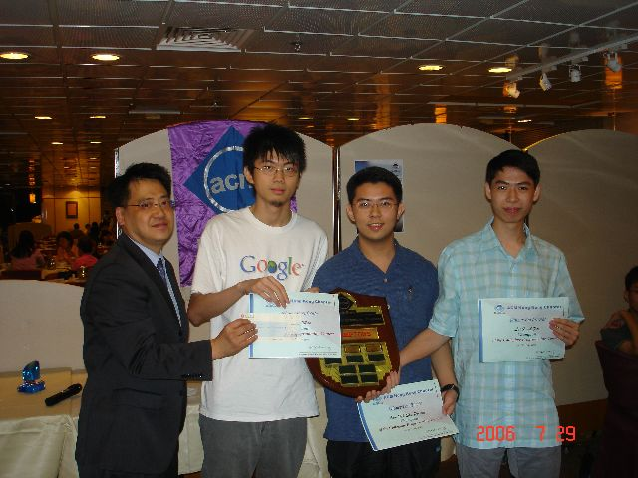
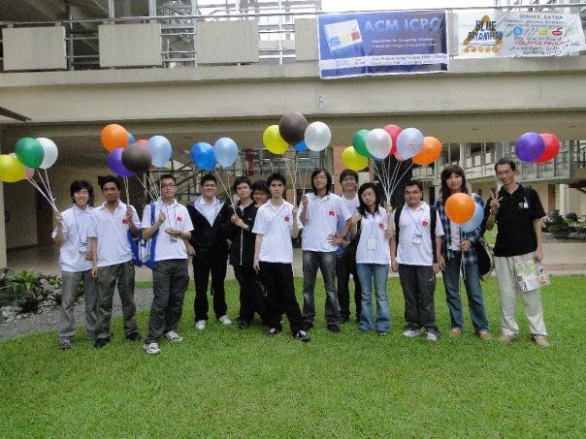
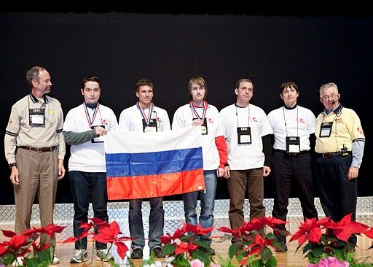
Local: June, 2010
Regional: October, 2010
World Final: Feb/Mar, 2011

Slide 4
What's the format of local?
Before competition:
Form teams for 3 members each (registered 7 teams, admit ? teams)
On June 12:
Exact schedule will be known later

Slide 5
More details on competition
Team competition: 3 students + 1 computer
3.5 - 5 hours, 6 - 8 questions
You can submit a question at any time
the judge will test your program with test data
if test passed, judge replies "YES" and you get 1 question solved
if test not passed, judge replies "Wrong Answer", "TLE", "Runtime Error", "Compile Error", "PA"; You can submit again
The team who solves most questions wins
If draw, penalty of a solved question = time it gets "YES" + 20 * (# of non-yes submission)
Penalty = total penalty of solved questions

Slide 6
How to perform well?
Individual abilities
Algorithms & programming
Solution & implementation
Cooperation
A team with different talents has advantage
Some math people, some dp, some greedy, some programmers
Strategy
how to allocate time
how to utilize the single computer
Luck

Slide 7
A real example
ACM-HK Local 2000

Slide 8
Strategy 1. Getting started
My team usually read different questions separately
Find one or two question that can be coded immediately by some individual
Need to know your teammates well
Check input and output method

Slide 9
Strategy 2. Ask for clarification
For question 5, if there are multiple solutions, which to print?
For question 6, what is the maximum value for n? 20

Slide 10
Question 5
Do questions that have a small input size.
Usually don't need to care about running time.
Try all possibilities by a brute-force method.

Slide 11
Question 6
Observation 1. Every square is either toggle once or zero times.
Observation 2. Once toggle sequence for the left-most line, then the toggle sequence for all other cells are known.

Slide 12
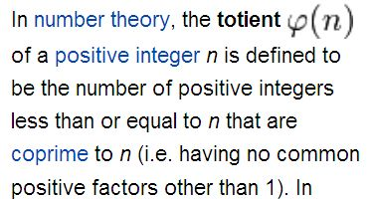
Question 1.
Euler's theorem

