Slide 1
3D Human Reconstruction from Sparse Uncalibrated Views
Xiaoguang Han
Department of Computer Science
Probation talk – 2015.05.27

Slide 2
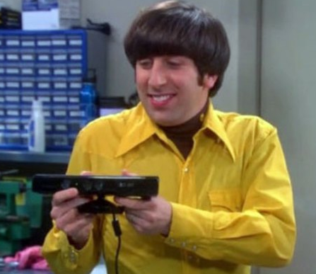
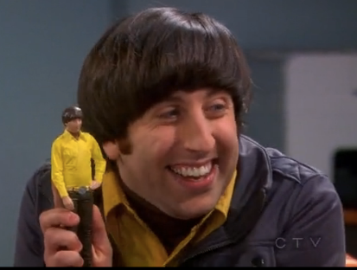
3D human reconstruction
Create high-quality 3D human model from easy-captured data
Applications: 3D self-portraits, computer games, virtual reality etc.

Slide 3
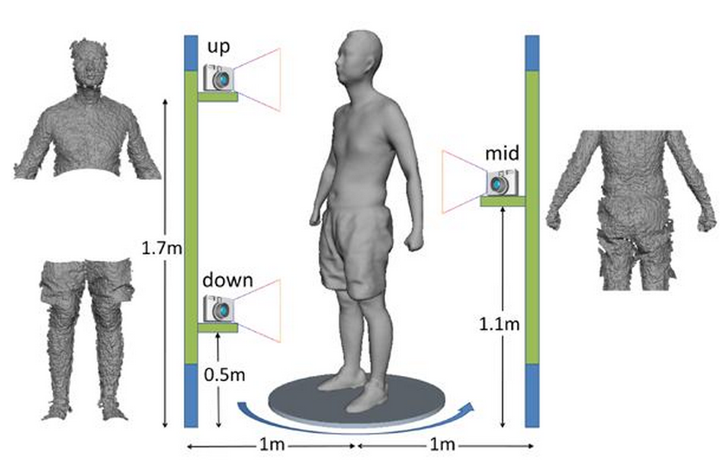
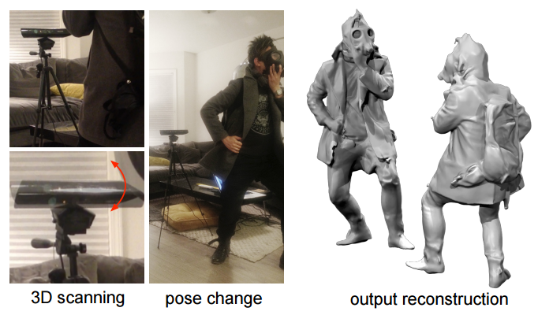
Existing methods – Kinect based
Key problem – point cloud registration
Weaknesses of the method
- require complicated capturing steps
- or generate low-quality results
- limited to indoor environment
[TVCG 2012]
[Siggraph Asia 2013]

Slide 4
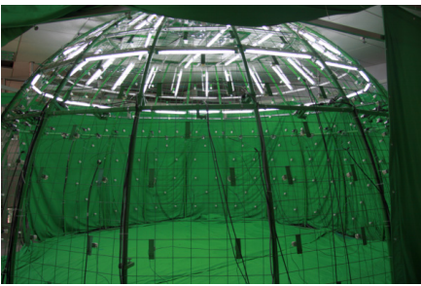
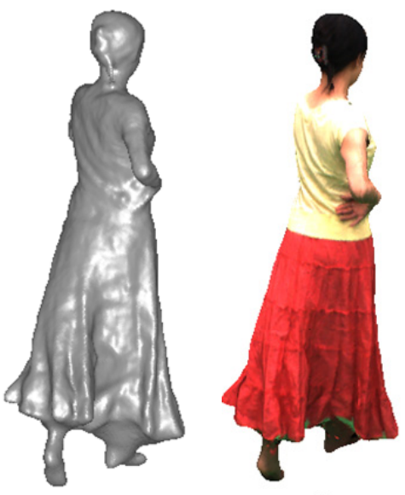
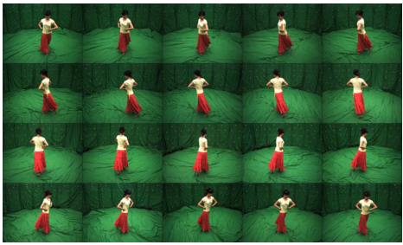
Existing methods – Multi-view stereo
Weakness
- require fully calibrated cameras

Slide 5
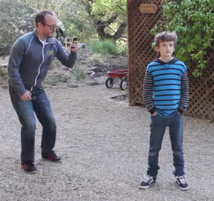
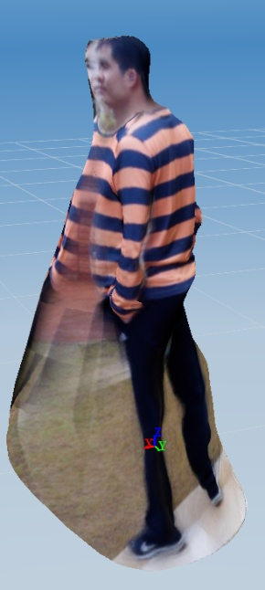
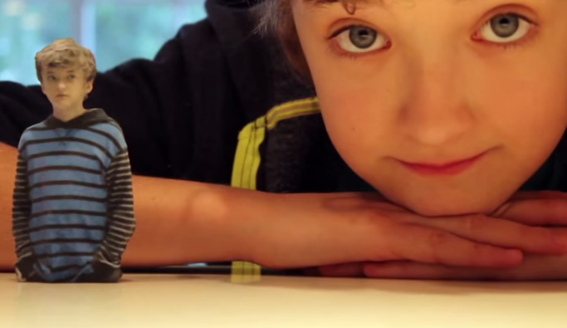
Existing methods – 123D catch
Input uncalibrated images
Calibrating cameras and then MVS
- SFM from feature correspondences
Weaknesses
- around 40 images for half body
- should have textured area
- usually fails
- low-quality results

Slide 6
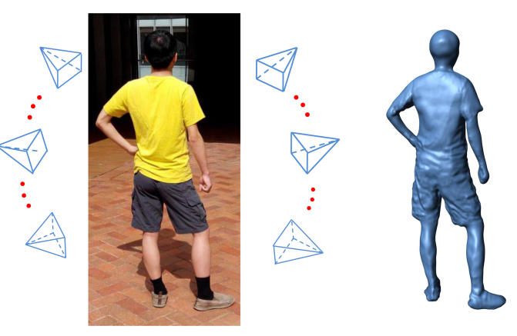
The Goal in this paper
Using sparse uncalibrated images to create high-quality mesh
- around 15 casual images are enough
- reconstruct geometric details: winkles

Slide 7
Approach overview
Coarse model generation
- dense feature correspondences
- structure-from-motion : generate point cloud
- template-based model fitting : point cloud and visual hull
Model refinement
- density-based pixel clustering
- shading information extraction
- geometry optimization using shading cues

Slide 8
Dense correspondences
Traditional feature correspondences (DOG, SIFT, ASIFT etc.)
- sparse views → sparse feature points → SFM failed
Non-rigid dense correspondence (Siggraph 2011)

Slide 9
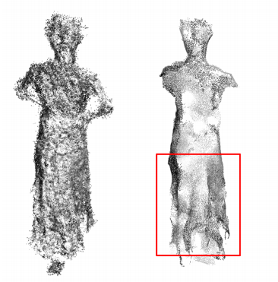
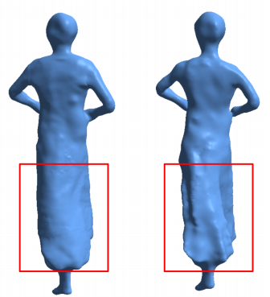
Point cloud reconstruction
Match-Propagate-Filter
- NRDC for each adjacent images
- propagate image by image
- consistency of correspondences
Structure-from-motion
- estimating cameras and rough point cloud
- filtering the point cloud
Edge-preserving resampling

Slide 10
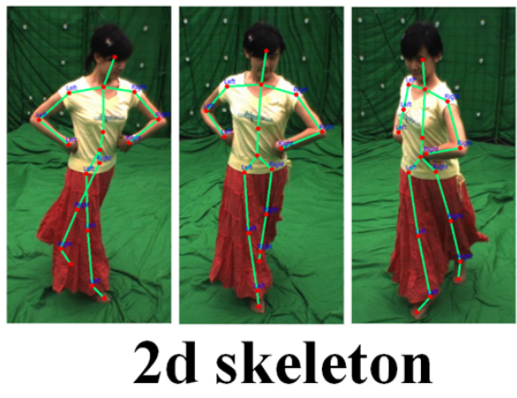
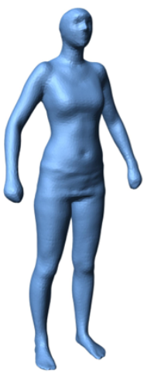
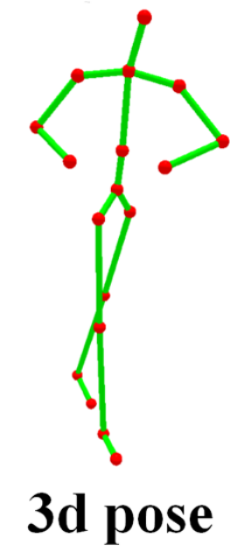
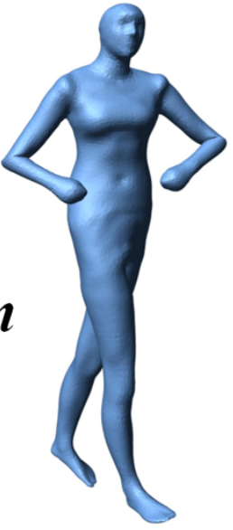
Mesh initialization
Labeling 2D skeletons
3D pose reconstruction
- via structure-from-motion
Skeleton-based mesh deformation
- linear blending skinning

Slide 11
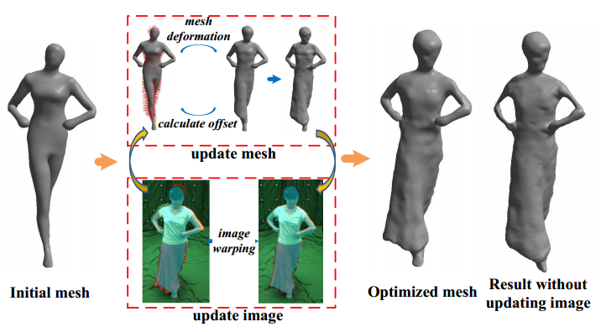
Template-based model fitting
Objective: 2D silhouettes (visual hull) and point cloud
Variable: Mesh and silhouettes (inaccurate camera estimation)
Optimization: Laplacian mesh deformation

Slide 12
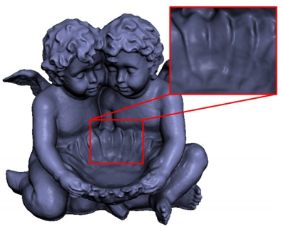
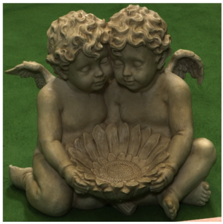
Shape from shading
Rendering
Inverse rendering
- recover L and n from the observed image
Geometry optimization (CVPR 2011)
- variable: the displacements of vertices along normal
- formulate the Lighting as spherical harmonics
- non-linear optimization

Slide 13
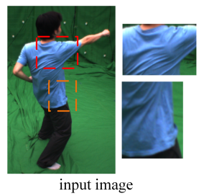
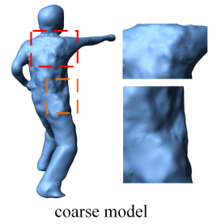
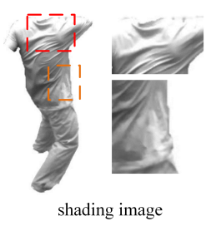
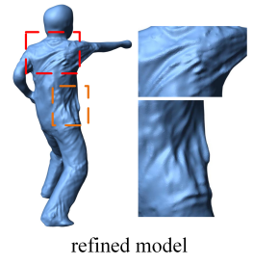
Our geometry refinement
Input: coarse model and shading images
Optimization
- data term: shading constraint
- smoothness term: preserve the smoothness of the mesh

Slide 14
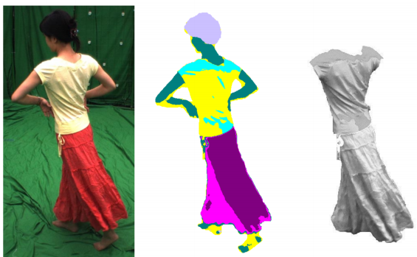
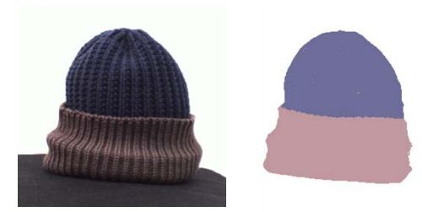
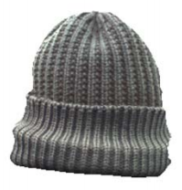
Challenges for shading extraction
Intrinsic image
- image decomposition: reflectance (albedo) and shading
Challenge
- varying shading
Clustering based methods
- group pixels into several clusters
- view each cluster with constant albedo

Slide 15
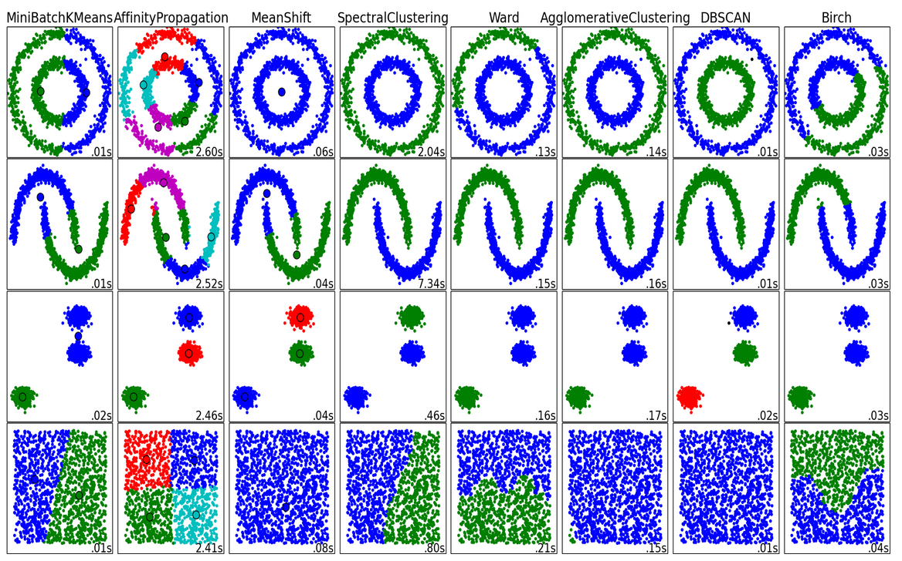
Density-based clustering

Slide 16
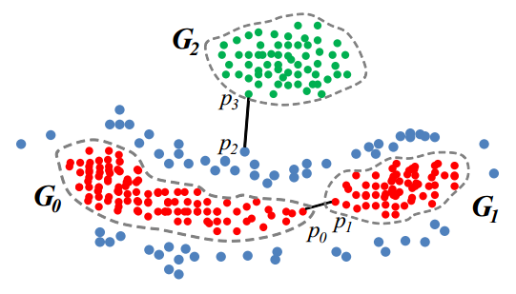
Density-based pixel clustering
Construct nearly fully connected graph
Extract minimum spanning tree (MST)
Each point forms one cluster
Visit the edge of MST in an increasing order
- weight of edge is defined as distance
- pseudo-merge/absorb/merge
Obtain the most stable clustering

Slide 17
Shading extraction
Clustering for all input images
Global lighting estimation
- pick the biggest cluster
- using its mean color as the reflectance and obtain the shading
- estimate the global lighting from shading and rough normal
Calculate reflectance for other clusters
- shading calculation with the lighting and rough geometry
- using the average reflectance as the desired one for each cluster

Slide 18
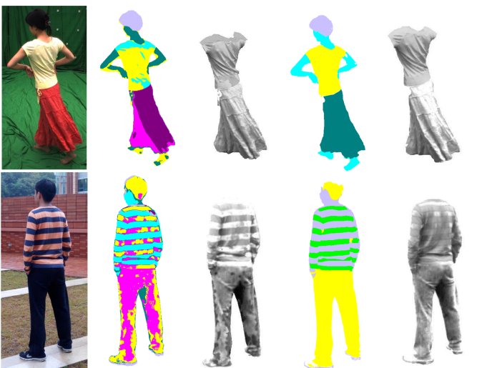
Shading results
K-means
Our

Slide 19
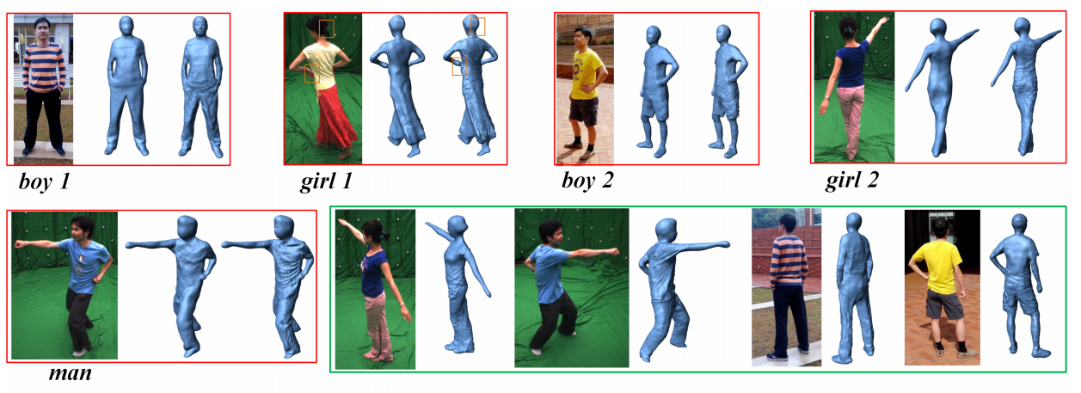
Experimental results
“boy 1” – 15 images, “boy 2” – 16 images, “girl 1” – 16 images,
“girl 2” – 13 images, “man” – 15 images

Slide 20
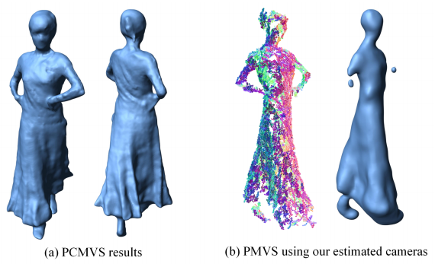
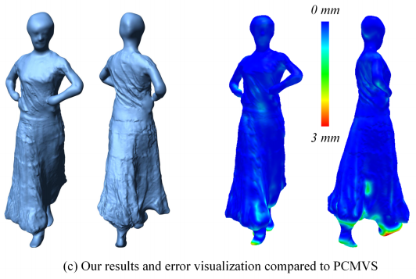
Comparison
Our vs PMVS (TPAMI2010) vs PCMVS (TVCG2010)

Slide 21
How many input images we need?
Around 15 uniformly sampled views are recommended
8 images
12 images
16 images

Slide 22
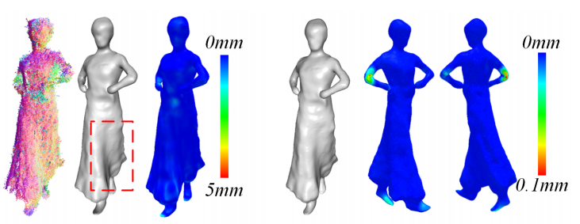
How many labeled images we need?
The number of labeled images will not influence results
At least 3 labeled images are enough
3 labeled images
6 labeled images

Slide 23
Thanks for your attention!

