Slide 1
Analysis and Design of Enterprise Applications in UML
Prof. T.H. Tse
Honorary Professor
Department of Computer Science
Email: thtse@cs.hku.hk
Web: hku.hk/thtse .

Slide 2
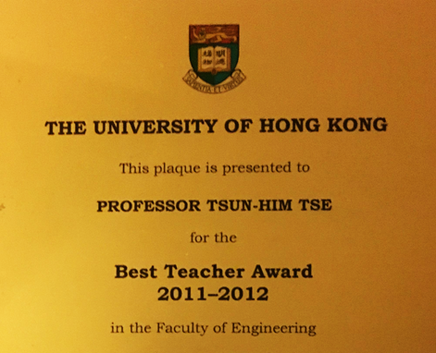
About the Instructor
Teaching
Best teacher award
Teacher effectiveness 94.4% in 2022
Course effectiveness 93.1% in 2022 .

Slide 3


About the
Instructor
Teaching
Research
Ranked internationally as no. 2 among experts in metamorphic testing
Grand champion of most influential paper award 2021
New book 2023 .

Slide 4

About the Instructor
Teaching
Research
Administration
Intermediary of $140,000,000 donations for The University of Hong Kong .

Slide 5
About the Instructor
Selected Past Students
Associate Professor, City University of Hong Kong
Associate Professor, Institute of Software, Chinese Academy of Sciences
Associate Professor, Beihang University .

Slide 6
About the Instructor
Selected Past Students
Associate Professor, City University of Hong Kong
Associate Professor, Institute of Software, Chinese Academy of Sciences .
Associate Professor, Institute of Software, Chinese Academy of Sciences
Associate Professor, Beihang University

Slide 7
About the Instructor
Selected Past Students
Apple
Alibaba
Executive Director in Goldman Sachs
Further study in Carnegie Mellon University
Further study in University of California, Berkeley
A+ in MSc Dissertation 2022 .

Slide 8
About the Tutor
Jolly Cheng mycheng@cs.hku.hk
MSc(CompSc) with distinction
Grade A in most courses
Best Tutor Award in 2015 .

Slide 9
Important Links
Moodle website for the course https://moodle.hku.hk/course/view.php?id=96555 or https://www.cs.hku.hk/~c7201
News and open discussions forum for the course
  Via the Moodle website
Open discussions forum is an important element of this course
To apply for CS account https://intranet.cs.hku.hk/account/
Technical problems support@cs.hku.hk .

Slide 10
Assessments
3 assignments 40%
Examination 60% .

Slide 11
What Do You Learn from this Course?
We cover
Software
Analysis
Software
Design
User
Programmer .
Notes:
HK$4900 per participant

Slide 12
What Do You Learn from this Course?
We cover
Concepts
  Object-orientedness
Prime concept in programming
Prime methodology in SE
Methodologies
  Unified process
Prime technique in SE
Techniques
  UML diagrams
Tools
  CASE tools .
Notes:
HK$4900 per participant

Slide 13
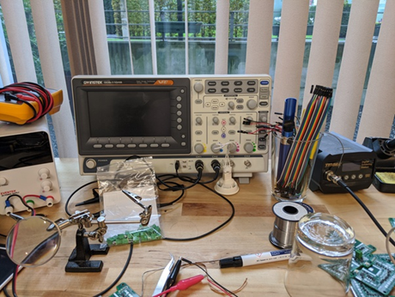
What Don’t You Learn from this Course?
Software engineering fundamentals?
Systems analysis fundamentals?
Object-oriented programming?
Technician skills? .

Slide 14
What Do You Learn from this Course?
Will this course be taught at an abstract level?
  It will be taught as a real-life practical course
Will it be a theoretical course?
  It will be a real-life practical course
What programming language will be taught?
  Programming is not part of the course
How can the course be practical if it does not involve programming?
  We learn from real-life examples …

Slide 15
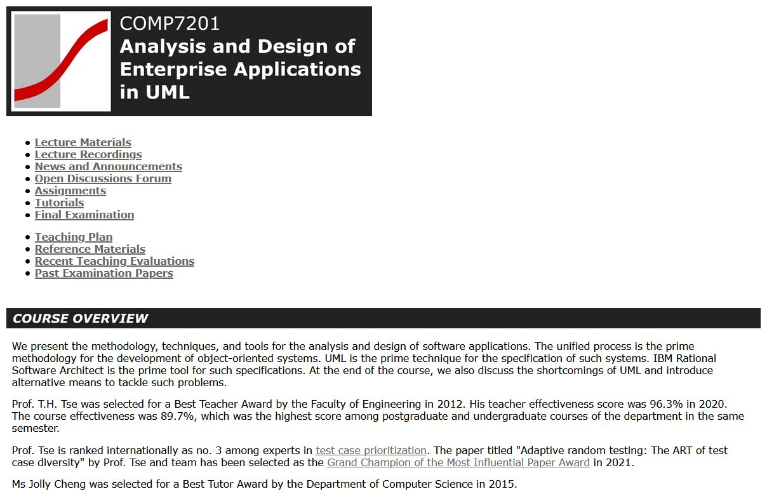
We Learn from Real-Life Examples
Our Moodle Website
Click

Slide 16
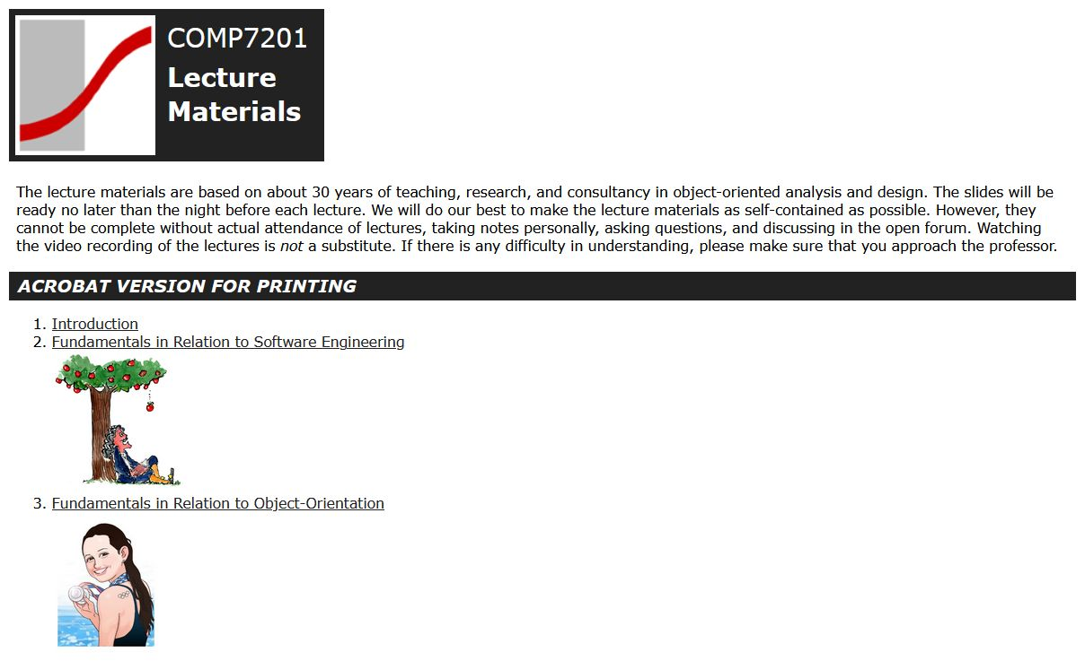
We Learn from Real-Life Examples
Our Moodle Website

Slide 17
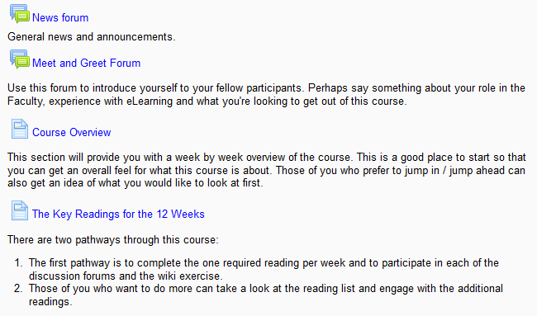
We Learn from Real-Life Examples
Our Moodle Website
Demonstrates that a good design with interacting components and graphical user interface is more interesting
☹
☺

Slide 18
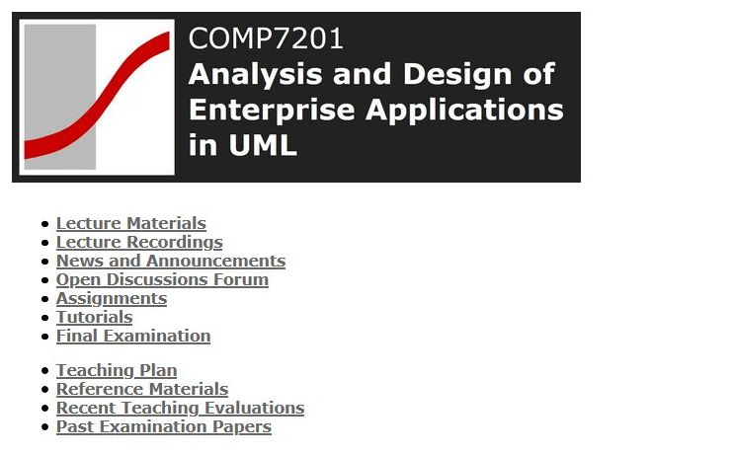
We Learn from Real-Life
Our Moodle Website
Mistakes
☹
Hidden hardcoded hyperlink
http://www.cs.hku.hk/course/20XX/c7201/THTse/lectures.html
changes every year
Hidden hardcoded hyperlink
http://moodle.hku.hk/course/view.php?id=12345#section-2
may change at any time
Demonstrates that object-oriented design with good contractual interfaces (pre-agreed interfaces between interacting components) is necessary .

Slide 19

What Else Do You Learn from this Course?
How to sell your project
How to sell yourself .

Slide 20
Is This Course Easy?
No! ☹
This course is about real life
Real life is challenging
Especially if you are a team leader
Rather than following instructions, you need to understand concepts and make decisions
“Never, ever, let management promote you to an analyst, designer, or team lead. It will promote you out of programming” .

Slide 21
Is This Course Easy?
No! ☹
Software analysis is user-driven
User requirements are challenging
We will deduct marks if you invent user requirements
In real life, your senior manager will not like it either .

Slide 22
Is This Course Easy?
No! ☹
Software analysis is user-driven
Software design is a creative process
Software is not a product to be reproduced
It is a product to be created innovatively
Not part of the user requirements .

Slide 23
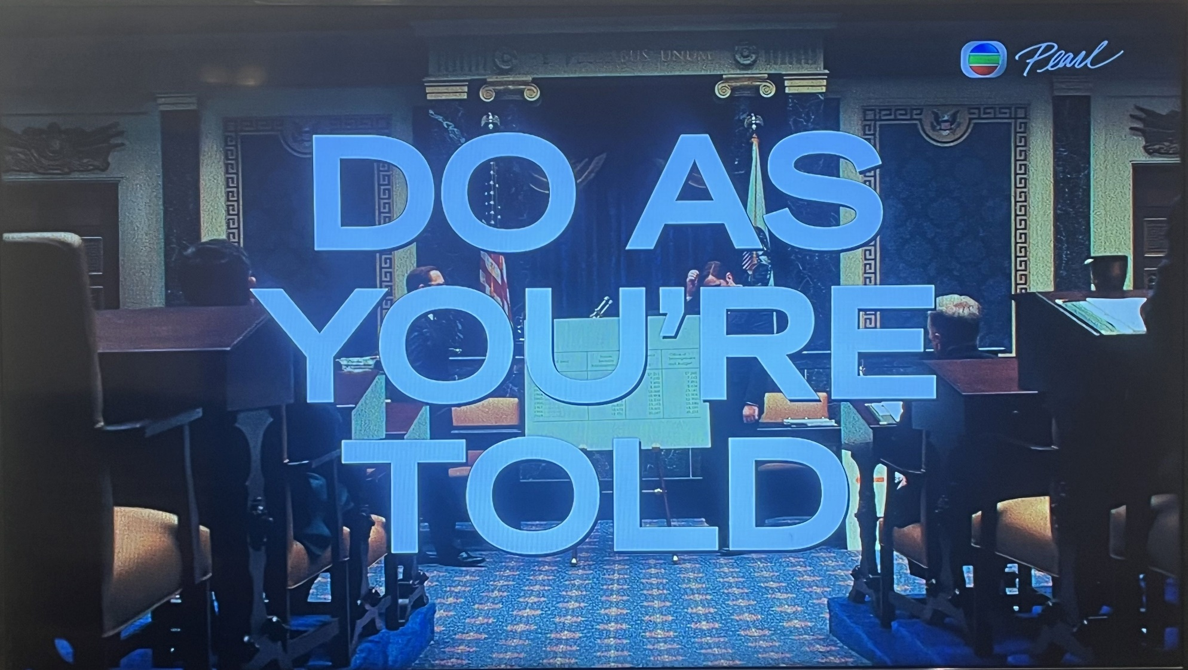
We Learn from Mistakes
Misconception in Software Design

Slide 24

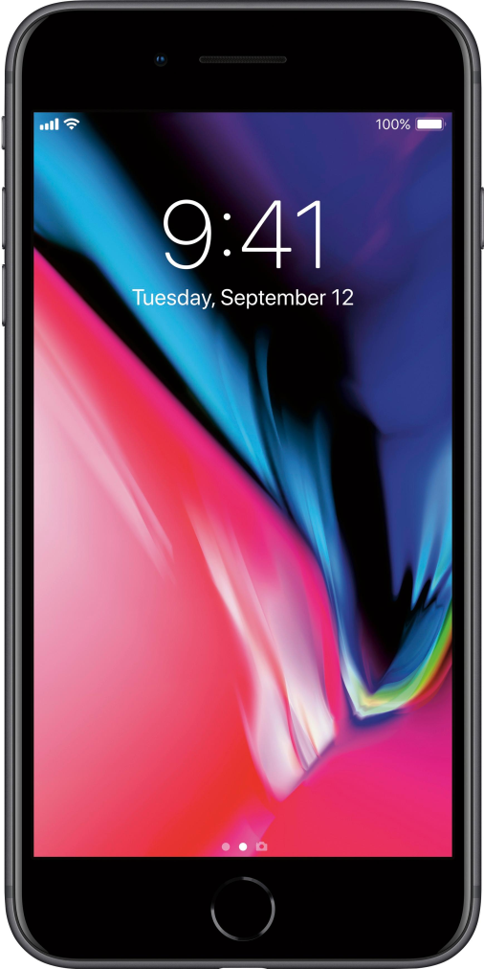
What if Designs were not Creative?
iPhone 13
iPhone 8
=
The home button would be retained if designers followed a “model answer” .

Slide 25
Is This Course Easy?
No! ☹
Software analysis is user-driven
Software design is a creative process
No model answer in real life
You must liberate yourself from
Past examination papers
Model answers .

Slide 26
Is This Course Easy?
No! ☹
Software analysis is user-driven
Software design is a creative process
No model answer in real life
No theory in software engineering
Step by step procedure proved to be problematic
Learn from experience, with trial and error .

Slide 27
Is This Course Practical?
Is it practical to draw so many diagrams?
  Why don’t we assign a programmer to code directly?
Millions of lines of code in a typical system
How many lines of code per day?
  10 lines per day 一日十行
How many person years?
  300+
Which is more practical: Direct programming or teamwork with well-controlled process? .

Slide 28
Is This Course Practical?
Why object-oriented analysis and design?
  Why not component-based development?
  Why not service-oriented software development?
  Why not cloud computing?
Object-oriented analysis and design lay the foundation
Clouds .
Services
Components
Objects

Slide 29

Your Longer Term Expectations from this Course?
An easy degree?
This course is not easy (by nature)
A good job?
Yes!
A good professional career?
Yes! .

Slide 30
Course Outline
Subject to change depending on your background, interests, and feedback .
Introduction
Fundamentals in relation to software engineering
Fundamentals in relation to object-orientation
Introducing the unified process
Object-oriented analysis
Practical guidelines for identifying classes and relationships
Dynamic modelling with sequence diagrams
Dynamic modelling with state machines
Time and activity modelling
Object-oriented design
Introducing design patterns
Introducing enterprise applications
Shortcomings of UML
Formal methods and beyond
Modern Web design

Slide 31
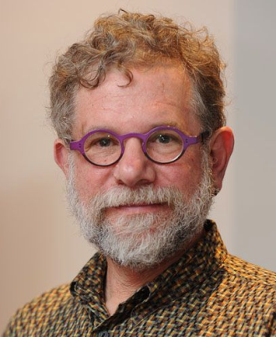
Textbook?
Unfortunately, no single book can possibly cover OO design and programming in real depth .
Allen Holub

Slide 32
Advanced References
OMG Unified Modeling Language (OMG UML) Version 2.5.1, Object Management Group, Needham, MA (2017), http://www.omg.org/spec/UML/2.5.1/PDF
C.A.R. Hoare, Communicating Sequential Processes, Prentice-Hall (1985), http://www.usingcsp.com/cspbook.pdf
Provides more breadth and depth to experienced students
Not for students who cannot understand the course
You should ask the professor .

Slide 33
Lectures
Lectures are lectures are lectures
Slides ≠ notes
  Interesting but not excessively detailed?
  Detailed but not interesting?
Complaints from students
who skip lectures
Complaints from students
who attend lectures .

Slide 34
Lectures
Lectures are lectures are lectures
Slides ≠ notes
  Interesting but not excessively detailed?
  Detailed but not interesting?
I will cater for students who attend lectures .

Slide 35
Lectures
Lectures are lectures are lectures
Slides ≠ notes

Slide 36
Lectures
Lectures are lectures are lectures
Slides ≠ notes

Slide 37
Lectures
Lectures are lectures are lectures
Slides ≠ notes

Slide 38
Lectures
Lectures are lectures are lectures
Slides ≠ notes
What I discuss may be more important than the slides
Your feedback is also important .

Slide 39


Causes of Dull Lectures
Poker-face students .
One-way communication

Slide 40
Causes of Dull Lectures
I dared not ask for your help
A good student should not have problems
A good student should always deliver
You should work with your supervisor as a team in order to excel .

Slide 41
Your Feedback is Important
I will
target for the average students
inspire the best students
help the weaker students
You need to tell me during the course .
You need to tell me during the course .
You need to tell me during the course .
You need to tell me during the course .

Slide 42
Feedback from Previous Students
Teacher Effectiveness
2022/23 94.4
2021/22 93.2
2020/21 96.3
2019/20 83.3
2018/19 89.6
2017/18 86.0
2016/17 89.2
2015/16 95.2
2014/15 95.0
Professor tries to interact with the class a lot, which I like
Unfortunately we had a rather shy class .

Slide 43
Feedback from Previous Students
Prof. Tse has given me some very good directions, which affects my career directly
This is the best course (really)
It is a really meaningful course!
Rich and stimulate thinking
I really enjoy the course Thank you very much!
Really intriguing
I found your course challenging and enjoyable
I enjoyed this course very much indeed
Very good in every aspect
I think he is the best teacher in the programme
You are one of my most respectful teachers who taught me a lot of things that I always feel grateful about
It was a pleasure learning from you this semester Thank you for the amazing lectures! ... I feel they had been my best class in my last 2 years here
I was impressed by your expertise and experience among this domain
Your lectures are the most interesting ones (in my opinion) in CS. And you are the first one who makes me feel software engineering is fun. Thanks for your teaching.
I have just enrolled in your undergraduate course this semester, and have already learned so much from you that I regret not having met you earlier ... Thank you!
Have insight! Clear concept! Good teacher!
Great explanations. Thanks
Explanations are clear with good examples
He uses common knowledge to explain professional problems. It made us very easy to understand the key point of this course
You are such a great professor
You are really a very responsible and professional professor
He is so good
Your lessons are great and I appreciate them
Long Term:
Prof. Tse has given me some very good directions, which affects my career directly .

Slide 44
Feedback from Previous Students
You are really a great teacher. You are the first teacher I've ever encountered throughout my undergraduate and postgraduate studies who would personally reply to every student's enquiry with patient and detail answers. Thank you very much
Prof. Tse answers questions from students in an impressive and responsible manner, which is of a great help in gaining full understanding of material
You can point out the root of our problems by using a few comments and that is really cool
Very willing to answer students’ questions
Willing to ensure students understand all details
A kind teacher who is very patient to students who may not have the background
Prof. Tse is a very committed teacher. He takes and answers questions from student in an impressive and responsible manner, which is of a great help in gaining full understanding of the material
You are a nice teacher, I like you, and I admire you
Up to now, the materials covered in the course are exactly those I am encountering, or the knowledge I need in my ... job, and I am sure you, no matter what jobs you are planning, will find useful in the future. Do pay some effort to this course
My own opinion coincided with the evaluation result and I strongly feel that the course was taught in a completely different manner as compared with those that I attended in my undergrad years
I am greatly impressed by your email instructions ... Not just the technology but the care, the concern and the effort to keep the student in tune and in progress
You are really a good teacher. I am really moved by your hard work and admire you
I am proud of being your student
Prof. Tse has given me some very good directions, which affects my career directly
I really appreciate your teaching method. It is totally different
Intermediate Term:
You are the first teacher I’ve ever encountered … who would personally reply to every student’s enquiry with patient and detail answers .

Slide 45
Feedback from Previous Students
Your course is very good, you give an penetrating analysis and you make it easy to understand
Everyone who has ever taken your courses knows of your commitment to excellence in teaching
Your slides are well-presented, concise and good
Thank you for the quality of the lectures, as well as for the energy you put to teach the course and the effort you make to ensure the slides are easy to understand
Excellent presentation and course materials
They told me several times that my presentation was very impressive — and this is because I learned a lot of presentation skills from you!
Encourage students for questions
I really appreciate your teaching
The assignment series of this course is really great that it provides a complete example of applying the unified process, from analysis to design
Our gratitude and respect for your effort in helping us to be a full-fledged and creative individual
Indeed what you have taught me is very solid (not only research, but also about personality)
Very interesting
Very useful for daily jobs
Very good
Good. Good. Good
Definitely very very very helpful
Excellent!
Excellent professor
Vivid
Cool!
Cool jokes
Very humorous and very helpful!
Full of passion
Keep up the good work
Short Term:
Cool jokes .

Slide 46
Not All Comments are Positive
Always don’t know what you are talking about
Please interrupt me when you don’t understand
Do not wait until the course is over .

Slide 47
Not All Comments are Positive
Please focus on assignments and exam and the final grade, instead of asking students to “think and guess”
This is an MSc course for professional career
No model answer to guess from your real project manager .

Slide 48
Not All Comments are Consistent
I need more examples
The course gives us many examples
Please interrupt me when you don’t understand
Do not wait until the course is over .

Slide 49
Not All Comments are Consistent
Too difficult: too much assumption on student background
As the teacher tries to balance student background, teaching material is a little bit too easy
Don’t adjust the course difficulty
Too simple
It is your opinion that counts .

Slide 50
Some Comments are Consistent
3 hour class is too much; better break it into two classes of 1.5 hour each
The lecture length should be split into 2
Done .

Slide 51
Feedback from Us
Assignments
Return grades in three weeks
Overall comments in Moodle
Further discussions in Moodle
Examination
Overall comments in Moodle .

Slide 52
We Learn from Mistakes
Learn also from other people’s mistakes
You do not need to pay the price of making these mistakes yourself .

Slide 53
We Learn from Mistakes
I have learnt everything about Java
What should I learn next?
In real life, programming is not everything .

Slide 54

We Learn from Mistakes

Slide 55
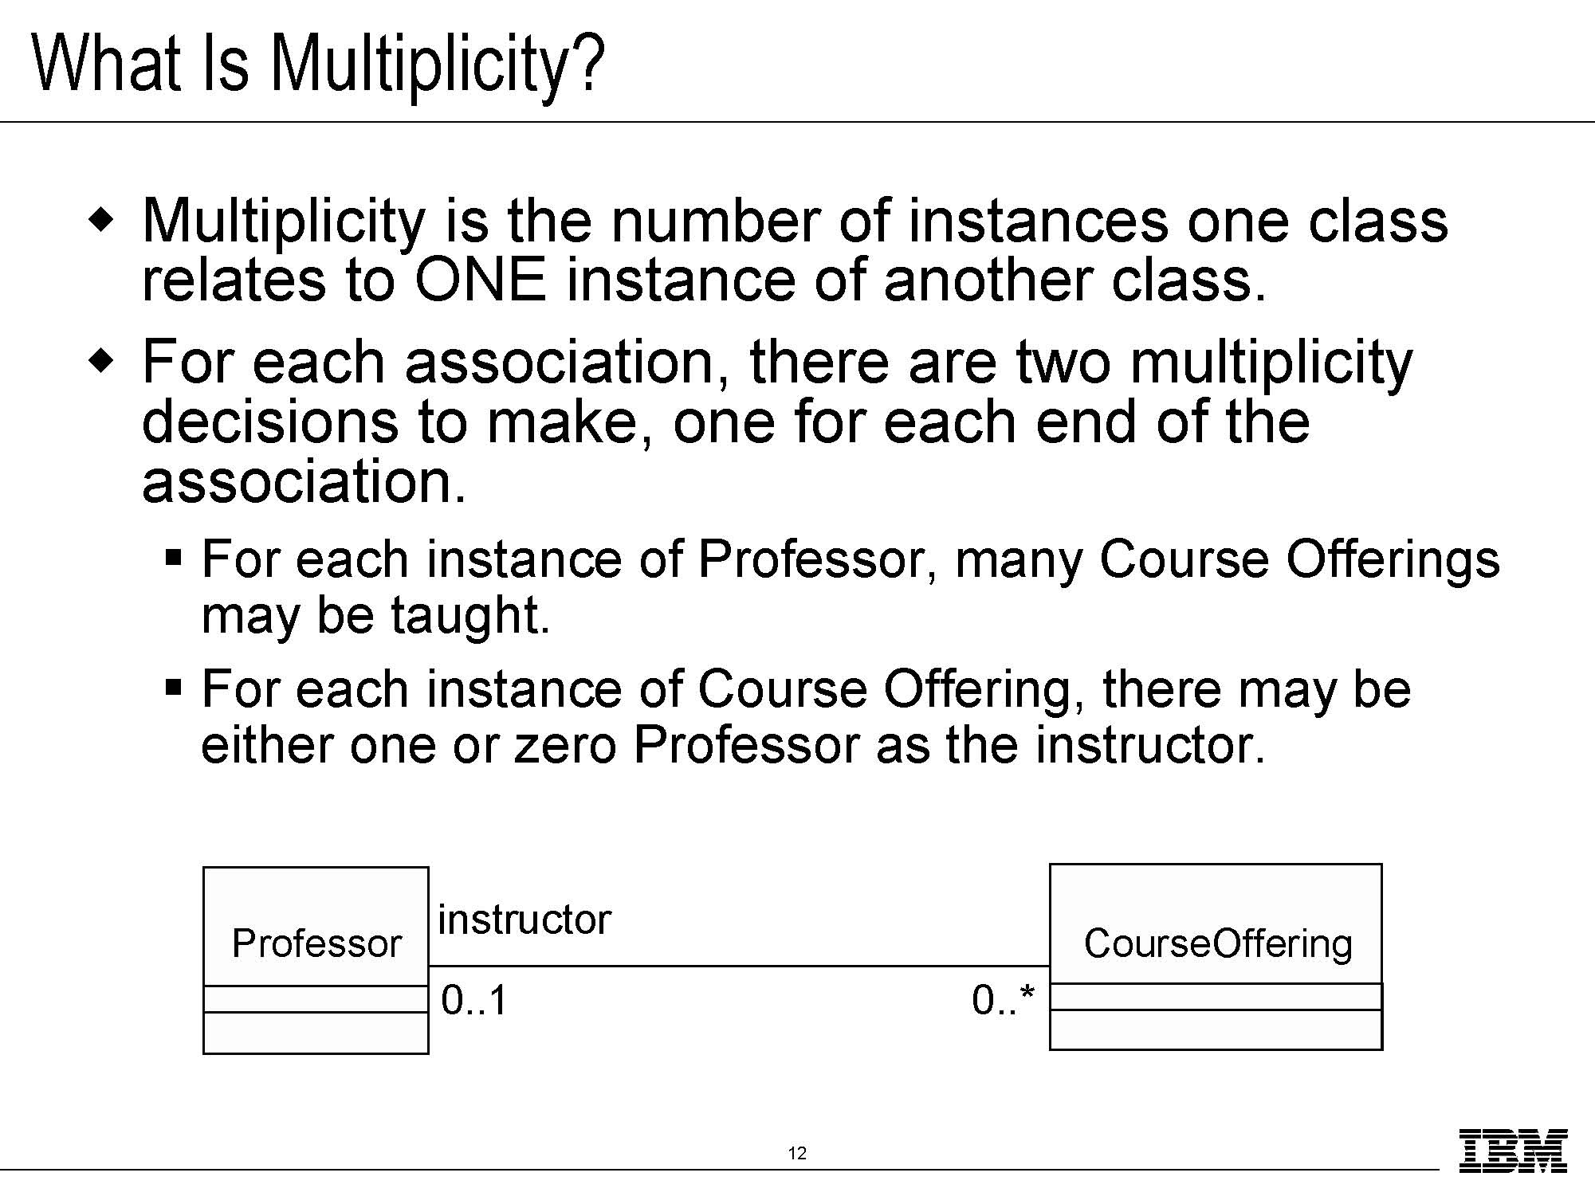
We Learn from Mistakes

Slide 56
We Learn from Mistakes
Professor
Student Record
Student Record
Professor
PG Student Record
Timer
Timer
PG Student Record
Professor
Student Record
Use Case
Diagram
Communication Diagram
Timer
PG Student Record
Class Diagram

Slide 57
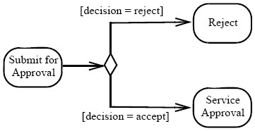
We Learn from Mistakes
State Machine
Activity Diagram

Slide 58
We Learn from Mistakes
no click
Pending
B
click
A

Slide 59
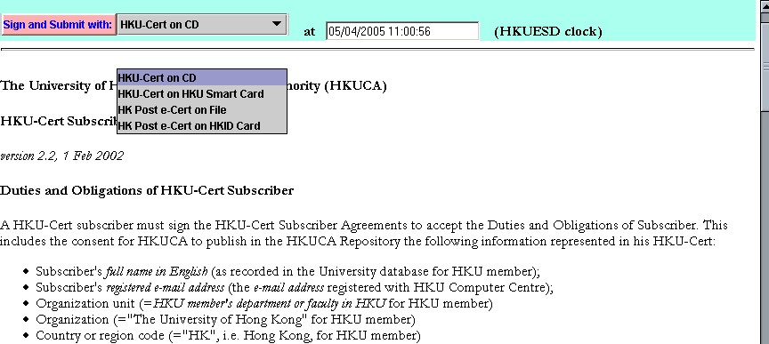
We Learn from Mistakes

Slide 60
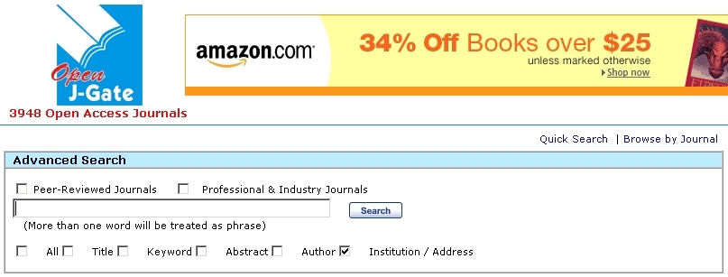
We Learn from Mistakes

Slide 61
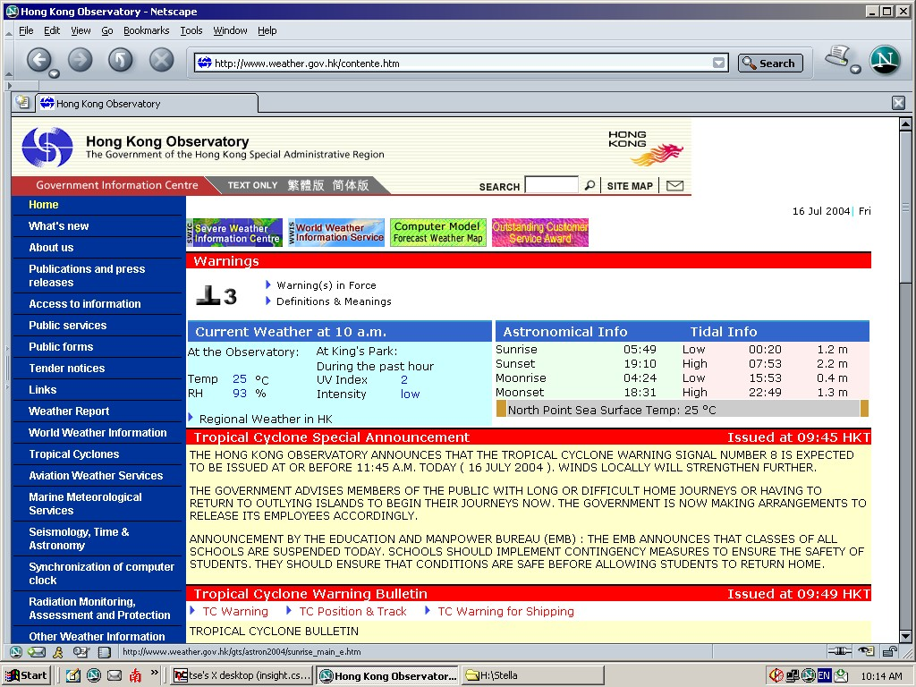
We Learn from Mistakes

Slide 62

We Learn from Mistakes

Slide 63
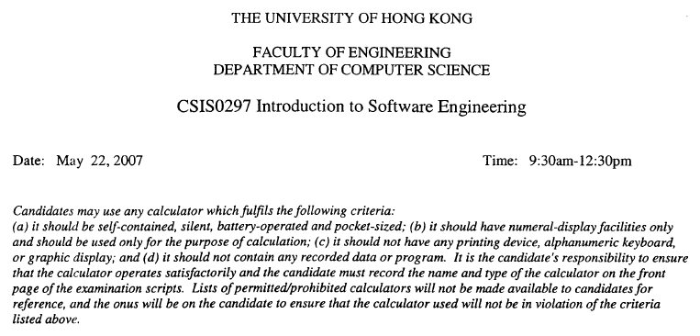
We Learn from Mistakes

Slide 64
We Learn from Mistakes
23% of all projects undertaken by internal information systems organizations are cancelled before completion
49% of projects cost 189% of their original estimates
Only 28% of projects are completed on time and within budget
Projects completed have 42% of the originally proposed features or functions .

Slide 65
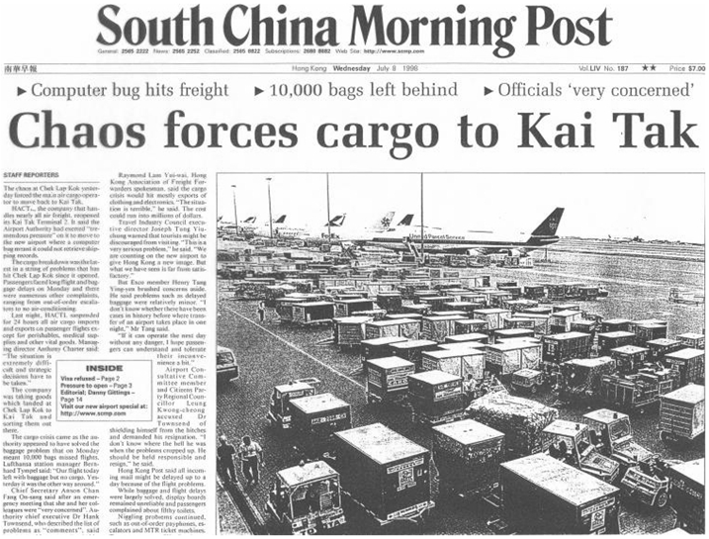
Not Just Small Problems ...
Examples of Major Software Crisis

Slide 66
Not Just Small Problems ...
Examples of Major Software Crisis
Hong Kong Airport is not alone
Denver Airport Automated Baggage System
American Airlines Sabre System
Advanced Aviation System .

Slide 67
Denver Airport
Automated Baggage System
Designed for brand new international airport
Comprised of 100 networked computers
Planned to deliver 60,000 bags per hour from more than 12 gates
Estimated cost US$200M
Delayed the grand opening of the airport four times .

Slide 68
American Airlines Sabre System
US$2B flight reservation system
Shining example of a strategic information system to enable American to be one of the world’s largest airlines
An attempt to add hotel and car reservations to the system collapsed with a write-off of US$165M .

Slide 69
Advanced Aviation System
FAA’s next generation Air Traffic Control System was conservatively estimated to cost US$500 per line of code
  Five times industry average for well-managed development process
Center for Naval Analysis further found that the actual cost was US$900 per line
“On average, every line of code developed needs to be rewritten once” .

Slide 70
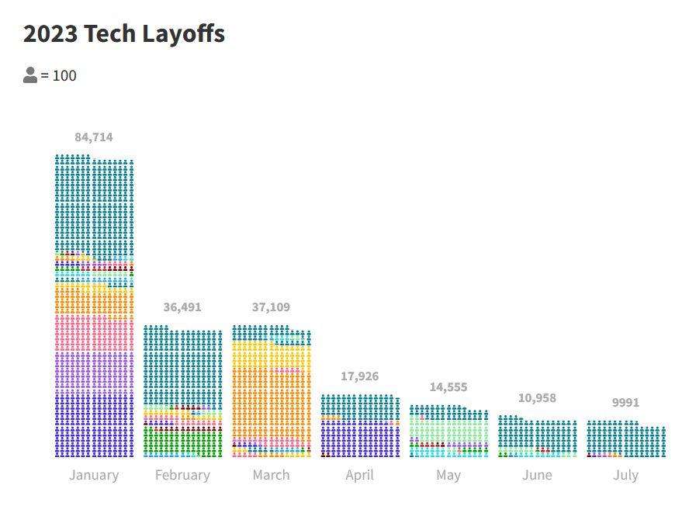
No Wonder ...

Slide 71
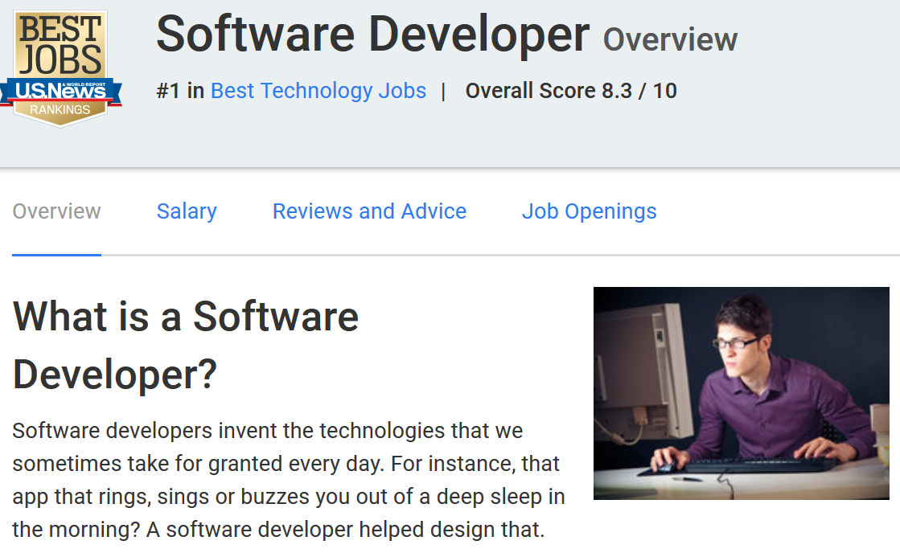
On the Other Hand
No. 1 in Best Technology Jobs

Slide 72
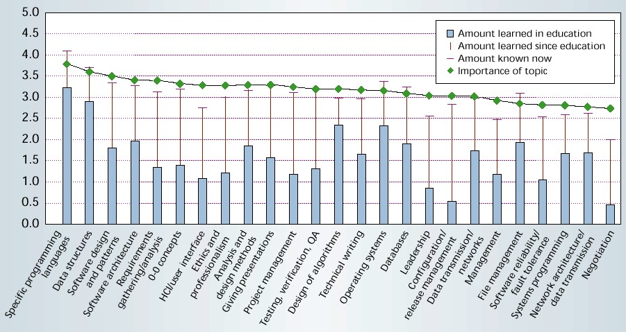
Mismatch?
25 Most Important Topics Ref: Lethbridge

Slide 73
Mismatch?
25 Most Important Topics Ref: Lethbridge

