Slide 1
Fundamentals in Relation to
Software Engineering
Prof. T.H. Tse
Department of Computer Science
Email: thtse@cs.hku.hk
Web: hku.hk/thtse .

Slide 2
What Fundamentals are Important in SE?
If you are a Programmer
This is your program:

Slide 3
What Fundamentals are Important in SE?
If you are a Software Engineer
It is part of a subsystem, which is part of a subsystem, which is part of a system:

Slide 4
What Fundamentals are Important in SE?
Summary No. 1
Product (Components) .

Slide 5
What Fundamentals are Important in SE?
If you are a Programmer
This is your world:

Slide 6
What Fundamentals are Important in SE?
If you are a Software Engineer
A programmer is part of a subsystem team, which is part of a team, which is part of a team:

Slide 7
What Fundamentals are Important in SE?
Summary No. 2
Product (Components)
Players .

Slide 8
What Fundamentals are Important in SE?
What are the Tasks in SE?
Feasibility Study
Requirements Analysis
Design
Programming
Unit test
Integration test
User training
Deployment
Maintenance
A programmer’s task is here .

Slide 9
What Fundamentals are Important in SE?
Summary No. 3
Product (Components)
Players
A programmer’s task is here .
Process

Slide 10
What Fundamental is the
Important in Software Engineering?
Most
Product?
Players?
Process? .

Slide 11


What Fundamental is the
Important in Software Engineering?
Most
Let us learn from successful enterprises

Slide 12
What Fundamental is the
Important in Software Engineering?
Most
Good products alone are not enough
But if the sponsor invests heavily in continuous product improvement, products of only modest capabilities can become the basis for architectural leadership .
Harvard Business Review

Slide 13

Not Just That
The Need For Practice
Software engineering is fundamentally a ... sport
No amount of theory about how to succeed … is going to come close to real experience .
Barry Boehm

Slide 14
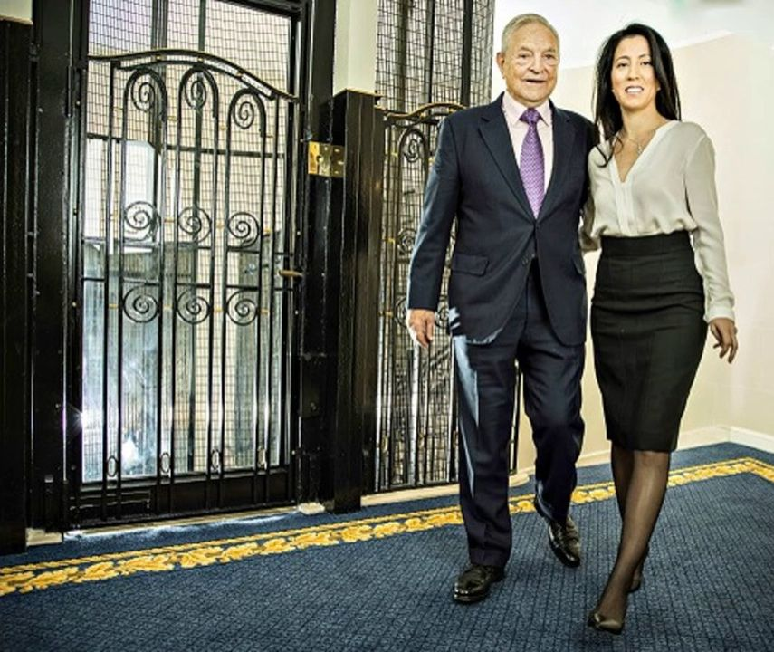
An Interesting Exercise
Mr George Soros
Mrs Soros
Me
Mrs Tse ...
American billionaire recognized as “the most generous giver”, donating 64% of his fortune

Slide 15

An Interesting Exercise
Mr George Soros
Mrs Soros
Me
Mrs Tse ...
I will drive
Who will sit next to me?
You are invited to analyse this problem .

Slide 16
An Interesting Exercise
“Process” is the most important aspect in software engineering
Analyse user requirements
Design using software engineering principles

Slide 17
An Interesting Exercise
Solution Space
User requirements
Design 2
Design 1
Design 3 .

Slide 18
What is Software Engineering?
The application of a systematic, disciplined, quantifiable approach to the development, operation, and maintenance of software [IEEE 1990]
Why is it engineering? .

Slide 19
What is Software Engineering?
The establishment and use of sound engineering principles (methods) in order to obtain economically software that is reliable and works on real machines [Bauer 1972]
What is engineering? .

Slide 20
What is Software Engineering?
Software engineering is that form of engineering that applies the principles of computer science and mathematics to achieving cost-effective solutions to software problems [CMU/SEI-90-TR-003]

Slide 21
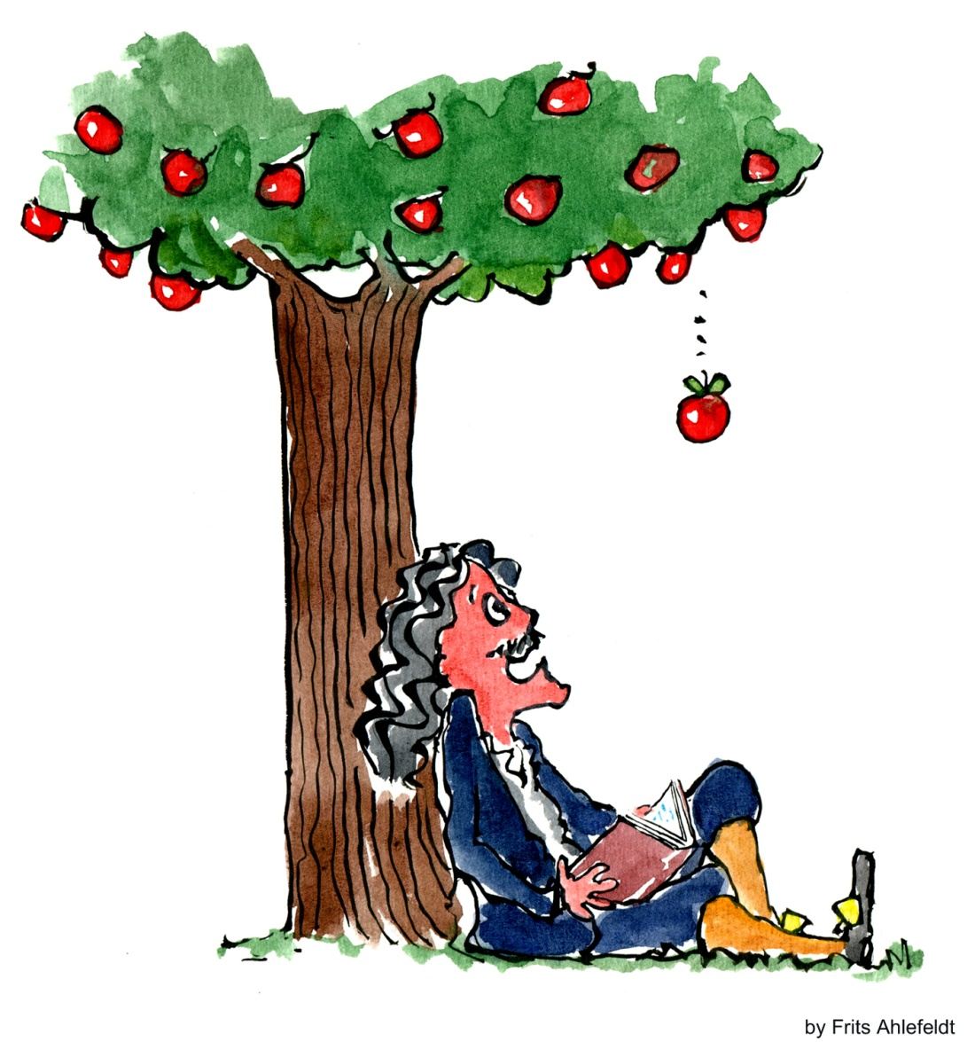
Software Engineering Applies a Scientific Approach
What is a Scientific Approach?
Deduction ??
  Make n observations
  Deduce a theory
Illogical .

Slide 22
Software Engineering Applies a Scientific Approach?
What is a Scientific Approach?
Deduction ??
Induction ??
  Make n observations
  Generalize to a theory
Illogical .

Slide 23
Software Engineering Applies a Scientific Approach?
What is a Scientific Approach?
Deduction ??
Induction ??
Hypothetico-deduction
  Make n observations
  Postulate (invent) a theory
  Make predictions
  Verify the results .

Slide 24
Software Engineering is the Application of a Scientific Approach
Analyse the problem
Specify a model of the requirements
Postulate (invent) a model of the solution
Evaluate the model against the original requirements
Reason about the model and refine it until we reach a detailed workable solution .

Slide 25
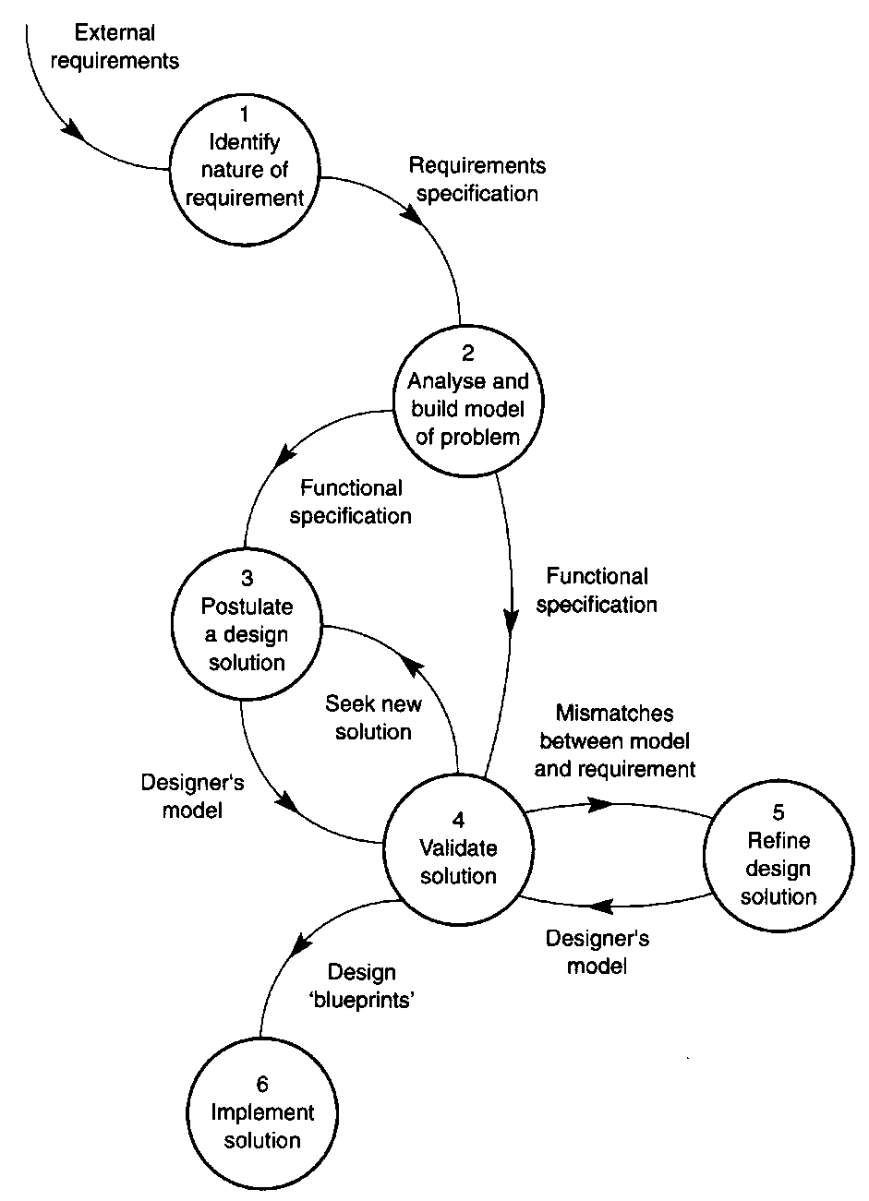
Software Engineering is the Application of a Scientific Approach
Iterations of refinements .

Slide 26
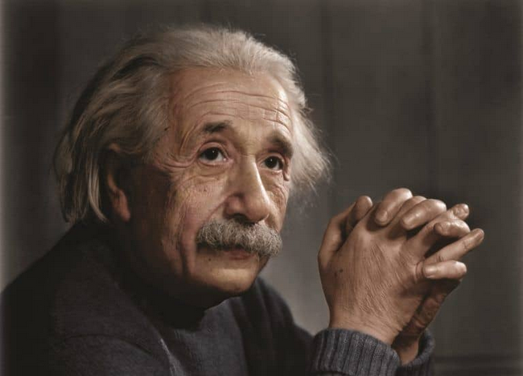
Software Engineering is the Application of a Scientific Approach
So many people today ... seem to me like somebody who has seen thousands of trees but has never seen a forest .
Albert Einstein
The Collected Papers
of Albert Einstein
Princeton University Press

Slide 27
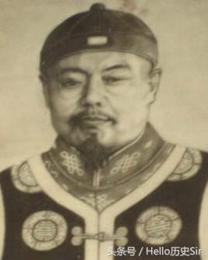
Software Engineering is the Application of a Scientific Approach
不謀全局者不足以謀一域 .
[清] 陳澹然 (1859 – 1930)
《寤言二 ‧ 遷都建藩議》

Slide 28


Software Engineering is the Application of a Scientific Approach
Postulate a general model .

Slide 29
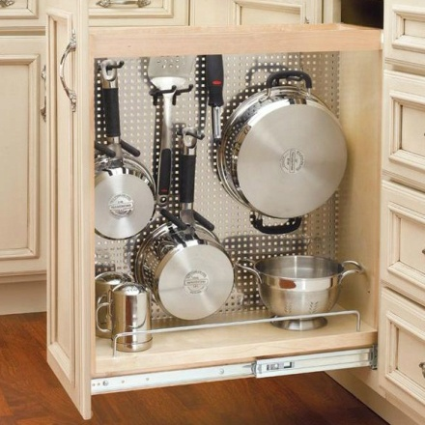





Software Engineering is the Application of a Scientific Approach
➔
➔
Apply general model .
➔

Slide 30
Software Engineering is
More than a Scientific Approach
Is the process efficient?
Resource considerations?
  Financial budget?
  Human resource budget?
  Time budget? .

Slide 31
Assumptions in a Scientific Approach
Expect some form of convergence, leading to a single solution of the problem
Divide and Conquer
Divide a problem into simpler sub-problems
If this fails, try another criterion for division
Integrate the solutions of sub-problems .

Slide 32
Problems in Software Engineering
Software engineering is an ill-structured problem
No definite formulation
No stopping rule
  For example, when do you stop analysing, designing, or testing?
Not true or false, but good or bad
Resolving a discrepancy or inconsistency may pose another problem .

Slide 33
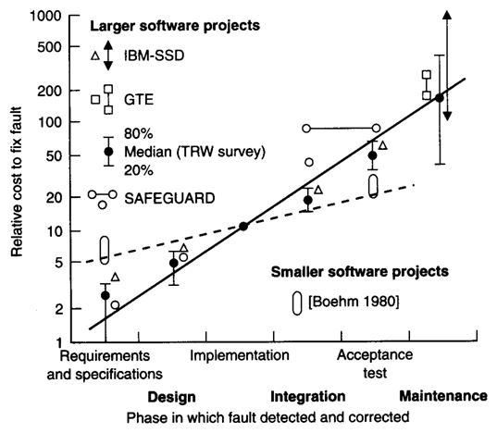
Problems in Software Engineering
Classic Cost Escalation
Cost of fixing problem after deployment is 100 times the cost of solving the problem during requirements specification .

Slide 34
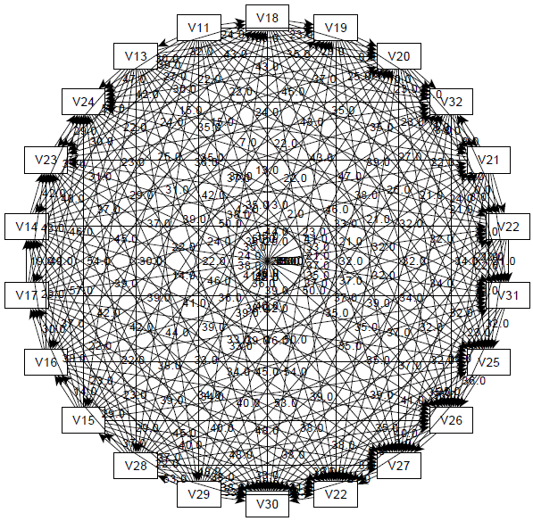
Further Problems in Software
Complex
System goes through many states during execution
No two parts of software are alike
Complexity depends on designer rather than the problem .

Slide 35
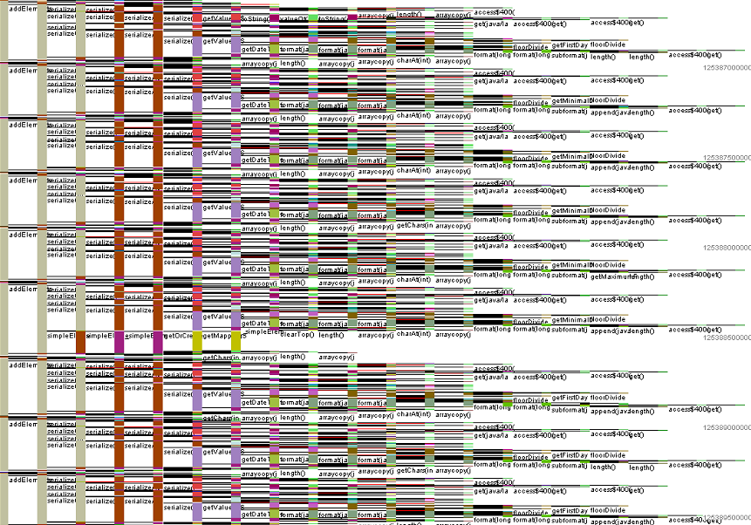
Further Problems in Software
Invisible
Compare with building plans or circuit diagrams .

Slide 36
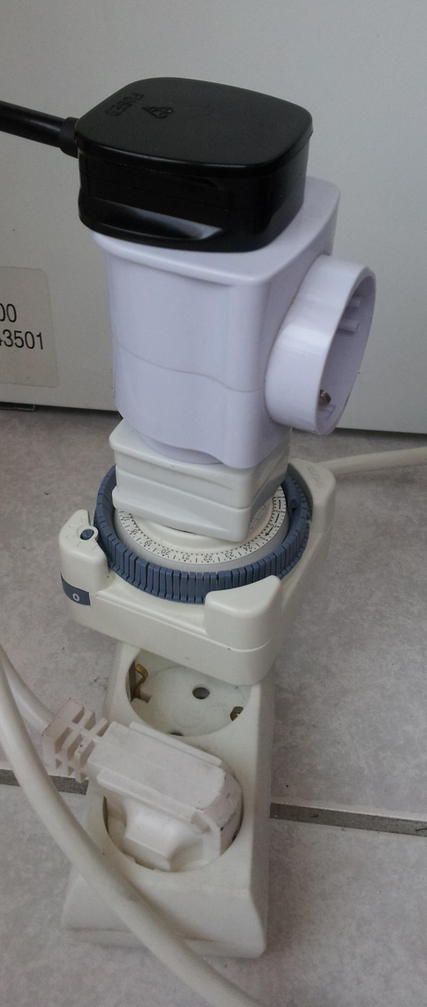
Further Problems in Software
Conformity
System must conform to other standards
  including hardware and software environment
Changeable
Constant need for change .

Slide 37
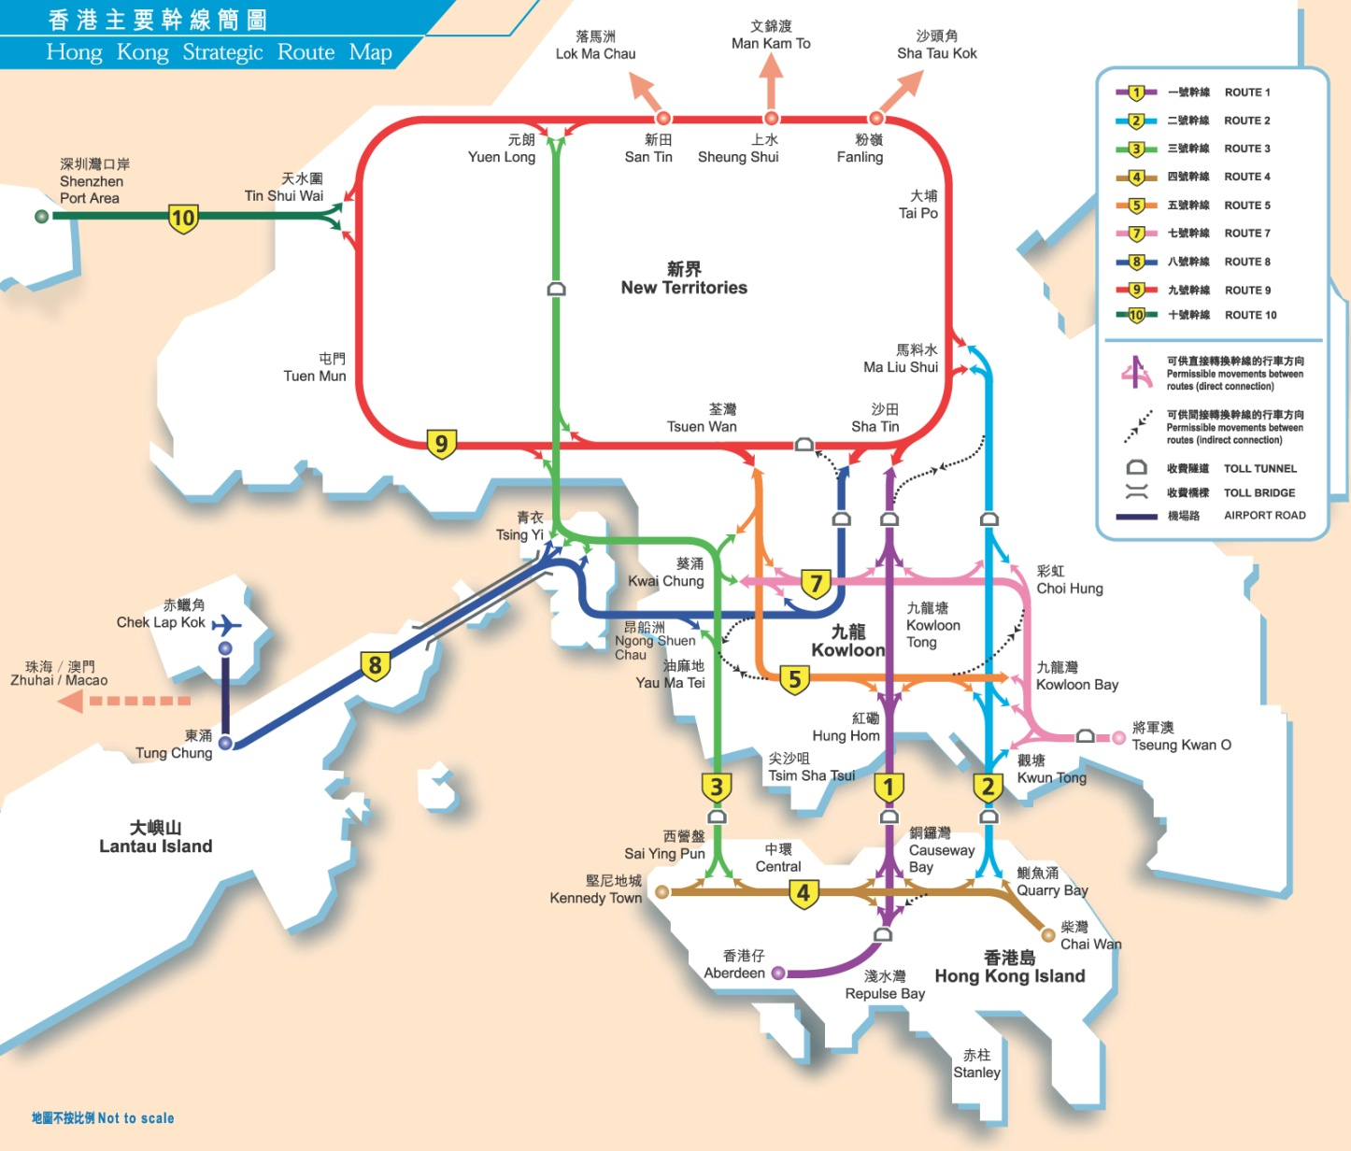
Software Engineering is Much More Than a Scientific Approach
Example: Driving to the Airport
HKU
Airport
Western Tunnel
Tsing Ma Bridge

Slide 38
Software Engineering is Much More Than a Scientific Approach
Example: Driving to the Airport
HKU
Airport
Western Tunnel
Tsing Ma Bridge
?
Central

Slide 39
Software Engineering is Much More Than a Scientific Approach
Example: Driving to the Airport
HKU
Airport
Western Tunnel
Tsing Ma Bridge
Central
A scientific principle should be general enough to allow reuse .

Slide 40
Software Engineering is Much More Than a Scientific Approach
Example: Driving to the Airport
HKU
Airport
Western Tunnel
Tsing Ma Bridge
Western Tunnel
ICC
In software engineering, resource constraints and resource optimization must be considered .

Slide 41
Software Engineering is Much More Than a Scientific Approach
Example: Driving to the Airport
HKU
Airport
Western Tunnel
Tsing Ma Bridge
ICC
Causeway
Bay
Central
Modular approach .

Slide 42
Software Engineering is Much More Than a Scientific Approach
Example: Driving to the Airport
HKU
Airport
Western Tunnel
Tsing Ma Bridge
$$$
Central Tunnel
Causeway
Bay
Flexibility and maintainability .

Slide 43

Software Engineering is Much More Than a Scientific Approach
Example: Driving to the Airport
HKU
Airport
Western Tunnel
Tsing Ma Bridge
$$$
Central Tunnel
Causeway
Bay
Lack of planning for a contractual interface .

Slide 44
More Examples of
Contractual Interfaces
getBalance (account, balance)
  Contractual interface: Interface agreed in advance between calling and called modules with well-defined parameters
getBalance
  Global variables not recommended: one module needs to understand the internal function of the other
balance = getBalance (account)
  Arbitrary change of contractual interface leads to unexpected results .

Slide 45
Software Engineering is Much More Than a Scientific Approach
Summary
Reuse
Resource constraints and resource optimization
Modular
Flexibility
Maintainability
Contractual interfaces ...
In object-oriented analysis and design, we cater for all these .

Slide 46
Recall:

Slide 47
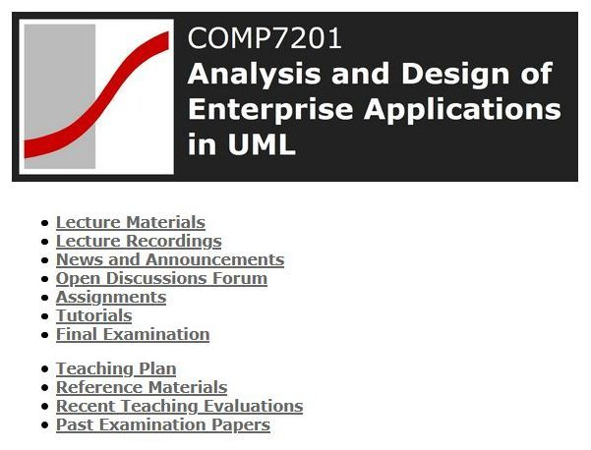
Another Example
How Good is Our Moodle Website?
Modular?
✓
Contractual interfaces?
✗
Flexible?
✗
Reuse?
✗
Maintainable?
✗
Resource constraints and resource optimization? .
✗

Slide 48
As a slow-witted human being I have a very small head and I had better learn to live with it and to respect my limitations and give them full credit, rather than to try to ignore them, for the latter vain effort will be punished by failure .
Edsger Dijkstra

Slide 49
Solution?
Object-oriented analysis and design using UML
☺ .

