Slide 1
What Fundamental is the Important in Software Engineering?
Most
Let us learn from successful enterprises
Process .

Slide 2
An Interesting Exercise
Mr George Soros
Mrs Soros
Me
Mrs Tse
I will drive
Who will sit next to me?
You are invited to conduct systems analysis and systems design .

Slide 3
An Interesting Exercise
Mr George Soros
Mrs Tse
Mrs Soros
Mr Soros or Mrs Soros or Mrs Tse
“I don’t know”
“I am not in the position to answer hypothetical questions”
“What’s the model answer?” .

Slide 4
An Interesting Exercise
“Process” is the most important aspect in software engineering
Systems Analysis based on user requirements
Mr Soros or Mrs Soros or Mrs Tse
End of analysis
Systems Design using software engineering principles
Portray working class image: Mr Soros
Portray middle class image: Mrs Tse
Portray old rich image: Mrs Soros .

Slide 5
What is Software Engineering?
The application of a systematic, disciplined, quantifiable approach to the development, operation, and maintenance of software [IEEE 1990]
Why is it engineering? .

Slide 6
What is Software Engineering?
The establishment and use of sound engineering principles (methods) in order to obtain economically software that is reliable and works on real machines [Bauer 1972]
What is engineering? .

Slide 7
What is Software Engineering?
Software engineering is that form of engineering that applies the principles of computer science and mathematics to achieving cost-effective solutions to software problems [CMU/SEI-90-TR-003]
Science
Engineering .

Slide 8
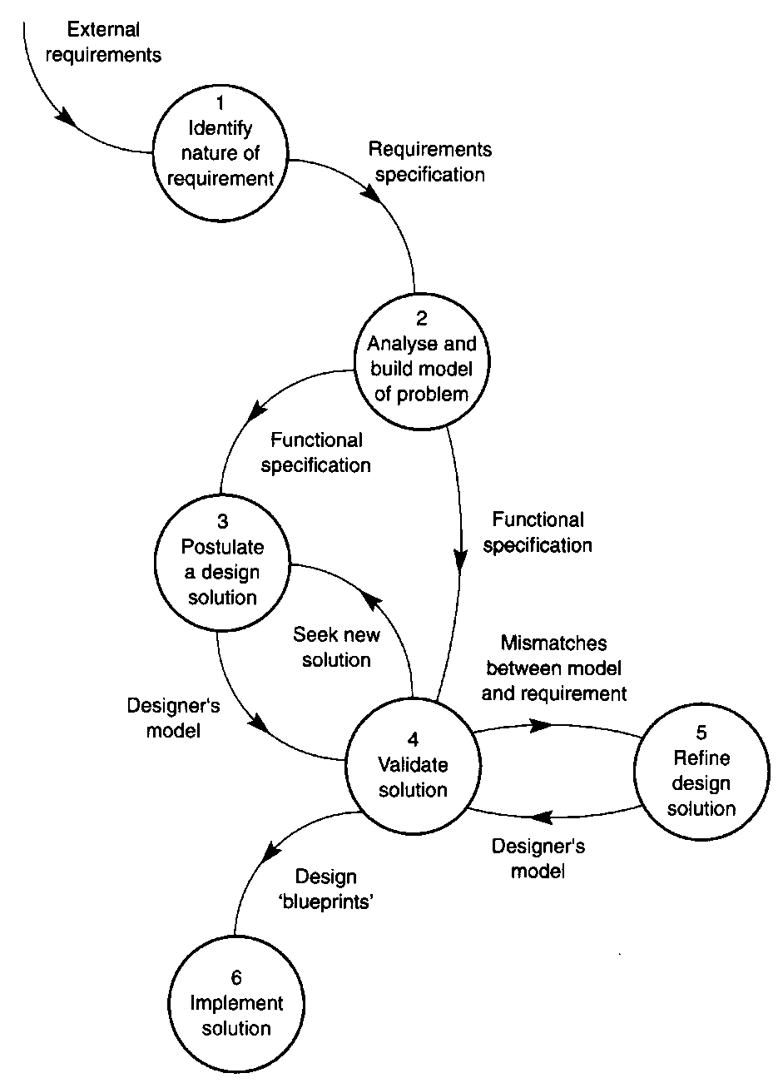
Software Engineering is the Application of a Scientific Approach
Analysis
Iterations of designs .

