Slide 1
Fundamentals in Relation to
Object-Orientation
Prof. T.H. Tse
Department of Computer Science
Email: thtse@cs.hku.hk
Web: hku.hk/thtse .

Slide 2

Object-Oriented Approaches
Object-oriented analysis
Object-oriented design
Object-oriented programming
Object-oriented database ??
Allow OO programmers to develop the product, store them as objects, and ... modify existing objects ☹ .

Slide 3
Advantages of Object-Oriented Analysis and Design
(1) User-friendly
Straightforward guidelines make it easy for novices to learn the trade
Partition complex systems into manageable units
Simple graphics
User-friendly CASE tools .

Slide 4
Advantages of Object-Oriented Analysis and Design
(2) Stand on shoulders of other giants
Direct extension from object-oriented programming
Simple transition from structured analysis and entity modelling .

Slide 5
Advantages of Object-Oriented Analysis and Design
(3) Object-oriented
Focus more on data structures than on target functions
More stable base for development process
Use objects as a single unifying software concept throughout development process
All other concepts based on objects
  Examples: attributes, relationships, methods, states, events .

Slide 6
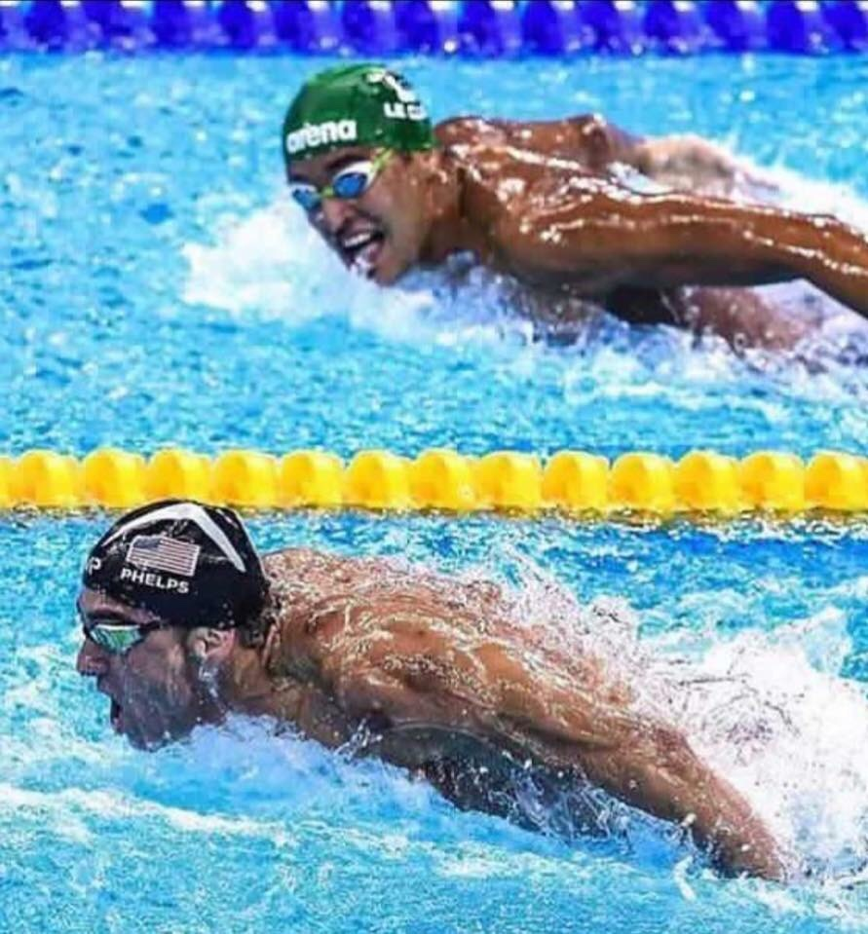
Advantages of Object-Oriented Analysis and Design
(3) Object-oriented
Encapsulated objects are protected from unexpected ripple effects
Inheritance encourages re-use .

Slide 7
Advantages of Object-Oriented Analysis and Design
(4) More comprehensive
Entity modelling concentrates on static relationships
Structured analysis concentrates on behaviour
Static relationship and dynamic behaviour in OO
(5) Easier to plan
No need to visualize the system as a single entity
No need to expect an “insight”, as in a top-down approach .

Slide 8
Advantages of Object-Oriented Analysis and Design
(6) More reusable
Previous methodologies assumed that we replace the current system (or a substantial portion) by a new system
In structured design, reuse of the same module for different purposes was explicitly discouraged .

Slide 9

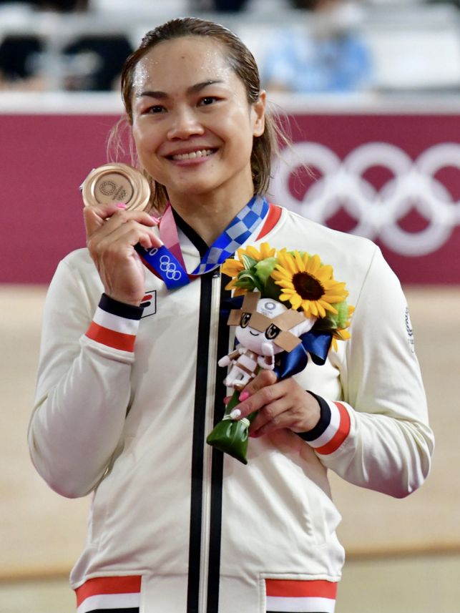
Advantages of Object-Oriented Analysis and Design
(7) Seamless development process
☺
☹

Slide 10
Advantages of Object-Oriented Analysis and Design
(7) Seamless development process
Objects are continuously used and extended throughout development cycle
Development phases are less distinct
No discontinuities
  The notation in one phase is not replaced by a different notation in another phase
Reduce information loss in design and implementation .

Slide 11
Advantages of Object-Oriented Analysis and Design
(8) Iterational rather than sequential
Seamless object-oriented development refines product to finer details
  Each iteration adds or clarifies features rather than modifying completed work
  Reduces inconsistencies or errors .

Slide 12

Objects
Is this an object?

Slide 13

Objects
Is this an object?

Slide 14
Objects
An object is an individual, identifiable
item, unit, or entity,
either physical or conceptual,
with a well-defined role
  Examples: A student
  A bank account .

Slide 15
Objects
Warning
Some authors define objects this way:
An object is something that is or is capable of being seen, touched, or otherwise sensed, and about which users store data and associate behaviour [Whitten et al.] ??
An object is an abstraction of something in a problem domain, reflecting the capabilities of the system to keep information about it, interact with it, or both [Coad and Yourdon; Bennett et al.] ?? .

Slide 16
Classes
A class is a set of objects that share
A common structure
Similar attributes
Common behaviour
Similar relationships with other objects
Common semantics
A single object is simply an instance of a class .
properties
operations
meanings

Slide 17

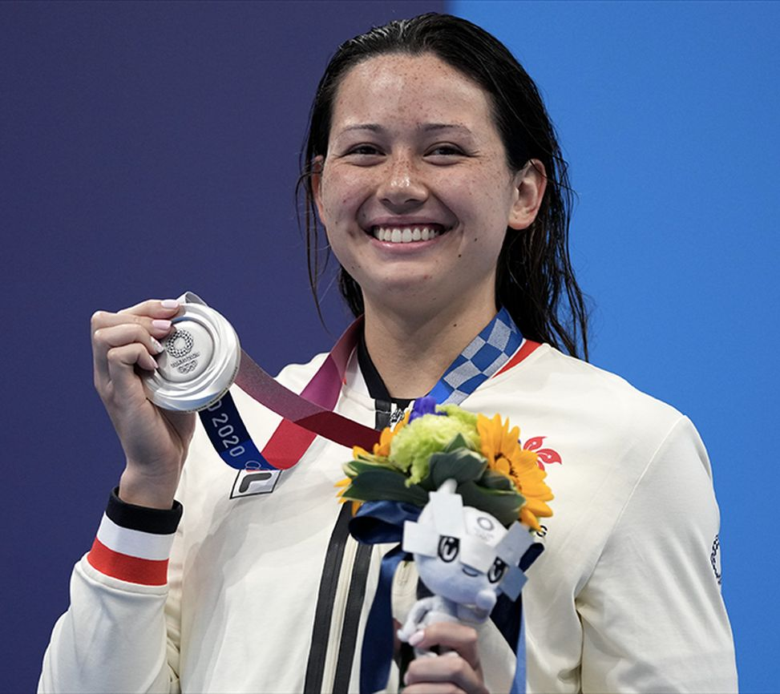
Classes and Objects
Examples
Class
Objects
Person
kalong:
Person
sipui:
Person
…

Slide 18
Attributes
An attribute is an observable property of objects in a class
Each object in the class has a value for each attribute
The value may or may not be unique for an individual object
Attributes are the data that represent characteristics of interest about an object ?? .

Slide 19
Attributes and Values
Examples
Class with
Attributes
Objects with
Values
Person
name
age
kalong: Person
name = Cheung Ka Long
age = 26
sipui: Person
name = Siobhán Haughey
age = 25
Observable attributes are not necessarily stored data items
Stored data items may be hidden ...
Notes:
Cheung Ka Long was born on 10 June 1997
Siobhán Haughey was born on 31 October 1997.

Slide 20
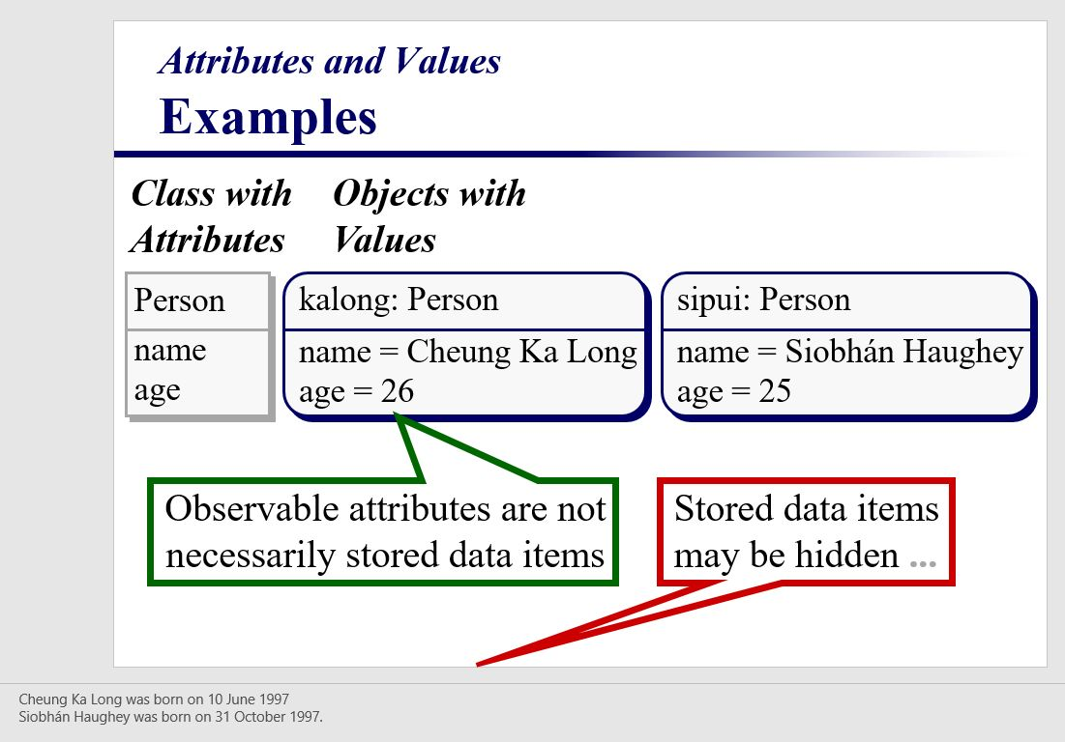
Attributes and Values
Examples
Hidden notes stored in PowerPoint
Cheng Ka Long was born on 10 June 1997
Siobhán Haughey was born on 31 October 1997 .
Notes:
Cheung Ka Long was born on 10 June 1997
Siobhán Haughey was born on 31 October 1997.

Slide 21
Behaviour
Behaviour refers to those things that the object can do
In the object-oriented paradigm, behaviour is modelled by operations .

Slide 22
Operations
An operation is a function or transformation that may be applied to or by an object in a class
  Examples: debit, credit
All objects in a class share the same operations
Each operation has the current object as an implicit argument .

Slide 23
Operations
Method
A method is an operation that may change the value of some attribute of an object
Query
A query is an operation that only reports the value of some attribute of an object without changing any attribute .

Slide 24
Operations
Examples
Is “debit” a method or query?
Is “get balance” a method or query?
Suppose the system computes the balance using “for (int i = 0; i <= 10; i++)”, and changes i from 0 to 10 after processing
  Is “get balance” a method or query?
Suppose the bank charges $5 when you ask for the balance
  Is “get balance” a method or query? .

Slide 25
Operations
Examples
Account
balance
debit
credit
Query “get balance” by default .
Customer
name
age
address
changeName
changeAge
changeAddress

Slide 26
More on Methods and Queries
Is it really necessary to distinguish between methods and queries?
Methods describe the dynamic behaviour of objects
Queries describe their static attributes
Is it really necessary to distinguish between dynamic behaviour and static attributes? .

Slide 27
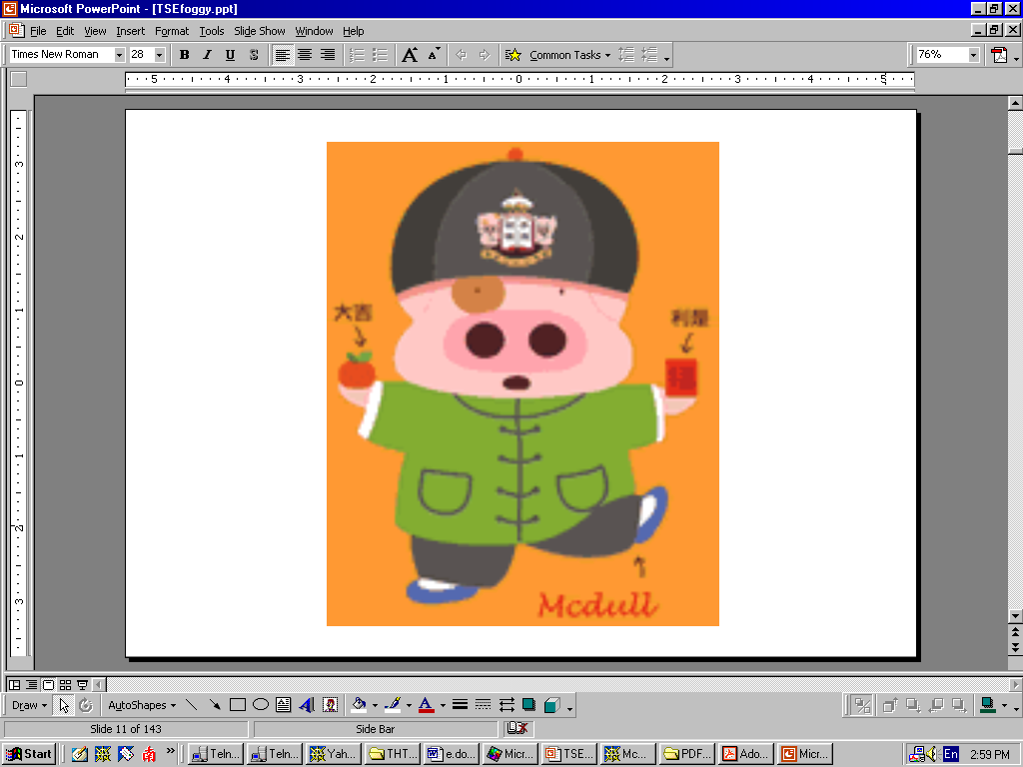
Methods and Queries
Software Testing Example

Slide 28
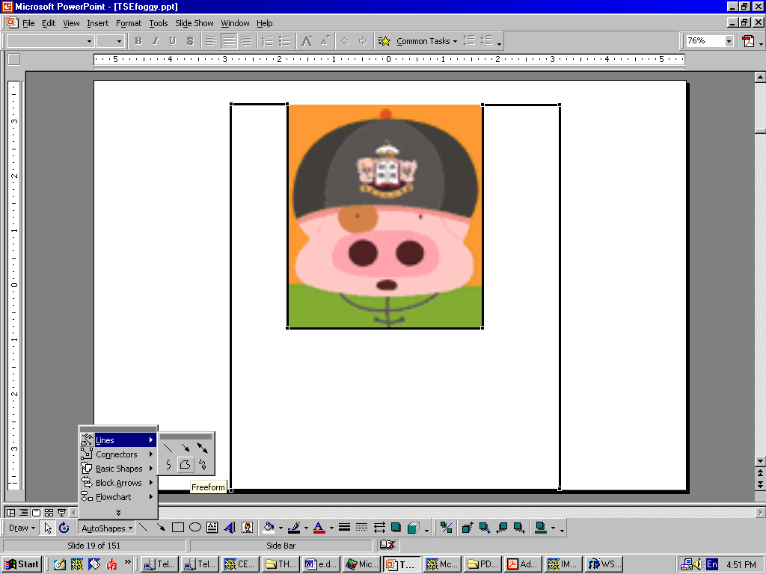
Methods and Queries
Software Testing Example

Slide 29
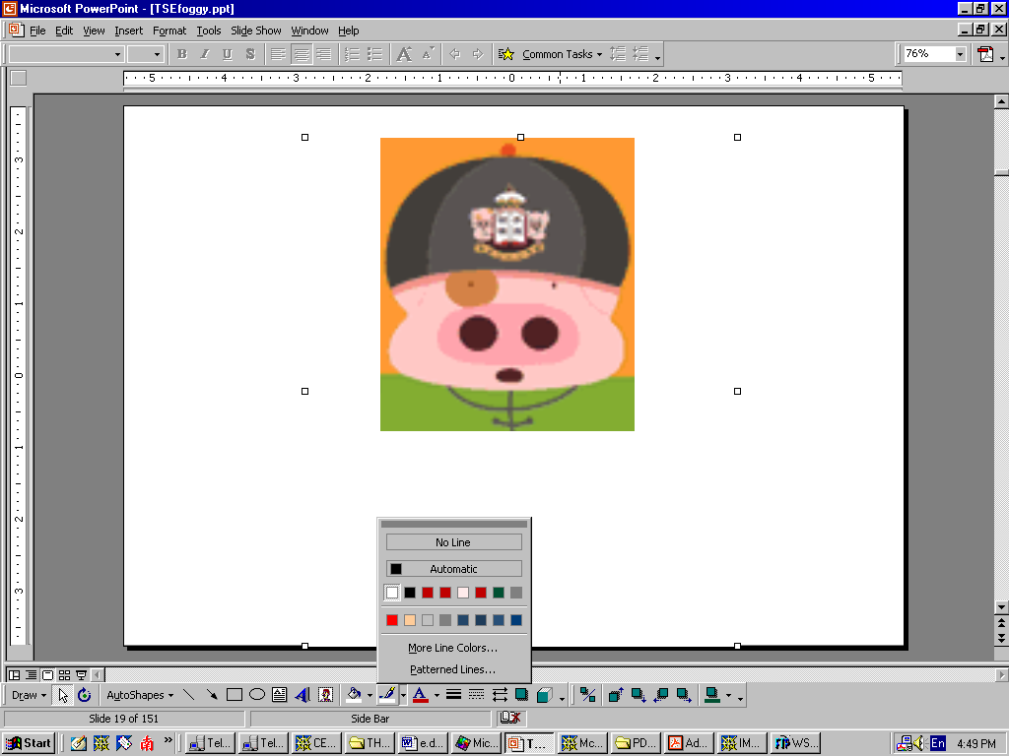
Methods and Queries
Software Testing Example

Slide 30
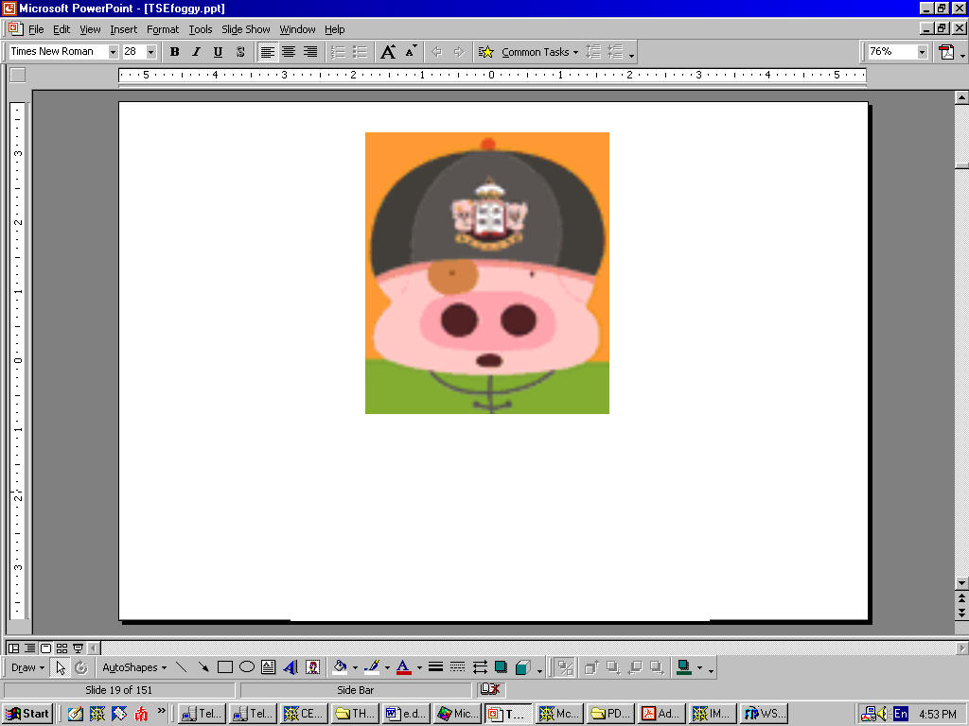
Software Testing Example
Expected Object = Actual Object ?
?
=
What exactly is “=”? .

Slide 31
Software Testing Example
Attributive Equivalence
Two objects will be attributively equivalent if they have the exactly the same static attributes
Simple to test
But the definition is too weak to be useful
Why? …

Slide 32
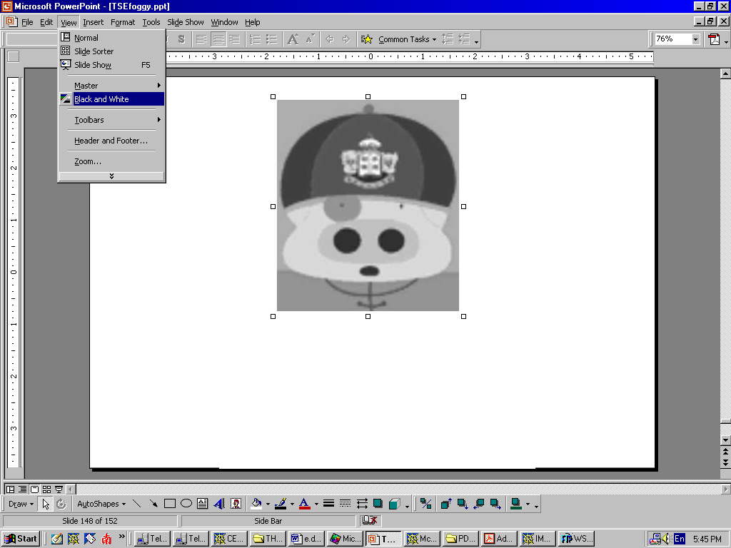
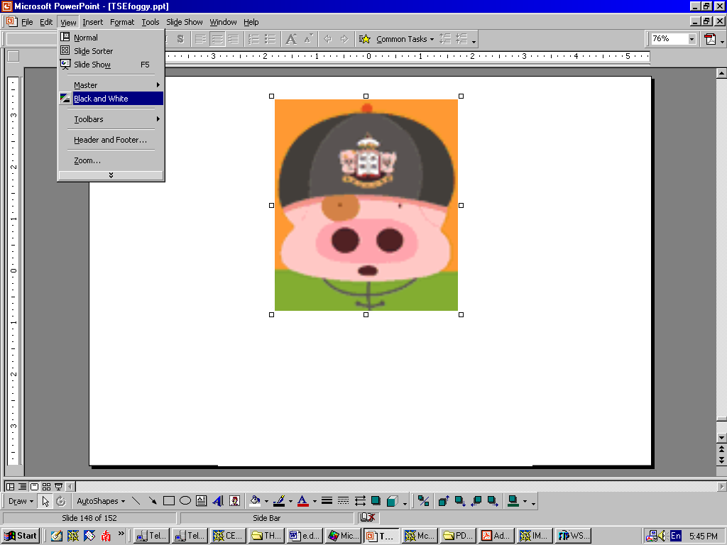
Software Testing Example
Behaviour of Expected Object

Slide 33
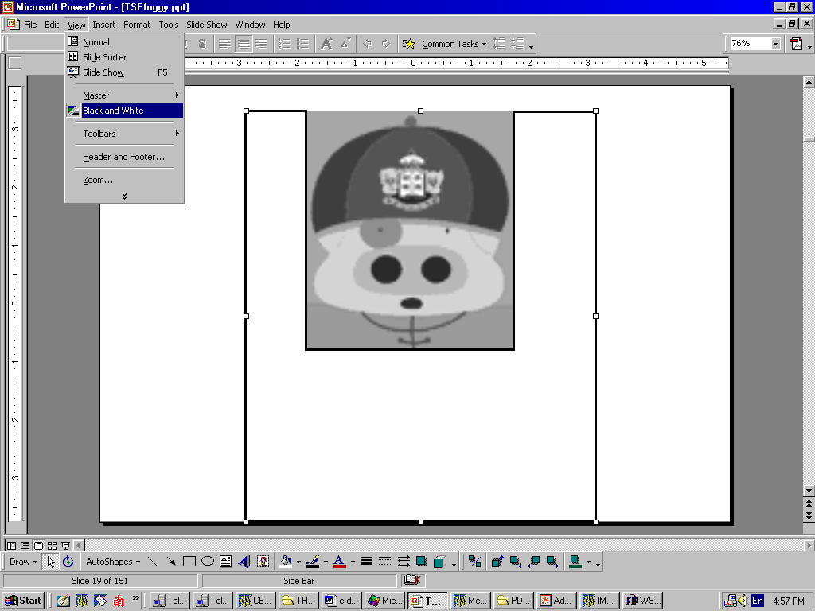
Software Testing Example
Behaviour of Actual Object

Slide 34
Software Testing Example
Expected Object = Actual Object ?
?
=
Attributively equivalent
Observationally non-equivalent .

Slide 35
Software Testing Example
Observational Equivalence
Two objects will be observationally equivalent if they have the exactly the same static attributes and dynamic behaviour
Very useful object-oriented concept
But very very very very very very very very very very very very very very very very difficult to test
Need to check an infinite combination of possible behaviour for every test case
Solved by Chen and Tse (2001 and 2013) .

Slide 36
Object-Oriented Concepts
Abstraction
Encapsulation
Inheritance
Polymorphism
Persistence and states .

Slide 37
Object-Oriented Concepts
Abstraction
Models the most important aspects while suppressing or ignoring less important details
Manage complexity by concentrating on essential characteristics
Domain and perspective specific
  What is important in one context may not be the case in another .

Slide 38
Object-Oriented Concepts
Encapsulation
“Just do it. Don’t tell me how.”
Separate the external aspects of an object from the internal, implementation details
Summarize both the structure and behaviour of an abstraction
Define the contractual interface between abstraction and implementation
Also called information hiding .

Slide 39
Object-Oriented Concepts
Encapsulation Example
push “Apple”
push “Banana”
pop
What is the resulting stack? .

Slide 40
Object-Oriented Concepts
Encapsulation Example
According to the specification:
push “Apple”
Apple
depth = 1
top = Apple

Slide 41
Object-Oriented Concepts
Encapsulation Example
According to the specification:
push “Apple”
push “Banana”
Banana
Apple
depth = 2
top = Banana

Slide 42
Object-Oriented Concepts
Encapsulation Example
According to the specification:
push “Apple”
push “Banana”
pop .
Apple
depth = 1
top = Apple

Slide 43
Object-Oriented Concepts
Encapsulation Example
According to the implementation:
push “Apple”
Apple
depth = 1
top = Apple

Slide 44
Object-Oriented Concepts
Encapsulation Example
According to the implementation:
push “Apple”
push “Banana”
Banana
Apple
depth = 2
top = Banana

Slide 45
Object-Oriented Concepts
Encapsulation Example
According to the implementation:
push “Apple”
push “Banana”
pop
Banana
Apple
Is the implementation correct? .
depth = 1
top = Apple

Slide 46
Object-Oriented Concepts
Inheritance Example
Superclasses
Student
Postgrad Student
Undergrad Student
Subclasses
Understanding is more than just syntax or format .
PhD Student
MSc Student
Notes:
It would be a useful class exercise to:
add more detail to other parts of this hierarchy
to suggest ways in which the various subclasses differ from each other in behaviour and structure.

Slide 47
Object-Oriented Concepts
Inheritance Example
Student
Postgrad
Student
Undergrad Student
PhD Student
MSc Student
Notes:
It would be a useful class exercise to:
add more detail to other parts of this hierarchy
to suggest ways in which the various subclasses differ from each other in behaviour and structure.

Slide 48
Object-Oriented Concepts
Inheritance Example
Student
Postgrad Student
PhD Student
MSc Student
Undergrad Student
Notes:
It would be a useful class exercise to:
add more detail to other parts of this hierarchy
to suggest ways in which the various subclasses differ from each other in behaviour and structure.

Slide 49
Object-Oriented Concepts
Inheritance
Y
Y
X
X
A class X inherits from another class Y if X is a subclass (smaller class) of Y having special properties
Y is called the superclass ...
Notes:
It would be a useful class exercise to:
add more detail to other parts of this hierarchy
to suggest ways in which the various subclasses differ from each other in behaviour and structure.

Slide 50
Object-Oriented Concepts
Inheritance
Y
Y
X
X
X has access to all operations defined on Y as well as special operations of its own
Inheritance is also known as generalization-specialization relationships .
Notes:
It would be a useful class exercise to:
add more detail to other parts of this hierarchy
to suggest ways in which the various subclasses differ from each other in behaviour and structure.

Slide 51
Object-Oriented Concepts
Polymorphism
Traditional typed languages, such as Pascal, assume that a parameter of a function or procedure has a unique type
Said to be monomorphic
A parameter in polymorphic languages may have more than one type .

Slide 52
Object-Oriented Concepts
Polymorphism
3 kinds of polymorphisms:
  Subtype polymorphism will work correctly if passed an argument that is a subtype of the object it expects
    Example: sqrt(4.0) and sqrt(4)
  Parametric polymorphism is obtained when a function works uniformly on a range of types, which normally exhibit a common structure
    Example: gpa(undergrad) and gpa(postgrad)
  Ad-hoc polymorphism is obtained when a function works, or appears to work, on several different types
    Example: 50 – 50 and fifty-fifty .

Slide 53
Object-Oriented Concepts
Polymorphism
In terms of implementation:
  A subtype or parametric polymorphic function will execute the same code for arguments of any admissible type
  An ad-hoc polymorphic function may execute different code for each type of argument .

Slide 54
Object-Oriented Concepts
Polymorphism
Overloading is another name for ad-hoc polymorphism
Overriding supersedes subtype polymorphism
  Example: debit in Account and debit in Minimum Balance Account .

Slide 55
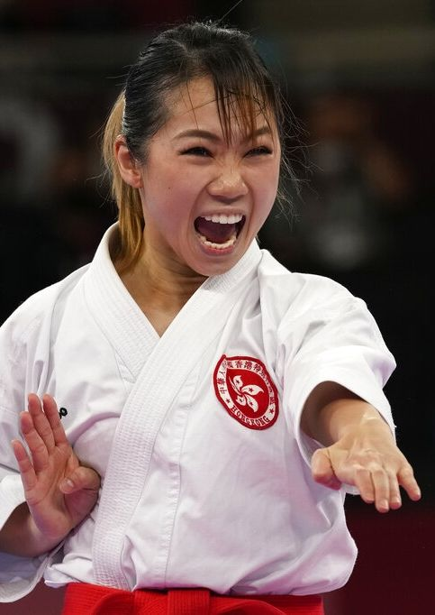

Object-Oriented Concepts
Persistence
Unlike transient data item, an object must be persistent and have a life history
Created at some point in time, undergoes changes in states, and only destroyed at the request of the user or another object
Must have an identity .

Slide 56
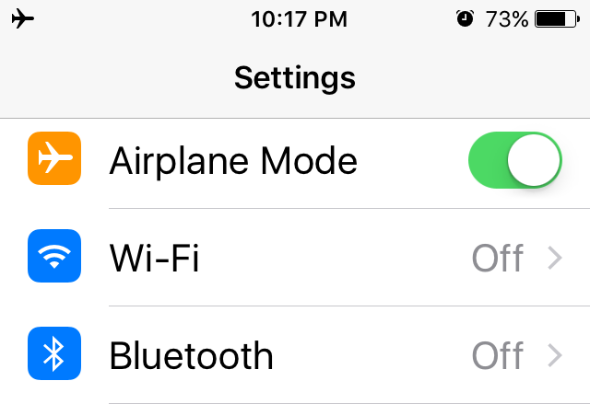
Object-Oriented Concepts
States
A state is a collection of the attribute values and links of an object
  Example: Airplane Mode is “on”,
  which represents
    Wi-Fi is “off” and
    Bluetooth is “off”
A state specifies the response of the object to input events
Corresponds to time interval between 2 events received by an object .

