Slide 1
Unified Process
Introducing the
Acknowledgement
Some of the slides are adapted from the course “Object-Oriented Analysis and Design Using UML” by IBM Rational .

Slide 2
Objectives
Explain the six best practices
Present the (Rational) Unified Process in the context of the six best practices .

Slide 3

Software Development Problems
Symptoms
Patient’s experience of disease
User requirements are not met
Users have mixed requirements
Modules cannot integrate
Difficult to maintain
Late discovery of errors
Poor user experience
Poor performance under load
Team effort not coordinated
Build-and-release issues .

Slide 4

Software Development Problems
Diagnosis
Root causes identified by doctor
Insufficient requirements analysis
Ambiguous interfaces
Fragile architecture
Unnecessary complexity
Undetected inconsistencies
Poor testing
Subjective assessment
Waterfall development
Uncontrolled change
Insufficient automation .

Slide 5
Best Practices to Cure Root Causes
Symptoms
Needs are not met
Mixed requirements
Modules can’t fit
Hard to maintain
Late discovery
Poor experience
Poor performance
Team effort is not coordinated
Build-and-release
Root Causes
Insufficient analysis
Ambiguous interfaces
Fragile architecture
Unnecessary complexity
Undetected inconsistencies
Poor testing
Subjective assessment
Waterfall development
Uncontrolled change
Insufficient automation
Best Practices
Develop iteratively
Manage requirements
Use component architecture
Model visually
Continuously verify quality
Manage change

Slide 6
Best Practices
Develop iteratively
Manage requirements
Use component architecture
Model visually
Continuously verify quality
Manage change
Harvested from ...
Thousands of customers
Thousands of projects
Industry experts .

Slide 7
Best Practices
Develop iteratively
Manage requirements
Use component architecture
Model visually
Continuously verify quality
Manage change .

Slide 8

Waterfall Development

Slide 9
Waterfall Development
Characteristics
Delays handling of critical subsystems
  All subsystems are treated equal .

Slide 10
Waterfall Development
Characteristics
Cannot predict time-to-completion
  50% of the project completed here? .

Slide 11
Waterfall Development
Characteristics
Disallows early deployment
  How much of the system can be run here? .

Slide 12
Waterfall Development
Characteristics
Delays integration and testing
  Most difficult phase here .

Slide 13
Waterfall Development
Characteristics
Frequently results in major unplanned iterations
  What if a requirements fault is found here? .

Slide 14
Iterative Development
Requirements
Analysis & Design
Planning
Initial
Planning
Implementation
Evaluation
Test
Each iteration results in an executable release
Deployment

Slide 15
Risk Profiles
Waterfall
development
Risk
Risk Reduction .
Iterative
development
Time

Slide 16
Best Practices
Develop iteratively
Manage requirements
Use component architecture
Model visually
Continuously verify quality
Manage change .

Slide 17




Requirements Management
Make sure you
  Address the right issues
  Build the system right

Slide 18
Requirements Management
Need a systematic approach to
  capturing
  organizing
  documenting
  and managing
  the changing requirements of a software application

Slide 19
Best Practices
Develop iteratively
Manage requirements
Use component architecture
Model visually
Continuously verify quality
Manage change .

Slide 20
Component-Based Architecture
Reuse or customize components
Select from commercially-available components
Evolve existing software incrementally .

Slide 21
Component-Based Architecture
Application-
specific
Basis for reuse
  Component reuse
  Architecture reuse
Basis for project management
  Planning
  Staffing
  Delivery
Intellectual control
  Manage complexity
  Maintain integrity .
Business-
specific
Middleware
System-
software
Layered
component-based architecture

Slide 22
Resilient Architecture
Meets current and future requirements
Improves extensibility
Enables reuse
Encapsulates system dependencies .

Slide 23
Best Practices
Develop iteratively
Manage requirements
Use component architecture
Model visually
Continuously verify quality
Manage change .

Slide 24
Common Types of
Specification Languages
Textual
Formal
Graphic .

Slide 25
Example of Textual Specification
McDull https://www.youtube.com/watch?v=0oCP7nZhZJo
麥兜與雞 曲: 舒伯特 詞: 謝立文 編: 何崇志
我個名叫麥兜兜，我啊媽叫麥太太，
我最喜愛食麥甩咯，一起吃雞一起在歌唱。
我個名叫麥兜兜，我老師叫 Miss Chan Chan，
我最喜愛食碟雞飯，一起吃雞一起在歌唱。
但現實就似一只鴨，吓吓一定要 duck duck。
唔得！唔得！點算嘞？點樣令只雞變做鴨？
含住個雞包仔，望住四寶雞扎，
可嘆現實系要一只鴨，加塊荔芋共我一起扎。
我最喜愛食啫啫雞，我最喜愛食雞 pat pat，
我最喜愛食豉油皇雞翼，一起吃雞一起在歌唱。
我最想吃雞，我最終變臘鴨！鴨！鴨！鴨！鴨！

Slide 26
Textual Specification
Problems:
Structures are implicit and obscured
  Lists, tables and hypertext are partial solutions to this problem
Natural language is prone to ambiguity
  Unless expressed as long and complex sequences of text, as in legal documents
Hence, only plays supplementary role in analysis and design .

Slide 27
Formal Specification
Mathematically defined syntax and semantics
Helps to reason on the problems and solutions
Helps to verify against ambiguities, inconsistencies, and incompleteness .

Slide 28
Example of Formal Specification
NEW_MACHINE
= ( coinslot.$5
→ ( coinslot.$5 → hatch.cappucino → NEW_MACHINE
 drink_button.press → hatch.tea → NEW_MACHINE )
| coinslot.$10
→ ( change_button.press → change.$5 → hatch.tea → NEW_MACHINE
 drink_button.press → hatch.cappucino
→ NEW_MACHINE ) )

Slide 29
Formal Specification
Problems:
Involve unfamiliar concepts and complex notation
Difficult in large-scale systems
Use only when necessary, such as
Defense systems
Safety critical systems
Situations where other specifications do not work .

Slide 30

Example of Graphic Specification
McDull

Slide 31
Graphic Specification
Capture the structure and behavior of architectures and components
Easily show how all the pieces fit together
Help maintain consistency between design and implementation
Promote human communication
Hide or expose details as appropriate
Most popular in analysis and design .

Slide 32
Graphic Specification
Problems:
Lack of precise syntax and semantics
May be interpreted differently by different designers and users .

Slide 33
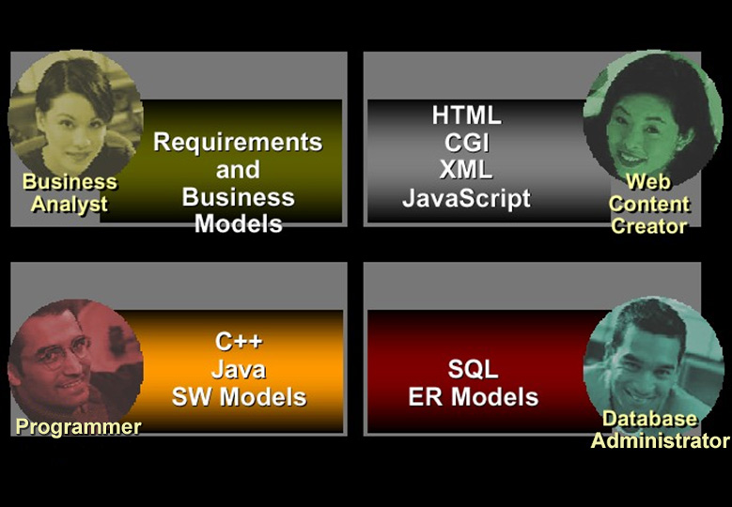
Multiple Languages = Communication Barriers

Slide 34
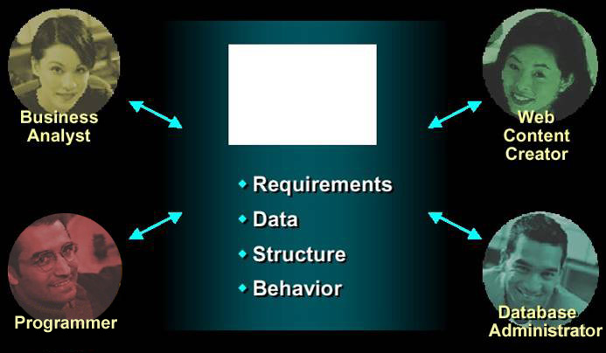
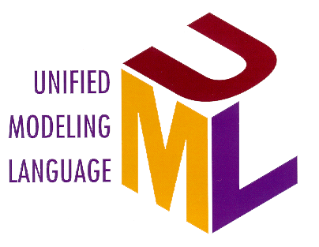
UML: One Language for All Practitioners

Slide 35
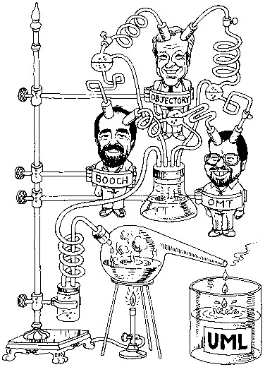
History of UML
Integration of
Object Modelling Technique
  by James Rumbaugh
Objectory Process
  by Ivar Jacobson
Booch Method
  by Grady Booch .

Slide 36
Visual Modelling with UML
Multiple views
“Semi-formal” syntax and semantics .

Slide 37
Visual Modelling with UML
Use case
Diagram
Class Diagram
mainWnd
fileMgr :
document :
gFile
repository
user
FileMgr
Document
Æ¯Á¤¹®¼­¿¡ ´ëÇÑ º¸±â¸¦
1: Doc view request ( )
Use Case 1
FileMgr
DocumentList
»ç¿ëÀÚ°¡ ¿äÃ»ÇÑ´Ù.
2: fetchDoc( )
3: create ( )
Actor A
add( )
Document
4: create ( )
Actor B
fetchDoc( )
delete( )
name : int
sortByName( )
docid : int
numField : int
5: readDoc ( )
get( )
read() fill the
È­ÀÏ°ü¸®ÀÚ´Â ÀÐ¾î¿Â
Use Case 2
open( )
code..
¹®¼­ÀÇ Á¤º¸¸¦ ÇØ´ç ¹®¼­
6: fillDocument ( )
close( )
°´Ã¼¿¡ ¼³Á¤À» ¿äÃ»ÇÑ´Ù.
FileList
read( )
7: readFile ( )
fList
sortFileList( )
create( )
add( )
fillDocument( )
8: fillFile ( )
delete( )
1
È­¸é °´Ã¼´Â ÀÐ¾îµéÀÎ
9: sortByName ( )
1
°´Ã¼µé¿¡ ´ëÇØ ÀÌ¸§º°·Î
Á¤·ÄÀ» ½ÃÄÑ È­¸é¿¡
Use Case 3
º¸¿©ÁØ´Ù.
rep
Sequence
Diagram
State
Machine
Repository
File
(from Persistence)
read( )
GrpFile
name : char * = 0
read( )
readDoc( )
open( )
readFile( )
create( )
fillFile( )
add file
Deployment
Diagram
add file [ numberOffile==MAX ] /
Writing
Repository
DocumentList
Openning
flag OFF
close file
FileManager
close file
Closing
Document
Reading
GraphicFile
Window95
Windows95
Windows95
File
FileList
¹®¼­°ü¸®
Å¬¶óÀÌ¾ðÆ®.EXE
Windows
¹®¼­°ü¸® ¾ÖÇÃ¸´
CommunicationDiagram
NT
Solaris
Component
Diagram
¹®¼­°ü¸® ¿£Áø.EXE
Alpha
Windows
ÀÀ¿ë¼­¹ö.EXE
UNIX
NT
IBM
Target
System .
9: sortByName ( )
Mainframe
mainWnd : MainWnd
µ¥ÀÌÅ¸º£ÀÌ½º¼­¹ö
Forward and Reverse Engineering
1: Doc view request ( )
2: fetchDoc( )
gFile : GrpFile
4: create ( )
user : »ç¿ëÀÚ
8: fillFile ( )
fileMgr : FileMgr
3: create ( )
7: readFile ( )
6: fillDocument ( )
repository : Repository
5: readDoc ( )
document : Document

Slide 38
Best Practices
Develop iteratively
Manage requirements
Use component architecture
Model visually
Continuously verify quality
Manage change .

Slide 39
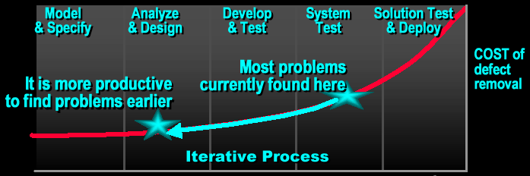
Continuously Verify Software Quality
Earlier detection and repair
Problems found earlier are less costly to repair
Fixing problems earlier leads to higher quality software
Identifying and resolving problems earlier result in more realistic and reliable development schedule .

Slide 40
Test All Dimensions of Software Quality
Usability
Test application from the perspective of convenience to end-user
Functionality
Test the accurate workings of each usage scenario
Reliability
Test the application behaves consistently and predictably
Supportability
Test the ability to maintain and support application under production use
Performance
Test online response under average and peak loading

Slide 41
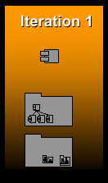
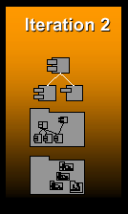
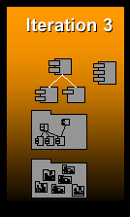
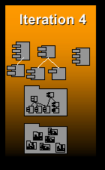
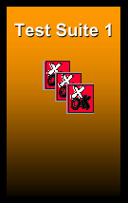
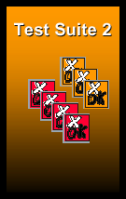
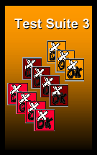
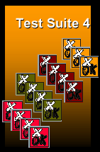
Test Each Iteration
UML models and implemen-tations
Tests

Slide 42
Best Practices
Develop iteratively
Manage requirements
Use component architecture
Model visually
Continuously verify quality
Manage change .

Slide 43
Change Management for Development Team
Establish secure
workspace for
each developer
Controlled
parallel
development
ALERT
REPORT
Automated build and integration management
Iterative development

Slide 44
Best Practices Reinforce One Another
Develop iteratively
Manage requirements
Use component architecture
Model visually
Continuously verify quality
Manage change

Slide 45
Unified Process

Slide 46
Unified Process

Slide 47
Major Phases in Unified Process
Inception
  Mainly to specify project scope
Elaboration
  Mainly to analyse problem domain, plan project, and establish baseline architecture
Construction
  Mainly to develop system
Transition
  Mainly to pass final system to users .

Slide 48
Major Phases in Unified Process
Time
Inception
Elaboration
Construction
Transition
Major
Major
Major
Major Milestones

Slide 49
Bringing it All Together:
The Iterative Approach
Disciplines group activities logically
Walk through all disciplines in every iteration
Each iteration results in an executable release

Slide 50


Within Each Phase
Disciplines and Models
Each discipline describes how to create and maintain a set of models
Business
Modelling
Business Model
Business
Object Model
Requirements
Capture
realized by
Use Case Model
Analysis and Design
implemented by
Analysis Model
Design Model
verified by
Implementation
Implementation Model
Test
Test Model

Slide 51
Compared with
Waterfall Development
Finish each discipline before the next
Cannot go back to a previous discipline
No deliverables until all done .

Slide 52
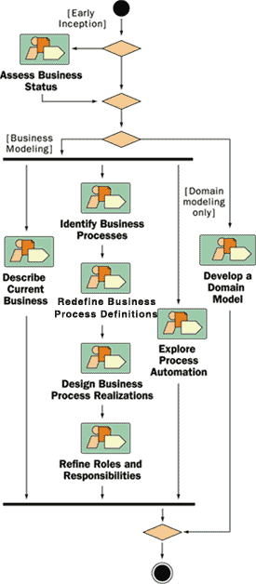
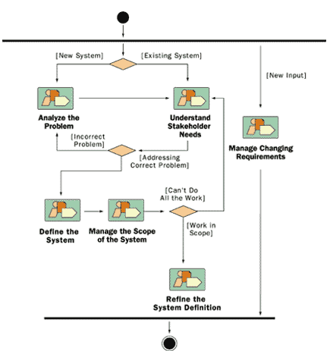
Disciplines Guide Iterative
Development
Business Modeling:
Discipline Details
Requirements:
Discipline Details

Slide 53
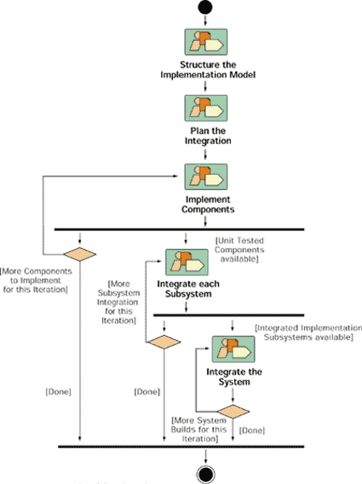
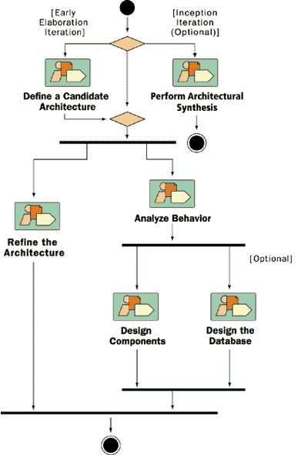
Disciplines Guide Iterative
Development
Analysis and Design:
Discipline Details
Implementation:
Discipline Details

Slide 54
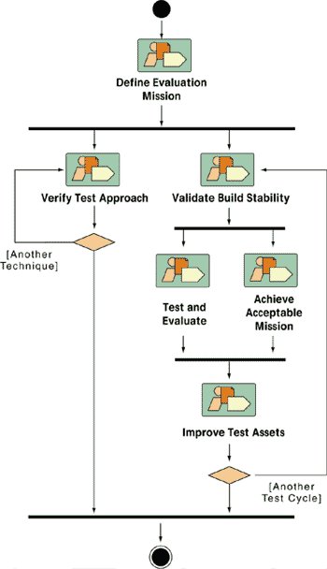
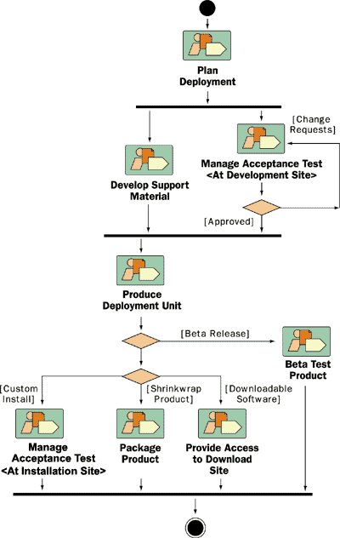
Disciplines Guide Iterative
Development
Test:
Discipline Details
Deployment:
Discipline Details

Slide 55
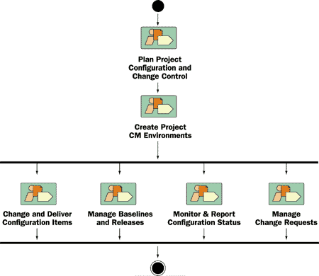
Disciplines Guide Iterative
Development
Configuration and Change Management:
Discipline Details

Slide 56
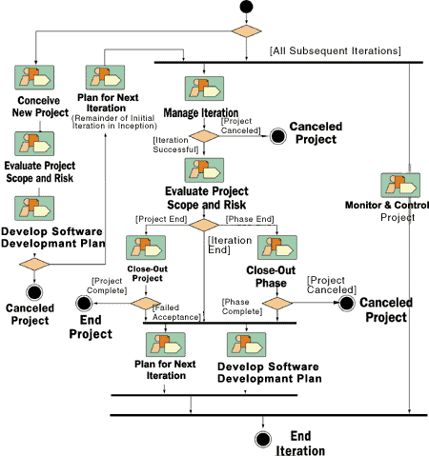
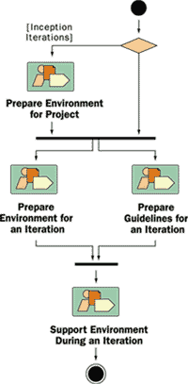
Disciplines Guide Iterative
Development
Project Management:
Discipline Details
Environment:
Discipline Details

Slide 57
More Reading Material at Student Request
Develop Iteratively
Most software teams still use a waterfall process for development projects, completing in strict sequence the phases of requirement analysis, design, implementation, integration and test
UP represents an iterative approach:
  It lets you take into account changing requirements
  Integration is not one “big bang” at the end; instead, elements are integrated progressively
  With UP, what used to be a lengthy time of uncertainty and pain − taking up to 40% of the total effort at the end of a project − is broken down into six to nine smaller integrations involving fewer elements .

Slide 58
More Reading Material
Develop Iteratively
  Risks are usually discovered or addressed during integration. With the iterative approach, you can mitigate risks earlier.
  Iterative development provides management with a means of making tactical changes to the product − to compete with existing products, for example. It allows you to release a product early with reduced functionality to counter a move by a competitor, or to adopt another vendor for a given technology.
  Iteration facilitates reuse; it is easier to identify reusable components as they are partially designed or implemented than to recognize them during planning
  When you can correct errors over several iterations, the result is a more robust architecture .

Slide 59
More Reading Material
Develop Iteratively
Project managers often resist the iterative approach, seeing it as a kind of endless and uncontrolled hacking
In UP, the iterative approach is very controlled; the number, duration, and objectives of iterations are carefully planned, and the tasks and responsibilities of participants are well defined .

Slide 60
More Reading Material
Manage Requirements
UP is a use-case-driven approach
  The use cases defined for the system can serve as the foundation for the rest of the development process
  Use cases used for capturing requirements play a major role in several of the process disciplines, especially design, test, user-interface design, and project management
  They are also critical to business modeling
Use cases provide a consistent, visible thread through the system when it performs certain tasks .

Slide 61
More Reading Material
Manage Requirements
They provide an important link between system requirements and other development artifacts, such as design and tests
Other object-oriented methods provide use-case-like representation but use different names for it, such as scenarios or threads .

Slide 62
More Reading Material
Use Component Architectures
Use cases drive UP throughout the entire lifecycle, but design activities center on architecture
The main focus of early iterations is to produce and validate a software architecture
In the initial development cycle, this takes the form of an executable architectural prototype that gradually evolves, through subsequent iterations, into the final system .

Slide 63
More Reading Material
Use Component Architectures
A component can be defined as a nontrivial piece of software: a module, package, or subsystem that fulfills a clear function, has a clear boundary, and can be integrated into a well-defined architecture
  Physical realization of abstraction in your design
In defining a modular architecture, you identify, isolate, design, develop, and test well-formed components. These components can be individually tested and gradually integrated to form the whole system.
  Exploiting the concepts of modularity and encapsulation .

Slide 64
More Reading Material
Use Component Architectures
Some of these components can be developed to be reusable, especially components that provide solutions to a wide range of common problems
The advent of commercially successful infrastructures supporting the concept of software components – such as Common Object Request Broker Architecture (CORBA), the Internet, and JavaBeans – has launched a whole industry of off-the-shelf components for various domains, allowing developers to buy and integrate components rather than develop them in-house
  Shift software development from programming software (one line at a time) to composing software (by assembling components) .

Slide 65
More Reading Material
Use Component Architectures
UP supports component-based development in several ways
  The iterative approach allows developers to progressively identify components and decide which ones to develop, which ones to reuse, and which ones to buy
  The architecture defines the components and the ways they integrate, as well as the fundamental mechanisms and patterns by which they interact
  Concepts such as packages, subsystems, and layers are used during analysis and design to organize components and specify interfaces
  Testing is organized around single components first and then is gradually expanded to include larger sets of integrated components .

Slide 66
More Reading Material
Model Visually
Models are simplifications of reality; they help us to understand and shape both a problem and its solution, and to comprehend large, complex systems that we could not otherwise understand as a whole
A large part of UP is about developing and maintaining models of the system under development
The Unified Modeling Language (UML) is a Graphic language for visualizing, specifying, constructing, and documenting the artifacts of a software-intensive system .

Slide 67
More Reading Material
Model Visually
UML does not tell you how to develop software
UP is a guide to the effective use of UML for modeling
  It describes the models you need, why you need them, and how to construct them .

Slide 68
More Reading Material
Continuously Verify Quality
Our concern about quality is focused on two areas: product quality and process quality
Product quality
  The quality of the principal product being produced (the software or system) and all the elements it comprises (for example, components, subsystems, architecture, and so on) .

Slide 69
More Reading Material
Continuously Verify Quality
Process quality
  The degree to which an acceptable process (including measurements and criteria for quality) was implemented and adhered to during the manufacturing of the product
  Additionally, process quality is also concerned with the quality of the artifacts (such as iteration plans, test plans, use-case realizations, design model, and so on) produced in support of the principal product .

Slide 70
More Reading Material
Manage Change
By allowing flexibility in the planning and execution of the development and by allowing the requirements to evolve, iterative development emphasizes the vital issues of keeping track of changes and ensuring that everything and everyone is in sync
Focused closely on the needs of the development organization, change management is a systematic approach to managing changes in requirements, design, and implementation .

Slide 71
More Reading Material
Manage Change
It also covers the important activities of keeping track of defects, misunderstandings, and project commitments as well as associating these activities with specific artifacts and releases
Change management is tied to configuration management and measurements .

Slide 72
More Reading Material
Inception Phase
Purpose
  To establish the business case for a new system or for a major update of an existing system
  To specify the project scope
Outcome
  A general vision of the project’s requirements, that is, the core requirements
    Initial use-case model and domain model (10−20% complete)
  An initial business case, including:
    Success criteria (such as revenue projection)
    An initial risk assessment
    An estimate of resources required
Milestone: Lifecycle objectives .

Slide 73
More Reading Material
Elaboration Phase
Purpose
  To analyze the problem domain
  To establish a sound architectural foundation
  To address the highest risk elements of the project
  To develop a comprehensive plan showing how the project will be completed
Outcome
  Use-case and domain model 80% complete
  An executable architecture and accompanying documentation
  A revised business case, including revised risk assessment
  A development plan for the overall project
Milestone: Lifecycle architecture .

Slide 74
More Reading Material
Construction Phase
Purpose
  To incrementally develop a complete software product which is ready to transition into the user community
Products
  A complete use-case and design model
  Executable releases of increasing functionality
  User documentation
  Deployment documentation
  Evaluation criteria for each iteration
  Release descriptions, including quality assurance results
  Updated development plan
Milestone: Initial operational capability .

Slide 75
More Reading Material
Transition Phase
Purpose
  To transition the software product into the user community
Products
  Executable releases
  Updated system models
  Evaluation criteria for each iteration
  Release descriptions, including quality assurance results
  Updated user manuals
  Updated deployment documentation
  “Post-mortem” analysis of project performance
Milestone: Product release .

