Slide 1
Unified Process
Introducing the
Acknowledgement
Some of the slides are adapted from the course “Object-Oriented Analysis and Design Using UML” by IBM Rational .

Slide 2
Objectives
Explain the six best practices
Present the (Rational) Unified Process in the context of the six best practices .

Slide 3
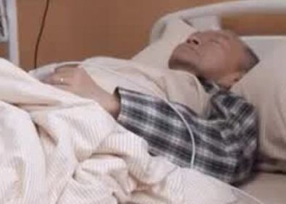
Software Development Problems
Symptoms
Systems Analysis from user requirements
User requirements are not met
Users have mixed requirements
Modules cannot integrate
Difficult to maintain
Late discovery of errors
Poor user experience
Poor performance under load
Team effort not coordinated
Build-and-release issues .

Slide 4

Software Development Problems
Diagnosis
Systems Design by innovation and invention
Insufficient requirements analysis
Ambiguous interfaces
Fragile architecture
Unnecessary complexity
Undetected inconsistencies
Poor testing
Subjective assessment
Waterfall development
Uncontrolled change
Insufficient automation .

Slide 5
Best Practices to Cure Root Causes
Symptoms
Needs are not met
Mixed requirements
Modules can’t fit
Hard to maintain
Late discovery
Poor experience
Poor performance
Team effort is not coordinated
Build-and-release
Root Causes
Insufficient analysis
Ambiguous interfaces
Fragile architecture
Unnecessary complexity
Undetected inconsistencies
Poor testing
Subjective assessment
Waterfall development
Uncontrolled change
Insufficient automation
Best Practices
Develop iteratively
Manage requirements
Use component architecture
Model visually
Continuously verify quality
Manage change

Slide 6
Best Practices
Develop iteratively
Manage requirements
Use component architecture
Model visually
Continuously verify quality
Manage change
Harvested from ...
Thousands of customers
Thousands of projects
Industry experts .

Slide 7
Best Practices
Develop iteratively
Manage requirements
Use component architecture
Model visually
Continuously verify quality
Manage change .

Slide 8

Waterfall Model
Traditional
development process
Strictly analysis followed by design
No iteration allowed .

Slide 9

Waterfall Model

Slide 10
Waterfall Development
Characteristics
Delays handling of critical subsystems
  All subsystems are treated equal .

Slide 11
Waterfall Development
Characteristics
Cannot predict time-to-completion
  50% of the project completed here? .

Slide 12
Waterfall Development
Characteristics
Disallows early deployment
  How much of the system can be run here? .

Slide 13
Waterfall Development
Characteristics
Delays integration and testing
  Most difficult phase here .

Slide 14
Waterfall Development
Characteristics
Frequently results in major unplanned iterations
  What if a requirements fault is found here? .

Slide 15
Iterative Development
Requirements
Analysis & Design
Planning
Initial
Planning
Implementation
Evaluation
Test
Each iteration results in an executable release
Deployment

Slide 16
Risk Profiles
Waterfall
development
Risk
Risk Reduction .
Iterative
development
Time

Slide 17
Best Practices
Develop iteratively
Manage requirements
Use component architecture
Model visually
Continuously verify quality
Manage change .

Slide 18
Requirements Management
Make sure you
  Address the right issues
Systems Analysis from user requirements

Slide 19
Requirements Management
Systems Design by innovation and invention
Make sure you
  Address the right issues
  Build the system right

Slide 20



Requirements Management
Examples
Make sure you
  Address the right issues
⊗

Slide 21
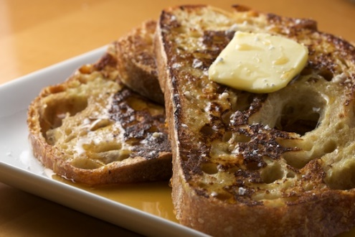
Requirements Management
Examples
Make sure you
  Address the right issues
  Build the system right
⊗

Slide 22
Requirements Management
Need a systematic approach to
  capturing
  organizing
  documenting
  and managing
  the changing user requirements of software application

Slide 23
Best Practices
Develop iteratively
Manage requirements
Use component architecture
Model visually
Continuously verify quality
Manage change .

Slide 24
Component-Based Architecture
Reuse or customize components
Select from commercially-available components
Evolve existing software incrementally .

Slide 25
Component-Based Architecture
Application-
specific
Basis for reuse
  Component reuse
  Architecture reuse
Basis for project management
  Planning
  Staffing
  Delivery
Intellectual control
  Manage complexity
  Maintain integrity .
Business-
specific
Middleware
System-
software
Layered
component-based architecture

Slide 26
Resilient Architecture
Meets current and future requirements
Improves extensibility
Enables reuse
Encapsulates system dependencies .

Slide 27
Best Practices
Develop iteratively
Manage requirements
Use component architecture
Model visually
Continuously verify quality
Manage change .

Slide 28
Common Types of
Specification Languages
Textual
Formal
Graphic .

Slide 29
Example of Textual Specification
McDull https://www.youtube.com/watch?v=0oCP7nZhZJo
麥兜與雞 曲: 舒伯特 詞: 謝立文 編: 何崇志
我個名叫麥兜兜，我啊媽叫麥太太，
我最喜愛食麥甩咯，一起吃雞一起在歌唱。
我個名叫麥兜兜，我老師叫 Miss Chan Chan，
我最喜愛食碟雞飯，一起吃雞一起在歌唱。
但現實就似一只鴨，吓吓一定要 duck duck。
唔得！唔得！點算嘞？點樣令只雞變做鴨？
含住個雞包仔，望住四寶雞扎，
可嘆現實系要一只鴨，加塊荔芋共我一起扎。
我最喜愛食啫啫雞，我最喜愛食雞 pat pat，
我最喜愛食豉油皇雞翼，一起吃雞一起在歌唱。
我最想吃雞，我最終變臘鴨！鴨！鴨！鴨！鴨！

Slide 30
Textual Specification
Problems:
Structures are implicit and obscured
  Lists, tables and hypertext are partial solutions to this problem
Natural language is prone to ambiguity
  Unless expressed as long and complex sequences of text, as in legal documents
Hence, only plays supplementary role in analysis and design .

Slide 31
Formal Specification
Mathematically defined syntax and semantics
Helps to reason on the problems and solutions
Helps to verify against ambiguities, inconsistencies, and incompleteness .

Slide 32
Example of Formal Specification
NEW_MACHINE
= ( coinslot.$5
→ ( coinslot.$5 → hatch.cappucino → NEW_MACHINE
 drink_button.press → hatch.tea → NEW_MACHINE )
| coinslot.$10
→ ( change_button.press → change.$5 → hatch.tea → NEW_MACHINE
 drink_button.press → hatch.cappucino
→ NEW_MACHINE ) )

Slide 33
Formal Specification
Problems:
Involve unfamiliar concepts and complex notation
Difficult in large-scale systems
Use only when necessary, such as
Defense systems
Safety critical systems
Situations where other specifications do not work .

Slide 34

Example of Graphic Specification
McDull

Slide 35
Graphic Specification
Capture the structure and behavior of architectures and components
Easily show how all the pieces fit together
Help maintain consistency between design and implementation
Promote human communication
Hide or expose details as appropriate
Most popular in analysis and design .

Slide 36
Graphic Specification
Problems:
Lack of precise syntax and semantics
May be interpreted differently by different designers and users .

Slide 37
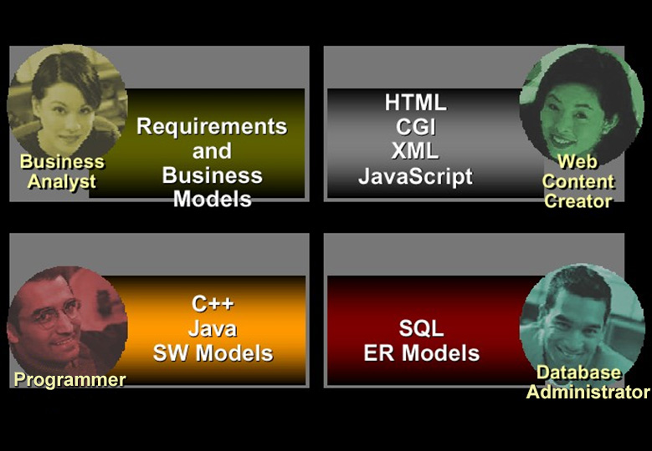
Multiple Languages = Communication Barriers

Slide 38
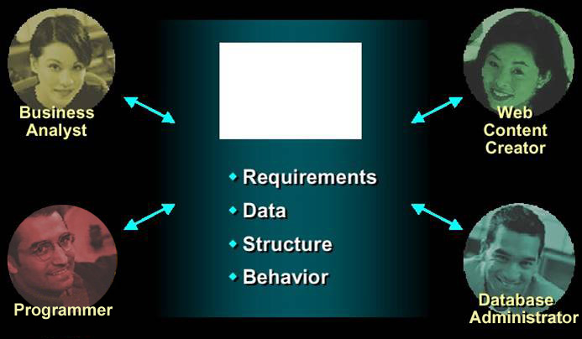

UML: One Language for All Practitioners

Slide 39
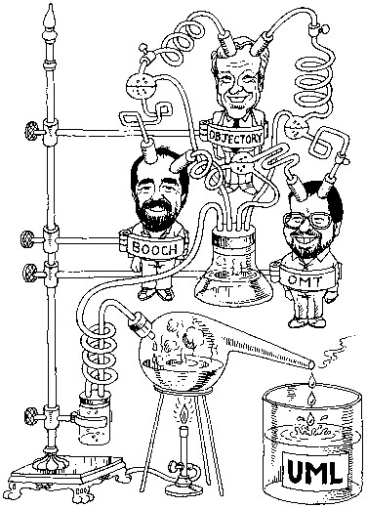
History of UML
Integration of
Object Modelling Technique
  by James Rumbaugh
Objectory Process
  by Ivar Jacobson
Booch Method
  by Grady Booch .

Slide 40
Visual Modelling with UML
Multiple views
“Semi-formal” syntax and semantics .

Slide 41
Visual Modelling with UML
Use case
Diagram
Class Diagram
mainWnd
fileMgr :
document :
gFile
repository
user
FileMgr
Document
Æ¯Á¤¹®¼­¿¡ ´ëÇÑ º¸±â¸¦
1: Doc view request ( )
Use Case 1
DocumentList
»ç¿ëÀÚ°¡ ¿äÃ»ÇÑ´Ù.
2: fetchDoc( )
3: create ( )
Actor A
FileMgr
add( )
Document
4: create ( )
Actor B
fetchDoc( )
delete( )
name : int
sortByName( )
docid : int
numField : int
5: readDoc ( )
get( )
read() fill the
È­ÀÏ°ü¸®ÀÚ´Â ÀÐ¾î¿Â
Use Case 2
open( )
code..
¹®¼­ÀÇ Á¤º¸¸¦ ÇØ´ç ¹®¼­
6: fillDocument ( )
close( )
°´Ã¼¿¡ ¼³Á¤À» ¿äÃ»ÇÑ´Ù.
FileList
read( )
7: readFile ( )
fList
sortFileList( )
create( )
add( )
fillDocument( )
8: fillFile ( )
delete( )
1
È­¸é °´Ã¼´Â ÀÐ¾îµéÀÎ
9: sortByName ( )
1
°´Ã¼µé¿¡ ´ëÇØ ÀÌ¸§º°·Î
Á¤·ÄÀ» ½ÃÄÑ È­¸é¿¡
Use Case 3
º¸¿©ÁØ´Ù.
rep
Sequence
Diagram
State
Machine
Repository
File
(from Persistence)
read( )
GrpFile
name : char * = 0
read( )
readDoc( )
open( )
readFile( )
create( )
fillFile( )
add file
Deployment
Diagram
add file [ numberOfFile==MAX ] /
Writing
Repository
DocumentList
Opening
flag OFF
FileManager
close file
Document
Reading
close file
Closing
Windows95
GraphicFile
File
FileList
Window95
Windows95
¹®¼­°ü¸®
Å¬¶óÀÌ¾ðÆ®.EXE
Windows
¹®¼­°ü¸® ¾ÖÇÃ¸´
Communication Diagram
NT
Solaris
Component
Diagram
¹®¼­°ü¸® ¿£Áø.EXE
Alpha
Windows
ÀÀ¿ë¼­¹ö.EXE
UNIX
NT
IBM
Target
System .
9: sortByName ( )
Mainframe
mainWnd : MainWnd
µ¥ÀÌÅ¸º£ÀÌ½º¼­¹ö
Forward and Reverse Engineering
1: Doc view request ( )
2: fetchDoc( )
gFile : GrpFile
4: create ( )
user : »ç¿ëÀÚ
8: fillFile ( )
fileMgr : FileMgr
3: create ( )
7: readFile ( )
6: fillDocument ( )
repository : Repository
5: readDoc ( )
document : Document

Slide 42
Best Practices
Develop iteratively
Manage requirements
Use component architecture
Model visually
Continuously verify quality
Manage change .

Slide 43
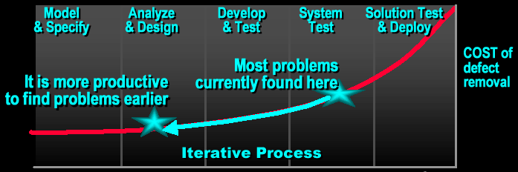
Continuously Verify Software Quality
Earlier detection and repair
Problems found earlier are less costly to repair
Fixing problems earlier leads to higher quality software
Identifying and resolving problems earlier result in more realistic and reliable development schedule .

Slide 44
Test All Dimensions of Software Quality
Usability
Test application from the perspective of convenience to end-user
Functionality
Test the accurate workings of each usage scenario
Reliability
Test the application behaves consistently and predictably
Supportability
Test the ability to maintain and support application under production use
Performance
Test online response under average and peak loading

Slide 45
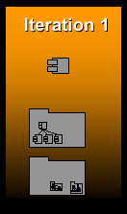
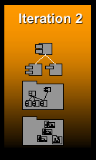
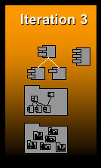
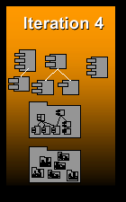
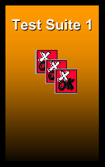
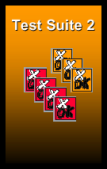
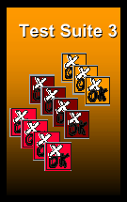
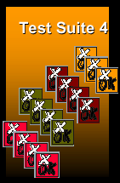
Test Each Iteration
UML models and implemen-tations
Tests

Slide 46
Best Practices
Develop iteratively
Manage requirements
Use component architecture
Model visually
Continuously verify quality
Manage change .

Slide 47
Change Management for Development Team
Establish secure
workspace for
each developer
Controlled
parallel
development
ALERT
REPORT
Automated build and integration management
Iterative development

Slide 48
Best Practices Reinforce One Another
Develop iteratively
Manage requirements
Use component architecture
Model visually
Continuously verify quality
Manage change

Slide 49
Unified Process

Slide 50
Unified Process

Slide 51
Major Phases in Unified Process
Inception
  Mainly to specify project scope
Elaboration
  Mainly to analyse problem domain, plan project, and establish baseline architecture
Construction
  Mainly to develop system
Transition
  Mainly to pass final system to users .

Slide 52
Major Phases in Unified Process
Time
Inception
Elaboration
Construction
Transition
Major
Major
Major
Major Milestones

Slide 53
Bringing it All Together:
The Iterative Approach
Disciplines group activities logically
Walk through all disciplines in every iteration
Each iteration results in an executable release

Slide 54


Within Each Phase
Disciplines and Models
Each discipline describes how to create and maintain a set of models
Business
Modelling
Business Model
Business
Object Model
Requirements
Capture
realized by
Use Case Model
Analysis and Design
implemented by
Analysis Model
Design Model
verified by
Implementation
Implementation Model
Test
Test Model

Slide 55
Compared with
Waterfall Development
Finish each discipline before the next
Cannot go back to a previous discipline
No deliverables until all done .

Slide 56
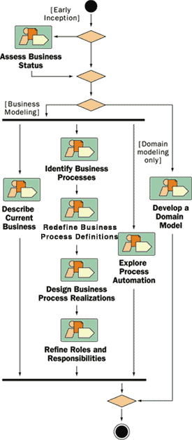
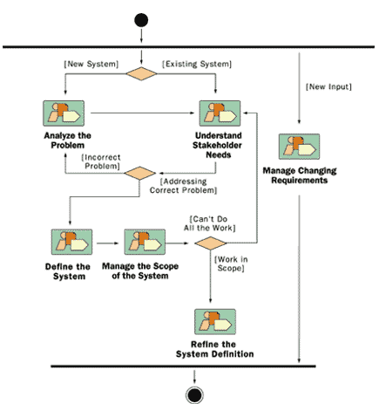
Disciplines Guide Iterative
Development
Business Modeling:
Discipline Details
Requirements:
Discipline Details

Slide 57
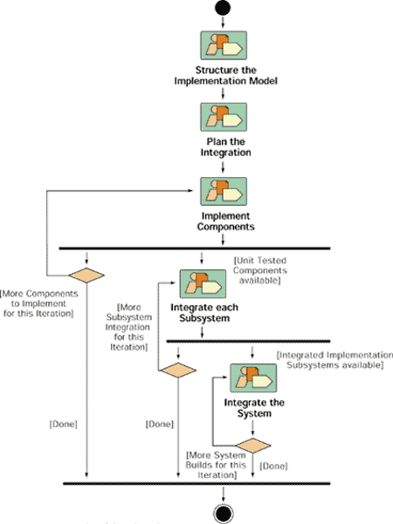
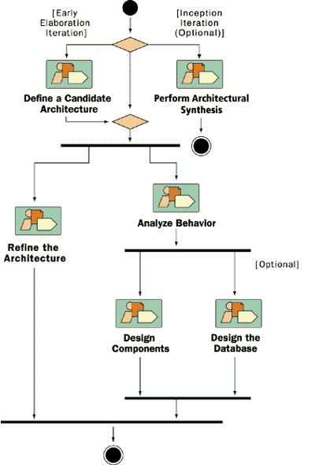
Disciplines Guide Iterative
Development
Analysis and Design:
Discipline Details
Implementation:
Discipline Details

Slide 58
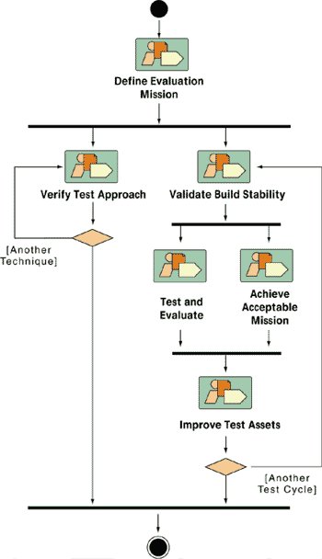
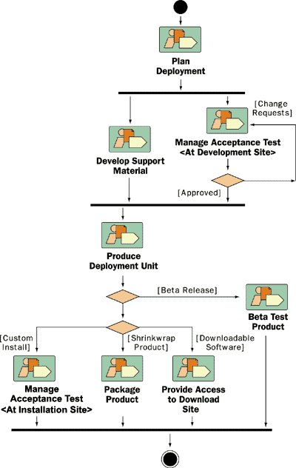
Disciplines Guide Iterative
Development
Test:
Discipline Details
Deployment:
Discipline Details

Slide 59
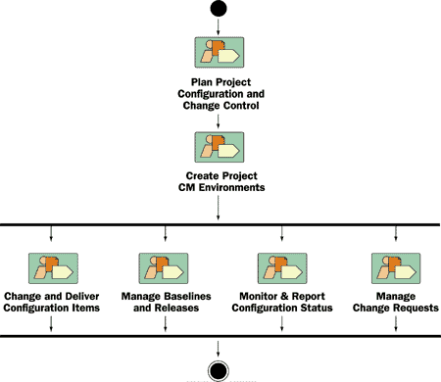
Disciplines Guide Iterative
Development
Configuration and Change Management:
Discipline Details

Slide 60
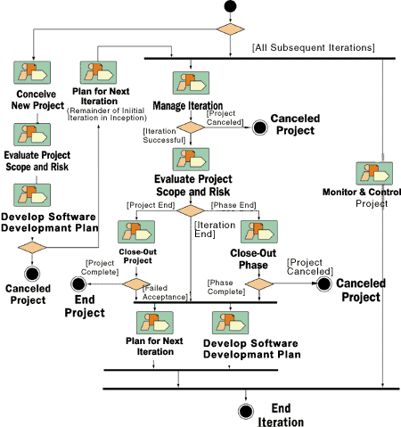
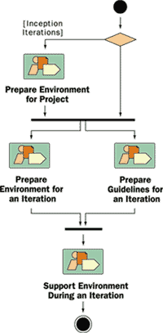
Disciplines Guide Iterative
Development
Project Management:
Discipline Details
Environment:
Discipline Details

