Slide 1
Object-Oriented Analysis
Prof. T.H. Tse
Department of Computer Science
Email: thtse@cs.hku.hk
Web: hku.hk/thtse .

Slide 2
Object-Oriented Analysis
Find and identify business classes
Organize classes and identify their relationships
Use case modelling
Object modelling
Object modelling .

Slide 3
UML
Unified Modelling Language (UML) is a set of modelling conventions used to specify a software system in terms of classes
  Does not prescribe a method for developing systems
  Only a notation widely accepted as a standard for object-oriented analysis and design .
Notes:
Teaching Notes
In 1994 Grady Booch and James Rumbaugh joined forces to merge their respective object-oriented development methods with the goal of creating a single, standard process for developing object-oriented systems. Ivar Jacobson joined them in 1995 and the three altered their focus to create a standard object modelling language instead of a standard object-oriented approach or method. Referencing their own work as well as countless others in the OO industry, the Unified Modelling Language (UML) version 1.0 was released in 1997. UML version 2.0 is in 2000.
At the time of this writing, Booch, Rumbaugh, and Jacobson have developed and marketed an object modelling methodology called the Unified Process, previously known as the Objectory.

Slide 4
UML Diagrams
Structural and behavioural
Use case diagram
Deployment diagram
  Showing execution architecture
Structural
Class diagram
Component diagram
Package diagram
Behavioural
Interactions
  Communication diagram
  Sequence diagram
  Timing diagram
State machine
Activity diagram .
Notes:
· Activity Diagram - Activities
· Class Diagram - Structured Classifiers
· Communication Diagram - Interactions
· Component Diagram - Structured Classifiers
· Composite Structure Diagram - Structured Classifiers
· Deployment diagram - Deployments
· Interaction Overview Diagram - Interactions
· Object Diagram - Classification
· Package Diagram - Packages
· Profile Diagram - Packages
· State Machine Diagram - State Machines
· Sequence Diagram - Interactions
· Timing Diagram - Interactions
· Use Case Diagram - Use Cases

Slide 5
Use Case Modelling
The process of modelling system scenarios in terms of
  business events
  who initiates or participates in the events
  how the system responds to the events .
Notes:
Teaching Notes
Use cases describe the system functions from the perspective of external users and in the manner and terminology in which they understand. To accurately and thoroughly accomplish this demands a high level of user involvement.
Use cases are the results of decomposing the scope of system functionality into many smaller statements of system functionality. The creation of use cases has proven to be an excellent technique in order to better understand and document system requirements. A use case itself is not considered a functional requirement, but the story (scenario) the use case tells captures the essence of one or more requirements. Use cases are initiated or triggered by external users or systems called actors.
An actor initiates system activity, a use case, for the purpose of completing some business task. An actor represents a role fulfilled by a user interacting with the system and is not meant to portray a single individual or job title.

Slide 6
Scenarios and Use Cases
A scenario is a behaviourally related sequence of events, automated or manual, for the purpose of completing a business task
A use case is a collection of related scenarios, including normal and alternative scenarios
Borrow
book
Not directly related to object technology .
Notes:
295-296

Slide 7


Actors
An actor in a use case is an external party that uses or interacts with the system
UML standard notation
IBM Rationalnotation
Police
Police
In general, for any use case, there is one initiating actor, and possibly other participating actors .

Slide 8



Actors
An actor can be a user or a role, such as a person or an external system
It can also be a characteristic of the environment, such as time or temperature change
Notes:
295-296

Slide 9


Actors
Examples
Single-User Systems
End user serves as actor
HSBC
App
Customer
Driver
Car
Notes:
295-296

Slide 10


Actors
Examples
Traditional Multi-User Systems
End user does not interact directly with system
Support staff serves as actor
⊗
HSBC
System
Bank Teller
Customer
⊗
Park ’n Shop
System
Cashier
Customer
Notes:
295-296

Slide 11
Actors
Examples
New Multi-User Systems
New system will directly interact with end user
Eliminates the need for existing support staff
New
HSBC
System
⊗
Customer
Bank Teller
New
Park ’n Shop
System
⊗
Customer
Cashier
Notes:
295-296

Slide 12




Actors
Examples
上下文 ?
Context-Sensitive Systems
New system will directly sense the environment
Eliminates the need for user interactions
Self-driving car
Notes:
295-296

Slide 13
Actors
Examples
⊗
Self-driving
Car
Environmental
Context
Driver

Slide 14
“Temporal Event” Use Cases
A temporal event is a system event that is triggered by time
  The actor of a temporal event use case is time .
Time
Notes:
Teaching Tips
Have students provide examples of temporal events (nightly download, monthly billing, etc.).

Slide 15
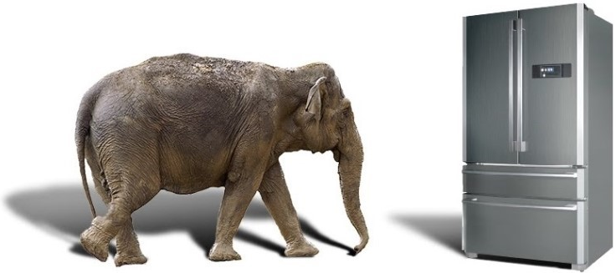
Use Case Example
User Requirement 1
Put an elephant into the refrigerator
How many events?
How many scenarios?
How many use cases? .

Slide 16
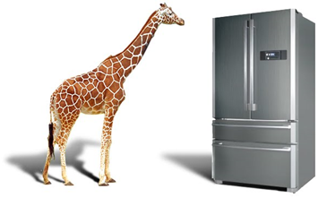
Use Case Example
User Requirement 1
Put an elephant into the refrigerator
User Requirement 2
Put a giraffe into the refrigerator
How many events altogether?
How many scenarios altogether?
How many use cases altogether? .

Slide 17
Use Case Diagrams
Order Subsystem
Club
Member
Maintain Member
Order
Place New
Member Order
Make Purchase
Inquiry
Operations Subsystem
Time
Generate Quarterly
Make Account
Membership
Inquiry
Analysis
Generate Annual
Sales Analysis
Generate Annual
Generate Quarterly
Membership
Sales Analysis
Analysis
Notes:
Teaching Notes
A use case diagram can be used to graphically depict the system scope and boundaries in terms of use cases and actors. The use case diagram for the Member Services System is shown in the above figure. It was created using Popkin Software’s System Architect and represents the relationships between the actors and use cases defined for each business subsystem. The subsystems (UML package symbol) represent logical functional areas of business processes. The partitioning of system behavior into subsystems is very important in understanding the system architecture and is very key to defining your development strategy — which use cases will be developed first and by whom.

Slide 18


We Learn from Mistakes
Timer
An analysis use case model should be device independent

Account
An object is not an analysis use case
Club
Member
It is all right to have an initiating actor and a participating actor .

Slide 19
Use Case Modelling
Benefits
A basis to help identify classes and their high-level relationships and responsibilities
A view of system behaviour from an external point of view
An effective tool for validating requirements
An effective communication tool
A basis for test plan
A basis for users’ manual .
With users?
With designers?
With programmers?

Slide 20
Object Modelling
Object modelling is a technique for identifying classes within the systems environment and the relationships among the classes
Should be implementation independent
Class diagrams rather than object diagrams (which are instance diagrams) .

Slide 21
Object Modelling
Object modelling involves
  A study of existing classes to see if they can be reused or adapted for new uses
  Defining new or modified classes that will be combined with existing ones for a useful application .
Notes:
Teaching Notes
The object modelling technique prescribes the use of methodologies and diagramming notations that are completely different from the ones used for data modelling and process modelling. In the late 1980s and early 1990s many different object-oriented methods were being used throughout the industry. The most notable of these were Grady Booch’s Booch Method, James Rumbaugh’s Object Modelling Technique (OMT), and Ivar Jacobson’s Object-Oriented Software Engineering (OOSE).

Slide 22
Class Diagrams
Class diagram graphically depicts the classes and their relationships
What are the differences between class diagrams and entity-relationship diagrams?
  Classes encapsulate ___________________________
  Relationships include _________________________
  ___________________________________________ .
Notes:
303
When constructing the diagram, we will use James Rumbaugh’s Object Modelling Technique (OMT), object model notation. Our examples are created with Popkin Software’s System Architect CASE tool.

Slide 23
Examples of Classes
Customer
name
age
address
changeName
changeAge
changeAddress
Account
balance
debit
credit .

Slide 24
Associations
A link is a physical or conceptual relation between 2 or more objects
An association describes a collection of links with common structure and common semantics
  A link is an instance of an association
Inherently bi-directional
  but need not be implemented in both directions
Also known as
  relationships
  client-server relationships
  actor-server relationships
  seniority relationships .

Slide 25
Example of Association
1..*
Customer
Account
owns
Persistent .
Notes:
Teaching Notes
Objects and classes do not exist in isolation. The things they represent interact with and impact one another to support the business mission.
An object/class relationship is graphically illustrated in UML as a connecting line between two classes. This relationship is commonly referred to as an association. The line is labeled with a verb phrase that describes the association. All associations are implicitly bidirectional, meaning that they can interpreted in both directions.
The figure above shows the complexity or degree of each association. For example, in the above business assertions, we must also answer the following questions:
Must there exist an instance of CUSTOMER for each instance of ORDER? Yes!
Must there exist an instance of ORDER for each instance of CUSTOMER? No!
How many instances of ORDER can exist for each instance of CUSTOMER? Many!
How many instances of CUSTOMER can exist for each instance of ORDER? One!

Slide 26
Multiplicity
The multiplicity between classes X and Y refers to the number of instances of X that will be present for a given instance of Y, and vice versa
Multiplicities are commonly referred to as 1:1, 1:M, M:1 and M:M associations
Also known as
  cardinality constraints
  instance connections .

Slide 27
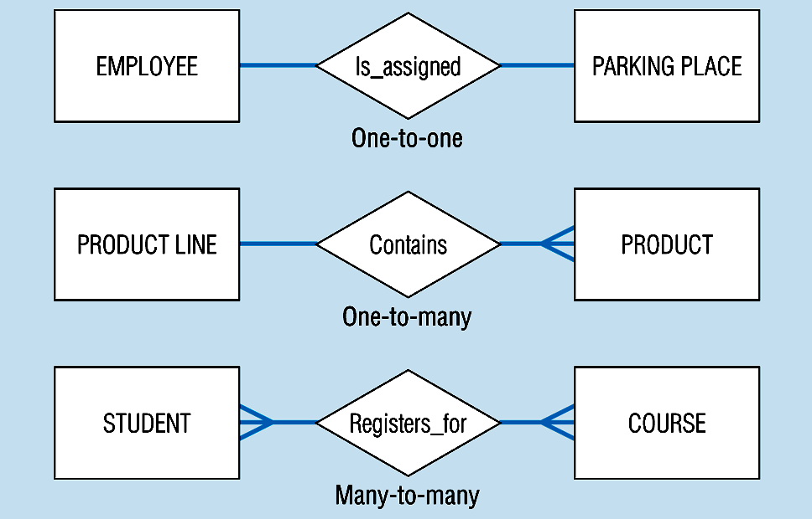
Multiplicity
We Learn from Mistakes
A product line may contain no product
A repeating student may register for one course
A lousy course may not be registered by any student
Should be 1:M and M:M, where M stands for multiple .
J.A. Hoffer, M.B. Prescott, and F.R. McFadden, Modern Database Management

Slide 28
Sample UML Multiplicity Notation
Multiplicity
Notation
Example
1
1
Employee
works for
Department
Exactly 1
or
blank
Employee
Department
works for
0..1
Zero or one
0..1
Employee
Spouse
has
0..*
0..*
Customer
Payment
or
has settled
Zero or more
*
Customer
*
Payment
has settled
1..*
One or more
1..*
University
Course
offers
7..9
Specific range
7..9
Team
Game
has scheduled

Slide 29
Aggregations
Aggregation is a kind of association
Aggregations are also called “is-part-of ” relationships
Composition aggregation (or simply composition) versus shared aggregation (or simply aggregation) .
Notes:
Teaching Notes
Sometimes objects/classes are made up of other objects/classes. This type of relationship is called aggregation. It is also sometimes referred to as “whole-part” or “part-of” relationships.
Aggregation relationships do not support inheritance. Their benefit lies in the ability to send a message to the parent class and that message is automatically applied to all the child classes.
Teaching Tips
Have students provide other examples of objects where aggregation relationships are appropriate (car – or any bill of material, church, order-line item, etc.).

Slide 30
Example of Composition Aggregation
Solid diamond indicates composition aggregation
Book
1
0..1
1..*
0..1
Cover
Table of
Contents
Chapter
Index
1..*
Page
0..*
Paragraph
1..*
Word .
Notes:
Teaching Notes
Sometimes objects/classes are made up of other objects/classes. This type of relationship is called aggregation. It is also sometimes referred to as “whole-part” or “part-of” relationships.
Aggregation relationships do not support inheritance. Their benefit lies in the ability to send a message to the parent class and that message is automatically applied to all the child classes.
Teaching Tips
Have students provide other examples of objects where aggregation relationships are appropriate (car – or any bill of material, church, order-line item, etc.).

Slide 31
Example of Shared Aggregation
Team
Hollow diamond indicates shared aggregation
A component may belong to any number of aggregates
  For example, a player may belong to any number of teams .
0..*
0..*
Player

Slide 32
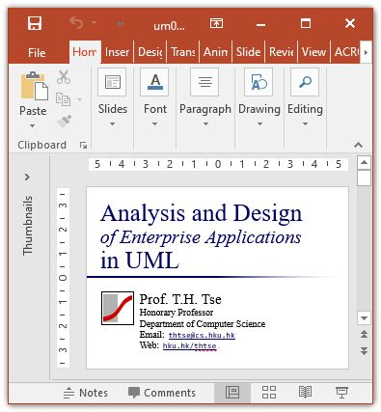
Why Do We Need Aggregations?
Move
All the parts move with the whole .

Slide 33
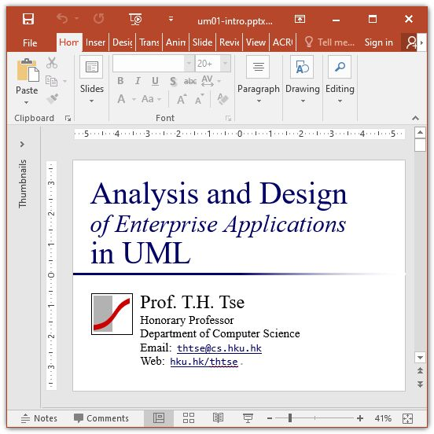
Why Do We Need Aggregations?
Resize
Some parts are resized
Others are not
Need specific methods for each part .

Slide 34
Inheritance
Person
surname
given name
age
gender
speak( )
email( )
Inheritance .
Student
Professor
GPA
rank
honour classification
enroll( )
teach( )
research( )
Notes:
Teaching Tips
Have students identify what attributes and methods are inherited by the STUDENT and TEACHER classes.

Slide 35
Messages
A message is passed when one object invokes one or more of another object’s operations to request information or some action
It is not a (persistent) relationship and not included in class diagrams .
Order
order number
Message
order date
order status
Customer
add ( )
modify ( )
delete ( )
display status
(order 12345)
Notes:
Teaching Notes
The object sending a message does not need to know how the receiving object is organized internally or how the behaviour is to be accomplished, only that it responds to the request in a well-defined way. A message can be sent only between two objects that have an association between them.

Slide 36
Object-Oriented Analysis
Find and identify business classes
Organize classes and identify their relationships .

Slide 37




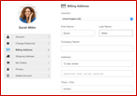



Example
Member Services System
Club Promotion
Subscription Offer
Promotion Order
Club Member
Regular Order
New Subscription
Potential
Member
Subscription Renewal Offer
Subscription Renewal
Member Credit Status
Accounts Department System
Past Member
Member Services
System
Delivery Note
Sales Report
Membership Plan and Subscription Offer
Membership Report
Warehouse
Monthly or
Seasonal Promotion .
Marketing
Department
Member Services Department
Notes:
Recall that a system context model illustrates the external parties which interact with the system to provide inputs and receive outputs. In doing so, it identifies the system’s scope and boundaries. The figure above is a context model for the Soundstage Member Services System. Find the external parties which provide inputs to the system. Does the external party initiate the input or is the input a response to a request from the system? If the external party initiates the input, it is considered an actor. Some of the inputs are self explanatory, but others may be misleading, it is always wise to confirm your findings with the system’s business analyst.
In the figure above, Club Member is an actor which initiates and provides an input call Promotion order. The sequence of events in which the Member Services System would respond to the club member Submitting a Promotion Order would be considered the use case.
295-296

Slide 38
Find and Identify Business Classes
Step 1. Identify actors and use cases
Step 2. Construct a use case diagram
Step 3. For each use case, document normal course of events
Step 4. For each use case, document alternative courses of events
Step 5. Identify any use case relationships
Step 6. Find potential classes
Step 7. Select proposed classes .

Slide 39
Step 1.
Identify Actors and Use Cases
Analyse the context of the system
If an external party initiates the input, it is an actor
Some inputs are self-explanatory, but others may be misleading
Confirm your findings with the business analyst .
Notes:
295-296

Slide 40
Step 1.
Identify Actors and Use Cases
Use Case Actor(s) Description
Place Member Order Member Describes the process of a member submitting an order for SoundStage products .
Notes:
295-296

Slide 41
Step 2.
Construct Use Case Diagram
A use case diagram graphically depicts the system scope and boundaries
It represents the relationships between actors and use cases
Partitioning system behaviour into subsystems is important in the development strategy: Which use cases will be developed first and by whom .
Notes:
296
Once all the use cases and actors have been identified, we have defined the total functionality of the entire system.

Slide 42
Step 2.
Construct Use Case Diagram
Order Subsystem
Subscription Subsystem
Maintain Member
Submit Change of
Submit New
Potential Member
Order
Address
Subscription
Club Member
Place New
Submit
Member Order
Resubscription
Make Purchase
Submit Past
Submit New
Past Member
Inquiry
Member
Member
Resubscription
Subscription
Program
Program
Operations Subsystem
Promotion Subsystem
Make Account
Generate Quarterly
Inquiry
Membership
Time
Marketing
Analysis
Generate Annual
Generate Quarterly
Submit New
Sales Analysis
Promotion Analysis
Promotion
Generate Quarterly
Generate Annual
Sales Analysis
Membership
Analysis
Notes:
Teaching Notes
A use case diagram can be used to graphically depict the system scope and boundaries in terms of use cases and actors. The use case diagram for the Member Services System is shown in the above figure. It was created using Popkin Software’s System Architect and represents the relationships between the actors and use cases defined for each business subsystem. The subsystems (UML package symbol) represent logical functional areas of business processes. The partitioning of system behavior into subsystems is very important in understanding the system architecture and is very key to defining your development strategy — which use cases will be developed first and by whom.

Slide 43
Step 3. For Each Use Case
Document Normal Course of Events
The normal course of events is a step-by-step description starting with the actor initiating the use case until the end of the business events
For each use case identified, document its normal course of events
Express in structured English
At this point, include only the major events occurring most of the time
  Document exceptional conditions and events later .
Notes:
296

Slide 44
Step 3. For Each Use Case
Document Normal Course of Events
Author: S. Shepherd Date: 01/07/2047
Use Case Name Place Member Order
Actor(s) Member, Warehouse
Description Describes the process of a member submitting an order for SoundStage products.
Reference MSS-1.0
Normal Course
of Events
Actor Action
Step 1. Initiate this use case when a member submits an order.
System Response
Step 2. Validate member’s personal information such as address against what is currently on file.
Step 3. Check member’s credit status with accounts department system to ensure no outstanding payment.
Step 4. For each product ordered, validate the product number, check availability in inventory, and record the ordered product information such as quantity ordered.
Step 5. Calculate order subtotal and sales tax.
Step 6. Verify member’s credit card information based on the amount due.
Step 7. Create packing slip for the member order containing all ordered products available and route it to warehouse.
Step 8. Generate order confirmation notice indicating the status of the order and send it to the member.
‘‘information”
“such as”
Step 9. Conclude this use case when the member receives the
order confirmation notice .
Notes:
Teaching Notes
The above figure was initially presented in Chapter 6.
1. A reference to the requirement(s) in which it can be traced to.
2. A typical event course describing the use case’s major steps, from beginning to end of this interaction with the actor.
3. Alternative courses describing exceptions to the typical course of events.
4. Precondition describing the state the system is in before the use case is executed.
5. Postcondition describing the state the system is in after the use case is executed.
6. An assumptions section, which includes any nonbehavioural issues, such as performance or security, that is associated with the use case, but is difficult to model within the use case’s course of events.

Slide 45
Step 3. For Each Use Case
Document Normal Course of Events
Pre-Condition Member has logged in.
Post-Condition Member order has been recorded and packing slip has been routed to warehouse.
Assumption None at this time .
Notes:
Teaching Notes
The above figure was initially presented in Chapter 6.
1. A reference to the requirement(s) in which it can be traced to.
2. A typical event course describing the use case’s major steps, from beginning to end of this interaction with the actor.
3. Alternative courses describing exceptions to the typical course of events.
4. Precondition describing the state the system is in before the use case is executed.
5. Postcondition describing the state the system is in after the use case is executed.
6. An assumptions section, which includes any nonbehavioural issues, such as performance or security, that is associated with the use case, but is difficult to model within the use case’s course of events.

Slide 46
Example of Pre-Condition
Member has logged in
Compare with
Step 1. Initiate this use case when a customer logs in and submit an order
The difference is not important because use cases only show scenarios, not implementation .

Slide 47
Example of Post-Condition
Member order has been recorded
Useful check if there is more than one scenario .

Slide 48
Step 4. For Each Use Case
Document Alternative Courses of Events
Alternative courses of events are deviations from the normal course
A use case can have multiple alternative courses
They are documented separately .
Notes:
298
During the previous steps of use case modelling, we focused on the normal courses of the use cases. This allowed us to concentrate on the system concept without getting bogged down in too many details. At this point the alternate courses and exception conditions in the use cases need to be defined.

Slide 49
Step 4. For Each Use Case
Document Alternative Courses of Events
Alternative
Courses
Alt. Step 2A. If member has indicated an address change in the order, update the member’s
record.
Alt. Step 3A. If accounts department system returns a credit status that the member is in arrears, send order rejection notice to the member.
Alt. Step 4A. If product number is invalid, send notification to member requesting them to resubmit product number. If the ordered product is not available, record the product information and mark as “back order”.
Alt. Step 6. If member’s credit card information is invalid or if member is in arrears, send credit problem notice to the member. Modify the order’s status to “on hold pending payment” .
Pre-Condition Member has logged in.
Post-Condition Member order has been recorded and packing slip has been routed to warehouse.
Assumption None at this time.
Notes:
Teaching Notes
The above figure was initially presented in Chapter 6.
1. A reference to the requirement(s) in which it can be traced to.
2. A typical event course describing the use case’s major steps, from beginning to end of this interaction with the actor.
3. Alternative courses describing exceptions to the typical course of events.
4. Precondition describing the state the system is in before the use case is executed.
5. Postcondition describing the state the system is in after the use case is executed.
6. An assumptions section, which includes any nonbehavioural issues, such as performance or security, that is associated with the use case, but is difficult to model within the use case’s course of events.

Slide 50
Step 5.
Identify Any Use Case Relationships
Part of the use case diagram
Only useful for excessively complex use cases
Hence, more useful in design than in analysis .
Notes:
297
For example, a precondition of sending a club promotion is that the promotion must first be created.

Slide 51
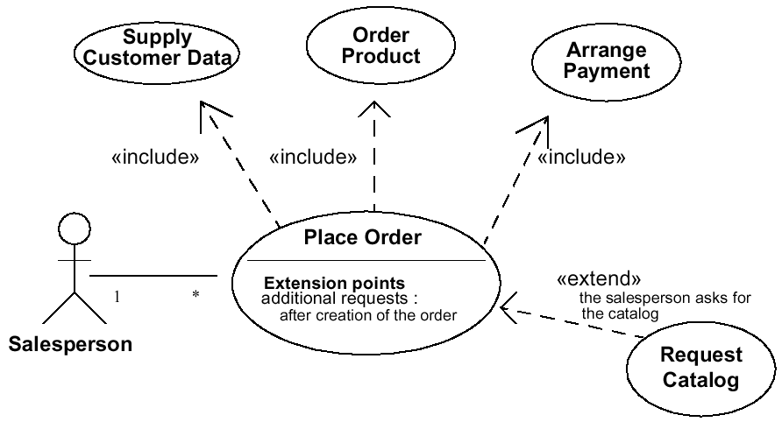
Use Case Relationships
Example

Slide 52
Use Case Relationships
Association
Instances of the actor and instances of the use case communicate with each other
The only relationship between actors and use cases
Include
An include relationship from use case A to use case B indicates that an instance of A will also contain the behaviour as specified by B .

Slide 53
Use Case Relationships
Extend
An extend relationship from use case B to use case A indicates that an instance of A may be augmented (subject to conditions specified in the extension) by the behaviour specified by B .

Slide 54
Use Case Relationships
Generate Warehouse
Revise Street
Packing Slip
Address
<< include >>
<< extend >>
Calculate Subtotal
and Tax
Submit
Member Order
<< include >>
Calculate Order Subtotal
and Sales Tax
Generalization .
Notes:
Generalization relationships are denoted as solid lines or paths with a hollow arrow-head pointing at the generalized use case.

Slide 55
Use Case Relationships
Generalization
A generalization from use case A to use case B indicates that A inherits B .

Slide 56
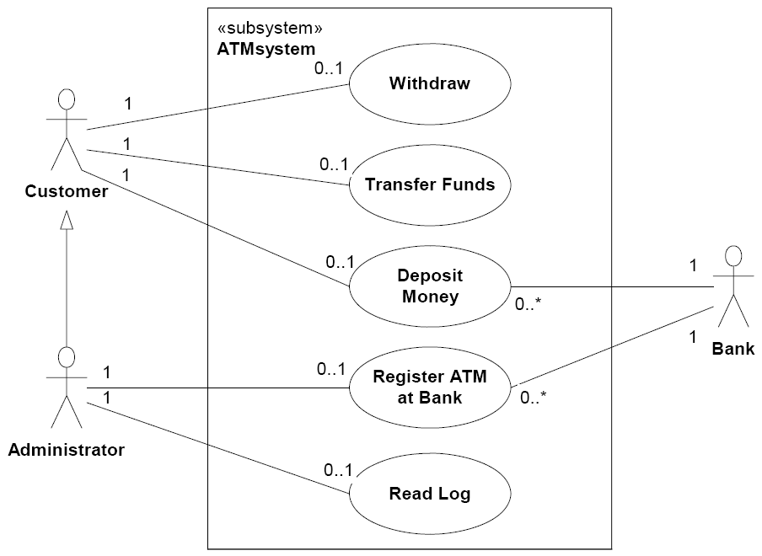
Use Case Relationships
Generalization can also occur between actors .
Notes:
Generalization relationships are denoted as solid lines or paths with a hollow arrow-head pointing at the generalized use case.

Slide 57
Example
Include and Generalization
Author: S. Shepherd Date: 01/07/2047
Use Case Name Place Member Order
Actor(s) Member, warehouse
Description Describes the process of a member submitting an order for SoundStage products.
Reference MSS-1.0
Normal Course
of Events
Actor Action
Step 1. Initiate this use case when a member submits an order.
System Response
Step 2. Validate member’s personal information such as address against what is currently on file.
Step 3. Check member’s credit status with accounts department system to ensure no outstanding payment.
Step 4. For each product ordered, validate the product number, check availability in inventory, and record the ordered product information such as quantity ordered.
Step 5. Invoke use case Calculate Order Subtotal and Sales Tax.
Step 6. Verify member’s credit card information based on the amount due.
Step 7. Invoke use case Generate Warehouse Packing Slip.
Step 8. Generate order confirmation notice indicating the status of the order and send it to the member.
Step 9. Conclude this use case when the member receives the order confirmation notice.
Notes:
Example of an analysis use case with extension and abstract use cases highlighted.

Slide 58
Example
Extend
Alternative
Courses
Alt. Step 2A. ⟨Extension Point⟩ If member has indicated an address change in the order,
invoke use case Revise Street Address.
Alt. Step 3A. If accounts department system returns a credit status that the member is in arrears, send order rejection notice to the member.
Alt. Step 4A. If product number is invalid, send a notification to the member requesting them to resubmit the product number. If the ordered product is not available, record the product information and mark as “back order”.
Alt. Step 6. If member’s credit card information is invalid or if member is in arrears, send credit problem notice to member. Modify the order’s status to “on hold pending payment.”
Pre-Condition Member has logged in.
Post-Condition Member order has been recorded and packing slip has been routed to warehouse.
Assumption None at this time.
Notes:
Teaching Notes
Example of an analysis use case with extension and abstract use cases highlighted.

Slide 59
Use Case Modelling (Steps 1 to 5)
We Learn from Mistakes
No
A use case is a collection of related scenarios
Is login a collection of related scenarios?
Only if students log in and do nothing else! .
Notes:
Teaching Notes
Use cases describe the system functions from the perspective of external users and in the manner and terminology in which they understand. To accurately and thoroughly accomplish this demands a high level of user involvement.
Use cases are the results of decomposing the scope of system functionality into many smaller statements of system functionality. The creation of use cases has proven to be an excellent technique in order to better understand and document system requirements. A use case itself is not considered a functional requirement, but the story (scenario) the use case tells captures the essence of one or more requirements. Use cases are initiated or triggered by external users or systems called actors.
An actor initiates system activity, a use case, for the purpose of completing some business task. An actor represents a role fulfilled by a user interacting with the system and is not meant to portray a single individual or job title.

Slide 60
Use Case Modelling (Steps 1 to 5)
We Learn from Mistakes
Student
A student may not View Report and Register Courses in the same session
<< include >>
View
Report
Login
<< include >>
Register
Courses
Student
A main use case should not extend a sub-use case
<< extend >>
View
Report
Login
<< extend >>
Register
Courses
Login is not the main purpose of the session .
Student
<< extend >>
View
Report
Login
<< extend >>
Register
Courses

Slide 61
Use Case Modelling (Steps 1 to 5)
Recommended Examples
Student
View
Report
Usually the best model in analysis
Register
Courses
Only if login contains a substantial number of steps
Usually applicable to design rather than analysis .
Student
View
Report
<< include >>
Login
Register
Courses
<< include >>

Slide 62
Use Case Modelling (Steps 1 to 5)
Further Mistakes to Avoid
(Don’t) confuse use case diagrams with use case descriptions
(Don’t) confuse use cases with system functions
(Don’t) use a system perspective
(Don’t) avoid details in user requirements ...
Use case diagrams are not flowcharts
Use cases are collections of scenarios
Analysis use cases describe user requirements
Notes:
10. Don't write functional requirements instead of usage scenario text. Requirements are generally stated in terms of what the system shall do, while usage scenarios describe actions that the users take and the responses that the system generates. Eventually, our use case text will be used as a run-time behavioural specification for the scenario we'll describe, and this text will sit on the left margin of a sequence diagram. We want to be able to easily see how the system (shown with objects and messages) implements the desired behaviour, as described in the use case text. So, we need to clearly distinguish between usage descriptions (behaviour) and system requirements.
9. Don't describe attributes and methods rather than usage. Your use case text shouldn't include too many presentation details, but it should also be relatively free of details about the fields on your screens. Field names often match the names of attributes on your domain classes, which we discussed in January's article. Methods shouldn't be named or described in use case text because they represent how the system will do things, as opposed to what the system will do.
8. Don't write the use cases too tersely. When it comes to writing text for use cases, expansive is preferable. You need to address all of the details of user actions and system responses as you move into robustness analysis and interaction modeling, so you might as well put some of those details in your use cases. Remember also that your use cases will serve as the foundation for your user manual. It's better to err on the side of too much detail when it comes to user documentation.
7. Don't divorce yourself completely from the user interface. One of the fundamental notions of "use case driven" is that the development team conforms the design of the system to the viewpoints of the users. You can't do this without being specific as to what actions the users will perform on your screens. As we mentioned for item number nine, you don't need to talk about fields in your use case text, and you don't want to discuss the cosmetic appearance of your screens; however, you can let your prototypes, in whatever form they take, do that work for you. You do need to discuss those features of the user interface that allow the user to tell the system to do something.
6. Don't avoid explicit names for your boundary objects. Boundary objects are the objects with which actors will interact. These frequently include windows, screens, dialogs and menus. In keeping with our theme of including ample detail and being explicit about user navigation, we submit that it's necessary to name your boundary objects explicitly in your use case text. It's also important to do this because you will explore the behaviour of these objects during robustness analysis (the subject of the next article in this series), and it can only reduce ambiguity and confusion to name them early.

Slide 63
Use Case Modelling (Steps 1 to 5)
Further Mistakes to Avoid
(Don’t) describe only user interactions and ignore system responses
(Don’t) forget alternative courses of events
(Don’t) write in passive voice
System responses may be part of the user requirements
Use present tense, active voice ...
Notes:
10. Don't write functional requirements instead of usage scenario text. Requirements are generally stated in terms of what the system shall do, while usage scenarios describe actions that the users take and the responses that the system generates. Eventually, our use case text will be used as a run-time behavioural specification for the scenario we'll describe, and this text will sit on the left margin of a sequence diagram. We want to be able to easily see how the system (shown with objects and messages) implements the desired behaviour, as described in the use case text. So, we need to clearly distinguish between usage descriptions (behaviour) and system requirements.
9. Don't describe attributes and methods rather than usage. Your use case text shouldn't include too many presentation details, but it should also be relatively free of details about the fields on your screens. Field names often match the names of attributes on your domain classes, which we discussed in January's article. Methods shouldn't be named or described in use case text because they represent how the system will do things, as opposed to what the system will do.
8. Don't write the use cases too tersely. When it comes to writing text for use cases, expansive is preferable. You need to address all of the details of user actions and system responses as you move into robustness analysis and interaction modeling, so you might as well put some of those details in your use cases. Remember also that your use cases will serve as the foundation for your user manual. It's better to err on the side of too much detail when it comes to user documentation.
7. Don't divorce yourself completely from the user interface. One of the fundamental notions of "use case driven" is that the development team conforms the design of the system to the viewpoints of the users. You can't do this without being specific as to what actions the users will perform on your screens. As we mentioned for item number nine, you don't need to talk about fields in your use case text, and you don't want to discuss the cosmetic appearance of your screens; however, you can let your prototypes, in whatever form they take, do that work for you. You do need to discuss those features of the user interface that allow the user to tell the system to do something.
6. Don't avoid explicit names for your boundary objects. Boundary objects are the objects with which actors will interact. These frequently include windows, screens, dialogs and menus. In keeping with our theme of including ample detail and being explicit about user navigation, we submit that it's necessary to name your boundary objects explicitly in your use case text. It's also important to do this because you will explore the behaviour of these objects during robustness analysis (the subject of the next article in this series), and it can only reduce ambiguity and confusion to name them early.

Slide 64
Use Case Modelling (Steps 1 to 5)
Further Mistakes to Avoid
(Don’t) implement from use case descriptions
(Don’t) aim for functional decomposition using <<include>> or <<extend>>
(Don’t) aim at perfect use case descriptions
Use cases are not object-oriented
Use cases are not for implementation
Use cases are not for implementation .
Notes:
5. Don't write in the passive voice, using a perspective other than the user's. A use case is most effectively written from the user's perspective as a set of present-tense verb phrases in active voice. The tendency of engineers to use passive voice is well-established, but use cases should state the actions that the user performs, and the system's responses to those actions. This kind of text is only effective when it's expressed in the active voice.
4. Don't describe only user interactions; ignore system responses. The narrative of a use case should be event- response oriented, as in, "The system does this when the user does that." The use case should capture a good deal of what happens "under the covers" in response to what the actor is doing, whether the system creates new objects, validates user input, generates error messages or whatever. Remember that your use case text describes both sides of the dialog between the user and the system.
3. Don't omit text for alternative courses of action. Basic courses of action are generally easier to identify and write text for. That doesn't mean, however, that you should put off dealing with alternative courses until, say, detailed design. Far from it. In fact, it's been our experience that when important alternative courses of action are not uncovered until coding and debugging, the programmer responsible for writing or fixing the code tends to treat them in ways that are most convenient for him. Needless to say, this isn't healthy for a project.
2. Don't focus on something other than what is "inside" a use case, such as how you get there or what happens afterward. Several prominent authors, such as Alistair Cockburn and Larry Constantine, advocate the use of long, complicated use case templates. Spaces for preconditions and post-conditions are generally present on these templates. We like to think of this as the 1040 "long form" approach to use case modeling, in comparison to the 1040EZ-like template that we advocate (two headings: Basic Course and Alternative Course). You shouldn't insist on using long and complex use case templates just because they appeared in a book or article.
1. Don't spend a month deciding whether to use includes or extends. In our years of teaching use case driven development, we've yet to find a situation where we've needed more than one mechanism for factoring out commonality. Whether you use UML's include construct, or OML's invoke and precede mechanisms, or something else that you're comfortable with, doesn't matter; simply pick one way of doing things and stick with it. Having two similar constructs is worse than having only one. It's just too easy to get confused—and bogged down—when you try to use both. Don't spin your wheels.

Slide 65

Step 6.
Find Potential Classes
Review each use case and highlight nouns that correspond to business entities
Notes:
299-303
No additional notes provided.

Slide 66
Recall Step 3. For Each Use Case
Document Normal Course of Events
Author: S. Shepherd Date: 01/07/2047
Use Case Name Place Member Order
Actor(s) Member, warehouse
Description Describes the process of a member submitting an order for SoundStage products.
Reference MSS-1.0
Normal Course
of Events
Actor Action
Step 1. Initiate this use case when a member submits an order.
System Response
Step 2. Validate member’s personal information such as address against what is currently on file.
Step 3. Check member’s credit status with accounts department system to ensure no outstanding payment.
Step 4. For each product ordered, validate the product number, check availability in inventory, and record the ordered product information such as quantity ordered.
Step 5. Calculate order subtotal and sales tax.
Step 6. Verify member’s credit card information based on the amount due.
Step 7. Create packing slip for the member order containing all ordered products available and route it to warehouse.
Step 8. Generate order confirmation notice indicating the status of the order and send it to the member.
Step 9. Conclude this use case when the member receives the
order confirmation notice .
Notes:
Teaching Notes
The above figure was initially presented in Chapter 6.
1. A reference to the requirement(s) in which it can be traced to.
2. A typical event course describing the use case’s major steps, from beginning to end of this interaction with the actor.
3. Alternative courses describing exceptions to the typical course of events.
4. Precondition describing the state the system is in before the use case is executed.
5. Postcondition describing the state the system is in after the use case is executed.
6. An assumptions section, which includes any nonbehavioural issues, such as performance or security, that is associated with the use case, but is difficult to model within the use case’s course of events.

Slide 67
Step 6. Find Potential Classes
Highlight Nouns
Author: S. Shepherd Date: 01/07/2047
Use Case Name Place Member Order
Actor(s) Member, warehouse
Description Describes the process of a member submitting an order for SoundStage products.
Reference MSS-1.0
Normal Course
of Events
Actor Action
Step 1. Initiate this use case when a member submits an order.
System Response
Step 2. Validate member’s personal information such as address against what is currently on file.
Step 3. Check member’s credit status with accounts department system to ensure no outstanding payment.
Step 4. For each product ordered, validate the product number, check availability in inventory, and record the ordered product information such as quantity ordered.
Step 5. Calculate order subtotal and sales tax.
Step 6. Verify member’s credit card information based on the amount due.
Step 7. Create packing slip for the member order containing all ordered products available and route it to warehouse.
Step 8. Generate order confirmation notice indicating the status of the order and send it to the member.
Step 9. Conclude this use case when the member receives the
order confirmation notice.
Notes:
Teaching Notes
The above figure was initially presented in Chapter 6.
1. A reference to the requirement(s) in which it can be traced to.
2. A typical event course describing the use case’s major steps, from beginning to end of this interaction with the actor.
3. Alternative courses describing exceptions to the typical course of events.
4. Precondition describing the state the system is in before the use case is executed.
5. Postcondition describing the state the system is in after the use case is executed.
6. An assumptions section, which includes any nonbehavioural issues, such as performance or security, that is associated with the use case, but is difficult to model within the use case’s course of events.

Slide 68
Recall Step 4. For Each Use Case
Document Alternative Courses of Events
Alternative
Courses
Alt. Step 2A. If member has indicated an address change in the order, update the member’s
record.
Alt. Step 3A. If accounts department system returns a credit status that the member is in arrears, send order rejection notice to the member.
Alt. Step 4A. If product number is invalid, send notification to member requesting them to resubmit product number. If the ordered product is not available, record the product information and mark as “back order”.
Alt. Step 6. If member’s credit card information is invalid or if member is in arrears, send credit problem notice to member. Modify the order’s status to “on hold pending payment”.
Pre-Condition Member has logged in.
Post-Condition Member order has been recorded and packing slip has been routed to warehouse.
Assumption None at this time .
Notes:
Teaching Notes
The above figure was initially presented in Chapter 6.
1. A reference to the requirement(s) in which it can be traced to.
2. A typical event course describing the use case’s major steps, from beginning to end of this interaction with the actor.
3. Alternative courses describing exceptions to the typical course of events.
4. Precondition describing the state the system is in before the use case is executed.
5. Postcondition describing the state the system is in after the use case is executed.
6. An assumptions section, which includes any nonbehavioural issues, such as performance or security, that is associated with the use case, but is difficult to model within the use case’s course of events.

Slide 69
Step 6. Find Potential Classes
Highlight Nouns
Alternative
Courses
Alt. Step 2A. If member has indicated an address change in the order, update the member’s
record.
Alt. Step 3A. If accounts department system returns a credit status that the member is in arrears, send order rejection notice to the member.
Alt. Step 4A. If product number is invalid, send notification to member requesting them to resubmit product number. If the ordered product is not available, record the product information and mark as “back order”.
Alt. Step 6. If member’s credit card information is invalid or if member is in arrears, send credit problem notice to the member. Modify the order’s status to “on hold pending payment”.
Pre-Condition Member has logged in.
Post-Condition Member order has been recorded and packing slip has been routed to warehouse.
Assumption None at this time.
Notes:
Teaching Notes
The above figure was initially presented in Chapter 6.
1. A reference to the requirement(s) in which it can be traced to.
2. A typical event course describing the use case’s major steps, from beginning to end of this interaction with the actor.
3. Alternative courses describing exceptions to the typical course of events.
4. Precondition describing the state the system is in before the use case is executed.
5. Postcondition describing the state the system is in after the use case is executed.
6. An assumptions section, which includes any nonbehavioural issues, such as performance or security, that is associated with the use case, but is difficult to model within the use case’s course of events.

Slide 70
Find
Potential
Classes
Potential Class
Accounts Department System
Address
Address Change
Amount Due
Availability
Credit Problem Notice
File
Inventory
Member
Member Order
Member’s Credit Card Information
Member’s Credit Status
Member’s Personal Information
Member’s Record
Notification
Order
Order Confirmation Notice
Order Rejection Notice
Order Subtotal
Ordered Product Information
Outstanding Payment
Packing Slip
Product
Product Number
Product Ordered
Quantity Ordered
Sales Tax
Status of Order
Warehouse .

Slide 71
Step 7.
Select Proposed Classes
Not all the of the nouns represent good business classes
Remove the nouns that represent:
  Synonyms
  Nouns outside the scope of the system
  Nouns that are roles without unique behaviour or are external roles
  Unclear nouns that need focus
  Nouns that are really actions or attributes .
Notes:
299-303

Slide 72
Select
Proposed
Classes
Potential Class |  | Reason
Accounts Department System | ✗ | Actor
Address | ✗ | Attribute of Member
Address Change | ✗ | Attribute of Member
Amount Due | ✗ | Attribute of Member Order
Availability | ✗ | Vague attribute of Product
Credit Problem Notice | ✗ | Potential interface to be considered in design
File | ✗ | Vague alias of Member
Inventory | ✗ | Vague alias of Product
Member | ✓
Member Order | ✓
Member’s Credit Card Information | ✗ | Vague attribute of Member
Member’s Credit Status | ✗ | Attribute of Member
Member’s Personal Information | ✗ | Vague attribute of Member
Member’s Record | ✗ | Alias of Member
Notification | ✗ | Potential interface to be considered in design
Order | ✗ | Alias of Member Order
Order Confirmation Notice | ✗ | Attribute of Member Order
Order Rejection Notice | ✗ | Potential interface to be considered in design
Order Subtotal | ✗ | Attribute of Member Order
Ordered Product Information | ✗ | Vague attribute of Product
Outstanding Payment | ✗ | Attribute of Member
Packing Slip | ✗ | Potential interface to be considered in design
Product | ✓
Product Number | ✗ | Attribute of Product and Product Ordered
Product Ordered | ✓
Quantity Ordered | ✗ | Attribute of Product Ordered
Sales Tax | ✗ | Attribute of Member Order
Status of Order | ✗ | Attribute of Member Order
Warehouse | ✗ | Actor .
Actor
Attribute
Interface
Synonym
Proposed class .

Slide 73
Select Proposed Classes
Potential Class
Member
Member Order
Product
Product Ordered
Notes:
Teaching Notes
Additional objects were included that are part of the case study but were not identified in the use case. These additional objects are introduced here because they appear in later diagrams.

Slide 74

Select Proposed Classes
Potential Class
Member
Member Order
Product
Product Ordered
Plus
Agreement
Audio Title
Club Member
Game Title
Merchandise
Past Member
Potential Member
Promotion
Return
Title
Transaction
Video Title
Some classes have been “pre-cooked” before the lecture to save time
They will be useful later .
Notes:
Teaching Notes
Additional objects were included that are part of the case study but were not identified in the use case. These additional objects are introduced here because they appear in later diagrams.

Slide 75
Object-Oriented Analysis
Find and identify the business classes
Organize classes and identify their relationships .

Slide 76
Organize Classes and
Identify their Relationships
A class diagram is used to graphically depict classes and their relationships
  Relationships include associations (multiplicities), inheritance, and aggregations .
Notes:
When constructing the diagram, we will use James Rumbaugh’s Object Modelling Technique (OMT), object model notation. Our examples are created with Popkin Software’s System Architect CASE tool.
303

Slide 77
Organize Classes and
Identify their Relationships
Step 1. Identify associations and multiplicities
Step 2. Identify inheritance
Step 3. Identify aggregations
Step 4. Prepare a class diagram
Iterations of these 4 steps
Not necessarily in sequence .

Slide 78
Organize Classes and
Identify their Relationships
Step 1. Identify Associations and Multiplicities
Recall that a relationship between 2 objects/classes is what one object/class “needs to know” about the other
Once an association has been identified, the multiplicities should also be defined .
Notes:
303
It is very important that the analyst not only identify relationships that are obvious or recognized by the users. On way to help ensure that possible relationships are identified is to use a object/class matrix. This matrix lists the objects/class as column headings as well as row headings. The matrix can then be used as a check list to ensure that each object/class appearing on a row is checked against each object/class appearing in a column for possible relationships. The name of the relationship and the multiplicity can be recorded directly in the intersection cell of the matrix.

Slide 79
Organize Classes and
Identify their Relationships
Step 2. Identify Inheritance
Consider situations where “class X is a kind of class Y ”
Consider common attributes and behaviour across classes ??
Consider reuse of program code ??
Do not tackle design issues during analysis .
Do not tackle design issues during analysis .
zzzzzz
Do not tackle design issues during analysis .
Notes:
Once we have identified the basic associations and their multiplicity, we must determine if any Generalization/Specialization relationships exist. Recall that generalization/specialization relationships also know as classification hierarchies or “is a” relationships, consist of super-objects and sub-objects. The super-object being general in that it contains the common attributes and behaviours of the hierarchy. The sub-objects being specialized in that it contains attributes and behaviours unique to that object, but it inherits the super-object’s attributes and behaviours also.
303

Slide 80
Organize Classes and
Identify their Relationships
Step 3. Identify Aggregations
Consider situations where “class X is part of class Y”
Aggregation does not imply inheritance
  Part of an object does not inherit attributes or behaviour from the whole
Aggregation propagates behavior
  Selected behaviour applied to the whole is applied to the part .
Notes:
Recall that aggregation is an unique type of association in which one object “is part of” another object. It is often referred to as a whole/part relationship and can be read where as object A contains object B and object B is part of object A.
Aggregations propagate behaviour in that behaviour applied to the whole is automatically applied to the parts. For example ,if I want to send object A to a customer, object B would be sent also.
303

Slide 81
Aggregations Propagate Behaviour
Recall

Slide 82
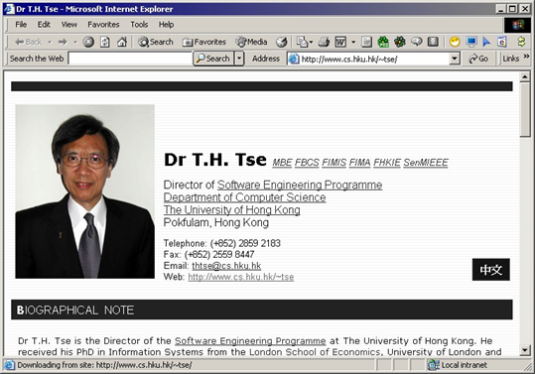
Aggregations Propagate Behaviour
Example of Failure

Slide 83
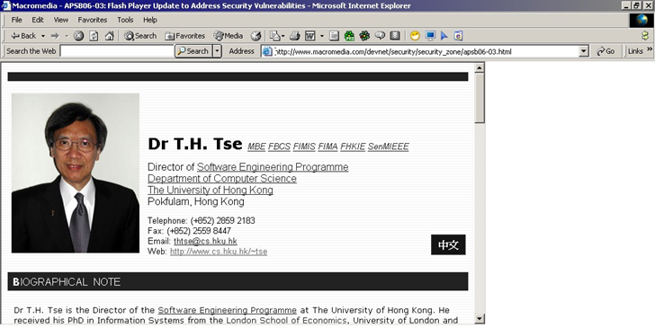
Aggregations Propagate Behaviour
Example of Failure
  Behaviour applied to the whole is not correctly applied to the part.

Slide 84
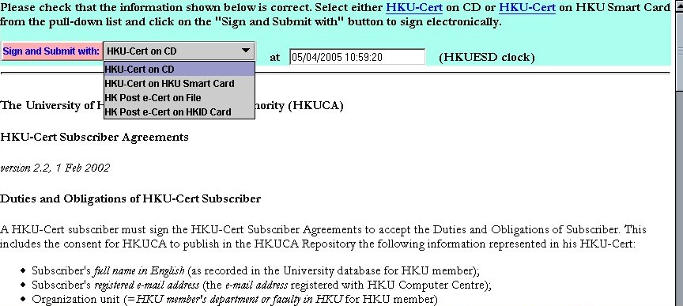
Aggregations Propagate Behaviour
Example of Failure

Slide 85
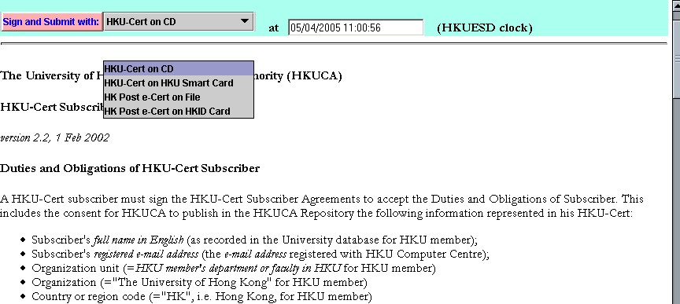
Aggregations Propagate Behaviour
Example of Failure
  Behaviour applied to the whole is not correctly applied to the part .

Slide 86
Organize Classes and
Identify their Relationships
Step 4. Prepare a class diagram
Construct a class diagram with class names, attributes, and relationships
Methods ?? .
Notes:
304

Slide 87
Member Services System
Class Diagram
Class name
Customer
Attributes
Customer Number
Customer Name
Customer Status
Customer Street Address
Customer PO Box
Customer City
Customer State
Customer Zip Code
Methods ?? .
Association
Potential Member
Member
Past Member
Member Date Of Last Order
Expiration Date
Agreement
Member Daytime Phone Number
Member Credit Card Expire Date
Member Credit Card Number
Agreement Number
Member Credit Card Type
Agreement Expire Date
Member Balance Due
Agreement Active Date
Member Bonus Balance Available
1..*
Fulfillment Period
Audio Category Preference
Required Number Of Credits
Has
1
Audio Media Preference
binds
1
purchased
Date Enrolled
Email Address
0..*
Game Category Preference
Product
Game Media Preference
Product Ordered
Number Of Credits Earned
Product Number
Privacy Code
Universal Product Code
Quantity Ordered
Video Category Preference
Transaction
Quantity In Stock
Quantity Shipped
Video Media Preference
1
Conducts
Product Type
1
Quantity Backordered
Transaction Reference Number
Suggested Retail Price
Sold as
Purchase Unit Price
0..*
Transaction Date
Default Unit Price
0..*
Credits Earned
Transaction Type
Current Special Unit Price
Transaction Description
Current Month Units Sold
Transaction Amount
Current Year Units Sold
Total Lifetime Units Sold
1..*
Places
Member Order
0..*
Return
Sells
Order Number
Merchandise
Title
Order Creation Date
Merchandise Name
Promotion
Order Fill Date
Merchandise Description
Title Of Work
Shipping Address Name
Merchandise Type
Title Cover
1..*
Promotion Number
Shipping Street Address
Unit of Measure
Catalog Description
Promotion Release Date
Generates
Shipping City
Copyright Date
Features
0..*
Promotion Status
0..1
Shipping State
Entertainment Company
Promotion Type
0..*
Shipping Zip Code
Credit Value
Shipping Instructions
Order Sub Total
Order Sales Tax
Order Shipping Method
Order Shipping & Handling Cost
Order Status
Order Prepaid Amount
Order Prepayment Method
Inheritance
Audio Title
Video Title
Game Title
Artist
Producer
Manufacturer
Audio Category
Director
Game Category
Aggregation
Audio Sub Category
Video Category
Game Sub Category
Number Of Units In Package
Video Sub Category
Game Platform
Audio Media Code
Closed Captioned
Game Media Type
Content Advisory Code
Language
Number Of Players
Running Time
Parent Advisory Code
Video Media Type
Video Encoding
Screen Aspect
MPA Rating Code
Notes:
See Figure A.15, page 667

