Slide 1
Practical Guidelines for Identifying Classes and Relationships
Prof. T.H. Tse
Department of Computer Science
Email: thtse@cs.hku.hk
Web: hku.hk/thtse .

Slide 2
Identifying Objects and Classes
Recall:

Slide 3
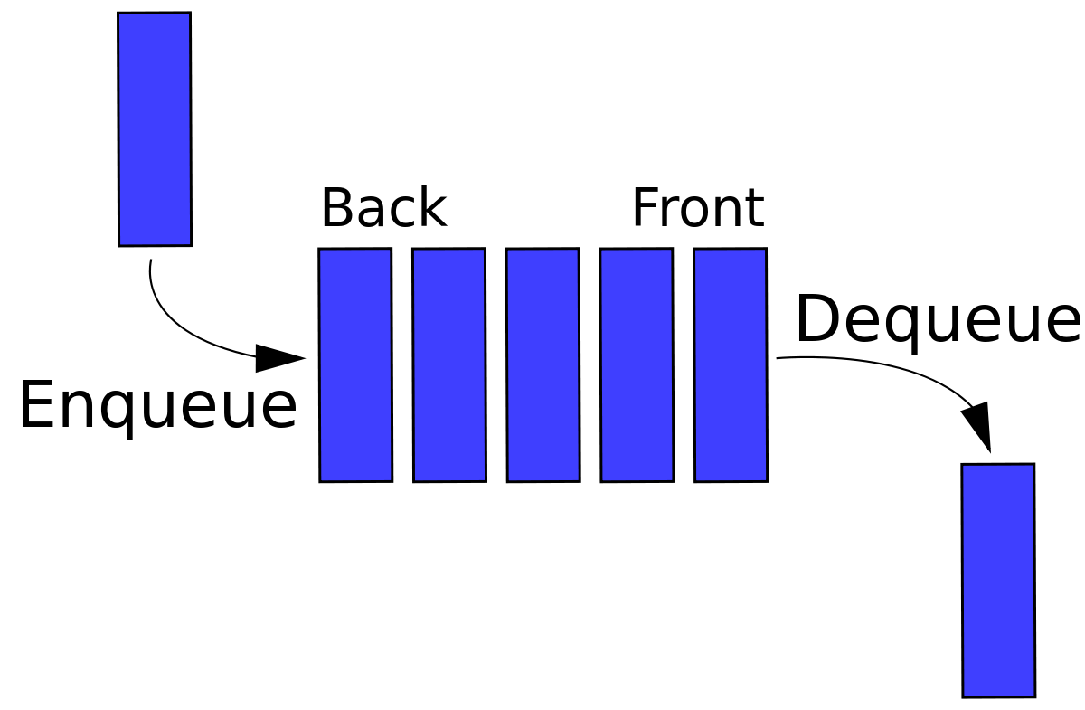
Identifying Objects and Classes
Objects must either be
physical entities (such as persons), or
conceptual entities on their own (such as accounts)
Must be meaningful in the application domain (not just the target system)
Example: queue ?? ...
or

Slide 4
Identifying Objects and Classes
Objects must either be
physical entities (such as persons), or
conceptual entities on their own (such as accounts)
Must be meaningful in the application domain (not just the target system)
Example: queue ?? ...
or

Slide 5
Identifying Objects and Classes
Recall:

Slide 6
Identifying Objects and Classes
An object has observable attributes, which can be changed using its encapsulated methods
But an object should not simply be a convenient collection of attributes and methods .

Slide 7
Identifying Objects and Classes
Classes are collections of related objects
They are usually described by
nouns (such as Account), or
noun phrases (such as Cheque Account)
During Systems Analysis, a class should not be considered for normalization or implementation .

Slide 8
Example: ATM Classes
Access
Account
Account data
ATM
Bank
Bank computer
Banking network
Cash
Cash card
Cashier
Cashier station
Central computer
Communications line
Consortium
Cost
Customer
Receipt
Recordkeeping provision
Security provision
Software
System
Transaction
Transaction data
Transaction log
User .

Slide 9
Example: ATM Classes Find Problematic Classes
Access
Account
Account data
ATM
Bank
Bank computer
Banking network
Cash
Cash card
Cashier
Cashier station
Central computer
Communications line
Consortium
Cost
Customer
Receipt
Recordkeeping provision
Security provision
Software
System
Transaction
Transaction data
Transaction log
User .

Slide 10
Example: ATM Classes Keep the Right Classes
Account
ATM
Bank
Bank computer
Cash card
Cashier
Cashier station
Central computer
Consortium
Customer
Transaction .

Slide 11
Keeping the Right Classes
Redundant Classes
If 2 classes express very similar information, select only the more descriptive one
⊗
versus
User
Customer
Irrelevant Classes
Eliminate classes having little to do with the problem
Cost .

Slide 12
Keeping the Right Classes
Vague Classes
Reconsider ill-defined boundaries
System
Security provision
Recordkeeping provision
Banking network .

Slide 13
Keeping the Right Classes
Attributes
Names that describe properties of objects should be restated as attributes
Account data
Cash
Receipt
Transaction data
Operations
Reconsider classes whose names describe operations
Telephone call .

Slide 14
Keeping the Right Classes
Roles
A class name should reflect its intrinsic nature and not the role of an association
Owner
Rename as
Customer .

Slide 15
Keeping the Right Classes
Implementation Constructs
During Systems Analysis, eliminate constructs related to implementation, rather than user requirements
Access
Communication line
Software
Transaction log
More about this later .

Slide 16
Identifying Associations
Correspond to verbs or verb phrases connecting 2 or more classes
Often related with ownership:
has -a
Student
Program
has-many
Student
Course
can-use-a
Student
Library
can-use-many
Student
Workstation .

Slide 17
Identifying Associations
May also be related with
supervises
directed action:
Professor
Student
is-in
physical location:
Lab
Building
teaches
communication:
Professor
Course
has-taken
some condition:
Students
Course
Depends on user requirements .

Slide 18
Keeping the Right Associations
Associations between Eliminated Classes
If a class in the association has been eliminated, then eliminate the association or reinstate the class
Irrelevant or Implementation Associations
Eliminate associations dealing with implementation constructs unrelated to user requirements .

Slide 19
Keeping the Right Associations
Actions
An association describes a persistent property, not a transient event:
accepts
ATM
Card
?? .

Slide 20
Keeping the Right Associations
Derived Associations
Cancel associations defined indirectly in terms of other associations
Examples:
Multiple paths
“Grandparent of ”
Conditions on attributes
Define “younger than” using birth dates .

Slide 21
Keeping the Right Associations
Misnamed Associations
Avoid name that reflect historical event:
opens
Customer
Account
??
has
Customer
Account .

Slide 22
Keeping the Right Associations
Role Names
Add role name to clarify ambiguous situation:
supervises
Person
Person
supervisor
subordinate .

Slide 23
Keeping the Right Associations
Multiplicity
Specify multiplicity
Challenge 1:1 multiplicities
But do not put too much effort into getting multiplicities, since they often change during analysis
Ask whether the objects need to be ordered .

Slide 24
Keeping the Right Associations
Missing Associations
Add any missing association discovered:
opens
Customer
Account
These are actually associations .
These are actually associations .
These are actually associations .
These are actually associations .
enters
Customer
Transaction
enrols
Student
Course

Slide 25
Identifying Attributes
Attributes are observable properties of objects
Usually corresponds to noun followed by preposition:
colour of
Car
white
state of
Button
pressed .
Adjective may indicate attribute value

Slide 26
Keeping the Right Attributes
Divergent Attributes
A class with 2 sets of attributes unrelated to each other may indicate the need for splitting ...

Slide 27
Divergent Attributes Example
Student
student ID
student name
The same course name duplicated in many student objects
Course
course ID
course name
course ID
course name
grade
student ID
student name
grade
The same student name duplicated in many course objects .

Slide 28
Divergent Attributes Example (Continued)
But not the result of database normalization
Learn from database normalization
Student
student ID
student name
Course
course ID
course name
Grade
student ID
course ID
grade
*
* .

Slide 29
Keeping the Right Attributes
Classes
Entities that have features of their own within the given application constitute a class
City
in a mailing list is an attribute
City
in a census is a class .

Slide 30
Keeping the Right Attributes
Classes (continued )
If the independent existence of an entity is important (rather than just the value), we should have a class
Supervisor
is a class
Salary
is an attribute .

Slide 31
Keeping the Right Attributes
Identifiers
Distinguish between
identifiers in the application domain
object identifiers for implementation
Should not specify pure object identifiers in the analysis model
Account Code
is an identifier used by the bank
may be an identifier in the implemented system ?? .
Transaction ID

Slide 32
Keeping the Right Attributes
Internal Values
Eliminate any attribute which describes the internal state of an object and which is invisible outside the object .

Slide 33
Aggregations
A special type of association
Class X is an aggregation of class Y if every object in Y is-part-of some object in X:
is-part-of
Student
University
is-aggregation-of
University
Student
is-part-of
Classroom
University
is-aggregation-of
University
Classroom .

Slide 34
Aggregations We Learn from Mistakes
has-a
Be careful with
has-a
has-many
Branch
Manager
is-part-of
Manager
Branch
has-a
Employee
Manager
is-part-of
Manager
Employee
??
However, do not spend too much time trying to distinguish between associations and aggregations .

Slide 35
Identifying Inheritance
Common descriptors to help to identify inheritance:
is-a-kind-of
is-a .

Slide 36
Identifying Inheritance We Learn from Mistakes
Be careful with
is-a
is-a-kind-of
Bmw
Car
is-a
My Car
Car
??
is-an-instance-of .

Slide 37
Identifying Inheritance
Two directions:
Top down
Refine classes into specialized subclasses
More common in analysis
Look for extra behavioural constraints in the subclass that differentiates it from the superclass
Inherits all methods in Account plus special operations like “honour cheque” .
Cheque
Account
is-a-kind-of
Account

Slide 38
Identifying Inheritance
Two directions:
Bottom up
Generalize classes into a superclass
Look for classes with common attributes, associations, or methods
But is a queue a-kind-of linked list ??
Example: Generalize stack and queue into a superclass “linked list”
May not reflect the real world, hence only recommended in design .

Slide 39
Multiple Inheritance
A class inherits from two superclasses
Cheque Account
Savings Account
May increase complexity
Premium Account
During analysis, let the user decide .

Slide 40
Test the Access Paths
Trace the access paths in a class diagram to see whether they give sensible results
Example:
Unique result for 1-associations? .

Slide 41
Iterative Modelling
The entire object-oriented development is a continual iterative process
Different parts of a model may be at different stages of completion
Refine the class diagram after dynamic modelling .

Slide 42
More Reading Materials at Student Request Further Guidelines
(1) Common Operations
The existence of operations common to 2 or more objects indicate a high probability of identifying an association, aggregation and/or inheritance .

Slide 43
Further Guidelines
(2) Polymorphic methods
Polymorphic methods should not be considered as common methods when reviewing objects and relationships
Examples: “open” and “close”
On the other hand, we should not only look at the name when deciding whether a method is polymorphic ...

Slide 44
Further Guidelines
(2) Polymorphic methods
Check whether the method have common behaviour among related objects
Example: To open a cheque account, we
create account object
copy information from customer object
set the transaction history to nil
We do exactly the same things when opening a savings account or reserve account .

Slide 45
Further Guidelines
(3) Normalization
The usual recommendations on the normalization of databases can be extended from associations to aggregations and inheritance, and from attributes to methods ...

Slide 46
Further Guidelines
(3) Normalization
Example:
Given 2 objects X and Y, an operation Z is transitively dependent on one of them if
Z is an operation of both X and Y
There exists a relationship between X and Y
The presence of transitive dependence indicates a high probability that Z is a redundant operation of either X or Y .

Slide 47
Further Guidelines
(4) Meaningfulness
Look at the meaningfulness of the classes and their relationships
Especially if we attempt to create new classes because of normalization
Classes should not be factorized purely for the convenience of implementation, or to reduce the fan-in ratio
Neither should new relationships be created for such purposes .

Slide 48
Further Guidelines
(5) Reverse Associations
For every
has-a
has-many
uses-a
uses-many
relationship between 2 objects, consider also the reverse association, resulting in complete multiplicities of the form
1:1, 1:M, M:1, or M:M ...

Slide 49
Further Guidelines
(5) Reverse Associations
Reverse associations may be only for human consumption, to show users the full picture
Not necessarily implemented in the final system because of efficiency considerations .

Slide 50
Further Guidelines
(6) Resolving M:M Associations
Most methodologies recommend specifying M:M associations as two 1:M associations
Example: Since there is an M:M association between “student” and “teacher”, we create an artificial “student-teacher” object
Classical example of allowing design issues to influence analysis ...

Slide 51
Further Guidelines
(6) Resolving M:M Associations
Recommend retaining the M:M association unless the need for a middle man is a genuine user requirement (indicated by the presence of genuine operations at the intersection) .

Slide 52
Further Guidelines
(7) Aggregations vs Inheritance
If an object X is made of one or pieces of object Y, together with other objects, then we have a candidate for an aggregation
If an object X is made of exactly one piece of object Y, then we have a candidate for an inheritance
Example: “A keyboard is-part-of a computer”
“A notebook is-a-kind-of computer” .

