Slide 1
Dynamic Modelling with Sequence Diagrams
Prof. T.H. Tse
Department of Computer Science
Email: thtse@cs.hku.hk
Web: hku.hk/thtse .

Slide 2


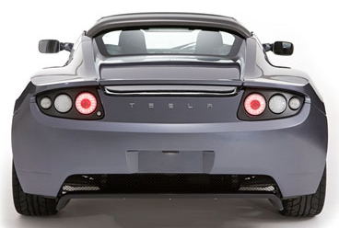

Importance of Dynamic Modelling

Slide 3
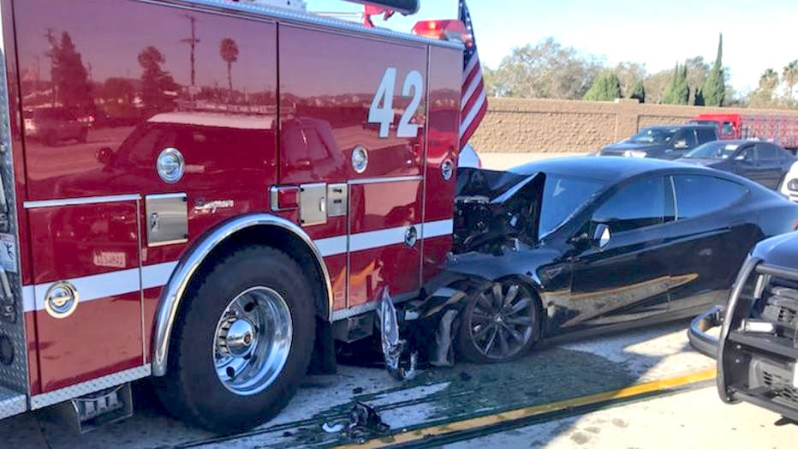
Importance of Dynamic Modelling

Slide 4
Dynamic Models
Specify behaviour of objects by describing sequentiality and interaction control of their operations
Disregard
  what the operations do
  how they are implemented .
4

Slide 5
Dynamic Models
Represented graphically by
  sequence diagrams
  state machines
Can also be regarded as a use case model
but never as a program
Can also be regarded as a design model .

Slide 6


Events
An event occurs when a message is passed
  between an object and an external party
  or between two objects
Happens at a point in time and has no duration
Information may exchange through parameters .
Caller hands up
Disconnect phones

Slide 7
Examples of Events
Possibly with Objects and Attributes
caller hangs up
car has just exceeded speed limit
caller dials (digit)
debit (amount)
user enters (text)
transfer to (Account, amount)
depart (Airport, date, time)
Current object is an implicit parameter
Current object is an implicit parameter
Current object is an implicit parameter .

Slide 8
Example
Scenario for Phone Call
caller lifts receiver
dial tone begins
caller dials digit (2)
dial tone ends
caller dials digit (8)
caller dials digit (5)
caller dials digit (9)
caller dials digit (2)
caller dials digit (1)
caller dials digit (8)
caller dials digit (0) …
called phone begins ringing
ringing tone appears in calling phone
called party answers
called phone stops ringing
ringing tone disappears in calling phone
connect phones
called party hangs up
disconnect phones
caller hangs up .

Slide 9
Sequence Diagrams
A sequence diagram is a graphical representation of related scenarios
Shows
  objects as vertical dotted lines
  events as horizontal arrows from sender object to receiver object .

Slide 10
Sequence Diagrams
Syntax Overview
Frame
sd borrowBook
Actors and Objects
:Book
r1:Reader
r2:Reader
Time
dateDue
time
reminder
Life lines
return
Message
Execution occurrence
available
borrow
[mayBorrow]
Condition .

Slide 11
Message Types
Asynchronous message
Synchronous message (with operation call)
Reply message
Object creation message
Lost message
Found message .
Notes:
Synchronous messages typically represent method calls and are shown with a filled arrow head.
The reply message from a method has a dashed line.
Asynchronous messages have an open arrow head.
Object creation message has a dashed line with an open arrow.
Lost messages are described as a small black circle at the arrow end of the Message.
Found messages are described as a small black circle at the starting end of the Message.
On Communication Diagrams, the messages are decorated by a small arrow along the connector close to the message name and sequence number in the direction of the message.

Slide 12
Asynchronous Messages
Caller does not wait for the message to be handled before continuing with other messages
Most messages in sequence diagrams are asynchronous .
12

Slide 13
Asynchronous Messages
Example 1
:Professor
:Student
doYouUnderstand
nextSlide .

Slide 14
Asynchronous Messages
Example 2
Word Processor object sends an asynchronous message to Printer object asking it to print a file
Printer object can print the file at any time when it is free
Word Processor object can do anything after it has sent off the asynchronous message .

Slide 15
Asynchronous Messages
Example 2
:Word
Processor
:Printer
print
callHelp .

Slide 16
Synchronous Messages
Caller waits for the message to be handled before continuing with other messages
Typically implemented together with operation call .
16

Slide 17
Synchronous Message and Synchronous Call
Example 1
Model synchronous call by execution occurrence
:Professor
:Student
Execution occurrence
Caller blocked
doYouUnderstand
yes .

Slide 18
Return Values
Indicated by dashed arrow, together with the actual value returned
Can skip the return value when it is obvious
  Such as total after calling getTotal
UML recommendation: Skip the obvious
My recommendation: Don’t skip .

Slide 19
Return Values
Must specify the return value when we need to use it elsewhere
  Say, when total is used as parameter in another message
My recommendation:
A lot of manual checks if you skipped the obvious .

Slide 20
Synchronous Message and Synchronous Call
Example 2
Word Processor object sends a synchronous message to Printer object asking it to print a file
Word Processor object does not do anything until it receives a (software) acknowledgement from Printer object saying that printing is complete .

Slide 21
Synchronous Message and Synchronous Call
Example 2
:Word
Processor
:Printer
Execution occurrence
Caller blocked
print
printComplete .

Slide 22
Object Creation Messages
An object may create another object via an object creation message
:Customer
:Order
Constructor .

Slide 23
Lost Messages
:Professor
:Student
doYouUnderstand ( )
no .

Slide 24
Found Messages
:Professor
:Student
doYouUnderstand ( )
yes .

Slide 25
Duration Constraints
Example 1: Single click
:Mouse
click
noClick?
highlight
Example 2: Double click
:Mouse
click
click
open

Slide 26
Duration Constraints
Example 1: Single click
:Mouse
click
1 s
highlight
Example 2: Double click
:Mouse
click
{0..1 s}
click
open

Slide 27
Time Constraints
Example 1: Single click
:Mouse
click
t = now
highlight
t + 1 s
Example 2: Double click
:Mouse
click
t = now
click
open
t + {0..1 s}

Slide 28
Control Information
CombinedFragments
Used to describe control information in sequence diagrams
They are only for modeling simple combinations of scenarios .

Slide 29
Control Information
CombinedFragments
Alternatives (alt)
Option (opt)
Parallel (par)
Critical Region (critical)
Iteration (loop)
Continuation .

Slide 30
CombinedFragments
Alternatives (alt)
Represents a choice of behavior
At most one of the operands will be chosen
The chosen operand have an explicit or implicit guard expression that evaluates to true
Like “if then else” in programming .

Slide 31
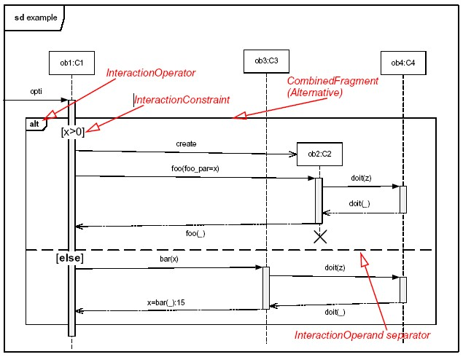
CombinedFragments
Alternatives (alt)
Alt
Explicit guard condition in this example
Separator
Else .

Slide 32
Alternatives
Single and Double Clicks
:Mouse
No explicit guard condition in this example .
alt
click
1 s
highlight
click
{0..1 s}
click
open

Slide 33
Alternatives
We Learn from Mistakes
:Mouse
We do not know what the user will do in advance .
alt
click
[single click]
highlight
[doubleclick]
click
click
open

Slide 34
CombinedFragments
Option (opt)
Represents a choice of behavior where
  either the (sole) operand happens
  or nothing happens
Like “alt” where the second operand is empty
Like “if then” without “else” in programming .

Slide 35
CombinedFragments
Option (opt)
:ATM
Explicit guard condition in this example .
insertCard
opt
[valid card]
requestKey
enterKey
35

Slide 36
CombinedFragments
Option (opt)
:Mouse
Highlight in any case
click
highlight
No explicit guard condition in this example .
opt
click
open

Slide 37
Alternatives and Option
We Learn from Mistakes
No
We do not know what the user will do in advance .
:Mouse
click
highlight
opt
click
[one more click]
open

Slide 38
CombinedFragments
Parallel (par)
Represents a parallel merge of the behavior of the operands
Different operands can be interleaved in any way as long as the order within each operand is preserved .

Slide 39
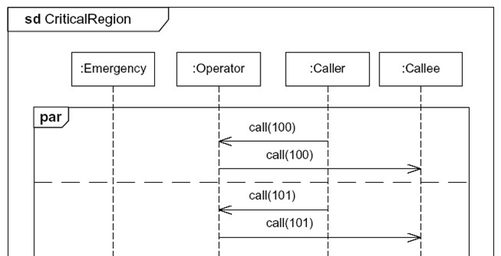
CombinedFragments
Parallel (par)
Par
Different calls can be freely interleaved
Different calls can be freely interleaved
Different calls can be freely interleaved .
Notes:
The interaction Operator critical designates that the CombinedFragment represents a critical region
A critical region means that the traces of the region cannot be interleaved by other Occurrence Specifications (on those Lifelines covered by the region)
This means that the region is treated atomically by the enclosing fragment when determining the set of valid traces
Even though enclosing CombinedFragments may imply that some Occurrence Specifications may interleave into the region, such as with par-operator, this is prevented by defining a region
Thus the set of traces of enclosing constructs are restricted by critical regions.

Slide 40
CombinedFragments
Critical Region (critical )
Events in a critical region must be handled first
Events in a critical region cannot be interleaved with events outside the region .

Slide 41
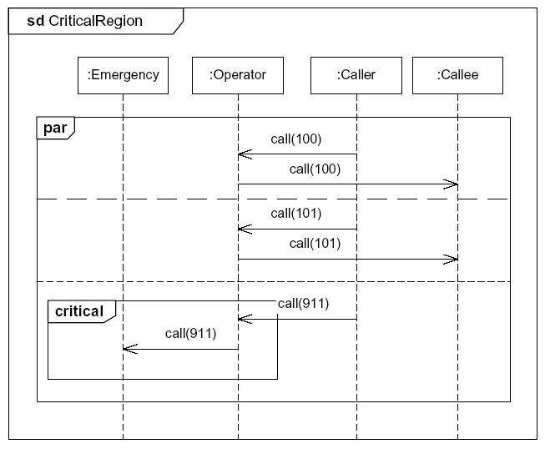
CombinedFragments
Critical Region (critical )
Normal calls can be freely interleaved
Critical inside Par
911-call must be contiguously handled
Operator must forward the 911-call before anything else .
Notes:
The interaction Operator critical designates that the CombinedFragment represents a critical region
A critical region means that the traces of the region cannot be interleaved by other Occurrence Specifications (on those Lifelines covered by the region)
This means that the region is treated atomically by the enclosing fragment when determining the set of valid traces
Even though enclosing CombinedFragments may imply that some Occurrence Specifications may interleave into the region, such as with par-operator, this is prevented by defining a region
Thus the set of traces of enclosing constructs are restricted by critical regions.

Slide 42
CombinedFragments
Iteration (loop)
loop
loop (3)
Exactly 3 iterations
[condition]
loop (3, 5)
loop (3, *)
At least 3 iterations .
Notes:
The interaction Operator critical designates that the CombinedFragment represents a critical region
A critical region means that the traces of the region cannot be interleaved by other Occurrence Specifications (on those Lifelines covered by the region)
This means that the region is treated atomically by the enclosing fragment when determining the set of valid traces
Even though enclosing CombinedFragments may imply that some Occurrence Specifications may interleave into the region, such as with par-operator, this is prevented by defining a region
Thus the set of traces of enclosing constructs are restricted by critical regions.

Slide 43
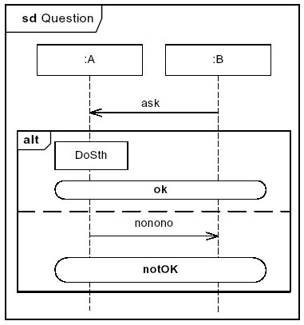
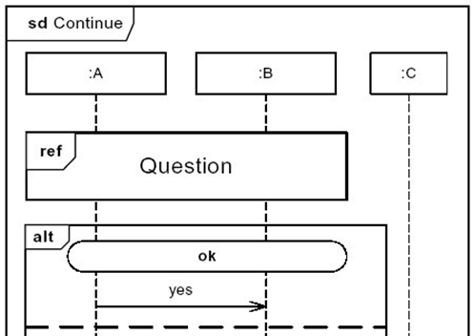
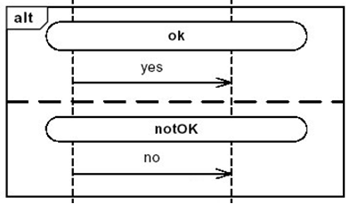
CombinedFragments
Continuation

Slide 44
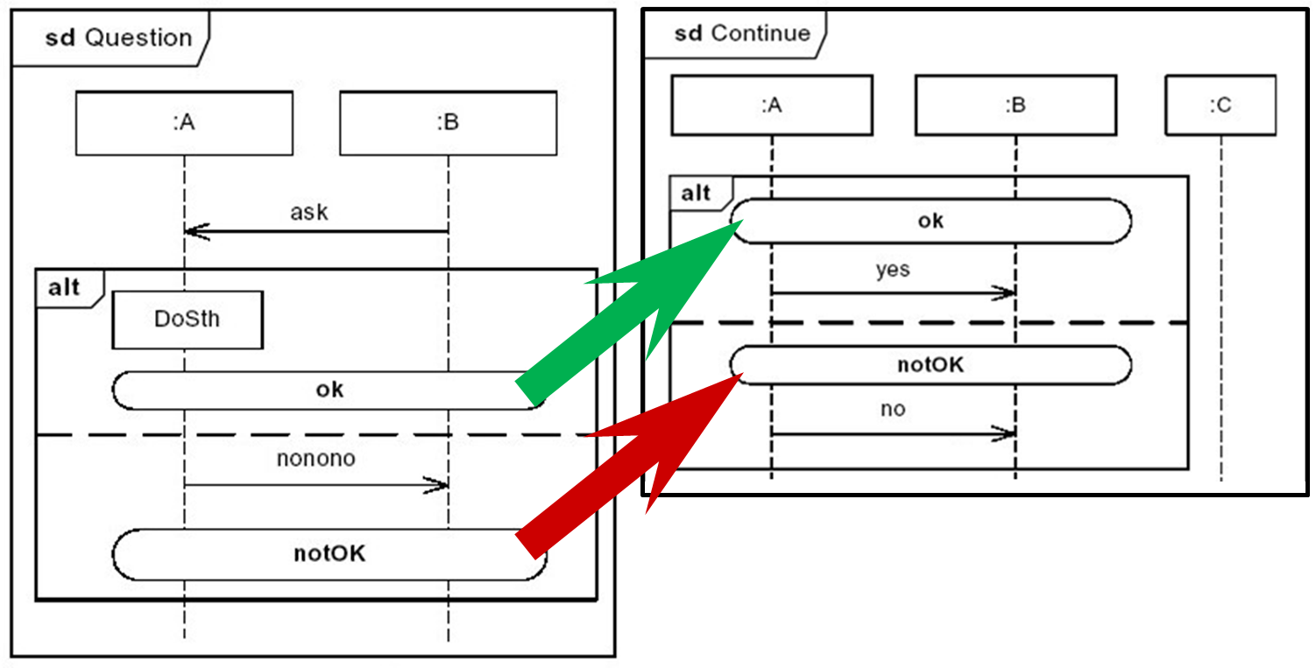
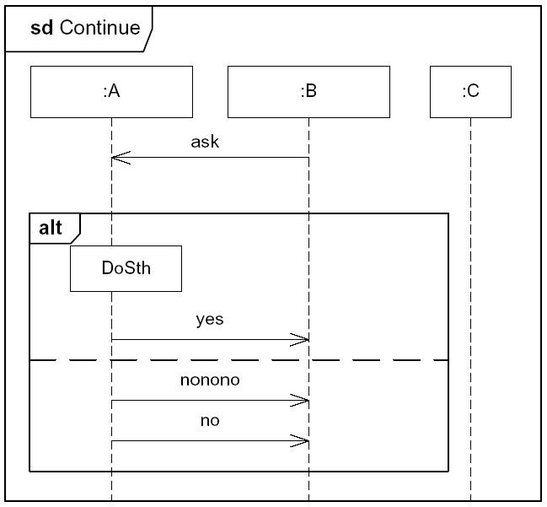
CombinedFragments
Continuation
=

Slide 45
CombinedFragments
Warning
Remember:
45

Slide 46
CombinedFragments
Warning
The modelling of real-life applications are usually much simpler than my examples
Consider drawing several diagrams for modeling complex combinations
Do not use sequence diagrams for detailed modelling of program algorithms
  Better done using state machines, activity diagrams, or pseudo-code .

Slide 47
InteractionUse (ref )
An InteractionUse refers to an Interaction
The InteractionUse is a shorthand for copying the contents of the referred Interaction to where the InteractionUse is
The copying may involve substituting parameters with actual values .

Slide 48
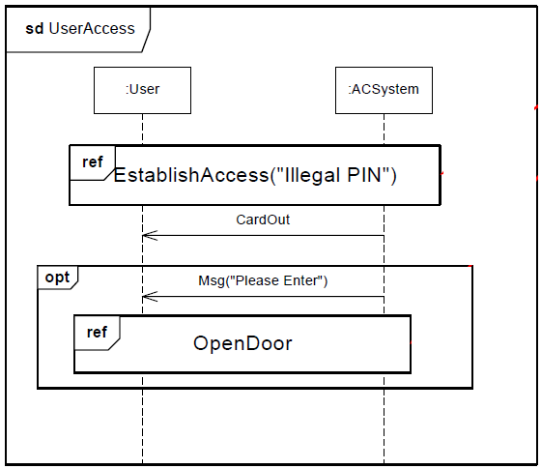
InteractionUse (ref )
Example
This InteractionUse refers to an Interaction :EstablishAccess with input parameter PIN .
(PIN)
This InteractionUse without parameter refers to an Interaction :OpenDoor

Slide 49
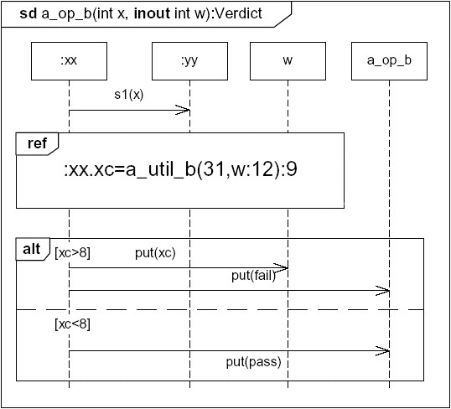
InteractionUse (ref )
Too Complicated Use
Interaction a_op_b with input integer parameter x, input/output integer parameter w, and return parameter Verdict
Refer to a_util_b with input 31 and input parameter w with value 12
Return value 9 to the attribute xc of :xx
The return value from the Interaction a_op_b is passed to Lifeline a_op_b .

Slide 50
InteractionUse (ref )
Warning
Do you find this example difficult?
Your users find it even more so
Sequence diagrams are not for Programmers
Avoid combining many scenarios together .

