Slide 1
Control Information
CombinedFragments
Option (opt)
Alternatives (alt)
Parallel (par)
Critical Region (critical)
Iteration (loop)
Continuation .

Slide 2
CombinedFragments
Option (opt)
Represents a choice of behavior where
  either the (sole) operand happens
  or nothing happens
Like “if then” without “else” in programming .

Slide 3
Option (opt)
Example 1
insertCard happened in the past
Explicit guard condition .
:ATM
insertCard
opt
[valid card]
requestKey
enterKey
3

Slide 4
Option (opt)
Example 2
:Mouse
click
highlight
2nd click happens in the future
No explicit guard condition .
opt
click
open

Slide 5
Example 2 (continued)
We Learn from Mistakes
:Mouse
2nd click happens in the future
Wrong explicit guard condition .
click
highlight
opt
click
[one more click]
open

Slide 6
CombinedFragments
Alternatives (alt)
2 or more behavioral options
At most 1 will be chosen
Like “if then else” in programming .

Slide 7
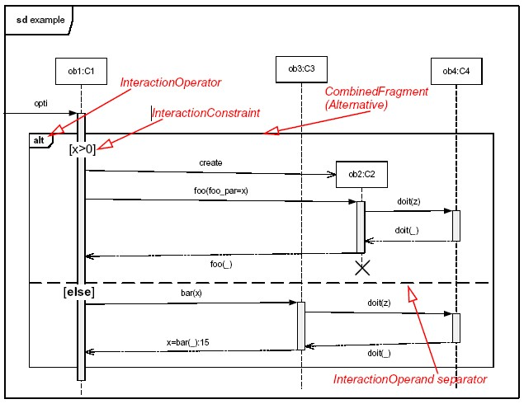
CombinedFragments
Alternatives (alt)
alt
Explicit guard condition in this example
Separator
else .

Slide 8
Duration Constraints
Example 1: Single click
:Mouse
click
noClick?
highlight
Example 2: Double click
:Mouse
click
click
open

Slide 9
Duration Constraints
Example 1: Single click
:Mouse
click
1 s
highlight
Example 2: Double click
:Mouse
click
{0..1 s}
click
open

Slide 10
Time Constraints
Example 1: Single click
:Mouse
click
t = now
highlight
t + 1 s
Example 2: Double click
:Mouse
click
t = now
click
open
t + {0..1 s}

Slide 11
Alternatives (alt)
Example 1
2nd click happens in the future
No explicit guard condition .
alt
click
1 s
click
{0..1 s}
click
open

Slide 12
Example 1 (Continued)
We Learn from Mistakes
:Mouse
Double click happens in the future
Wrong explicit guard condition .
alt
click
[single click]
highlight
[doubleclick]
click
click
open

Slide 13
CombinedFragments
Parallel (par)
Represents a parallel merge of the behavior of the operands
Different operands can be interleaved in any way as long as the order within each operand is preserved .

Slide 14
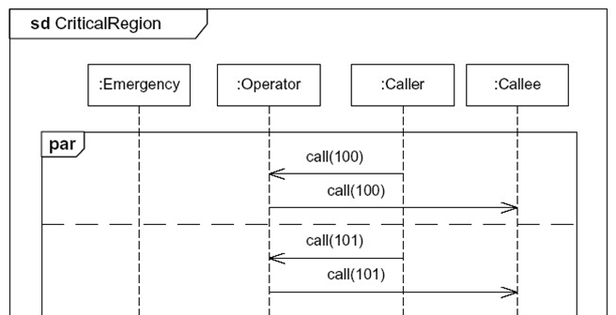
CombinedFragments
Parallel (par)
par
Different calls can be freely interleaved
Different calls can be freely interleaved
Different calls can be freely interleaved .
Notes:
The interaction Operator critical designates that the CombinedFragment represents a critical region
A critical region means that the traces of the region cannot be interleaved by other Occurrence Specifications (on those Lifelines covered by the region)
This means that the region is treated atomically by the enclosing fragment when determining the set of valid traces
Even though enclosing CombinedFragments may imply that some Occurrence Specifications may interleave into the region, such as with par-operator, this is prevented by defining a region
Thus the set of traces of enclosing constructs are restricted by critical regions.

Slide 15
CombinedFragments
Critical Region (critical )
Events in a critical region must be handled first
Events in a critical region cannot be interleaved with events outside the region .

Slide 16
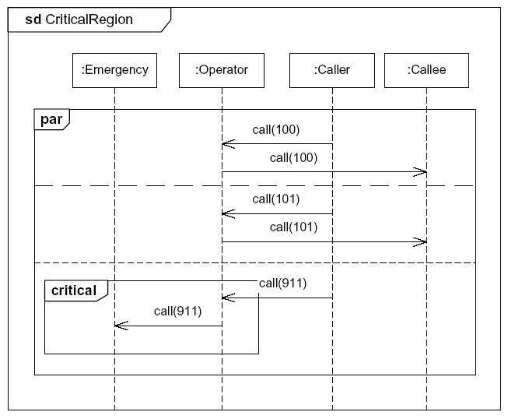
CombinedFragments
Critical Region (critical )
Normal calls freely interleaved
critical inside par
911-call forwarded immediately before anything else .
Notes:
The interaction Operator critical designates that the CombinedFragment represents a critical region
A critical region means that the traces of the region cannot be interleaved by other Occurrence Specifications (on those Lifelines covered by the region)
This means that the region is treated atomically by the enclosing fragment when determining the set of valid traces
Even though enclosing CombinedFragments may imply that some Occurrence Specifications may interleave into the region, such as with par-operator, this is prevented by defining a region
Thus the set of traces of enclosing constructs are restricted by critical regions.

