Slide 1
Dynamic Modelling with State Machines
Prof. T.H. Tse
Department of Computer Science
Email: thtse@cs.hku.hk
Web: hku.hk/thtse .

Slide 2
State Machines
Motivation
Two types of operations in real life
(1) Continuous Activities or Inactivities
(2) Actions ...

Slide 3
State Machines
Motivation
(1) Continuous Activities
or Inactivities
An activity or inactivity takes time
Persists until it is
  either completed
  or interrupted by an action
Alarm ringing
Alarm being off
15 min has passed
Press “Stop” button .

Slide 4
State Machines
Motivation
An activity or inactivity is modelled by a state in state machines:

Slide 5
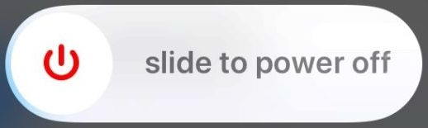

State Machines
Motivation
(1) Continuous Activities or Inactivities
(2) Actions
Everything takes time in real life
The time actually taken is
  either negligible
  or of no interest to the user
click ⟨ok⟩ button
wipe the slider
plane takes off .

Slide 6
State Machines
Motivation
An action is modelled by an event in state machines:

Slide 7
State Machines
Formerly known as state-transition diagrams
A transition is
a change of state
caused by an triggering event
possibly with a guard condition
may result in an effect action
I will use 5 different colours .
I will use 5 different colours .
I will use 5 different colours .
I will use 5 different colours .
I will use 5 different colours .

Slide 8
State Machines
Example 1
debit (amount)
[amount < balance]
Before
debit
After
debit
/ ok
State
Transition
Triggering event
Effect action .
Guard condition

Slide 9
Example 1 (Continued)
Triggering Events
debit (amount)
[amount < balance]
Before
debit
After
debit
/ ok
Event received by present object .

Slide 10
Example 1 (Continued)
Effect Action
debit (amount)
[amount < balance]
Before
debit
After
debit
/ ok
Event sent to another object .

Slide 11
State Machines
Guard Conditions
A condition is a Boolean expression relating attributes or values
  Example:
debit (amount) [amount < balance]
Conditions are used as guards on transitions
A transition fires
  when the triggering event occurs, and
  if the guard condition is satisfied .

Slide 12
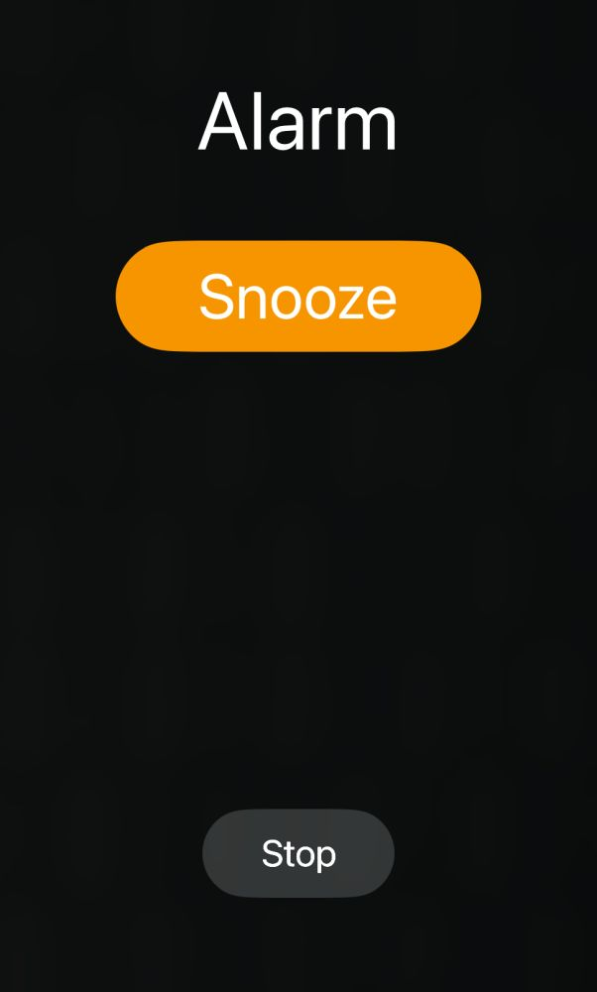
States
Example 1
Alarm ringing
Need programming .
Need programming .

Slide 13
States
Example 1 (Continued)
Difficult to connect with other events and states .
Traditional Documentation
State. Alarm ringing
Previous State. Alarm being turned on
Triggering Event. Reach target time
Guard Condition. Sound being turned on
Subsequent Events Accepted:
  Press ⟨snooze⟩ button
  Press ⟨ok⟩ button

Slide 14
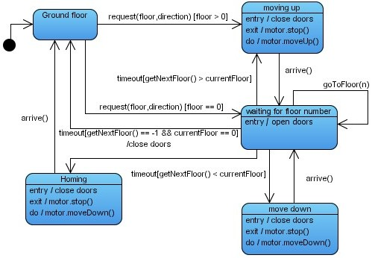
State Machines | UML Syntax
Overview
Triggering event
Guard condition
State
Continuous activity
after (3 seconds)
Initial State
after (3 seconds) / close doors
after (3 seconds)
Effect action .

Slide 15
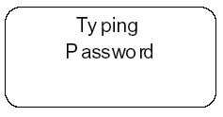
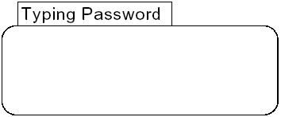
State Machines | UML Syntax
State
A state is generally shown as a rectangle with rounded corners, with the state name inside:
Optionally, it may have an attached name tab:
Normally used for a composite state .

Slide 16
State Machines | UML Syntax
A state machine describes the dynamic behaviour of one object
A node represents a state:
State
do / activity
triggering event [condition]
/ effect action .

Slide 17
State Machines | UML Syntax
“do / activity” represents the continuous activity during that state:
State
do / activity
triggering event [condition]
/ effect action

Slide 18
State Machines | UML Syntax
An arrow represents a transition, causing a change of state
It is due to a triggering event (an incoming event):
State
do / activity
triggering event [condition]
/ effect action .

Slide 19
State Machines | UML Syntax
The transition may result in a effect action (an outgoing event):
State
do / activity
triggering event [condition]
/ effect action

Slide 20
State Machines | UML Syntax
Square brackets represent a guard condition:
A guard condition is not a trigger by itself .
State
do / activity
triggering event [condition]
/ effect action

Slide 21
State Machines | UML Syntax
State machines can be
  One-shot life cycles, with initial and final states:
State
do / activity
Final state .
Initial state
triggering event [condition]
/ effect action

Slide 22
State Machines | UML Syntax
State machines can be
  One-shot life cycles, with initial and final states
  Or transition loops:
State
do / activity
Initial state
Transition loop .

Slide 23
State Machines | UML Syntax
Other Activity Labels
State
do / activity
entry / effect action
exit / effect action
Effect action upon entry to the state
Effect action upon exit from the state
Example:
Lecture
do / listening
entry / turn iPhone ringer off
exit / turn iPhone ringer on .

Slide 24
State Machines | UML Syntax
Other Activity Labels (Continued)
State
do / activity
entry / effect action
Same as
triggering event
/ effect action
State
We recommend putting it outside the state for clarity .

Slide 25
State Machines | UML Syntax
Other Activity Labels (Continued)
State
do / activity
entry / effect action
exit / effect action
Same as
triggering event
/ effect action
State
We also recommend putting it outside the state for clarity .

Slide 26
State Machines | UML Syntax
Composite States
Composite State
State 1
State 2
⊗

Slide 27
Composite States
Example 1
Taking Course
apply
Need more details .
pass / pass course

Slide 28
Composite States
Example 2
Explicit entry point
Taking Course
apply
Approving
meet prerequisite
Assessing
⊗
Explicit exit point
pass / pass course

Slide 29
Composite States
Example 3
Default entry point
Taking Course
apply
Approving
meet prerequisite
Assessing
Default exit point
pass / pass course

Slide 30
Composite States
Example 2 versus Example 3
=

Slide 31
Composite States
Example 4
Taking Course
miss prerequisite
/ drop course
apply
Approving
meet prerequisite
preapproved enroll
fail
/ fail course .
Assessing
pass / pass course

Slide 32
Composite States
Example 5
Taking Course
miss prerequisite
/ drop course
apply
Approving
meet prerequisite
preapproved enroll
fail
/ fail course .
Assessing
pass / pass course

Slide 33
Composite States
Example 5
Normal, default entry
Alternative, explicit entry
Taking Course
miss prerequisite
/ drop course
apply
Approving
meet prerequisite
⊗
preapproved enroll
Alternative, explicit exit .
fail
/ fail course
Assessing
Normal, default exit
pass / pass course

Slide 34
Composite States
Example 4 versus Example 5
=

Slide 35
State Machines | UML Syntax
Fork and Join
B1
B2
A
D
C1
C2
Fork
Join
The two streams are done in parallel .

Slide 36
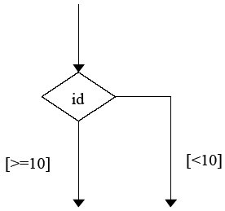
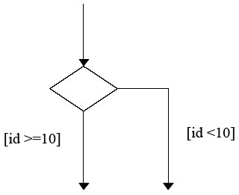
State Machines | UML Syntax
Choice Pseudostate
Recall that a guard condition is only part of a transition
Very confusing to beginners
Avoid at all costs .

Slide 37
Warning
Semantics (meaning) is more important than syntax
Process is also more important than syntax .

Slide 38
Dynamic Modelling
Philosophy
Specify the time-dependent behaviour of the system and its objects
Draw sequence diagrams and state machines
Important for interactive systems .

Slide 39
Dynamic Modelling
Process
Prepare interface formats
Identify scenarios from use cases
Identify event interactions among objects
according to class diagram
Prepare sequence diagrams for scenarios
Prepare a state machine for each class
Match events among objects to verify consistency .

Slide 40
Preparing Scenarios
Prepare normal scenario
Consider alternative scenarios .

Slide 41
Identifying Events
Examine the scenarios to identify all events external to an object
Events may include
  user inputs
  user choices such as ⟨ok⟩ and ⟨cancel⟩
  inputs from external devices
  signals from other objects
  interrupts
  effect actions .

Slide 42
Class Diagram versus
Sequence Diagram
Relationships in class diagrams are persistent
They show potential information flows
Paths in sequence diagrams
are transient
They show interactions
How many class diagram(s)?
How sequence diagram(s)? .

Slide 43
Building State Machines
Prepare a state machine for each class with dynamic behaviour
Pick a scenario from sequence diagram
Arrange the events into a path in state machine, with transitions labelled by the input/output events along a lifeline
Replace repeating sequences of events with loops ...

Slide 44
Building State Machines
Prepare a state machine for each class with dynamic behaviour (continued )
Iteratively add other paths to the state machine
  Find a point in the scenario where it diverges
  Attach the new event sequence to the existing state as an alternative path
Add any other possible events, such as boundary (interface) cases and exceptional cases .

Slide 45
Relating Sequence Diagram and State Machines
:P
:Q
User
One slide
that helps
you obtain
Grade A or B
a
b
P:
Q:
a / b
b
P1
P2
Q1
Q2

Slide 46
How Many State Machines?
State Machines.
46
Notes:
Software Design
46
Teaching Notes
The UML offers two types of diagrams (Sequence and Collaboration) to model detailed object interactions.
The figure above is read from top to bottom, following the logic of the use case. Each object referenced in the use case is symbolized by a vertical line. The behaviors or operations which each object needs to fulfill an obligation is represented by a box. These boxes represent program code. The arrows between the lines represent interactions or messages being sent to a particular object to invoke one of its operations to satisfy a request.

Slide 47
Example 1: Screen Control System
Sequence Diagram (1st Draft)
:Screen
Controller
:Screen
Professor
down button
down signal
ack
reached bottom
bottom signal .

Slide 48
Example 1: Screen Control System
(For Students Who Like Synchronous Version)
:Screen
Controller
:Screen
Professor
down button
down signal
Screen controller blocked
Not suitable in real life .
ack
bottom signal

Slide 49
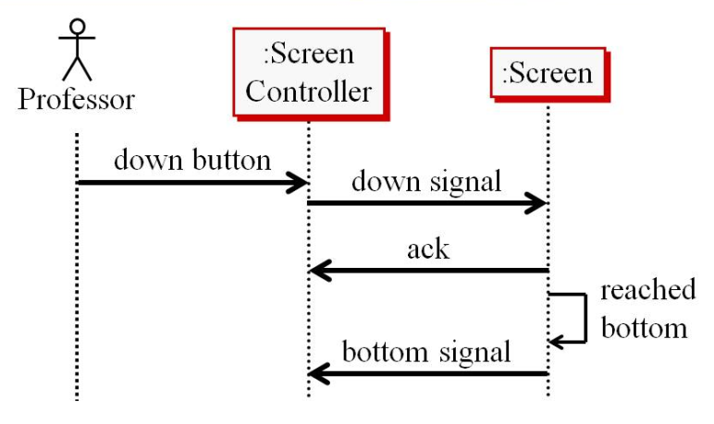
Screen Controller
State Machine (1st Draft)
Idle
down button / down signal
bottom
signal .
Pending
ack
Screen moving down

Slide 50
Screen
State Machine (1st Draft)
Top
down signal / ack
Moving Down
reached bottom / bottom signal
Bottom .

Slide 51
Screen Control System
Sequence Diagram (2nd Draft)
:Screen
Controller
:Screen
Professor
display please select
down button
down signal
display please wait
ack
display screen
moving down
reached bottom
bottom signal
display please select

Slide 52
Screen Control System
Sequence Diagram (2nd Draft)
:Screen
Controller
:Screen
Professor
display please select
down button
down signal
display please wait
Should not be events, but acceptable in sequence diagrams (only).
Should not be events, but acceptable in sequence diagrams (only).
Should not be events, but acceptable in sequence diagrams (only).
Should not be events, but acceptable in sequence diagrams (only).
Should not be events, but acceptable in sequence diagrams (only) .
ack
display screen
moving down
reached bottom
bottom signal
display please select

Slide 53
Screen Controller
State Machine (2nd Draft)
Idle
do / display please select
do / display please select
down button / down signal
Pending
do / display please wait
bottom
signal
do / display please wait
ack
Screen moving down
do / display screen moving down
do / display screen moving down .

Slide 54
Screen
State Machine (2nd Draft)
Top
down signal / ack
Moving down
do / moving down
do / moving down .
reached bottom / bottom signal
Bottom

Slide 55
Screen Control System
Sequence Diagram (2nd Draft)
:Screen
Controller
:Screen
Professor
display please select
down button
down signal
display please wait
What if the screen is at the bottom? .
ack
display screen
moving down
reached bottom
bottom signal
display please select

Slide 56
Screen Control System
Sequence Diagram (3rd Draft)
:Screen
Controller
:Screen
Professor
display please select
down button
opt
[screen not at bottom] .
down signal
display please wait
ack
display screen
moving down
reached bottom
display please select
bottom signal

Slide 57
Screen Controller
State Machine (3rd Draft)
Idle
do / display please select
do / display please select
[screen not at bottom] .
down button
/ down signal
Pending
do / display please wait
do / display please wait
bottom
signal
ack
Screen moving down
do / display screen moving down
do / display screen moving down

Slide 58
Screen Control System
Sequence Diagram (3rd Draft)
:Screen
Controller
:Screen
Professor
display please select
down button
opt
[screen not at bottom]
down signal
display please wait
What if the screen is not working? .
ack
display screen
moving down
reached bottom
display please select
bottom signal

Slide 59
Sequence Diagram
(4th Draft: New Scenario)
:Screen
Controller
:Screen
Professor
display please select
down button
opt
[screen not at bottom]
down signal
display please select .
2 s

Slide 60
Sequence Diagram
(For Students Who Like to Combine Scenarios)
:Screen
Controller
:Screen
Professor
display please select
down button
opt
[screen not at bottom]
down signal
display please wait
t = now
alt
ack
display screen moving down
reached bottom
display please select
bottom signal
display please select .
t + 2 s

Slide 61
Screen Controller
State Machine (4th Draft)
UML keyword .
Idle
do / display please select
do / display please select
after (2 seconds)
down button [screen not at bottom]
/ down signal
Pending
do / display please wait
bottom
signal
do / display please wait
ack
Screen moving down
do / display screen moving down
do / display screen moving down

Slide 62
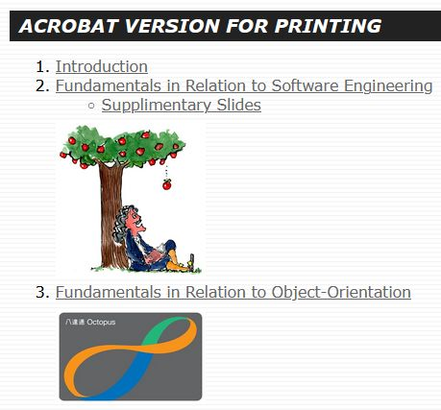
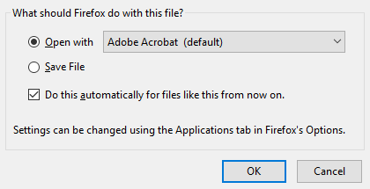
Example 2
Lecture Materials

Slide 63
We Learn from Mistakes
press save
button
Selecting
Saving
press open button
Opening
Open and save modes are conditions, not triggers .

Slide 64
We Learn from Mistakes
[save mode]
Selecting
Saving
[open mode]
Opening
A condition cannot trigger a change of state .

Slide 65
Recommended Solution
OK
[save mode]
Selecting
Saving
OK
[open mode] .
Opening

Slide 66
Example 3
Single and Double Clicks
double click
A
C
single click
B
Legitimate (high level) model
What if we would like to define “single click” and “double click” via the state machine? .

Slide 67
We Learn from Mistakes
A
click
click
Pending
C
no click
The lack of an event cannot trigger a change of state .
B

Slide 68
We Learn from Mistakes
A
click
click
Pending
C
[1 second]
A condition cannot trigger a change of state .
B

Slide 69
We Learn from Mistakes
A
click
click
Pending
C
wait (1 second)
Waiting cannot be an event .
B

Slide 70
Recommended Solution
A
click
click
Pending
C
after (1 second)
B
UML keyword .

Slide 71
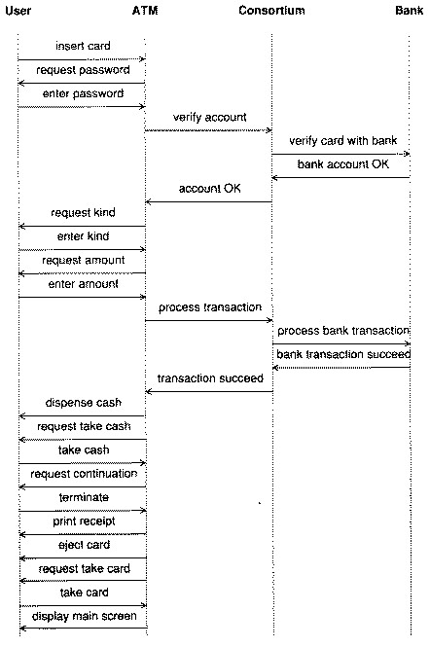
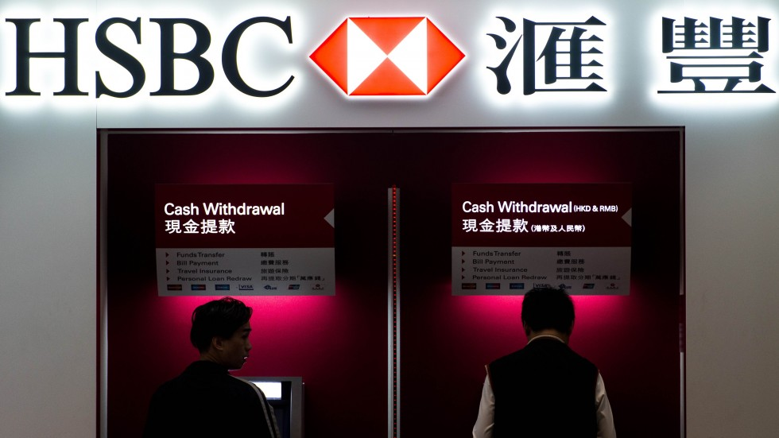
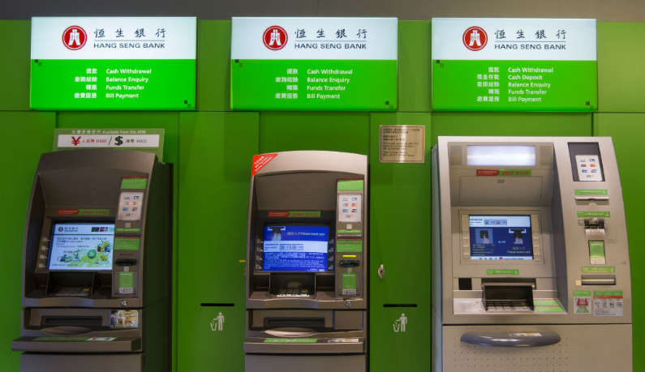
Example 4: ATM System
Sequence Diagram
display main
screen

Slide 72
ATM Class
State
Machine
enter password / verify account
Main screen
do / display main
screen
insert card
[readable]
do / request
password
do / display
verifying
account
OK
do / request
kind
enter
kind
continue
do / request
amount
enter amount
/process
transaction
end of
transaction
[successful]
take
cash
do / display
processing
starts
do / request
continuation
do / dispense cash;
request take cash

Slide 73
ATM Class
State
Machine
enter password / verify account
Main screen
do / display main
screen
insert card
[readable]
do / request
password
do / display
verifying
account
insert card [unreadable]
Unreadable:
do / display unreadable
OK
take
card
do / request
kind
ack
Card rejected
do / eject card;
request take card
enter
kind
continue
do / request
amount
enter amount
/process
transaction
end of
transaction
[successful]
take
cash
do / display
processing
starts
do / request
continuation
do / dispense cash;
request take cash

Slide 74
ATM Class
State
Machine
enter password / verify account
Main screen
do / display main
screen
insert card
[readable]
do / request
password
do / display
verifying
account
OK
take
card
cancel
do / request
kind
Card rejected
do / eject card;
request take card
ack
Cancel
do / display
cancellation
enter
kind
continue
do / request
amount
enter amount
/process
transaction
end of
transaction
[successful]
take
cash
do / display
processing
starts
do / request
continuation
do / dispense cash;
request take cash

Slide 75
ATM Class
State
Machine
enter password / verify account
Main screen
do / display main
screen
insert card
[readable]
do / request
password
do / display
verifying
account
bad
password
cancel/
network
request
insert card [unreadable]
take
card
Unreadable:
do / display unreadable
OK
cancel
bad
account
do / request
kind
ack
Card rejected
do / eject card;
request take card
Cancel
do / display
cancellation
cancel
ack
enter
kind
cancel
continue
end of printing
do / request
amount
Finish
do / print receipt
ack
do / display
bad account
enter amount
/process
transaction
after
(5 secs)
no
network
response
end of
transaction
[successful]
take
cash
do / display
processing
starts
do / request
continuation
do / dispense cash;
request take cash
cancel/network request
Interrupt
do / display cancellation
do / display
failure
end of transaction [failed]

Slide 76
Recall

Slide 77
Bank Class
State Machine
verify account
process
transaction
do / verifying account
do / updating
account
end verifying account
[valid]
end updating /
end of
transaction
do / verifying password
end verifying password [valid]
/ OK

Slide 78
Bank Class
State Machine
verify account
process
transaction
end verifying account
[invalid]
/ bad account
do / verifying account
do / updating
account
end verifying account
[valid]
end verifying password
[invalid]
/ bad password .
end updating /
end of
transaction
do / verifying password
end verifying password [valid]
/ OK

Slide 79
Bank Class
State Machine
verify account
process
transaction
end verifying account
[invalid]
/ bad account
do / verifying account
do / updating
account
end verifying account
[valid]
Also acceptable, but more clumsy.
Also acceptable, but more clumsy.
Also acceptable, but more clumsy .
end verifying password
[invalid]
/ bad password
end updating /
end of
transaction
do / verifying password
end verifying password [valid]
/ OK

Slide 80
Matching Events Between Objects
Check completeness and consistency
A sender and a receiver for each event
Predecessors or successors for every state
Consistencies of corresponding events between sequence diagrams and state machines
Consistencies of corresponding events between different state machines
Potential synchronization errors, especially when an input occurs at an awkward time .

Slide 81
Matching Events Between Objects
Example 5
Bank
This syntax is acceptable
verify account
Need more details for consistency with state machine
end verify
card no.
But not
.
end verify
password
OK

Slide 82
Matching Events Between Objects
Example 6
How many objects?
Hence, how many state machines?
How many state machines here?
State machine for Consortium class is missing .

