Slide 1
State Machines
Formerly known as state-transition diagrams
A transition is
a change of state
caused by an triggering event
possibly with a guard condition
may result in an effect action
I will use
5 different
colours .

Slide 2
Relating Sequence Diagram and State Machines
:P
:Q
User
One slide
that helps
you obtain
Grade A or B
a
b
P:
Q:
a / b
b
P1
P2
Q1
Q2

Slide 3
Example 1: Lecture Control System
Sequence Diagram (Draft #1)
:Touchscreen
User Interface
:Screen
Controller
Professor
Screen
down button
down signal
ack
move down
reached bottom
bottom signal .

Slide 4
Example 1: Lecture Control System
(For Students Who Like Synchronous Version)
:Touchscreen
User Interface
:Screen
Controller
Professor
Screen
down button
down signal
Touchscreen blocked
Not reflect real life .
ack
move down
bottom signal .

Slide 5
Touchscreen User Interface
State Machine (Draft #1)
Idle
down button / down signal
bottom
signal .
Pending
ack
Screen moving down

Slide 6
Example 1: Lecture Control System
Sequence Diagram (Draft #2): Displays
:Touchscreen
User Interface
:Screen
Controller
Professor
Screen
display pls select
down button
Not really events
Valid only in sequence diagrams .
down signal
display pls wait
ack
move
down
display screen
moving down
reached bottom
bottom signal
display pls select

Slide 7
Touchscreen User Interface
State Machine (Draft #2): Displays
Idle
do / display please select
down button / down signal
Must be inside
States .
Pending
do / display please wait
bottom
signal
ack
Screen moving down
do / display screen moving down .

Slide 8
Screen Controller
State Machine (Draft #2): Continuous Activity
Top
down signal / ack + move down
Must be inside
States .
Moving Down
do / moving down .
reached bottom / bottom signal
Bottom .

Slide 9
Example 1: Lecture Control System
Sequence Diagram (Draft #2): Displays
:Touchscreen
User Interface
:Screen
Controller
Professor
Screen
display pls select
down button
Not really events
Valid only in sequence diagrams .
down signal
display pls wait
ack
move
down
display screen
moving down
reached bottom
bottom signal
display pls select

Slide 10
Lecture Control System
Sequence Diagram (Draft #2) Revisit
:Touchscreen
User Interface
:Screen
Controller
Professor
Screen
display pls select
What if
the screen
is already at
the bottom? .
down button
down signal
display pls wait
ack
move
down
display screen
moving down
reached bottom
bottom signal
display pls select

Slide 11
Lecture Control System
Sequence Diagram (Draft #3)
:Touchscreen
User Interface
:Screen
Controller
Professor
Screen
display pls select
down button
opt
[screen not
at bottom]
down signal
display pls wait
ack
move down
display screen
moving down
reached bottom
bottom signal
display pls select .

Slide 12
Screen Controller
State Machine (Draft #3)
Idle
do / display please select
down button
[screen not
at bottom]
/ down signal .
Pending
do / display please wait
bottom
signal
ack
Screen moving down
do / display screen moving down
do / display screen moving down

Slide 13
Lecture Control System
Sequence Diagram (Draft #2) Revisit 2
:Touchscreen
User Interface
:Screen
Controller
Professor
Screen
display pls select
What if
the screen controller
is faulty? .
down button
down signal
display pls wait
ack
move down
display screen
moving down
reached bottom
bottom signal
display pls select

Slide 14
Lecture Control System
Sequence Diagram (Draft #4)
:Touchscreen
User Interface
:Screen
Controller
Professor
Screen
display pls select
down button
down signal
display pls wait
ack
opt
[screen not
at bottom]
move down
2 s
display screen moving down
reached bottom
bottom signal
display pls select

Slide 15
Touchscreen User Interface
State Machine (Draft #4)
UML keyword .
Idle
do / display please select
do / display please select
after (2 s)
down button [screen not at bottom]
/ down signal
Pending
do / display please wait
bottom
signal
do / display please wait
ack
Screen moving down
do / display screen moving down
do / display screen moving down

Slide 16
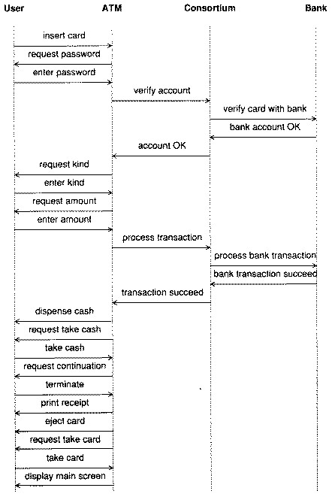
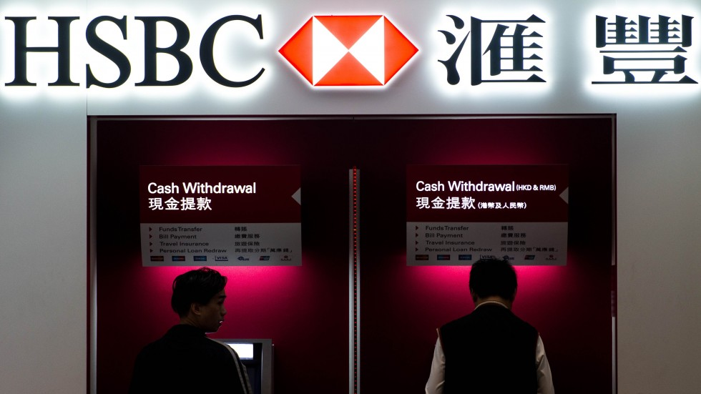
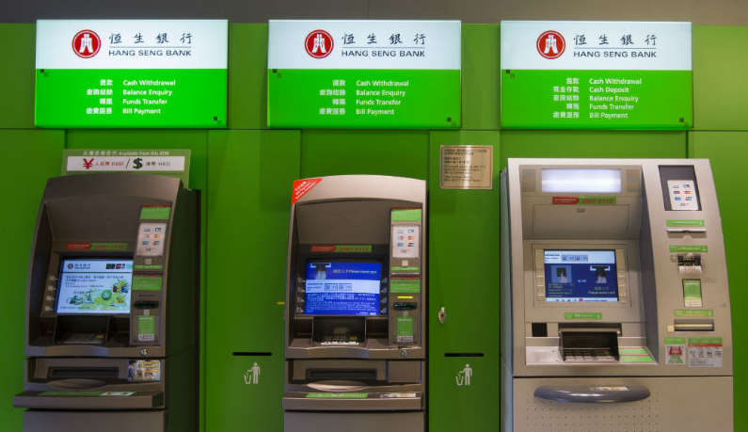
Example 4: e-Banking System
Sequence Diagram
display main
screen

Slide 17
ATM Class
State
Machine
enter password / verify account
Main screen
do / display main
screen
insert card
[readable]
do / request
password
do / display
verifying
account
OK
do / request
kind
enter
kind
continue
do / request
amount
enter amount
/process
transaction
end of
transaction
[successful]
take
cash
do / display
processing
starts
do / request
continuation
do / dispense cash;
request take cash

Slide 18
ATM Class
State
Machine
enter password / verify account
Main screen
do / display main
screen
insert card
[readable]
do / request
password
do / display
verifying
account
insert card [unreadable]
Unreadable:
do / display unreadable
OK
take
card
do / request
kind
ack
Card rejected
do / eject card;
request take card
enter
kind
continue
do / request
amount
enter amount
/process
transaction
end of
transaction
[successful]
take
cash
do / display
processing
starts
do / request
continuation
do / dispense cash;
request take cash

Slide 19
ATM Class
State
Machine
enter password / verify account
Main screen
do / display main
screen
insert card
[readable]
do / request
password
do / display
verifying
account
bad
password
cancel/
network
request
insert card [unreadable]
take
card
Unreadable:
do / display unreadable
OK
cancel
bad
account
do / request
kind
ack
Card rejected
do / eject card;
request take card
Cancel
do / display
cancellation
cancel
ack
enter
kind
cancel
continue
end of printing
do / request
amount
Finish
do / print receipt
ack
do / display
bad account
enter amount
/process
transaction
after
(5 secs)
no
network
response
end of
transaction
[successful]
take
cash
do / display
processing
starts
do / request
continuation
do / dispense cash;
request take cash
cancel/network request
Interrupt
do / display cancellation
do / display
failure
end of transaction [failed]

Slide 20
Recall

Slide 21
Bank Class
State Machine
verify account
process
transaction
do / verifying account
do / updating
account
end verifying account
[valid]
end updating /
end of
transaction
do / verifying password
end verifying password [valid]
/ OK

Slide 22
Bank Class
State Machine
verify account
process
transaction
end verifying account
[invalid]
/ bad account
do / verifying account
do / updating
account
end verifying account
[valid]
end verifying password
[invalid]
/ bad password .
end updating /
end of
transaction
do / verifying password
end verifying password [valid]
/ OK

Slide 23
Bank Class
State Machine
verify account
process
transaction
end verifying account
[invalid]
/ bad account
do / verifying account
do / updating
account
end verifying account
[valid]
Acceptable but clumsy .
end verifying password
[invalid]
/ bad password
end updating /
end of
transaction
do / verifying password
end verifying password [valid]
/ OK

Slide 24
Matching Events Between Objects
Check completeness and consistency
A sender and a receiver for each event
Predecessors or successors for every state
Consistencies of corresponding events between sequence diagrams and state machines
Consistencies of corresponding events between different state machines
Potential synchronization errors, especially when an input occurs at an awkward time .

Slide 25
Matching Events Between Objects
Example 5
Acceptable
syntax
But not
:Bank
verify account
Further
consistency
checks with
state
machines .
end verify
card no.
end verify
password
OK

Slide 26
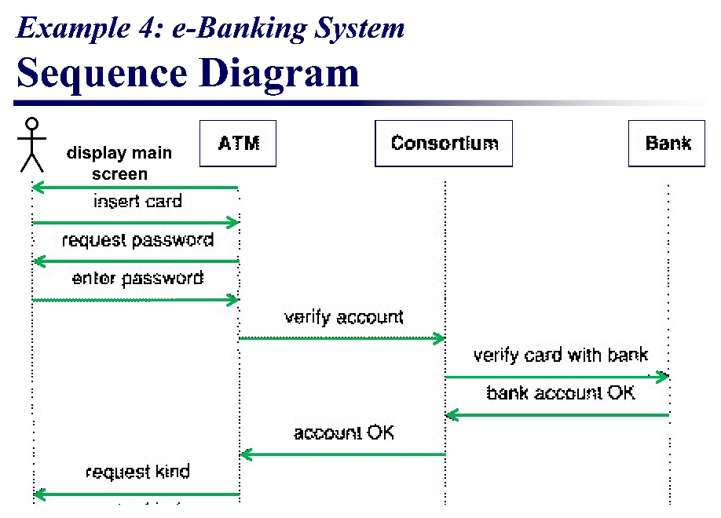
Matching Events Between Objects
Example 6
How many objects?
Hence, how many state machines?
How many state machines here?
State machine for Consortium class is missing .

