Slide 1
Timing and Activity Models
Prof. T.H. Tse
Department of Computer Science
Email: thtse@cs.hku.hk
Web: hku.hk/thtse .

Slide 2

Timing Diagrams
A new feature since UML 2.0
Shows
  time constraints
  how time constraints affect interactions among lifelines
Very useful when timing is important, such as in engineering applications .

Slide 3
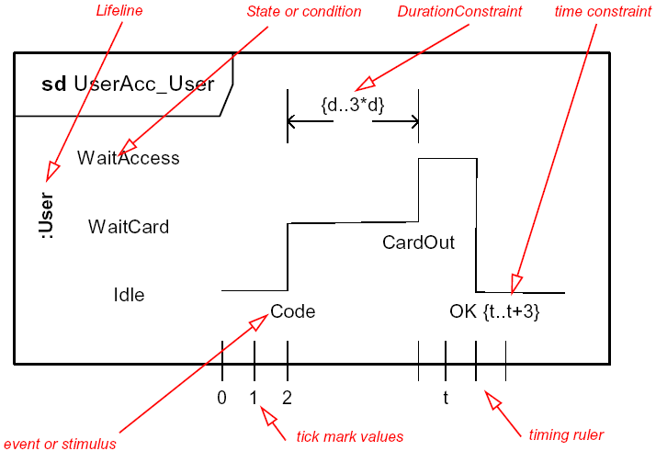
Timing Diagrams
Example 1
Like
sequence
diagram
rotated left by 90% .

Slide 4
Like life lines of sequence diagrams, but has states and explicit timing
States
Event between states
Duration constraint
Time constraint
Timing ruler .

Slide 5
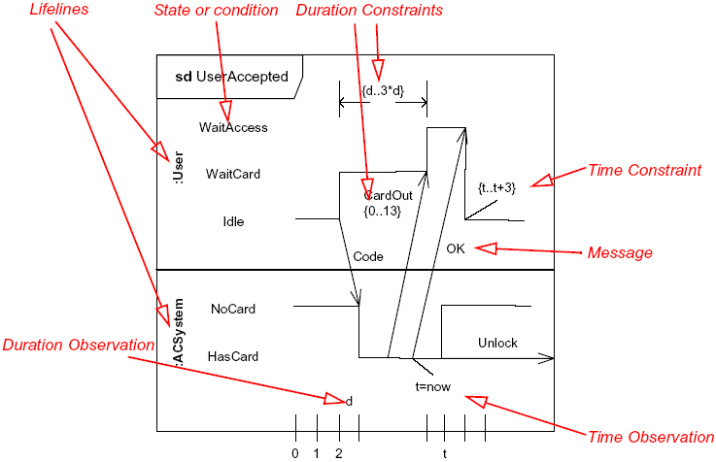
Timing Diagrams: Example 2
Lifelines Interacting via Messages

Slide 6
Like life lines of sequence diagrams, but has states and explicit timing
Message that takes time .

Slide 7
Activity Diagram
Specifies the detailed operations and conditions for lower-level behaviour within an object, rather than interactions with actors or other objects
Resembles traditional flowcharts
Mainly focuses on the flow of control
Activity diagrams are optional in UML
  It is not the most important diagram in UML
  Pseudocode may be used instead .
Notes:
According to UML Superstructure Specification v2.4.1, “Activity replaces ActivityGraph in UML 1.5. Activities are redesigned to use a Petri-like semantics instead of state machines.”

Slide 8
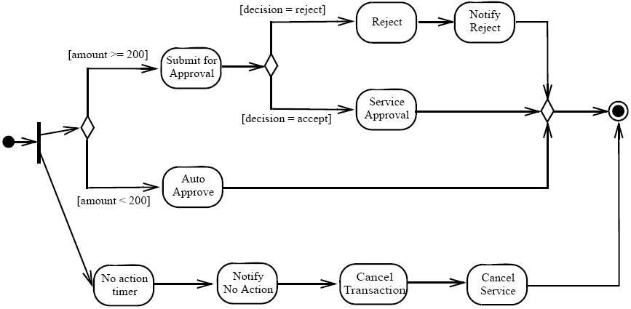
Activity Diagram
Example 1
Fork .

Slide 9
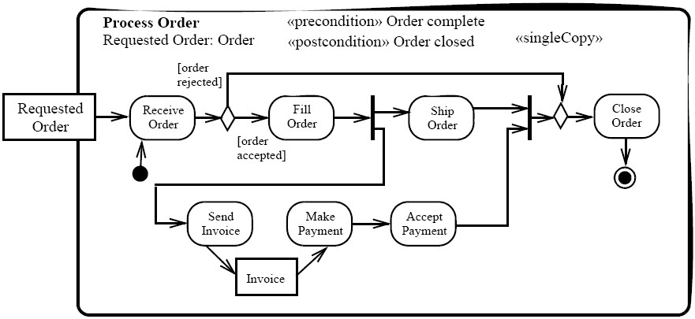
Activity Diagram
Example 2
Parameter name: type .
Parameter node
Join

Slide 10
Activity Diagram
Example 2
<<singleCopy>> means the same activity handles all invocations
Otherwise, a separate activity for each invocation .

Slide 11
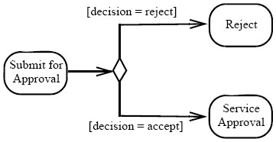
We Learn from Mistakes
Activity Diagram
State Machine
State machines are not activity diagrams and not flowcharts .

Slide 12
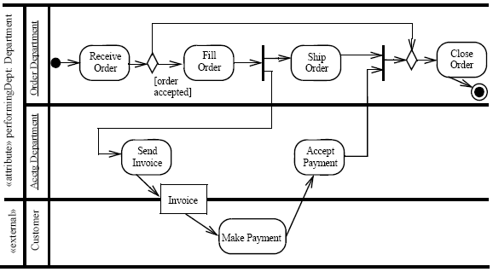
Activity Diagram with Swim Lanes
Too high level as activity diagram .

Slide 13
Interaction
Overview
Diagram
sd Add a new advert to a campaign if within budget
sd List Campaigns for Client
:CampaignManager
getName
:Client
:Campaign
listCampaigns
loop
[For all client’s campaigns]
getCampaignDetails
Too high level as activity diagram
Nodes may be sequence diagrams
Bad UML feature .
ref
Get campaign budget
sd Add costed advert
:CampaignManager
:Campaign
addCostedAdvert
[totalCost <= budget]
[totalCost > budget]
ref
Create advert
ref
Create request

