Slide 1
Object-Oriented Design
Prof. T.H. Tse
Department of Computer Science
Email: thtse@cs.hku.hk
URL: hku.hk/thtse .

Slide 2
Object-Oriented Design
Communication Diagrams
Sequence Diagrams
Use Case Document
Use Case Realization Document
Class
Diagram .

Slide 3
Object-Oriented Design
Categorize design classes into three types
Describe the activities for object-oriented design
Construct communication diagrams, sequence diagrams, state machines, and class diagram
Identify activity diagrams and implementation diagrams .
Notes:
Module B objectives.

Slide 4
Design Classes
Distribute system functionality across three types of classes
Simplifies maintenance, revisions, and visualization of classes .
Notes:
Software Design
4
The approach of using object-oriented techniques for designing a system is referred to as object-oriented design. Recall that object-oriented development approaches are best suited to projects that will implement systems using emerging object technologies to construct, manage, and assemble those objects into useful computer applications. Object-oriented design is the continuation of object-oriented analysis, continuing to center the development focus around object modelling techniques.
During object-oriented design we continue to realize these entity objects while identifying other types of objects that will be introduced as the result of physical implementation decisions for the new system. There are two additional types of objects that will be introduced during design.
The structuring of an object-based system into three types of objects was proposed by Dr. Ivar Jacobson, and is very similar to the mechanism used in Smalltalk programming called model-view-controller (MVC).
534

Slide 5
Design Classes
Entity Classes
  Contain objects that store and manipulate actual data
Boundary Classes
  Contain objects that represent interfaces with the actors
Control Classes
  Contain objects that involve decisions in application processes .
Notes:
Software Design
5
The approach of using object-oriented techniques for designing a system is referred to as object-oriented design. Recall that object-oriented development approaches are best suited to projects that will implement systems using emerging object technologies to construct, manage, and assemble those objects into useful computer applications. Object-oriented design is the continuation of object-oriented analysis, continuing to center the development focus around object modelling techniques.
During object-oriented design we continue to realize these entity objects while identifying other types of objects that will be introduced as the result of physical implementation decisions for the new system. There are two additional types of objects that will be introduced during design.
The structuring of an object-based system into three types of objects was proposed by Dr. Ivar Jacobson, and is very similar to the mechanism used in Smalltalk programming called model-view-controller (MVC).
534

Slide 6
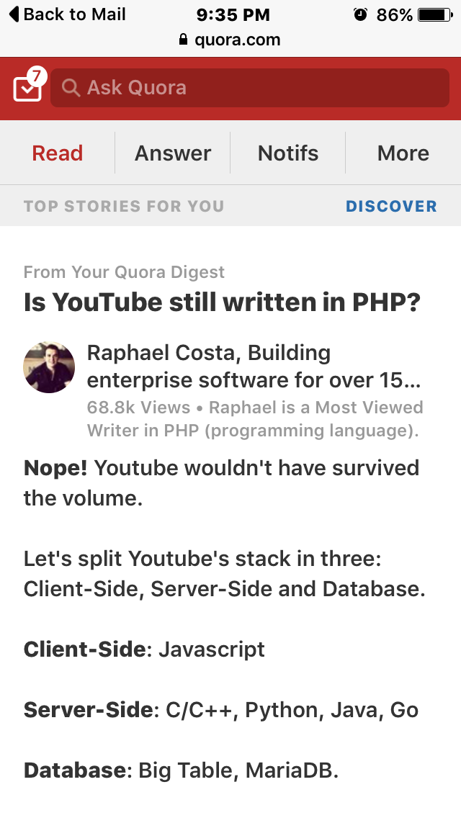
Design Classes
Motivating Example
Is YouTube written in hypertext preprocessor?
No, or else it cannot survive the volume
Client side: Boundary class
Server side: Control class
Database: Entity class.
Notes:
534

Slide 7
Design Classes
Use Cases
Analysis
Classes
Design
Classes
Source
Code
Executable.
Notes:
534

Slide 8
Design Classes
Note: Some authors also categorize analysis classes into 3 types

Slide 9
Design Classes
Entity Classes
Usually contain objects that correspond to items in real life
Encapsulate
  attributes and
  operations that update the attributes
Entity objects are persistent
  They continue to exist between use case executions because the attributes are typically stored in a database, allowing for manipulation and later retrieval .
Notes:
534-535

Slide 10
Design Classes
Entity Classes
Course Registration
Student
Registry
Course Object .

Slide 11
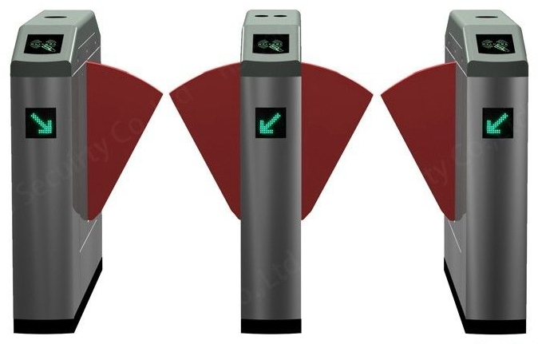
Design Classes
Boundary Classes
Intermediate between the system and the external world
May include user interface, system interface, and device interface
Responsibilities include:
  Translating user input into information that the system can understand and use in business events
  Taking data pertaining to a business event and translating them for appropriate presentation to users
At least one boundary class per actor / use case pair .
Notes:
In some cases the user may need multiple boundary objects. Take for example the ATM machine. Not only is there a display for presenting information, but there is also a card reader, money dispenser, and receipt printer. All of these would be considered boundary objects.
534

Slide 12
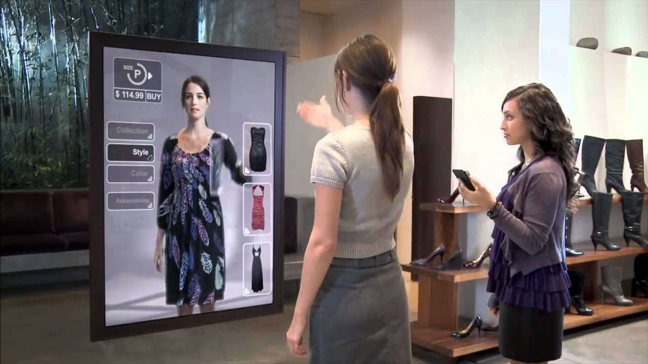
Boundary Class Example
The Future of Shopping
https://www.youtube.com/watch?v=CKnEtjpuEUg
Notes:
Software Design
12
In some cases the user may need multiple boundary objects. Take for example the ATM machine. Not only is there a display for presenting information, but there is also a card reader, money dispenser, and receipt printer. All of these would be considered boundary objects.
534

Slide 13
Design Classes
Boundary Classes
Course Registration
Student
Registry
Internet Window
Intranet Window .

Slide 14
Design Classes
Control Classes
<
Contain behaviour that does not naturally reside in entity or boundary classes
Decouple boundary classes (front end) and entity classes (storage) from one another
Contain the logic or rules of events for directing and managing the interactions among objects
Allow the system to be more tolerant of changes and simplify maintenance
Usually one control class per use case .
Notes:
535

Slide 15
Design Classes
Control Classes
Course Registration
Student
Registry
<
Registration Control .

Slide 16
Communication Diagrams
Entity Class
Control Class .
Boundary Class
Notes:
The diagram above was developed using Popkin Software’s System Architect CASE tool. We draw your attention to the following:
Notice we have included both the actor which “initiated” the use case (the CLUB MEMBER), and the actor who is the direct “user” of the system (the PROMOTION ORDER SPECIALIST). Another actor represented is the WAREHOUSE. The WAREHOUSE is a “receiver”. In this scenario, the warehouse receives the picking ticket information from the system.
Actors may only interact with the system via boundary objects. In our example above, the PROMOTION ORDER SPECIALIST (direct user of the system) interacted with the system by way of the MAIN WINDOW and ORDER PROCESSING WINDOW boundary objects. Notice that the WAREHOUSE (a receiver of the system) interacts with the PICKING TICKET PRINTER boundary object.
By following the logic of the use case we can construct a high level, first-cut view of how the objects need to interact with each other to support the functionality of the use case. Notice that the ORDER PROCESSOR control object sends messages (depicted using arrows) to the MEMBER entity object. Based on the text of the use case, we know that MEMBER information needs to be retrieved, displayed, and updated. Therefore the messages between ORDER PROCESSOR and MEMBER objects requests the MEMBER object to fulfill its object responsibility by providing those services.
Remember at this point the ideal object diagram is our first attempt at determining how the objects should interact with each other to support the business event. At a later step we will use this diagram to model more detailed object interactions.
541-542
1
3
2

Slide 17
Division of Labour: Example 1
Entity Class
Too much control in traditional mainframe systems .
Boundary Class
Notes:
The diagram above was developed using Popkin Software’s System Architect CASE tool. We draw your attention to the following:
Notice we have included both the actor which “initiated” the use case (the CLUB MEMBER), and the actor who is the direct “user” of the system (the PROMOTION ORDER SPECIALIST). Another actor represented is the WAREHOUSE. The WAREHOUSE is a “receiver”. In this scenario, the warehouse receives the picking ticket information from the system.
Actors may only interact with the system via boundary objects. In our example above, the PROMOTION ORDER SPECIALIST (direct user of the system) interacted with the system by way of the MAIN WINDOW and ORDER PROCESSING WINDOW boundary objects. Notice that the WAREHOUSE (a receiver of the system) interacts with the PICKING TICKET PRINTER boundary object.
By following the logic of the use case we can construct a high level, first-cut view of how the objects need to interact with each other to support the functionality of the use case. Notice that the ORDER PROCESSOR control object sends messages (depicted using arrows) to the MEMBER entity object. Based on the text of the use case, we know that MEMBER information needs to be retrieved, displayed, and updated. Therefore the messages between ORDER PROCESSOR and MEMBER objects requests the MEMBER object to fulfill its object responsibility by providing those services.
Remember at this point the ideal object diagram is our first attempt at determining how the objects should interact with each other to support the business event. At a later step we will use this diagram to model more detailed object interactions.
541-542
1
3
2

Slide 18
Division of Labour: Example 2
Too much emphasis on databases .
Control Class .
Boundary Class
Notes:
The diagram above was developed using Popkin Software’s System Architect CASE tool. We draw your attention to the following:
Notice we have included both the actor which “initiated” the use case (the CLUB MEMBER), and the actor who is the direct “user” of the system (the PROMOTION ORDER SPECIALIST). Another actor represented is the WAREHOUSE. The WAREHOUSE is a “receiver”. In this scenario, the warehouse receives the picking ticket information from the system.
Actors may only interact with the system via boundary objects. In our example above, the PROMOTION ORDER SPECIALIST (direct user of the system) interacted with the system by way of the MAIN WINDOW and ORDER PROCESSING WINDOW boundary objects. Notice that the WAREHOUSE (a receiver of the system) interacts with the PICKING TICKET PRINTER boundary object.
By following the logic of the use case we can construct a high level, first-cut view of how the objects need to interact with each other to support the functionality of the use case. Notice that the ORDER PROCESSOR control object sends messages (depicted using arrows) to the MEMBER entity object. Based on the text of the use case, we know that MEMBER information needs to be retrieved, displayed, and updated. Therefore the messages between ORDER PROCESSOR and MEMBER objects requests the MEMBER object to fulfill its object responsibility by providing those services.
Remember at this point the ideal object diagram is our first attempt at determining how the objects should interact with each other to support the business event. At a later step we will use this diagram to model more detailed object interactions.
541-542
1
3
2

Slide 19
Division of Labour: Example 3
Entity Class
Too much emphasis on modern interfaces .
Control Class .
Notes:
The diagram above was developed using Popkin Software’s System Architect CASE tool. We draw your attention to the following:
Notice we have included both the actor which “initiated” the use case (the CLUB MEMBER), and the actor who is the direct “user” of the system (the PROMOTION ORDER SPECIALIST). Another actor represented is the WAREHOUSE. The WAREHOUSE is a “receiver”. In this scenario, the warehouse receives the picking ticket information from the system.
Actors may only interact with the system via boundary objects. In our example above, the PROMOTION ORDER SPECIALIST (direct user of the system) interacted with the system by way of the MAIN WINDOW and ORDER PROCESSING WINDOW boundary objects. Notice that the WAREHOUSE (a receiver of the system) interacts with the PICKING TICKET PRINTER boundary object.
By following the logic of the use case we can construct a high level, first-cut view of how the objects need to interact with each other to support the functionality of the use case. Notice that the ORDER PROCESSOR control object sends messages (depicted using arrows) to the MEMBER entity object. Based on the text of the use case, we know that MEMBER information needs to be retrieved, displayed, and updated. Therefore the messages between ORDER PROCESSOR and MEMBER objects requests the MEMBER object to fulfill its object responsibility by providing those services.
Remember at this point the ideal object diagram is our first attempt at determining how the objects should interact with each other to support the business event. At a later step we will use this diagram to model more detailed object interactions.
541-542
1
3
2

Slide 20
Object-Oriented Design Process
Realize use case model to reflect implementation environment
Model object interactions and behaviour that support use case scenarios
Update class diagram to reflect implementation environment.
Notes:
In performing Object Oriented Analysis (OOA) we identified objects and use cases based on ideal conditions and independent of any hardware or software solution. During Object Oriented Design (OOD) we want to realize those objects and use cases to reflect the actual environment of our proposed solution.
536

Slide 21
Object-Oriented Design Process
Realize use case model to reflect implementation environment
Model object interactions and behaviour that support use case scenarios
Update class diagram to reflect implementation environment.
Notes:
In performing Object Oriented Analysis (OOA) we identified objects and use cases based on ideal conditions and independent of any hardware or software solution. During Object Oriented Design (OOD) we want to realize those objects and use cases to reflect the actual environment of our proposed solution.
536

Slide 22
Realizing the Use Case Model to Reflect the Implementation Environment
Realize the use cases to include details of how the actor will actually interact with the system and how the system will respond
This process is essential because
  The details will be necessary for program implementation
  The details will also be necessary for preparing user manuals and test scripts
  They may help to discover new use cases .
Notes:
In this iteration of use case modelling, the use cases will be realized to include details of how the actor (or user) will actually interface with the system and how the system will respond to that stimulus to process the business event.
The manner in which the user accesses the system; via a menu, window, button, bar code reader, printer, etc. should be explicitly described in detail. The contents of windows, reports, and queries should also be specified within the use case. While refining use cases are often time consuming and tedious, it is essential that they are completed.
536

Slide 23
Realizing the Use Case Model to Reflect the Implementation Environment
Step 1. Transform “Analysis” Use Cases to “Design” Use Cases
Realize every analysis use case to reflect implementation environment
Keep the analysis use cases separate from the design use cases, to allow reusing use cases for changes in implementation .
Notes:
It is important that each use case be highly detailed in describing the user interaction with the system. These realized use cases can be used by the user to validate system design and by the programmer for process and interface specifications.
Each realized use case should be labeled as a design use case to distinguish it from the analysis version previously completed. We want to keep the original analysis use cases separate from the realized design use cases to allow maximum flexibility in reusing use cases for variations of different physical implementations.
536-537

Slide 24
Realizing the Use Case Model to Reflect the Implementation Environment
Use Case Model
Design Model
<<realizes>>
Use Case
Realized Use Case .

Slide 25
Realizing the Use Case Model to Reflect the Implementation Environment
Use Case Model
Design Model
<<realizes>>
Use Case Document
Use Case Realization Document .

Slide 26
Realizing the Use Case Model to Reflect the Implementation Environment
Notes:
536-537

Slide 27
Analysis Use Case
Author: S. Shepherd Date: 01/07/2047
Use Case Name Place Member Order
Actor(s) Member, warehouse
Description Describes the process of a member submitting an order for SoundStage products.
Reference MSS-1.0
Normal Course
of Events
Actor Action
Step 1. Initiate this use case when a member submits an order.
System Response
Step 2. Validate member’s personal information such as address against what is currently on file.
Step 3. Check member’s credit status with accounts department system to ensure no outstanding payment.
Step 4. For each product ordered, validate the product number, check availability in inventory, and record the ordered product information such as quantity ordered.
Step 5. Calculate order subtotal and sales tax.
Step 6. Verify member’s credit card information based on the amount due.
Step 7. Create packing slip for the member order containing all ordered products available and route it to warehouse.
Step 8. Generate order confirmation notice indicating the status of the order and send it to the member.
Step 9. Conclude this use case when the member receives the
order confirmation notice.
Notes:
Teaching Notes
The above figure was initially presented in Chapter 6.
1. A reference to the requirement(s) in which it can be traced to.
2. A typical event course describing the use case’s major steps, from beginning to end of this interaction with the actor.
3. Alternative courses describing exceptions to the typical course of events.
4. Precondition describing the state the system is in before the use case is executed.
5. Postcondition describing the state the system is in after the use case is executed.
6. An assumptions section, which includes any non-behavioural issues, such as performance or security, that is associated with the use case, but is difficult to model within the use case’s course of events.

Slide 28
Analysis Use Case
Alternative
Courses
Alt. Step 2A. If member has indicated an address change in the order, update the member’s
record.
Alt. Step 3A. If accounts department system returns a credit status that the member is in arrears, send order rejection notice to the member.
Alt. Step 4A. If product number is invalid, send notification to member requesting them to resubmit product number. If the ordered product is not available, record the product information and mark as “back order”.
Alt. Step 6. If member’s credit card information is invalid or if member is in arrears, send credit problem notice to member. Modify the order’s status to “on hold pending payment”.
Pre-Condition Member has logged in.
Post-Condition Member order has been recorded and packing slip has been routed to warehouse.
Assumption None at this time.
Notes:
Teaching Notes
The above figure was initially presented in Chapter 6.
1. A reference to the requirement(s) in which it can be traced to.
2. A typical event course describing the use case’s major steps, from beginning to end of this interaction with the actor.
3. Alternative courses describing exceptions to the typical course of events.
4. Precondition describing the state the system is in before the use case is executed.
5. Postcondition describing the state the system is in after the use case is executed.
6. An assumptions section, which includes any non-behavioural issues, such as performance or security, that is associated with the use case, but is difficult to model within the use case’s course of events.

Slide 29
Transform into Design Use Cases
Author: Pat Chan
Date: 01/07/2047
Use Case Name
Actor(s)
Description
Reference
Typical Course of Events
Place Member Order
Member + Order Specialist
Describes the process of a member submitting an order for SoundStage products.
MSS-1.1
Actor Action
The main window is currently displayed on the screen waiting for the order specialist to select a menu option.
Step 1. Initiate this use case when an order is received from the member and the order specialist selects the option ⟨Place Member Order⟩.
Step 3. The order specialist enters Member No. and clicks ⟨OK⟩.
System Response
Step 2. Display a dialogue window requesting Member No. be entered.
Step 4. Verify whether the Member No. is valid. If so, display a member dialogue window with the following information: Member Name, Member Status, Member Street Address, Member P.O. Box, Member City, Member State, Member Zip, Member Daytime Phone Number, and Member Email Address, along with a menu button labeled ⟨Update Member⟩. Also display two read-only windows containing order related fields (initially blank). The first window contains Order Number, Order Creation Date, Subtotal Cost, Sales Tax, and Order Status. The second window contains the individual ordered products. This is a multi-lined, scrollable window containing Product Number, Description, Quantity Available, Quantity Ordered, Quantity Backordered, Suggested Retail Price, Purchased Unit Price, Extended Cost, and Credits Earned.
Notes:
Software Design
29
Teaching Notes
Notice we have included an entry that specifies the system user. In analysis, we concentrated on the actor — the party that initiates the business event. In design, we begin to think in terms of “how” the business event is accomplished and by whom. Thus we are concerned with identifying the party or “system user” that is involved in processing the business event or interacting with the system. In some cases, the actor and the system user may actually be the same person.
In this implementation of the system, the actor, “club member,” is not the party directly using the system. The club member simply triggers the business event by supplying information to the “promotion order specialist” who then enters it into the system. The system could be designed to allow club members to input their orders themselves (via a World Wide Web page or an automated phone system), thus participating as direct system users.
Notice that step 2 now describes the windows which will be displayed to the user, and the contents (i.e., field names) of the windows.
Descriptions of, error messages, special action buttons, possible cursor movements, and other window characteristics should be included in each design use case step.

Slide 30
Transform into Design Use Cases
Typical Course of Events
Step 5. The order specialist checks whether the member has made any address or phone number changes on the order. If changes have been made the order specialist clicks the ⟨Update Member⟩ menu button to invoke use case Revise Street Address. Otherwise, the order specialist clicks ⟨Enter Ordered Product⟩ menu button.
Step 7. The order specialist enters the Product No. of the item being ordered and then clicks ⟨Enter⟩.
Step 9. The order specialist enters the Quantity Ordered and a Purchase Unit Price if it differs from the Suggested Retail Price and clicks ⟨Enter⟩. If Purchase Unit Price is not entered it will default to the Suggested Retail Price.
Step 12. If the order specialist clicks ⟨Yes⟩, go back to Step 5.
Step 6. Display a dialogue window prompting the user to enter the Product No.
Step 8. Validate Product No. and retrieve and display the Description, Credit Value, Quantity In Stock, and Suggested Retail Price. Then, advance the cursor to the Quantity Ordered field.
Step 10. Validate the inputs and then calculate the new Extended Cost by multiplying the Purchase Unit Price by the Quantity Ordered. If the Quantity Ordered is greater than the Quantity in Stock, calculate Quantity Backordered by subtracting Quantity in Stock from Quantity Ordered. Display all fields in the ordered product read-only window.
Step 11. Display a window with the message “Is the Ordered Product Information Correct?” If so, display another window with the message “Additional Products to be Entered?” Otherwise, go to Step 7.
Step 13. Assign a unique Order No. and an Order Status of “O”, and then calculate Order Subtotal and Order Sales Tax by invoking use case Calculate Order Subtotal and Sales Tax. Display all fields in the Order read-only window and then display a message “Commit Order?” with ⟨Yes⟩ and ⟨Cancel⟩ buttons.
Notes:
Software Design
30
Teaching Notes
The design use case step includes references to extension and abstract use cases. Recall that extension use cases extend the functionality of the original use case by extracting complex or hard to understand logic into its own use case. Abstract use cases are those that contain steps that are used by more than one design use case.

Slide 31
Transform into Design Use Cases
Typical Course of Events
Step 14. The order specialist clicks ⟨Yes⟩.
Step 17. This use case concludes when the system displays a message “Order N has been processed successfully. Would you like to enter another one?” If the order specialist clicks ⟨Yes⟩ the use case is repeated. If the order specialist clicks ⟨No⟩, display the main system window.
Step 15. Reduce the Quantity in Stock by the Quantity Ordered for each product being ordered (replacing any negative result with zero) and then save all entries. Then, verify the member’s status and creditworthiness by invoking use case Verify Member Status.
Step 16. Generate a packing order by invoking use case Generate Warehouse Packing Slip and generate an order confirmation notice indicating the status of the order by invoking use case Generate Order Confirmation Notice. If there are invalid entries submitted by the member, invoke use case Generate Order Error Report.
Alternate Courses
Alt. Step 4A. If the Member No. is invalid, display a window with the error message “Member Number Not on File”. The order specialist can then re-enter the number or cancel the transaction.
Alt. Step 8A. If the Product No. is invalid, display a window with the error message “Product Number not Valid”. The order specialist either corrects the entry or advances to the next entry. In a later step, generate an error report for any invalid entries.
Alt. Step 10A. If the Quantity Ordered or Purchase Unit Price is invalid, highlight the field(s) in error and then display a window with the error message “Highlighted fields invalid”. The order specialist either corrects the entry or advances to the next entry. In a later step, generate an error report for any invalid entries.
Alt. Step 13A. If any of the products being ordered is not available, record the order status as “P” (for partially filled).
Alt. Step 16A. If member’s credit card information is invalid or if the member is found to be in arrears, send a credit problem notice to the member. Modify the order’s status to “H” (for on-hold pending payment). Exit transaction.
Order specialist has logged on the system and has authorization for this transaction. The main window is currently displayed on the screen.
Member order has been recorded, the Packing Order has been routed to the Warehouse, and a confirmation notice has been generated and sent to the member.
None at this time.
Precondition
Postcondition
Assumptions
Notes:
Software Design
31
No additional notes

Slide 32
Example 1
Before Design
Step 2. Validate the member’s personal information such as address against what is currently recorded on file .
32

Slide 33
Example 1
After Design
Step 2. Display a dialogue window requesting Member No. be entered
Step 3. The order specialist enters Member No. and clicks ⟨OK ⟩

Slide 34
Example 1
After Design
Step 4. Verify whether Member No. is valid. If so, display a member dialogue window with the following information: Member Name, Member Status, Member Street Address, Member PO Box, Member City, Member State, Member Zip, Member Daytime Phone Number, and Member Email Address, along with a menu button labeled ⟨Update Member⟩

Slide 35
Example 1
After Design
Step 4. ...
Also display two windows containing order-related fields (initially blank). The first window contains Order Number, Order Creation Date, Subtotal Cost, Sales Tax, and Order Status. The second window contains the individual ordered products. This is a multi-lined, scrollable window containing Product Number, Description, Quantity Available, Quantity Ordered, Quantity Backordered, Suggested Retail Price, Purchased Unit Price, Extended Cost, and Credits Earned

Slide 36
Example 1
After Design
Step 5. The order specialist checks to see if the member has made any address or phone number changes on the order. If changes have been made, the order specialist clicks the ⟨Update Member⟩ menu button to invoke use case Revise Street Address. Otherwise, the order specialist clicks ⟨Enter Ordered Product⟩ menu button.

Slide 37
Example 1
Use Precise Technical Terms
Traditional Mouse
Click = press and release
Double click = click and click
Move = move pointer without pressing
Drag = move pointer with pressing .

Slide 38
Example 1
Use Precise Technical Terms
Touchscreen
Tap = touch and lift finger
Double tap = tap and tap
Pinch = touch the screen with 2 fingers and move them closer together
Spread = touch the screen with 2 fingers and move them apart .

Slide 39
Example 2: Web Design
Before Design
Display the web page responsively
Fits desktop and mobile devices, all platforms, all screen sizes, and landscape and portrait modes .
39

Slide 40
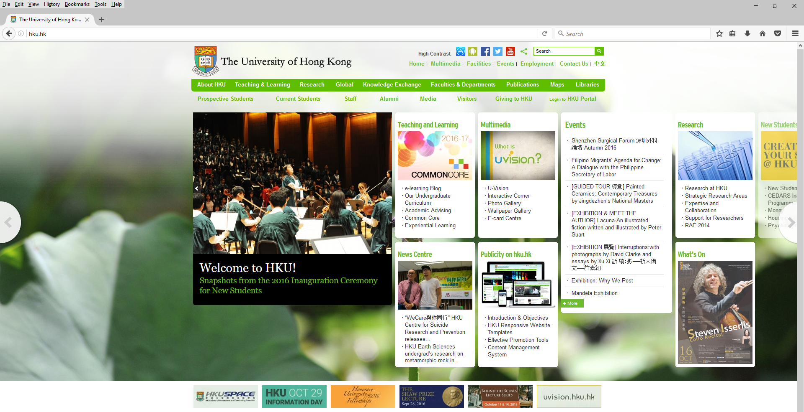
After Design
Desktop Version
Notes:
Software Design
40
In some cases the user may need multiple boundary objects. Take for example the ATM machine. Not only is there a display for presenting information, but there is also a card reader, money dispenser, and receipt printer. All of these would be considered boundary objects.
534

Slide 41
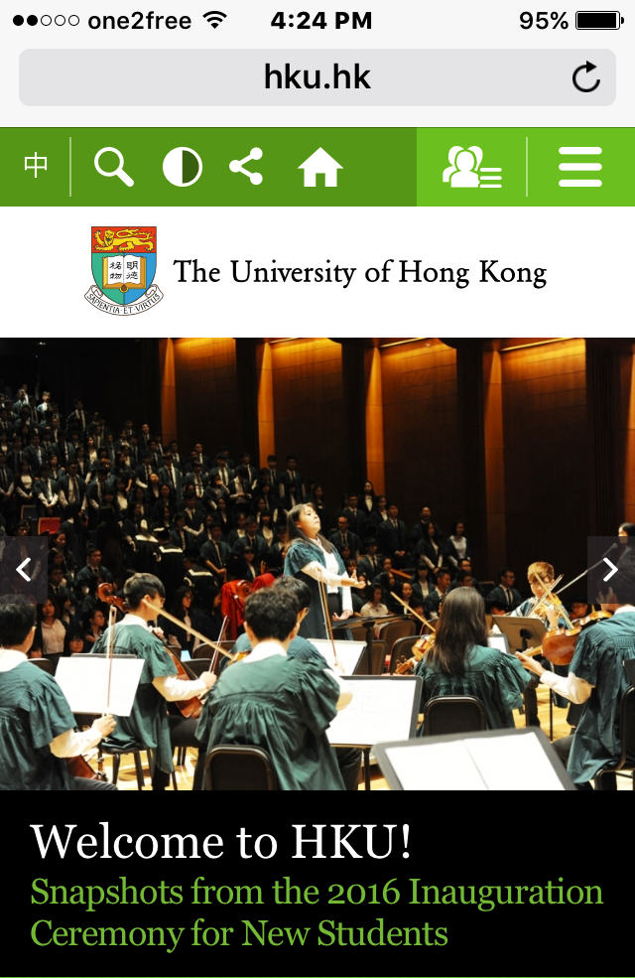

After Design iPhone Portrait Version
Notes:
Software Design
41
In some cases the user may need multiple boundary objects. Take for example the ATM machine. Not only is there a display for presenting information, but there is also a card reader, money dispenser, and receipt printer. All of these would be considered boundary objects.
534

Slide 42


After Design iPhone Landscape Version
Notes:
Software Design
42
In some cases the user may need multiple boundary objects. Take for example the ATM machine. Not only is there a display for presenting information, but there is also a card reader, money dispenser, and receipt printer. All of these would be considered boundary objects.
534

Slide 43
Example 3
Before Design
Enter user name and password .
43

Slide 44
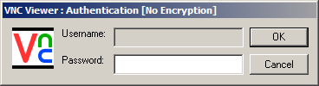
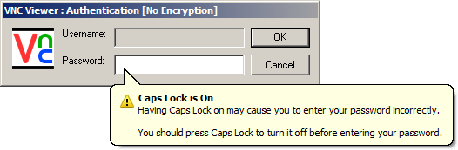
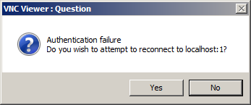
Example 3
After Design
.
44

Slide 45
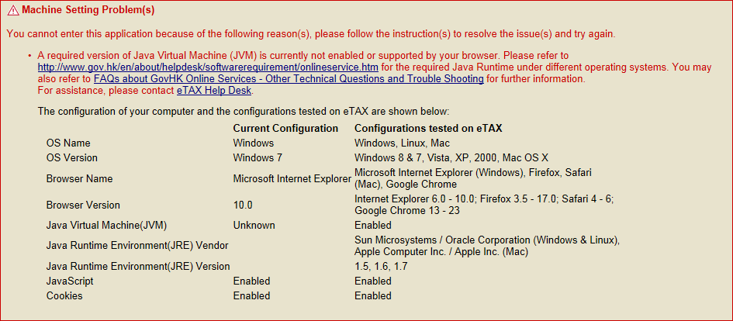
Example 4: Machine Setting Problems
After Design
Notes:
Software Design
45
In some cases the user may need multiple boundary objects. Take for example the ATM machine. Not only is there a display for presenting information, but there is also a card reader, money dispenser, and receipt printer. All of these would be considered boundary objects.
534

Slide 46
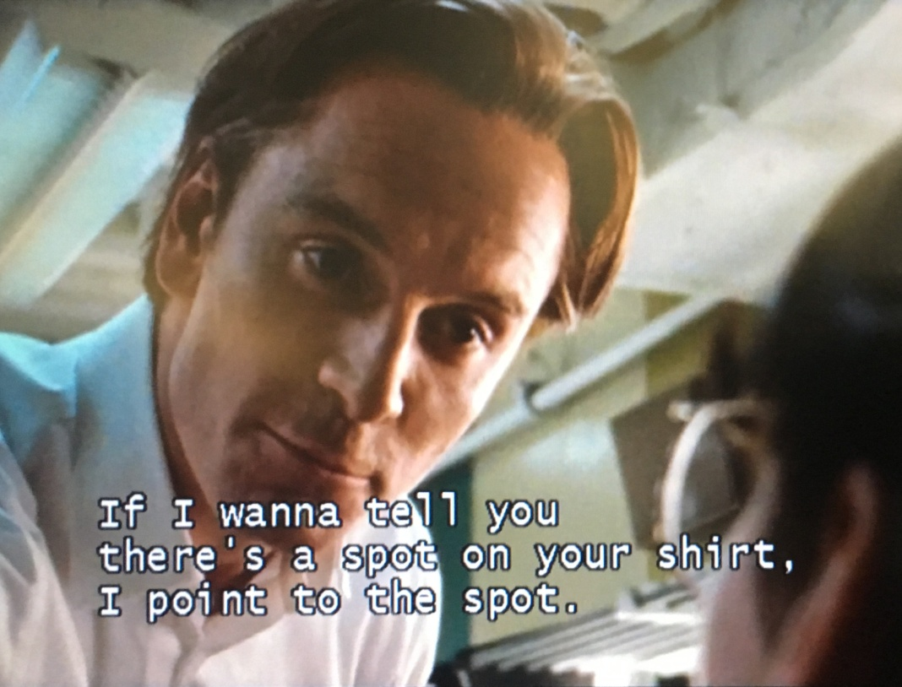
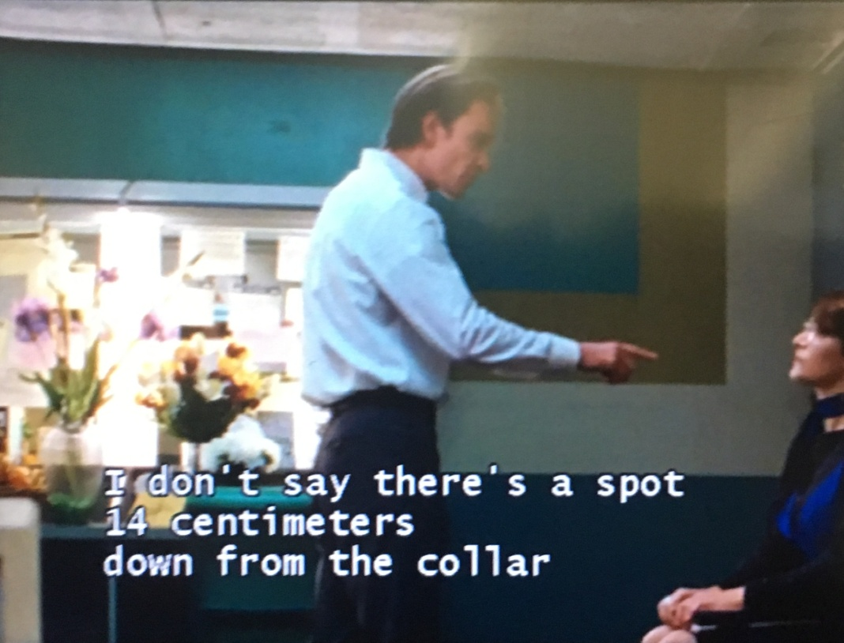
Example 5: Graphical Interface
Design by Steve Jobs
Notes:
Software Design
46
In some cases the user may need multiple boundary objects. Take for example the ATM machine. Not only is there a display for presenting information, but there is also a card reader, money dispenser, and receipt printer. All of these would be considered boundary objects.
534

Slide 47
Example 6: The Future of Shopping
Design by Cisco
Notes:
Software Design
47
In some cases the user may need multiple boundary objects. Take for example the ATM machine. Not only is there a display for presenting information, but there is also a card reader, money dispenser, and receipt printer. All of these would be considered boundary objects.
534

Slide 48
The Role of a Designer iPhone Example
We need a larger screen
The users need a larger screen
Let’s design a larger phone
Yes, sir!
I propose a new design without the home button .
User
Analyst
Lead
Designer
Junior
Designer A
Junior
Designer B

Slide 49
We Learn from Mistakes
Customer Profile
User Requirement
  The system asks for a customer profile, including such entries as the date of birth, the annual household income, and the number of years of investment experience
Analysis Use Case
Step 3. The system asks for a customer profile
Design Use Case
Step 3. The system asks for a customer profile, which captures the Date of Birth, Annual Household Income, and No. of Years of Investment Experience .

Slide 50
Realizing the Use Case Model to Reflect the Implementation Environment
Step 2. Update Use Case Diagram and other Documentation to Reflect any new Use Cases
Update
  the use case model diagram and
  the actor and use case glossaries
to reflect any new information introduced in step 1 .
Notes:
539

Slide 51

Is the Design Final?
Example:
Rewrite the entire system?
How can object classes help? .
Notes:
Software Design
51
539

Slide 52
Object-Oriented Design Process
Realize use case model to reflect implementation environment
Model object interactions and behaviour that support use case scenarios
Update class diagram to reflect implementation environment .
Notes:
In performing Object Oriented Analysis (OOA) we identified objects and use cases based on ideal conditions and independent of any hardware or software solution. During Object Oriented Design (OOD) we want to realize those objects and use cases to reflect the actual environment of our proposed solution.
536

Slide 53
Model Object Interactions and Behaviour that Support Use Case Scenarios
Identify and categorize the design classes required by the functionality specified in each use case, and identify object interactions, responsibilities, and behaviour .
Notes:
539-540

Slide 54
Model Object Interactions and Behaviour that Support Use Case Scenarios
Step 1. Identify and Categorize Design Classes
Examine each design use case to identify and categorize the classes into 3 types (boundary, control, and entity)
Recall:
.
Notes:
539-540

Slide 55
Boundary, Control, and Entity Classes
BOUNDARY CLASSES
CONTROL CLASSES
ENTITY CLASSES
Member Services Main Window
Order Processor
Member
Member Dialogue Window
Packing Slip Generator
Member Order
Order Processing Main Window
Product
Member Order Window
Product Ordered
Product Ordered Window
Product Dialogue Window
Message Window
Warehouse Printer
Notes:
The boundary object column contains a list of objects mentioned in the use case that that the users directly interface with, such as: screens, windows, card readers, and printers. The only way an actor or user can interface with a system is via an boundary object. Therefore, there should be at least one boundary object per actor or user.
The control object column contains a list of objects that encapsulate application logic or business rules. As a reminder, a use case should reveal one control object per unique user or actor.
The entity object column contains a list of objects that correspond to the business domain objects whose attributes were referenced in the use case.
540
1
3
2

Slide 56
Model Object Interactions and Behaviour that Support Use Case Scenarios
Step 2. Identify Attributes
During analysis, some attributes may have been discovered
Examine each use case for additional attributes that have not yet been identified, and update the class diagram to include such attributes.
Notes:
541

Slide 57
Model Object Interactions and Behaviour that Support Use Case Scenarios
Step 3. Model High-Level Object Interactions
For each use case, create a communication diagram to model high-level interactions of design objects
Include actors, boundary, control, and entity objects, as well as messages among objects .
Notes:
541

Slide 58
Model Object Interactions and Behaviour that Support Use Case Scenarios
Step 3. Model High-Level Object Interactions
Use Case Realization Document
Communication Diagram .
Notes:
541

Slide 59
Communication Diagram
Example
3. confirm
(Cust,
Acct)
Customer
1. debitRequest
(Cust,
Acct, X)
2. debitSummary
(Cust,
Acc, X)
Account
Control
4. ok
8. ack
(Cust,
Acct, X) .
Atm
7. displayAck
(Cust,
Acct, X)
Bank
Customer
Account
5. debit
(Acct, X)
6. done
Notes:
541

Slide 60
We Learn from Mistakes
Professor
Student Record
Student Record
Professor
PG Student Record
Timer
Timer
PG Student Record
Professor
Student Record
Analysis Use Case
Diagram
Communication Diagram .
Timer
PG Student Record
Class Diagram
60

Slide 61
Model Object Interactions and Behaviour that Support Use Case Scenarios
Step 4. Identify Behaviour
Tasks include:
  4.1 Examine use case descriptions to identify behaviour
  4.2 Examine class diagram for additional behaviour
  4.3 Associate behaviour with class types
  4.4 Verify the results .
Notes:
543

Slide 62
Model Object Interactions and Behaviour that Support Use Case Scenarios
Step 4. Identify Behaviour
Task 4.1 Examine use case descriptions to identify behaviour
For each use case description, highlight all action verb phrases
They represent actor or system behaviour, which are potential methods .
Notes:
543

Slide 63
Identify Behaviour
Author: Pat Chan Date: 01/07/2047
Use Case Name
Actor(s)
Description
Reference
Typical Course of Events
Place Member Order
Member + Order Specialist
This use case describes the process of a member submitting an order for SoundStage products.
MSS-1.1
Actor Action
The main window is currently displayed on the screen waiting for the order specialist to select a menu option.
Step 1. Initiate this use case when an order is received from the member and the order specialist selects the option “Submit Member Order”.
Step 3. The order specialist enters Member No. and clicks ⟨OK⟩.
System Response
Step 2. Display a dialogue window requesting Member No. be entered.
Step 4. Verify whether the Member No. is valid. If so, display a member dialogue window with the following information: Member Name, Member Status, Member Street Address, Member P.O. Box, Member City, Member State, Member Zip, Member Daytime Phone Number, and Member Email Address, along with a menu button labeled ⟨Update Member⟩. Also display two read-only windows containing order related fields (initially blank). The first window contains Order Number, Order Creation Date, Subtotal Cost, Sales Tax, and Order Status. The second window contains the individual ordered products. This is a multi-lined, scrollable window containing Product Number, Description, Quantity Available, Quantity Ordered, Quantity Backordered, Suggested Retail Price, Purchased Unit Price, Extended Cost, and Credits Earned.
Notes:
Software Design
63
Teaching Notes
Notice we have included an entry that specifies the system user. In analysis, we concentrated on the actor — the party that initiates the business event. In design, we begin to think in terms of “how” the business event is accomplished and by whom. Thus we are concerned with identifying the party or “system user” that is involved in processing the business event or interacting with the system. In some cases, the actor and the system user may actually be the same person.
In this implementation of the system, the actor, “club member,” is not the party directly using the system. The club member simply triggers the business event by supplying information to the “promotion order specialist” who then enters it into the system. The system could be designed to allow club members to input their orders themselves (via a World Wide Web page or an automated phone system), thus participating as direct system users.
Notice that step 2 now describes the windows which will be displayed to the user, and the contents (i.e., field names) of the windows.
Descriptions of, error messages, special action buttons, possible cursor movements, and other window characteristics should be included in each design use case step.

Slide 64
Model Object Interactions and Behaviour that Support Use Case Scenarios
Task 4.2 Examine class diagram for additional behaviour
Use case descriptions may not reveal all behaviour
Associate each class with CRUD behaviour:
  Create a new object
  Read attribute values of an object
  Update attribute values of an object
  Delete an object .
Notes:
Reference figure 16.4 on slide 21, and draw your attention to the relationship between MEMBER ORDER and MEMBER ORDERED PRODUCT. By designing the system to have the MEMBER ORDER object have a behaviour to “add ordered product”, we have effectively given the MEMBER ORDER object control to create this relationship.
545

Slide 65
Model Object Interactions & Behaviour that Support Use Case Scenarios
Task 4.2 (continued)
Moreover, an object may not be able to do everything by itself
Need collaboration by communicating with other objects
Examine use case scenarios and communication diagrams to find interactions .
Notes:
544

Slide 66
Model Object Interactions & Behaviour that Support Use Case Scenarios
Task 4.2 (continued)
Notes:
544

Slide 67
Model Object Interactions & Behaviour that Support Use Case Scenarios
Task 4.2 (continued)
Make full use of encapsulation
Example: debit (amount)
  Pass “old balance” and “new balance” between calling and called objects ??
  Implement the method in calling object ??
  Pass message “debit(amount)” to called object
  Implement the method in called object .
Notes:
544

Slide 68
Model Object Interactions & Behaviour that Support Use Case Scenarios
Task 4.3 Associate behaviour with class types
For each identified behaviour, determine whether it is manual or automated
If automated, associate it with appropriate class type .
Notes:
544

Slide 69
Behaviour and Responsibilities
BEHAVIOUR
AUTOMATED/MANUAL
CLASS TYPE
Display dialogue window for Member No.
Enter Member No.
Click ⟨OK⟩
Verify Member No.
Display club member dialogue window
Display blank order window
Display blank member ordered products window
Check address and phone no. change
Click ⟨Update Member⟩ menu button
Click ⟨Enter Ordered Product⟩ menu button
Display dialogue window for Product No.
Enter Product No.
Click ⟨Enter⟩
Validate Product No.
Display product details
Enter inputs
Click ⟨Enter⟩
Validate inputs
Calculate Extended Cost
Calculate Quantity Backordered
Compare Quantity Ordered with Quantity in Stock
Calculate Quantity Backordered
Displays member ordered product window
Display ordered product confirmation window
Display dialogue window for additional products
Assign unique Order No. and Order Status of “O”
Display order window
Automated
Manual
Manual
Automated
Automated
Automated
Automated
Manual
Manual
Manual
Automated
Manual
Manual
Automated
Automated
Manual
Manual
Automated
Automated
Automated
Automated
Automated
Automated
Automated
Automated
Automated
Automated
Boundary
Entity
Boundary
Boundary
Boundary
Boundary
Entity
Boundary
Entity
Entity
Entity
Control
Entity
Boundary
Boundary
Boundary
Control
Boundary
Notes:
Software Design
69
Teaching Notes
Our first task in identifying the object behaviour and responsibilities is accomplished by examining each use case description to identify all action verb phrases.
Action verb phrases suggest behaviour required to complete a use case scenario.

Slide 70
Condensed Behaviour List
BEHAVIOUR
CLASS TYPE
Verify Member No.
Validate Product No.
Validate inputs
Calculate Extended Cost
Calculate Quantity Backordered
Calculate Quantity Backordered
Display club member dialogue window
Display blank order window
Display blank member ordered products window
Display dialogue window for Member No.
Display dialogue window for Product No.
Display product details
Displays member ordered product window
Display ordered product confirmation window
Display dialogue window for additional products
Display order window
Compare Quantity Ordered with Quantity in Stock
Assign unique Order No. and Order Status of “O”
Entity
Entity
Entity
Entity
Entity
Entity
Boundary
Boundary
Boundary
Boundary
Boundary
Boundary
Boundary
Boundary
Boundary
Boundary
Control
Control
Notes:
Software Design
70
Teaching Notes
Our first task in identifying the object behaviour and responsibilities is accomplished by examining each use case description to identify all action verb phrases.
Action verb phrases suggest behaviour required to complete a use case scenario.

Slide 71
Model Object Interactions & Behaviour that Support Use Case Scenarios
Task 4.4 Verify the results
Walkthrough with relevant users
Or, through role playing
  Human participants play the roles of actors or objects
  Simulate messages by passing items (such as a ball) among participants .
Notes:
Role playing is quite effective in discovering missing objects and behaviour, as well as verifying the collaboration among objects.
547

Slide 72
Model Object Interactions & Behaviour that Support Use Case Scenarios
Step 5. Model Detailed Object Interactions
Use Case Realization Document
Sequence Diagram(s)
State Machine(s) .
Notes:
547

Slide 73
Model Object Interactions & Behaviour that Support Use Case Scenarios
Step 5. Model Detailed Object Interactions
For each use case, construct sequence diagram(s) showing how the objects will interact to support the scenarios
For each class, construct a state machine .
Notes:
547

Slide 74
Sequence Diagrams
Notes:
Teaching Notes
The UML offers two types of diagrams (Sequence and Communication) to model detailed object interactions.
The figure above is read from top to bottom, following the logic of the use case. Each object referenced in the use case is symbolized by a vertical line. The behaviour or operations which each object needs to fulfill an obligation is represented by a box. These boxes represent program code. The arrows between the lines represent interactions or messages being sent to a particular object to invoke one of its operations to satisfy a request.

Slide 75
State Machines
trigger1 / effect1
trigger2 / effect2
Notes:
Teaching Notes
The UML offers two types of diagrams (Sequence and Collaboration) to model detailed object interactions.
The figure above is read from top to bottom, following the logic of the use case. Each object referenced in the use case is symbolized by a vertical line. The behaviour or operations which each object needs to fulfill an obligation is represented by a box. These boxes represent program code. The arrows between the lines represent interactions or messages being sent to a particular object to invoke one of its operations to satisfy a request.

Slide 76
Object-Oriented Design Process
Realize use case model to reflect implementation environment
Model object interactions and behaviour that support use case scenarios
Update class diagram to reflect implementation environment .
Notes:
In performing Object Oriented Analysis (OOA) we identified objects and use cases based on ideal conditions and independent of any hardware or software solution. During Object Oriented Design (OOD) we want to realize those objects and use cases to reflect the actual environment of our proposed solution.
536

Slide 77
Update Class Diagram to Reflect Implementation Environment
Use Case Realization Document
Class Diagram .
Notes:
547

Slide 78
Update Class Diagram to Reflect Implementation Environment
Refine the class diagram to include behaviour or methods
  Give a unique name to every behaviour or method
    Normally the names reflect the naming convention in system implementation .
Notes:
547

Slide 79
Analysis Class Diagram
Excerpt for Lecture
Customer
Customer Number
Customer Name
Customer Status
Customer Street Address
Customer PO Box
Customer City
Customer State
Customer Zip Code
Product
Member
Product-Number
Member-Date-Of-Last-Order
Universal Product Code
Has purchased
Member-Daytime-Phone-Number
Quantity In Stock
Member-Credit-Card-Expire-Date
Product Type
Member-Credit-Card-Number
Suggested Retail Price
Sold as
1
Member-Credit-Card-Type
Default Unit Price
1
Member-Balance-Due
Current Special Unit Price
Member-Bonus-Balance-Available
Current Month Units Sold
0..*
Audio-Category-Preference
Current Year Units Sold
Audio-Media-Preference
Total Lifetime Units Sold
Date-Enrolled
Product Ordered
Email-Address
Transaction
Game-Category-Preference
Quantity Ordered
Game-Media-Preference
Transaction Reference Number
Quantity Shipped
Number-Of-Credits-Earned
Transaction Date
Quantity Backordered
Privacy-Code
Conducts
Transaction Type
Purchase Unit Price
Video-Category-Preference
Transaction Description
Credits Earned
Video-Media-Preference
1
0..*
Transaction Amount
0..*
1..*
1
Title
Title Of Work
Title Cover
Member Order
Catalog Description
Copyright Date
Order-Number
Entertainment Company
Order-Creation-Date
Credit Value
Order-Fill-Date
Shipping-Address-Name
Places
0..*
Shipping-Street-Address
Shipping-City
Shipping-State
Shipping-Zip-Code
Shipping-Instructions
Sells
Order-Sub-Total
Order-Sales-Tax
Order-Shipping-Method
Order-Shipping-&-Handling-Cost
1
Order-Status
Order-Prepaid-Amount
Order-Prepayment-Method
Notes:
Teaching Notes
By examining the class diagram, you may find additional behaviour (not mentioned in the use case scenarios) that need to be assigned to an object type.
Analyze the relationships between any two objects. How are those relationships created or deleted? Which object should be assigned that responsibility? As a general rule, the object that controls the relationship should be responsible for creating or deleting the relationship.
In the figure above draw your attention to the relationship between MEMBER ORDER and MEMBER ORDERED PRODUCT. By designing the system to have the MEMBER ORDER object have the behaviour to “add ordered product,” we have effectively given the MEMBER ORDER object control to create this relationship.

Slide 80
Design Class Diagram
Excerpt for Lecture
Member
Customer Number
Customer Name
Customer Status
Customer Street Address
Customer PO Box
Customer City
Customer State
Methods
Customer Zip Code
New (design) classes .
Product
Member
Product Number
Member Date Of Last Order
Universal Product Code
Member Daytime Phone Number
Quantity In Stock
Has purchased
Member Credit Card Expire Date
Product Type
Member Credit Card Number
Suggested Retail Price
Member Credit Card Type
Default Unit Price
1
Member Balance Due
Current Special Unit Price
Member Bonus Balance Available
Current Month Units Sold
1
Sold as
0..*
Audio Category Preference
Current Year Units Sold
Audio Media Preference
Total Lifetime Units Sold
Product Ordered
Date Enrolled
Email Address
Transaction
reportProduct
Quantity Ordered
Game Category Preference
isProduct
Quantity Shipped
Game Media Preference
Transaction Reference Number
calculateQtyInStock
Quantity Backordered
Number Of Credits Earned
Transaction Date
Purchase Unit Price
Privacy Code
1
Conducts
Transaction Type
Credits Earned
Video Category Preference
Transaction Description
calculateExtendedCost
Video Media Preference
0..*
Transaction Amount
calculateQuantityBackordered
reportClubMember
1
updates
reportStatus
0..*
isMember
1..*
1
1
Title
Order Processor
Title Of Work
enterNewOrder
Title Cover
assignOrderNumber
Member Order
Catalog Description
Copyright Date
Order Number
Entertainment Company
1
records
Order Creation Date
Credit Value
Order Fill Date
Shipping Address Name
1
Shipping Street Address
Places
Shipping City
Shipping State
Shipping Zip Code
0..*
Shipping Instructions
Order Sub Total
Order Sales Tax
Sells
Order Shipping Method
Order Shipping & Handling Cost
Order Status
1
Order Prepaid Amount
Order Prepayment Method
setStatus
calculateSalesTax
calculateSubtotal
Notes:
Teaching Notes
The figure above is a partial view of our class diagram which correlates to the objects used in the “Place New Member Order” use case. Notice we have given each behaviour or method a name. Normally these names reflect the programming language used to develop the system.

Slide 81
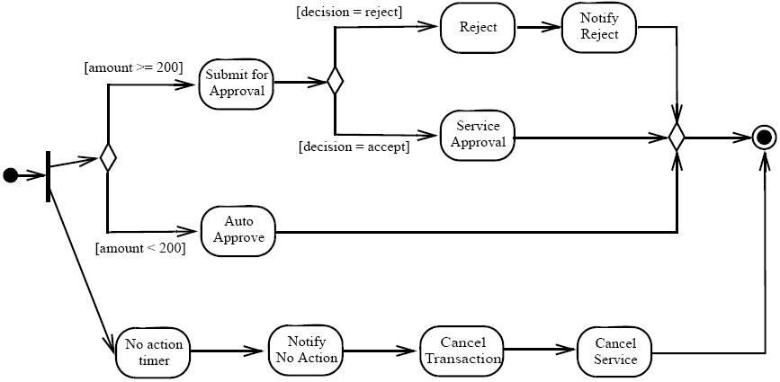
Activity Diagrams (Optional)
Notes:
Teaching Notes
Component diagrams are implementation type diagrams and are used to graphically depict the physical architecture of the software of the system. They can be used to show how programming code is divided into modules (or components) and depict the dependencies between those components.

Slide 82
Component Diagrams
Drawing Library
Client Source Code
Comment
Comment
(drawing.dll)
(client.exe)
dependency
Notes:
Teaching Notes
Component diagrams are implementation type diagrams and are used to graphically depict the physical architecture of the software of the system. They can be used to show how programming code is divided into modules (or components) and depict the dependencies between those components.

