Slide 1
Design Classes
Distribute system functionality across
3 types of classes
Simplifies maintenance, revisions, and
visualization ...
Notes:
Software Design
1
The approach of using object-oriented techniques for designing a system is referred to as object-oriented design. Recall that object-oriented development approaches are best suited to projects that will implement systems using emerging object technologies to construct, manage, and assemble those objects into useful computer applications. Object-oriented design is the continuation of object-oriented analysis, continuing to center the development focus around object modelling techniques.
During object-oriented design we continue to realize these entity objects while identifying other types of objects that will be introduced as the result of physical implementation decisions for the new system. There are two additional types of objects that will be introduced during design.
The structuring of an object-based system into three types of objects was proposed by Dr. Ivar Jacobson, and is very similar to the mechanism used in Smalltalk programming called model-view-controller (MVC).
534

Slide 2
Design Classes (Continued)
Control Classes
Contain objects for application processes
Entity Classes
Contain objects for storing and manipulating data
Boundary Classes
Contain objects for frontend interfaces
with actors .
Notes:
Software Design
2
The approach of using object-oriented techniques for designing a system is referred to as object-oriented design. Recall that object-oriented development approaches are best suited to projects that will implement systems using emerging object technologies to construct, manage, and assemble those objects into useful computer applications. Object-oriented design is the continuation of object-oriented analysis, continuing to center the development focus around object modelling techniques.
During object-oriented design we continue to realize these entity objects while identifying other types of objects that will be introduced as the result of physical implementation decisions for the new system. There are two additional types of objects that will be introduced during design.
The structuring of an object-based system into three types of objects was proposed by Dr. Ivar Jacobson, and is very similar to the mechanism used in Smalltalk programming called model-view-controller (MVC).
534

Slide 3

Design Classes
Motivating Example
Is YouTube still written in hypertext preprocessor?
No, it can’t survive the volume
Client side: Boundary class
Server side: Control class
Database: Entity class .
Notes:
534

Slide 4
Design Classes
Use Cases
Analysis
Classes
Design
Classes
Source
Code
Executable.
Notes:
534

Slide 5
Design Classes
Control Classes
<
Contain the logic or rules of events for directing and managing interactions among objects
Decouple storage (entity classes) and front end (boundary classes)
Allow system to be tolerant of changes and maintenance
Usually 1 control class per use case .
Notes:
535

Slide 6
Design Classes
Control Class Example
Course Registration
Student
Registry
<
Registration Control .

Slide 7
Design Classes
Entity Classes
Usually contain real-life objects
Encapsulate
  attributes and
  operations that update the attributes
Entity objects are persistent
  Continue to exist between use case executions
  Attributes are typically stored in database
  Allow for manipulation and retrieval .
Notes:
534-535

Slide 8
Design Classes
Entity Classes
Course Registration
Student
Registry
Course Object .

Slide 9
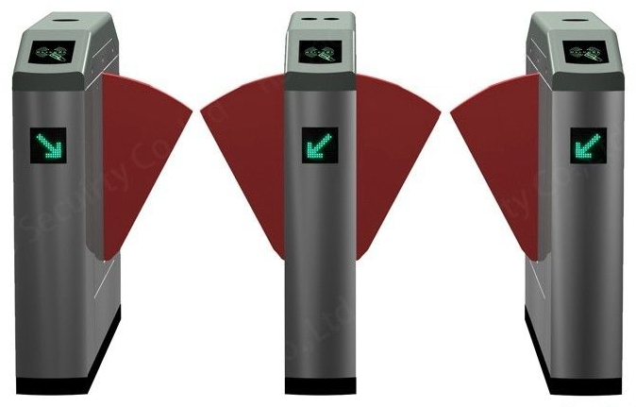
Design Classes
Boundary Classes
Interface between system and external world
May include user interface, system interface, and device interface
Responsibilities:
  Translate external input data into system information
  Translate system data into external presentation
At least 1 boundary class per actor / use case pair .
Notes:
In some cases the user may need multiple boundary objects. Take for example the ATM machine. Not only is there a display for presenting information, but there is also a card reader, money dispenser, and receipt printer. All of these would be considered boundary objects.
534

Slide 10
Design Classes
Boundary Classes
Course Registration
Student
Registry
Internet Window
Intranet Window .

