Slide 1
Introducing
Design Patterns
Provides pointers to students .
Prof. T.H. Tse
Department of Computer Science
Email: thtse@cs.hku.hk
Web: hku.hk/thtse

Slide 2
The Need for Design Patterns
New designers are overburdened by the options available, and fall back to non-OO techniques
Experienced designers make good designs
  They do not solve every problem from first principles
  No need to reinvent the wheel
  Reuse solutions that have worked for them
Let us reuse solutions of
experienced designers .

Slide 3
Design Patterns
Target for a general design problem in a particular context
Identify common class structures for reusable OO designs
Show participating objects, collaborations, and division of labour .
Examples
Sort by subject
Sort by date

Slide 4
Usefulness of Design Patterns
Many objects come from the analysis model
But designs often need classes with no counterparts in the real world
Design patterns help to identify less-obvious abstractions and objects .

Slide 5
Other Usefulness of Design Patterns
Relate compile-time and run-time structures
Enhance delegation
Enhance reuse
Via encapsulation
Via inheritance .

Slide 6
Other Usefulness of Design Patterns
Design for change: Avoid unnecessary redesigns
due to
Specific object representation
Specific operations, implementation, and algorithms
Dependence on hardware and software platforms
Tight coupling
Cannot replace classes easily .
Classes depend on one another

Slide 7
Design Patterns ≠ Frameworks
Frameworks are another source of reference for experienced design
A framework`k is a partially completed software system customized for a specific applicationx
Example
HSBC e-banking system
Design patterns are more general than frameworks
  A pattern can be used in any kinds of applications .

Slide 8
Design Patterns ≠ Frameworks
Design patterns are more fundamental than frameworks
  Frameworks are in compilable programming languages
  Design patterns are language independent and have to be implemented every time they are used
  Design patterns also explain the intent, trade-offs, and consequences of a design
Learn how to learn .

Slide 9
Note for those who wish me to write down what I say
It is fairly difficult to teach design patterns by means of lectures
It involves hands-on experience with real systems
I can only go through the concepts, philosophy, and a few examples .

Slide 10
Design Patterns
4 Essential Elements
The Problem
  Describes when to apply the pattern
  Explains the problem and its context
  May include a list of conditions for application
Pattern Name
  Allows us to design at a higher level of abstraction
  Free from the details .

Slide 11
Design Patterns
4 Essential Elements (Continued)
Solution
  Describes the elements that make up the design, their relationships, responsibilities, and collaborations
  Not a particular concrete design or implementation, but a general arrangement of elements
Consequences
  Results and (space and time) trade-offs, useful for evaluating design alternatives .

Slide 12
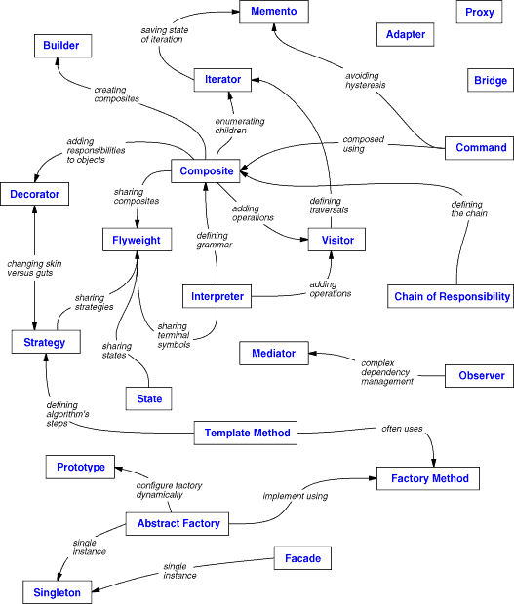
Example

Slide 13
Example (Continued)
GoF Design Patterns
Gang-of-Four: Gamma, Helm, Johnson, and Vlissides
Three categories
  Behavioural How to build powerful behaviour
  Creational How to build complex objects
  Structural How to build flexible structures .

Slide 14
About the GoF Design Patterns
Gang-of-Four: Gamma, Helm, Johnson, and Vlissides
Three categories
  Behavioural How to build powerful behaviour
  Creational How to build complex objects
  Structural How to build flexible structures.

Slide 15
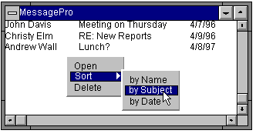
Behavioural Pattern Example
Strategy
Consider Sorting of Meeting Schedule

Slide 16
Behavioural Pattern Example
Strategy
Traditional Technique
Inbox
sort()
A lot of work when we need to change the sorting algorithm .

Slide 17
Behavioural Pattern Example
Strategy
Object-Oriented Design
Inbox
sort()
setStrategy()
Sorter
sort()
Delegate the sorting algorithm to another object .

Slide 18
Behavioural Pattern Example
Strategy
Problem
We want an adaptive method with various implementations selected at run time
We need different algorithms to accomplish
the same task in different circumstances .

Slide 19
Behavioural Pattern Example
Strategy
Use quicksort for subject
Use insertion sort for date .

Slide 20
Behavioural Pattern Example
Strategy
Design Pattern Solution
Define a family of algorithms,
and encapsulate each one
The strategy pattern lets the algorithm
vary according to clients ...

Slide 21
Behavioural Pattern Example
Strategy
Design Pattern Solution (Continued)
Inbox
sort()
setStrategy()
Sorter
sort()
SubjectQuickSort
sort()
DateInsertSort
sort() .

Slide 22
Behavioural Pattern Example: Strategy
Potential Implementation in C#
// Strategy pattern -- Structural example
using System;
namespace DoFactory.GangOfFour.Strategy.Structural
{
// MainApp test application
class MainApp
{
static void Main()
{
Context context;
// Three contexts following different strategies
context = new Context(new ConcreteStrategyA());
context.ContextInterface();
context = new Context(new ConcreteStrategyB());
context.ContextInterface();
context = new Context(new ConcreteStrategyC());
context.ContextInterface();
// Wait for user
Console.Read();
}
}
// "Strategy"
abstract class Strategy
{
public abstract void AlgorithmInterface();
}
// "ConcreteStrategyA"
class ConcreteStrategyA : Strategy
{
public override void AlgorithmInterface()
{
Console.WriteLine(
"Called ConcreteStrategyA.AlgorithmInterface()");
}
}
// "ConcreteStrategyB"
class ConcreteStrategyB : Strategy
{
public override void AlgorithmInterface()
{
Console.WriteLine(
"Called ConcreteStrategyB.AlgorithmInterface()");
}
}
// "ConcreteStrategyC"
class ConcreteStrategyC : Strategy
{
public override void AlgorithmInterface()
{
Console.WriteLine(
"Called ConcreteStrategyC.AlgorithmInterface()");
}
}
// "Context"
class Context
{
Strategy strategy;
// Constructor
public Context(Strategy strategy)
{
this.strategy = strategy;
}
public void ContextInterface()
{
strategy.AlgorithmInterface();
}
}
}

Slide 23
About the GoF Design Patterns
Gang-of-Four: Gamma, Helm, Johnson, and Vlissides
Three categories
  Behavioural How to build powerful behavior
  Creational How to build complex objects
  Structural How to build flexible structures .

Slide 24
Creational Pattern Example
Abstract Factory
Problem
Sometimes constructing an object is very complicated
  The object is made of many different kinds of complexly interconnected parts
  The object is made from two or more sets of compatible parts, but the sets are incompatible to each other .

Slide 25
Creational Pattern Example
Abstract Factory
Application: Graphical User Interface
Constructing user interface widgets
  Windows, scrollbars, radio buttons, menus, …
Various platforms to support
  Microsoft Windows, Apple macOS, Apple iOS, Unix-like X Window system .
Notes:
Motif: Graphical user interface specified by the Open Software Foundation and built on the MIT's X Windows. X Window System is the standard graphical interface on Unix, Unix-like operating systems and OpenVMS, and is available for most other modern operating systems.
OpenLook: A set of GUI specifications agreed upon by several software vendors for an interoperable graphical user interface. Sun's openwindows is an example of an implementation of OpenLook.
Presentation Manager (PM) was the name given to the GUI which IBM introduced in version 1.10 of its operating system OS/2 in 1988.

Slide 26
Creational Pattern Example
Abstract Factory
General Recommendation
Use an abstract class (called pure fabrication) to do the construction
Client
AbstractCreator
AbstractProduct
ConcreteCreator
ConcreteProduct .

Slide 27
Creational Pattern Example
Abstract Factory
Solution in GUI App
Window
Widget Factory
newWindow()
newScrollBar()
Client
WinWindow
MacWindow
ScrollBar
WinWidgetFactory
newWindow()
newScrollBar()
MacWidgetFactory
newWindow()
newScrollBar()
WinScrollBar
MacScrollBar.

Slide 28
Creational Pattern Example: Abstract Factory
Potential Implementation in C++
#include <memory>
using std::auto_ptr;
class Control { };
class PushControl : public Control { };
class Factory {
public:
// Returns Factory subclass based on classKey.
// Each subclass has its own getControl() implementation.
// This will be implemented after the subclasses have been declared.
static auto_ptr<Factory> getFactory(int classKey);
virtual auto_ptr<Control> getControl() const = 0;
};
class ControlFactory : public Factory {
public:
virtual auto_ptr<Control> getControl() const {
return auto_ptr<Control>(new PushControl());
}
};
auto_ptr<Factory> Factory::getFactory(int classKey) {
// Insert conditional logic here. Sample:
switch(classKey) {
default:
return auto_ptr<Factory>(new ControlFactory());
}
}

Slide 29
About the GoF Design Patterns
Gang-of-Four: Gamma, Helm, Johnson, and Vlissides
Three categories
  Behavioural How to build powerful behaviour
  Creational How to build problematic objects
  Structural How to build flexible structures .

Slide 30
Structural Pattern Example
Proxy
Common Types of Proxies
Virtual Proxy
  Lightweight object that creates heavyweight object on demand
Device Proxy
  Logical device that manages physical device
Remote Proxy
  Local representation of remote object
Protection Proxy
  Sentry (soldier) that guards secure object
Printer
Printer
Search engine
Search engine .

Slide 31
Structural Pattern Example
Proxy
General Recommendation
Create an abstract class to specify the logical interface to the object
Create two subclasses
  The proxy and the actual object class
The proxy forwards messages to actual object
Actual object returns messages through the proxy after actual operation .

Slide 32
Structural Pattern Example
Proxy
Problem
We do not want to directly access an object, but through an intermediary or agent
  This may arise from reliability or complexity concerns .

Slide 33
Structural Pattern Example
Proxy
General Recommendation
AbstractClass
Client
ProxyClass
RealClass .

Slide 34
Structural Pattern Example
Proxy
Printer Application
Printer
status
print(pdf)
PdfDocument
print()
PrinterProxy
status
print(pdf)
RealPrinter
status
print(pdf) .

Slide 35
Structural Pattern Example: Proxy
Potential Implementation in Java
import java.util.*;
interface Image {
public void displayImage( );
}
class RealImage implements Image {
private String filename;
public RealImage(String filename) {
this.filename = filename;
System.out.println("Loading "+filename);
}
public void displayImage( ) { System.out.println("Displaying "+filename); }
}
class ProxyImage implements Image {
private String filename;
private RealImage image;
public ProxyImage(String filename) { this.filename = filename; }
public void displayImage( ) {
if (image == null) image = new RealImage(filename);
// load only on demand
image.displayImage( );
}
}
class ProxyExample {
public static void main(String[ ] args) {
ArrayList<Image> images = new ArrayList<Image>( );
images.add( new ProxyImage("HiRes_10MB_Photo1") );
images.add( new ProxyImage("HiRes_10MB_Photo2") );
images.add( new ProxyImage("HiRes_10MB_Photo3") );
images.get(0).displayImage(); // loading necessary
images.get(1).displayImage(); // loading necessary
images.get(0).displayImage();
// no loading necessary; already done
// the third image will never be loaded - time saved!
}

