Slide 1
Introducing
Enterprise Applications
Provides pointers to students .
Prof. T.H. Tse
Department of Computer Science
Email: thtse@cs.hku.hk
Web: hku.hk/thtse .

Slide 2
Something Missing from the Course?
Enterprise applications .

Slide 3
Enterprise Applications
Software application hosted on a server that simultaneously provides services to a large number of users, typically over a computer network
Different from software application that run on local computer, serving one user at a time .

Slide 4

Enterprise Application Example
Digital Trade and Transportation Network
E-platform for logistics and shipment
One stop for supply-chain management .

Slide 5




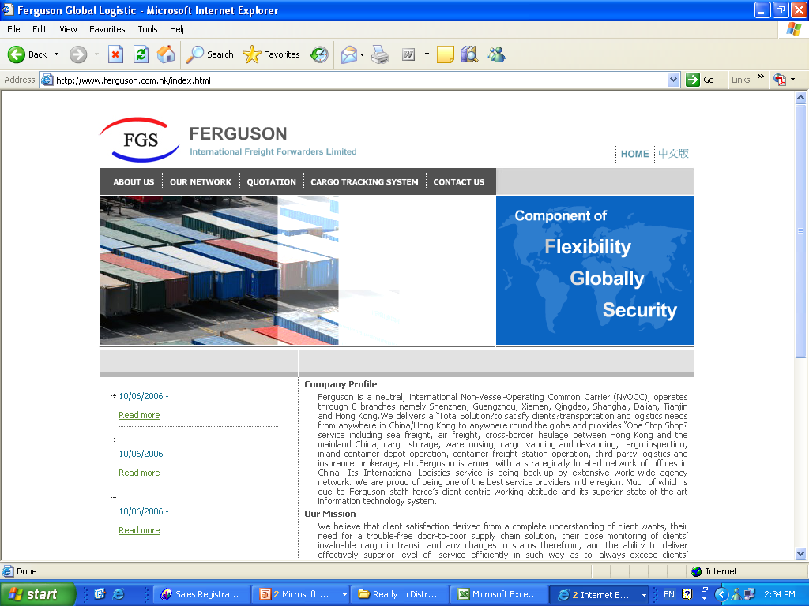
























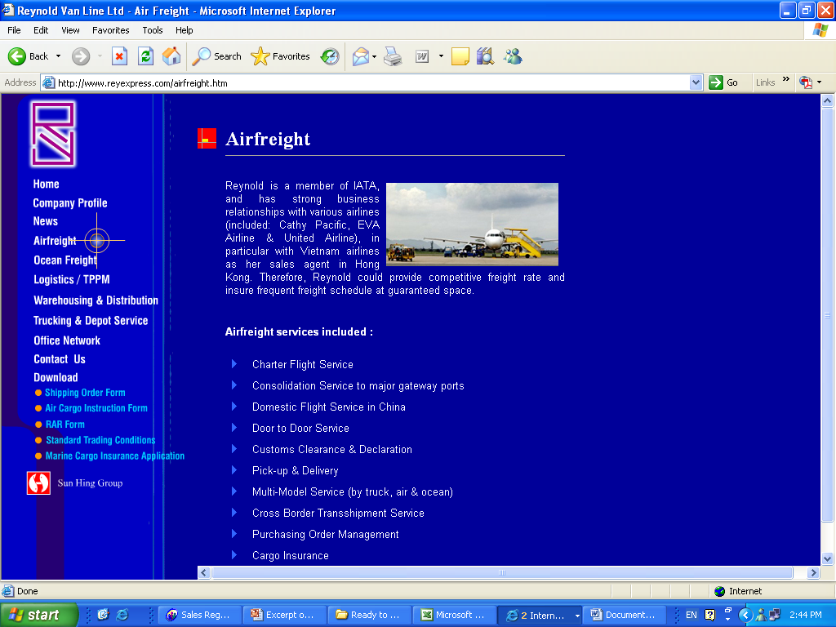




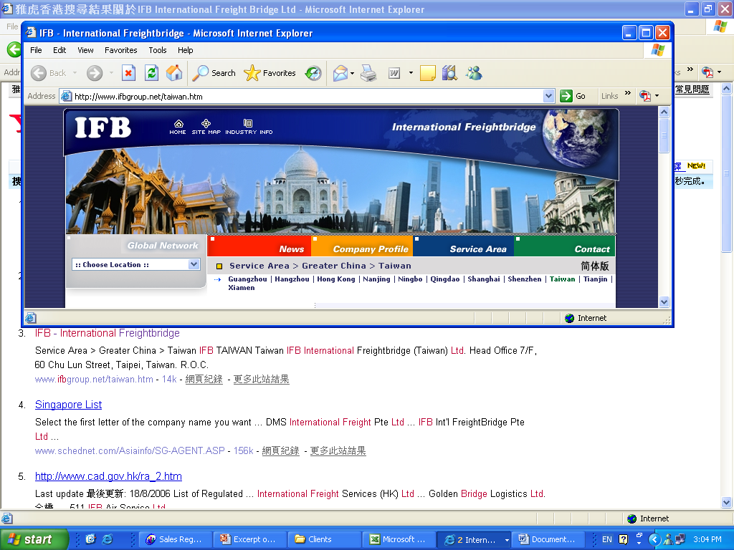






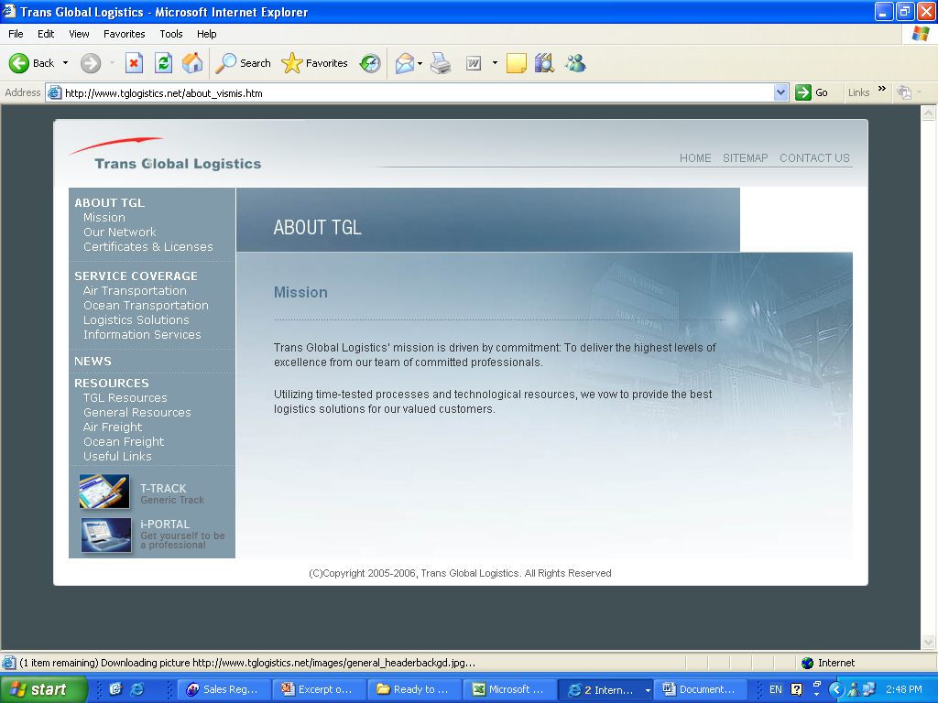







DTTN Logistics Service Providers
LSP
LSP
LSP
LSP

Slide 6















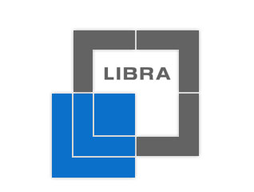

















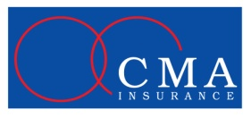





DTTN Shippers
Shipper
Shipper
Shipper
Others

Slide 7



































DTTN Connected Shipment Carriers

Slide 8

























DTTN Connected Airlines

Slide 9
Enterprise Applications
Challenges in Analysis and Design
Too many user scenarios and use cases
Too many design considerations
Low cost
Competitive, short time to market
Security, reliability, usability, performance
Flexible, modifiable .

Slide 10
Enterprise Applications
Challenges in Analysis and Design
Too many device-dependent implementation platforms
Java Platform, Enterprise Edition (Jakarta EE)
Microsoft .NET
IBM Websphere .

Slide 11
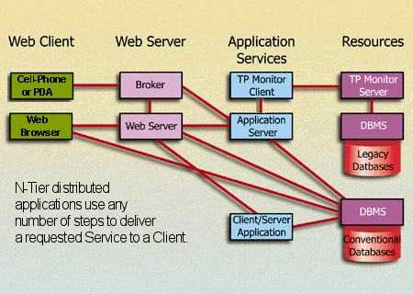
Common Design in Enterprise Applications
Multi-Tier Distributed Architecture
Extended concept of boundary, control, and entity classes
More easily said than done! ☹ .

