Slide 1
Presenting Your Proposal
Techniques that they don’t teach you for the MSc project
Numerous students expressed great interest in MSc Dissertations
These are very different from MSc Projects .
Prof. T.H. Tse
The University of Hong Kong
Pokfulam, Hong Kong
Email: thtse@cs.hku.hk
Web: hku.hk/thtse .

Slide 2
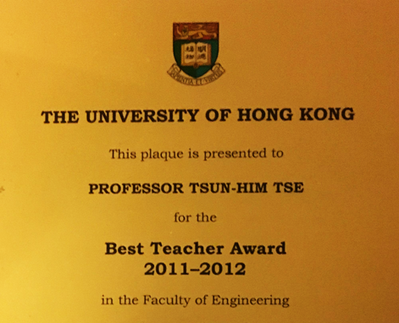
Track Record of Speaker
Start with something
to attract the audience .
Best teacher award
Teacher effectiveness
94.4% in 2022
93.2% in 2021
96.4% in 2020
Supervision of
Best Tutor Awards
  Lijun Mei
  Jack Zhai
  Jolly Cheng .

Slide 3

My Presentation
Strategy
Continue with something interesting
to attract the audience .
The Boiling Frog Syndrome
If a frog is placed in boiling water, it will jump out
If it is placed in cold water
and slowly heated,
it will never jump out
but boiled alive .

Slide 4
Who Do You Want to Attract ??
Experts in your area of research
Experts who may not be your area .

Slide 5
Start with Something to Attract the Audience
We Learn from Real Mistakes
Please excuse me if you cannot understand my talk because my English is not good
How attractive is this introduction ??
Learn from best international presenters, not other students .

Slide 6
Presentation
Outline
Continue with
an interesting Presentation Outline
Introduction
Preliminaries
Presentation skills
PowerPoint presentations
Summary and conclusion .
3 Ps
This is part of
your slide

Slide 7
We Learn from Mistakes of
Many MSc Projects
No information
or attraction whatsoever
Learn from best
international presenters,
not other students .

Slide 8
Presentation Outline
Introduction
Preliminaries
Presentation skills
PowerPoint presentations
Summary and conclusion

Slide 9
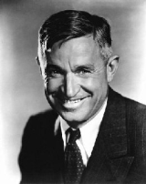
First Impression
You never get a second chance to make a first impression
Will Rogers, Actor 1879−1935
Even before starting with something interesting:
Proper dress
Title slide .

Slide 10
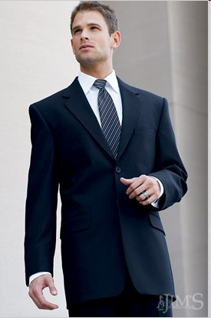
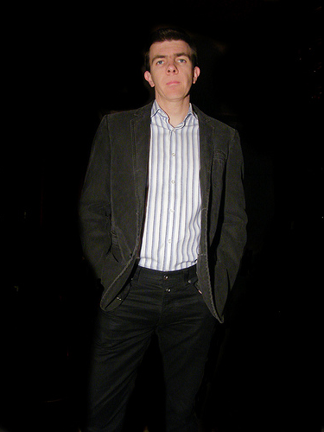
Dress Properly
According to Expectation
Informal
Smart casual

Slide 11

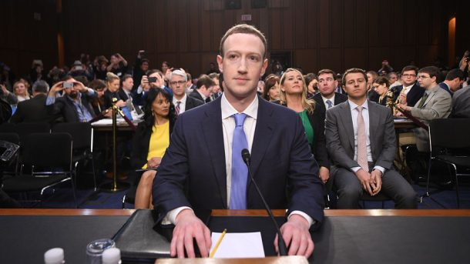
Dress Properly
According to Expectation (Continued)
Mark Zuckerburg
Same Person

Slide 12
Title Slide
Your presentation title is important
Your affiliation is important
The background of your title slide is not important .

Slide 13
Your Presentation Title: Example 1
Testing of Context-Aware
Applications
A Metamorphic Approach to
Integration Testing of Context-Aware
Middleware-Based Applications
Integration Testing of Context-Aware Middleware-Based Applications:
a Metamorphic Approach
Too general
Too long
Add subtitle .

Slide 14
Your Presentation Title: Example 2
Add Interesting Subtitle
Presenting Your Proposal:
Techniques that they don't teach you for the MSc project .

Slide 15
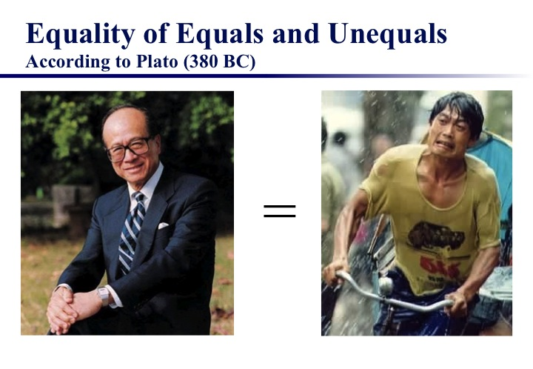
Your Presentation Title: Example 3
Add Interesting Main Title
Equality to Equals and Unequals:
A Revisit of the Equivalence and Nonequivalence Criteria
in Class-Level Testing of Object-Oriented Software

Slide 16
Your Presentation Title: Example 4
Add Interesting Acronyms
CHOC’LATE: a CHOiCe-reLAtion framework for TEst case generation
DESSERT: a DividE-and-conquer methodology for identifying categorieS, choiceS, and choicE Relations for Test case generation
MINTS: MINimum Test Suites
TIRAMISU: Testing context-sensItive, concurRent And MIddleware-baSed Ubiquitous software
TRIFL: TowaRds Improved techniques for Fault Localization .

Slide 17
Your Affiliation is Important
HK is not as well known as USA
University of HK ??
University of Hong Kong ??
The University of Hong Kong ??
The University of Hong Kong, Pokfulam, Hong Kong .
Which University of Hong Kong ??

Slide 18
We Learn from Real Mistakes
Background of Title Slide Not Important
Complex background distracts attention
Learn from modern design:
Keep it simple .

Slide 19
Presentation Outline
Introduction
Preliminaries
Presentation skills
PowerPoint presentations
Summary and conclusion

Slide 20
Main Presentation Skill
Tell them what you are going to say
Tell them
Tell them what you said
Tell them x 3 .

Slide 21
Main Presentation Skill
Implementation
Tell them what you are going to say

Slide 22
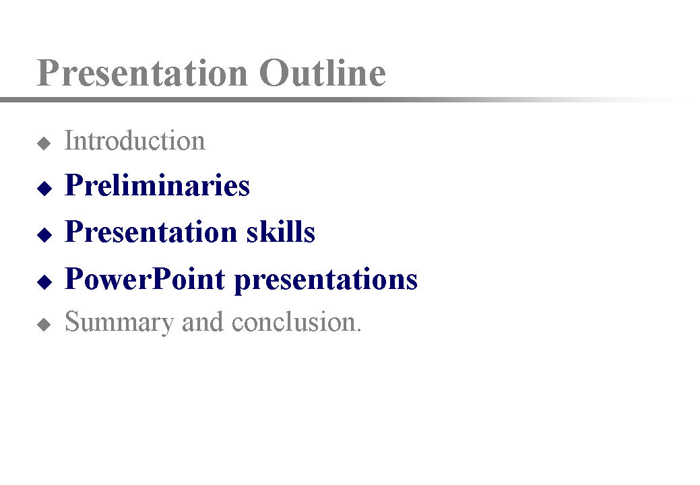
Main Presentation Skill
Implementation (Continued)
Tell them what you are going to say
Tell them

Slide 23
Main Presentation Skill
Implementation (Continued)
Tell them what you are going to say
Tell them
Tell them what you said

Slide 24
Speaker-Oriented Presentation
You lead the presentation
  Face the audience
  Deliver a message
  Provide the content
The slides support you
  Arouse interest
  Give visual messages
  Help signposting .
Argue your points
Persuade the audience
Promote your work

Slide 25
Speaker-Oriented Presentation
(Continued)
Speak to audience directly
Speak, not read
Ensure eye contact
Control the slides yourself
Don’t allow other team members to act as wallpaper
Don’t use cue cards
Memorize the sequence
Add hidden cues
.
Like this

Slide 26
Presentation Outline
Introduction
Preliminaries
Presentation skills
PowerPoint presentations
Summary and conclusion

Slide 27
PowerPoint
Presentations
Many challenges
Equipment control
Unfamiliarity of equipment setting is your fault
Get familiar well before presentation
  Book the room for rehearsal days before the talk
  Know how to dim lights
  Know how to use microphone
Equipment breakdown is your fault
Ask fellow student to bring a rehearsed notebook .

Slide 28
PowerPoint Presentations
Highlighting
Never use laser pointers
Avoid mouse pointers
Use prepared pointers
Use animation
Use callouts
Like this .

Slide 29
We Learn from Mistakes
Unbalanced PowerPoint List
Assertion Checking
  Da, Domine, propitius pacem in diebus nostis, ut, ope misericordiae tuae adiuti, et a peccato simus semper
  Ut unum Deum in Trinitate, et Trinitatem in unitate veneremur
  Defende nos in proelio; contra nequitiam et insidias diaboli esto praesidium
Metamorphic Testing
  Actiones nostras, quaesumus Domine, aspirando .

Slide 30
Balanced PowerPoint List
Assertion Checking
  Da, Domine, propitius pacem in diebus nostis, ut, ope misericordiae tuae adiuti
  Ut unum Deum in Trinitate, et Trinitatem in unitate veneremur
Metamorphic Testing
  Defende nos in proelio; contra nequitiam et insidias diaboli esto praesidium
  Actiones nostras, quaesumus Domine, aspirando praeveni et adiuvando prosequere .

Slide 31
All Rules Have Exceptions
Unbalanced Lists for Special Effect
Disadvantage of Metamorphic Testing
  Ut unum Deum in Trinitate, et Trinitatem in unitate veneremur
Advantages
  Da, Domine, propitius pacem in diebus nostis
  Ut, ope misericordiae tuae adiuti
  Defende nos in proelio
  Contra nequitiam et insidias diaboli esto praesidium
  Actiones nostras, quaesumus Domine
  Aspirando praeveni et adiuvando prosequere .

Slide 32
PowerPoint Presentations (Continued)
Referring Backwards
Assertion Checking
  Advantages ...
  Disadvantages ...
  Costs ...

Slide 33
PowerPoint Presentations (Continued)
Referring Backwards
Metamorphic Testing
  Advantages ...
  Disadvantages ...
  Costs
When referring backwards,
do not return to
previous slide .

Slide 34
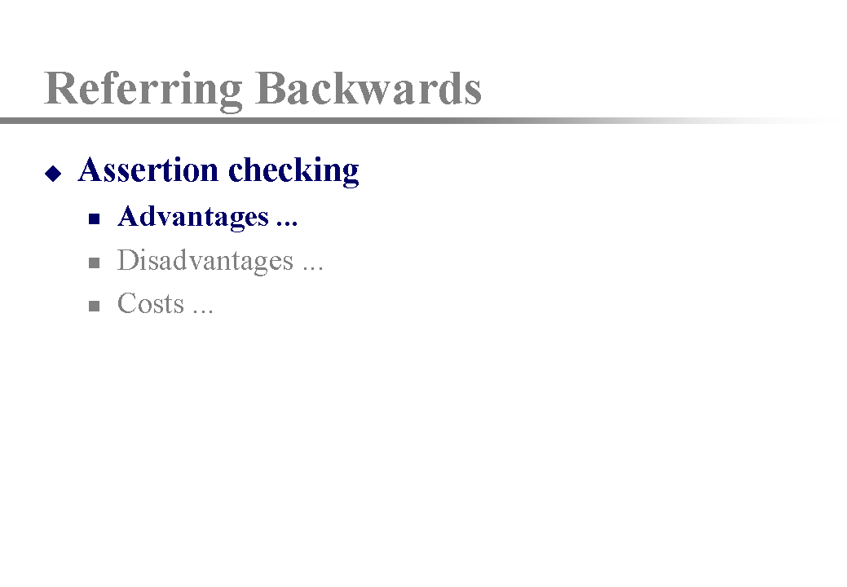
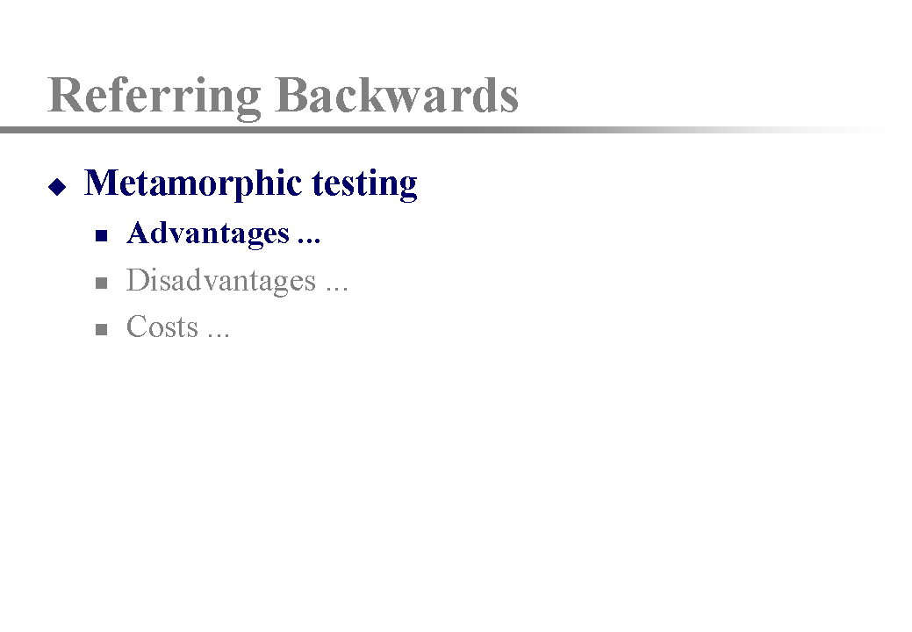
PowerPoint Presentations (Continued)
Referring Backwards
Comparing the Advantages:

Slide 35
Prepare PowerPoint Slides by Iterations
First Attempt
Comprehensive
Disciplined
Practical
Professional
Too vague ...

Slide 36
Prepare Slides by Iterations
Second Attempt
Too tiny ...
Comprehensive
Da, Domine, propitius pacem in diebus nostis, ut, ope misericordiae tuae adiuti, et a peccato simus semper liberi et ab omni perturbatione securi
Disciplined
Ut unum Deum in Trinitate, et Trinitatem in unitate veneremur
Practical
Defende nos in proelio; contra nequitiam et insidias diaboli esto praesidium
Professional
Actiones nostras, quaesumus Domine, aspirando praeveni et adiuvando prosequere: ut cuncta nosta oratio et operatio a te semper incipiat et per ta coepta finiatur.

Slide 37
Prepare Slides by Iterations
Third Attempt
Recommended

Slide 38
Prepare Slides by Iterations
Third Attempt
We are comprehensive
Da, Domine, propitius pacem in diebus nostis, ut, ope misericordiae tuae adiuti, et a peccato simus semper liberi et ab omni perturbatione securi

Slide 39
Prepare Slides by Iterations
Third Attempt
We are comprehensive
We are disciplined
Ut unum Deum in Trinitate, et Trinitatem in unitate veneremur

Slide 40
Prepare Slides by Iterations
Third Attempt
We are comprehensive
We are disciplined
We are practical
Defende nos in proelio; contra nequitiam et insidias diaboli esto praesidium

Slide 41
Prepare Slides by Iterations
Third Attempt
We are comprehensive
We are disciplined
We are practical
We are professional
Actiones nostras, quaesumus Domine, aspirando praeveni et adiuvando prosequere: ut cuncta nosta oratio et operatio a te semper incipiat et per ta coepta finiatur .

Slide 42
Presentation Outline
Introduction
Preliminaries
Presentation skills
PowerPoint presentations
Summary and conclusion

Slide 43
Timing
Stand up,
speak up,
shut up .
Level of
Attention
Time

Slide 44
Summary and Conclusion
Preliminaries
  Visibility
  Networking

Slide 45
Summary and Conclusion
Preliminaries
Presentation skills
  First impression
  Tell them × 3
  You lead the presentation, supported by the slides

Slide 46
Summary and Conclusion
Preliminaries
Presentation skills
PowerPoint presentations
  Highlighting
  Balanced lists
  Referring backwards
  Preparing by iterations

Slide 47
Summary and Conclusion
Preliminaries
Presentation skills
PowerPoint presentations
3 Ps
Practice makes perfect
3S in Drama
Suspense
Satisfaction
Surprise .

Slide 48
Your Comments are Welcome
Better than Q&A
Shows your confidence .

Slide 49
Thank you
Hang on:
Put potential Q&A slides after this, just in case .

Slide 50
What Do You Do When Attending
Talks and Meetings ??
Listen very carefully and take notes?
Do excellent presentations
Think of in-depth questions to discuss with the speakers
Visibility
Networking .

