Slide 1
Recent Progress and Future Directions in Online Matching
Part I: Adversarial Model
Zhiyi Huang
University of Hong Kong
2023/12/4 at WINE 2023

Slide 2
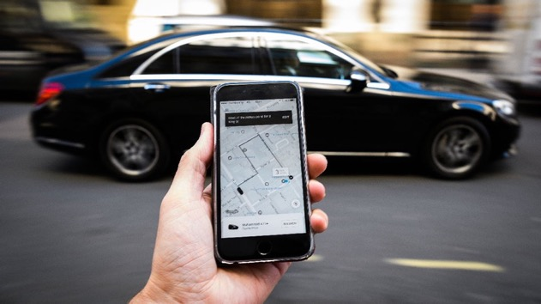



Matching Problems Around Us

Slide 3
Today’s Agenda
Basics of Online Matching
Online Correlated Selection
General Arrival Models
Other Progress and Outro

Slide 4
Online Bipartite Matching
Karp, Vazirani, and Vazirani (1990)
Offline
Vertices
(advertisers)
Online
Vertices
(impressions)
Competitive Ratio = ALG/OPT = 3/5
worst ratio in any graph and any arrival order

Slide 5
Greedy
Match to an arbitrary unmatched neighbor
0.5-competitive

Slide 6
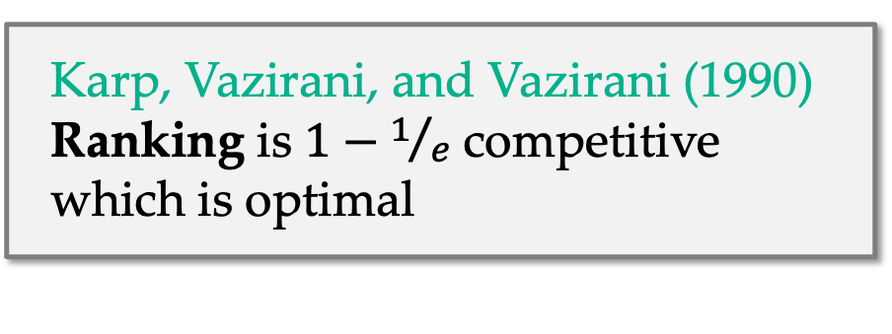
An Elegant Solution: Ranking Algorithm
Karp, Vazirani, and Vazirani (1990)
2
Rank offline vertices randomly
1
Offline
Vertices
Online
Vertices
4
Karp, Vazirani, and Vazirani (1990) Ranking is $1−1/e$ competitive which is optimal
5
3

Slide 7
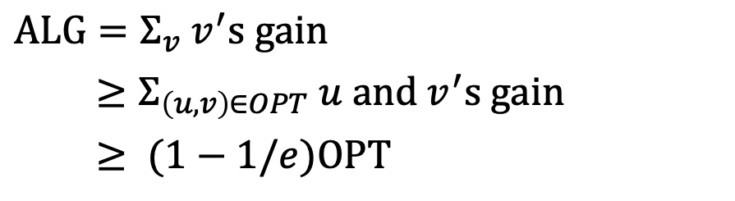

An Elegant Analysis: Randomized Primal Dual
Devanur, Jain, and Kleinberg (2013)
$0.5
2
Imagine having $1 on each edge
When two vertices are matched
they split the $1 on the edge
Matching size = amount of $ split
Plan: For any edge $(u, v)$, $u$ and $v$ get at least $1−1/e$ in expectation
$0.5
$0.5
$0.3
1
$0.7
$0.3
$0.65
4
$0.45
$0.65
$0.9
5
$0.0
$0.0
Ranking
Offline side sets random prices
Online side takes best offer
$ALG=Σ_{v} v^{′}s gain$
$≥Σ_{\left(u, v\right)∈OPT} u and v^{′}s gain$
$≥ (1−1/e)OPT$
$0.55
3
$0.55
$0.35
Offline
Vertices
Online
Vertices

Slide 8

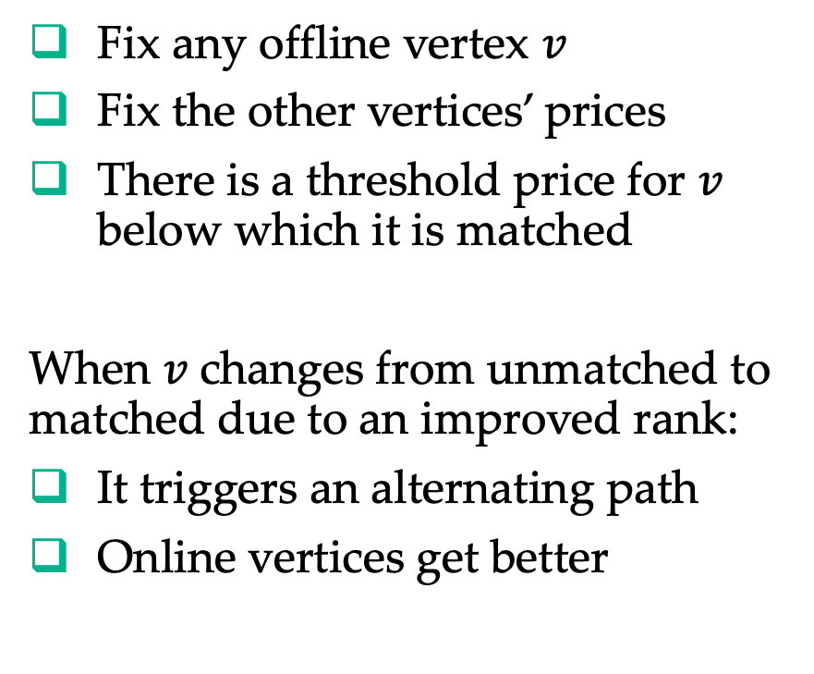


Alternating Path Argument
Fix any offline vertex $v$
Fix the other vertices’ prices
There is a threshold price for $v$ below which it is matched
When 𝑣 changes from unmatched to
matched due to an improved rank:
It triggers an alternating path
Online vertices get better
$0.5
$0.5
$0.5$+ε$
$0.3
$0.7
$0.65
$0.5
$0.45
$0.9
$$v$$
$0.5$−ε$
$0.65
$0.0
$0.55
$0.35
Offline
Vertices
Online
Vertices

Slide 9
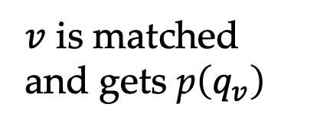

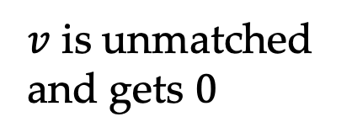

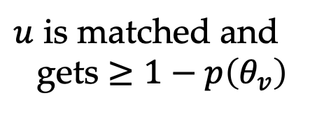



Random Prices
Sample rank/quantile $q_{v}$ uniformly between $0$ and $1$
Set price $p_{v}=p\left(q_{v}\right)$ for some monotone function $p$ to be determined
Focus on an edge $(u, v)$
$$1$$
Proof:
$u and v′s gain$
$$≥1−p\left(θ_{v}\right)+\int_{0}^{θ_{v}}{p\left(q_{v}\right)dq_{v}}$$
$=1−\frac{1}{e}$ (for $p(q)=e^{−1+q}$)
$v$ is unmatched
and gets $0$
$u$ is matched and
gets $≥1−p\left(θ_{v}\right)$
$$θ_{v}$$
$v$ is matched
and gets p$\left(q_{v}\right)$
$$0$$

Slide 10
Today’s Agenda
Basics of Online Matching
Online Correlated Selection
General Arrival Models
Other Progress and Outro

Slide 11
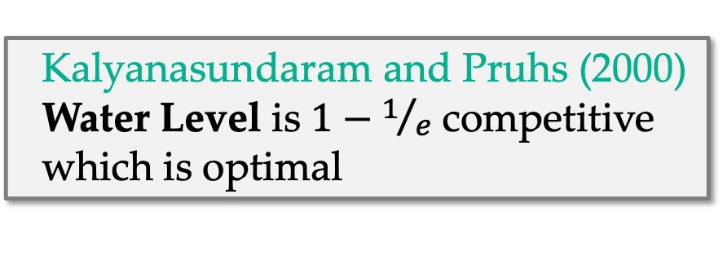
Water Level Algorithm for Fractional Matching
(a.k.a. Balance)
Match each online vertex to
least matched neighbors
Water level of a vertex equals
matched portion of a vertex
Offline
Vertices
Online
Vertices
Kalyanasundaram and Pruhs (2000) Water Level is $1−1/e$ competitive which is optimal
No alternating path argument in its analysis!

Slide 12
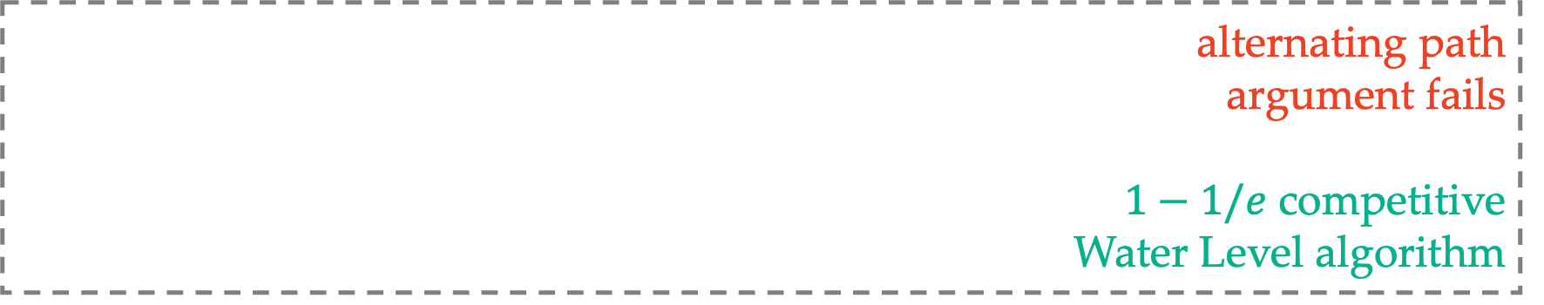
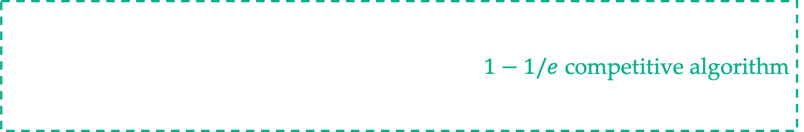
Generalizations of Online Bipartite Matching
$1−1/e$ competitive algorithm
Unweighted
Vertex-weighted
different advertisers pay differently
Edge-weighted
advertisers pay differently for different impressions
AdWords
advertisers’ payments are budget-additive
alternating path
argument fails
$1−1/e$ competitive
Water Level algorithm
How about Water Level + online rounding?

Slide 13

















Online Correlated Selection (OCS)
$$t=1$$
$$t=2$$
$$t=3$$
does not see the picks
a
$$0.2$$
a
a
$$0.4$$
$$0.6$$
$$0$$
b
$$0.3$$
b
$$0.1$$
b
$$0.1$$
… …
$$0.1$$
$$0.1$$
$$0.6$$
c
c
$$0.2$$
c
oblivious adversary
$$0.3$$
d
d
d
only see the marginals
roughly follows
the marginal
pick
pick
pick
… …
b
a
c
randomized OCS
negatively correlated
(credit of this slide goes to Guy Blanc)

Slide 14
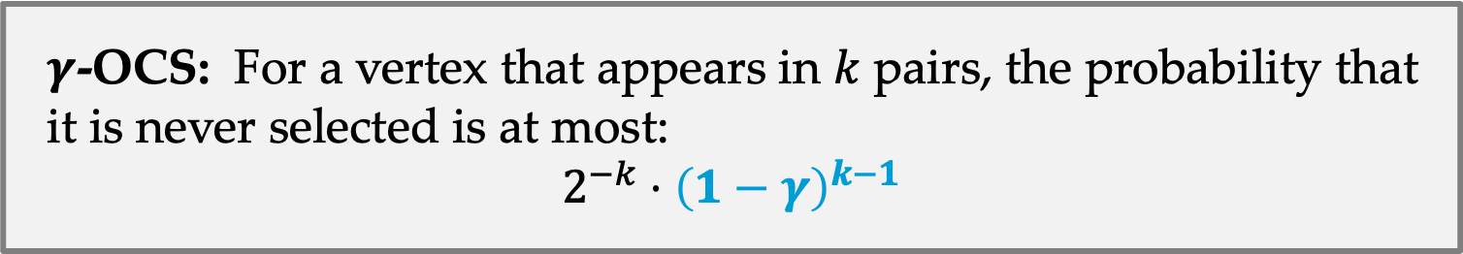
Half-Integral OCS (for Unweighted Matching)
Fahrbach, Huang, Tao, and Zadimorghaddam (2020)
Select from a sequence of pairs of vertices, one pair at a time:
The marginal distribution is 50-50 for each pair
Fixed any vertex, the randomness is “negatively correlated”
if it is not selected this time, it gets a higher chance next time
$γ$-OCS: For a vertex that appears in $k$ pairs, the probability that it is never selected is at most:
$$2^{−k}⋅{\left(1−γ\right)}^{k−1}$$

Slide 15
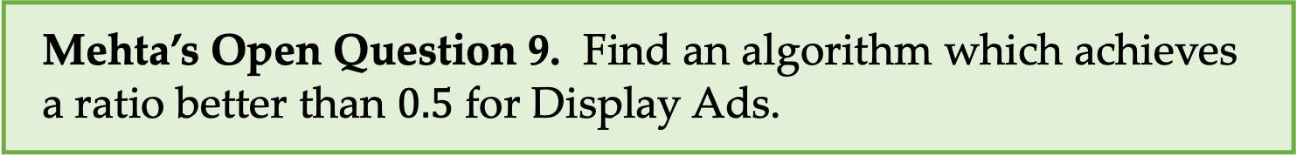
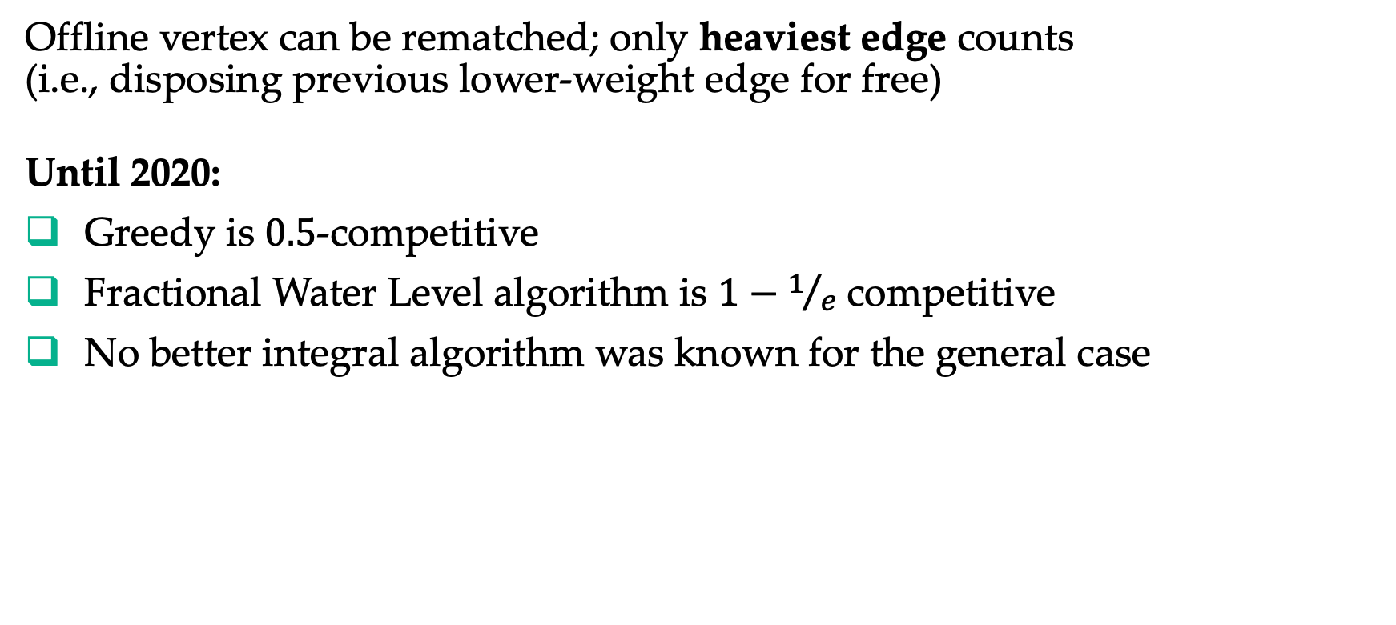
Edge-Weighted Matching (a.k.a., Display Ads)
Feldman, Korula, Mirrokni, Muthukrishnan, and Pál (2009)
Offline vertex can be rematched; only heaviest edge counts
(i.e., disposing previous lower-weight edge for free)
Until 2020:
Greedy is $0.5$-competitive
Fractional Water Level algorithm is $1−1/e$ competitive
No better integral algorithm was known for the general case
Mehta’s Open Question 9. Find an algorithm which achieves
a ratio better than $0.5$ for Display Ads.

Slide 16





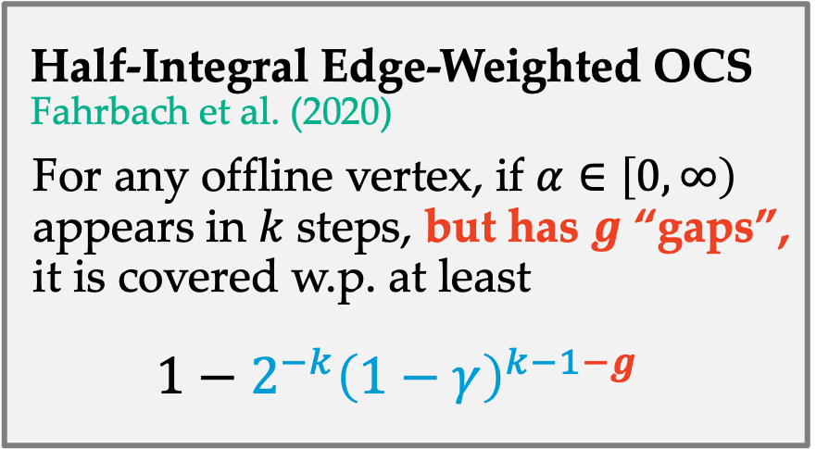








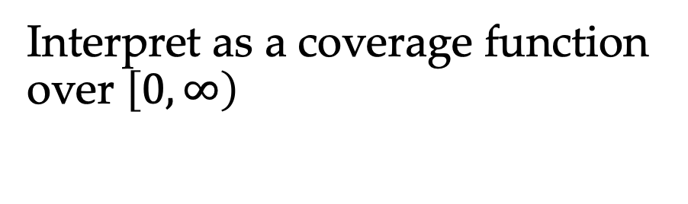

Edge-Weighted Matching with OCS
Offline
Vertices
(advertisers)
Online
Vertices
(impressions)
Interpret as a coverage function over $\left[0, ∞\right)$
$$1$$
$$0$$
$$∞$$
$$3$$
$$2$$
Half-Integral Edge-Weighted OCS
Fahrbach et al. (2020)
For any offline vertex, if $α∈\left[0, ∞\right)$ appears in $k$ steps, but has $g$ “gaps”, it is covered w.p. at least
$$1−2^{−k}{\left(1−γ\right)}^{k−1−g}$$
$$0$$
$$∞$$
$$1$$
$$2$$
$$4$$
$$0$$
$$∞$$
$$1$$
$$0$$
$$∞$$
$$0$$
$$∞$$

Slide 17









Edge-Weighted Matching with OCS (cont’d)
Half-Integral Edge-Weighted OCS
General Edge-Weighted OCS
  Shin and An (2021): Three-way, $0.509$-competitive
  Blanc and Charikar (2021): General, $0.536$-competitive
Independent
Sample
Fahrbach et al. (2020)
$$0$$
$$0.109$$
$$0.167$$
$$0.25$$
$$0.5$$
$$1$$
$0.508$-competitive
$0.519$-competitive
Gao et al. (2021)

Slide 18
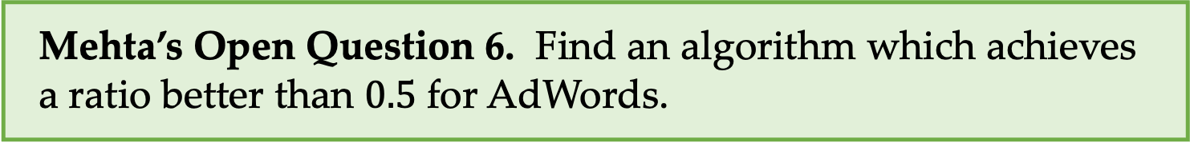
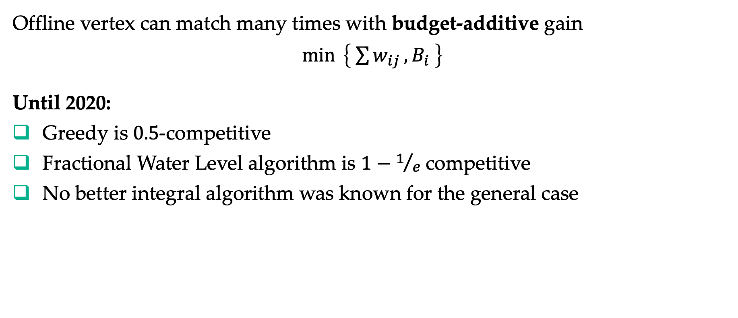
AdWords
Mehta, Saberi, Vazirani, and Vazirani (2005)
Offline vertex can match many times with budget-additive gain
$\min{ \left\{ \sum{w_{ij}}, B_{i} \right\}}$
Until 2020:
Greedy is $0.5$-competitive
Fractional Water Level algorithm is $1−1/e$ competitive
No better integral algorithm was known for the general case
Mehta’s Open Question 6. Find an algorithm which achieves
a ratio better than $0.5$ for AdWords.

Slide 19






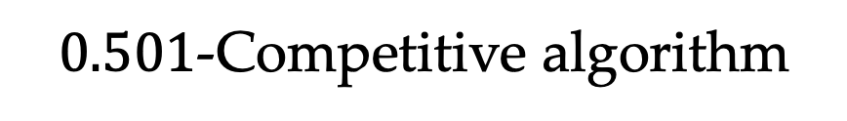
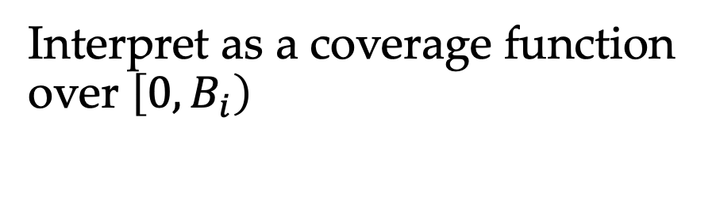

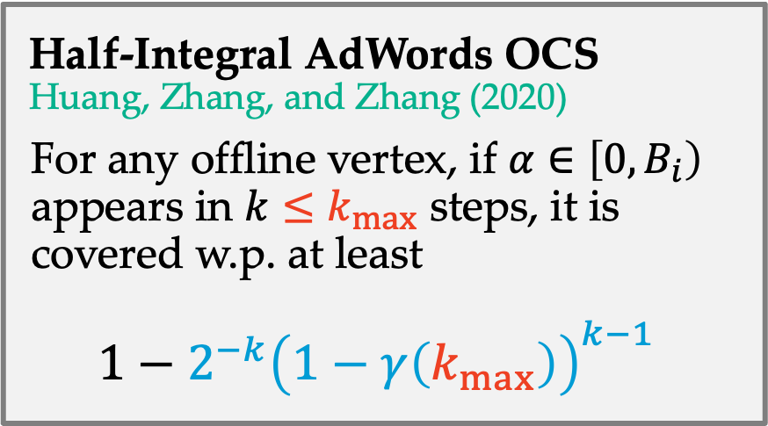

AdWords with OCS
Offline
Vertices
(advertisers)
Online
Vertices
(impressions)
Interpret as a coverage function over $\left[0, B_{i}\right)$
$$1$$
$$0$$
$$B_{1}$$
$$3$$
Half-Integral AdWords OCS
Huang, Zhang, and Zhang (2020)
For any offline vertex, if $α∈\left[0, B_{i}\right)$ appears in $k≤k_{max}$ steps, it is covered w.p. at least
$$1−2^{−k}{\left(1−γ\left(k_{max}\right)\right)}^{k−1}$$
$$2$$
$$0$$
$$B_{2}$$
$$1$$
$$2$$
$$2$$
$$0$$
$$B_{3}$$
$$1$$
$$0$$
$$B_{4}$$
$0.501$-Competitive algorithm
$$0$$
$$B_{2}$$

Slide 20
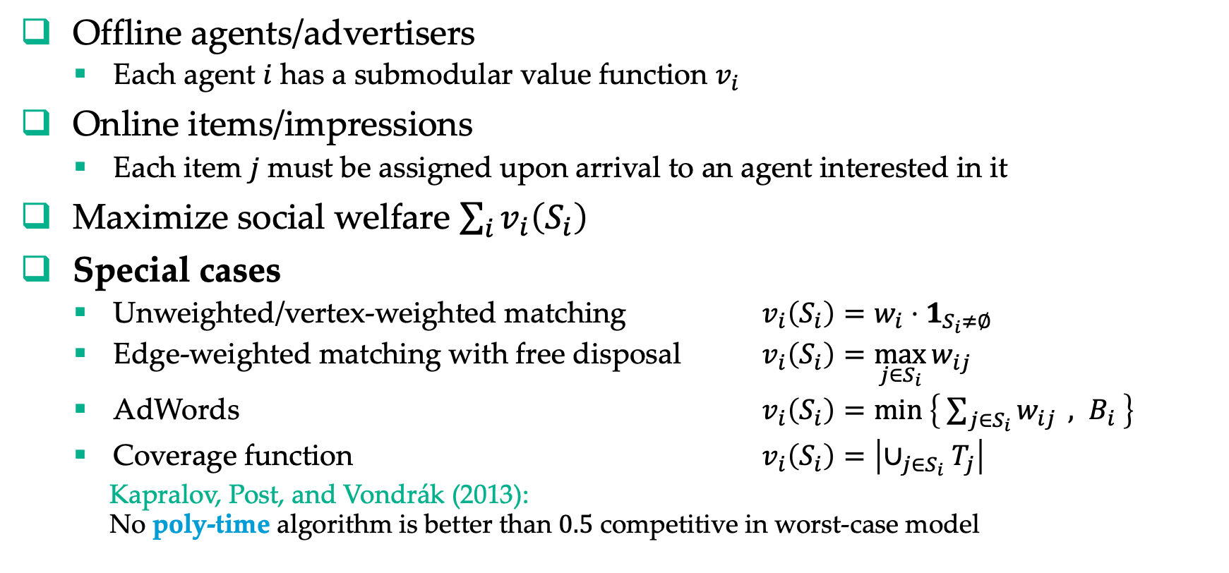
Online Submodular Welfare Maximization (SWM)
Offline agents/advertisers
  Each agent $i$ has a submodular value function $v_{i}$
Online items/impressions
  Each item $j$ must be assigned upon arrival to an agent interested in it
Maximize social welfare $\sum_{i}{v_{i}\left(S_{i}\right)}$
Special cases
  Unweighted/vertex-weighted matching $v_{i}\left(S_{i}\right)=w_{i}⋅1_{S_{i}≠∅}$
  Edge-weighted matching with free disposal $v_{i}\left(S_{i}\right)=\max_{j∈S_{i}}{w_{ij}}$
  AdWords $v_{i}\left(S_{i}\right)=\min\left\{ \sum_{j∈S_{i}}{w_{ij}} , B_{i} \right\}$
  Coverage function $v_{i}\left(S_{i}\right)=\left|∪_{j∈S_{i}}T_{j}\right|$
  Kapralov, Post, and Vondrák (2013):
  No poly-time algorithm is better than $0.5$ competitive in worst-case model

Slide 21
Online Submodular Welfare Maximization and
Online Labor Markets
Aouad and Saban (2023)
Offline vertices are jobs/suppliers
Online vertices are free lancers/customers
When a customer arrives, recommended to a supplier
  Original paper considers a harder assortment optimization version
At the end, each supplier choose a customer (or staying unmatched)
by the multinomial logit and nested logit choice models
  Original paper considers a harder model with suppliers’ departures
Platform aims to maximize match size
This is a special case of Submodular Welfare Maximization!

Slide 22
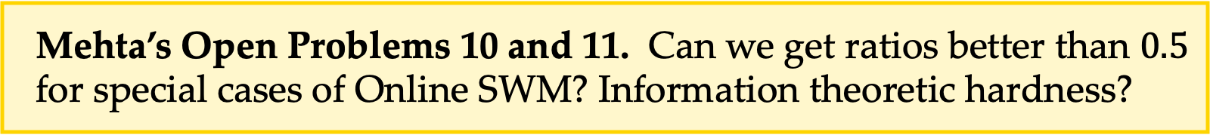
Open Problem. What is the “correct definition” of edge-weighted OCS? Can we remove the notions of gaps?
Open Problem. What is the “correct definition” of AdWords OCS? Can we remove the cap on number of appearances?
Open Problem. Is there be an OCS for general coverage functions, e.g., assuming an oracle that can solve max coverage problem?
Mehta’s Open Problems 10 and 11. Can we get ratios better than $0.5$ for special cases of Online SWM? Information theoretic hardness?

Slide 23
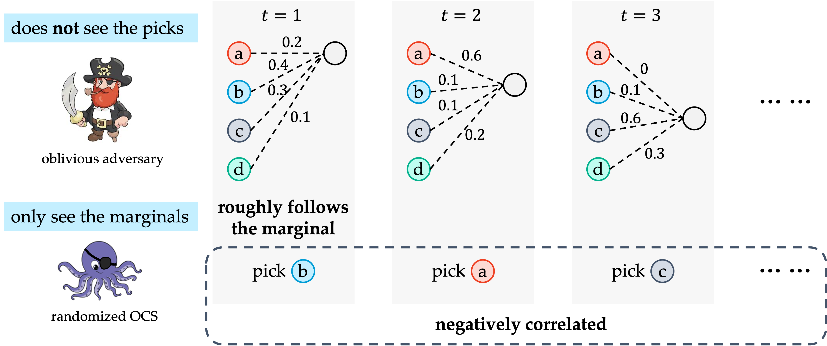
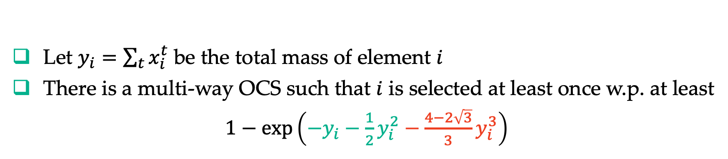
A Glimpse of Multi-Way OCS
Gao, He, Huang, Nie, Yuan, and Zhong (2021)
Let $y_{i}=\sum_{t}{x_{i}^{t}}$ be the total mass of element $i$
There is a multi-way OCS such that $i$ is selected at least once w.p. at least
$1−\exp\left(−y_{i}−\frac{1}{2}y_{i}^{2}−\frac{4−2\sqrt{3}}{3}y_{i}^{3}\right)$

Slide 24
Summary of Online Correlated Selection
OCS is a more flexible way to design online matching algorithms
  Edge-weighted matching with free disposal (a.k.a., Display Ads)
  AdWords
  Online stochastic matching (see Part II by Zhihao)
  Reusable resources
  Delong, Farhadi, Niazadeh, and Sivan (2022), see also Udwani (2022)
  Class fairness in online matching
  Hosseini, Huang, Igarashi, and Shah (2023)
Still many open problems, some regarding basic definitions
See also another line of rounding algorithms for matching by David Wajc
Cohen and Wajc (2018)
Buchbinder, Naor, and Wajc (2023)
Naor, Srinivasan, and Wajc (2023)

Slide 25
Today’s Agenda
Basics of Online Matching
Online Correlated Selection
General Arrival Models
Other Progress and Outro

Slide 26


Ride Hailing
Both sides are online

Slide 27

Ride Sharing
It is not even bipartite

Slide 28

Mehta’s Open Problems 19. Can we beat $0.5$ in a model of online matching with arrivals and departures?
Open Problem from Karp, Vazirani, and Vazirani (1990).
Is Ranking optimal for non-bipartite graphs?

Slide 29
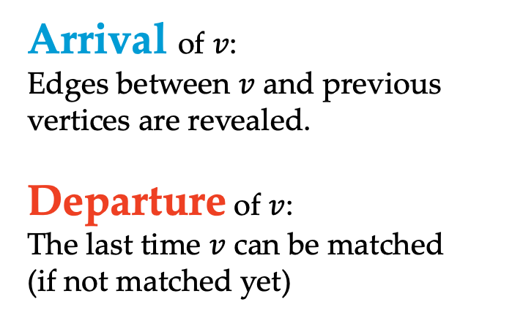
Fully Online Matching / Online Windowed Matching
Huang, Kang, Tang, Wu, Zhang, and Zhu (2018)
Ashlagi, Burq, Dutta, Jaillet, Saberi, and Sholley (2019)
Arrival of $v$:
Edges between $v$ and previous vertices are revealed.
Departure of $v$:
The last time $v$ can be matched
(if not matched yet)
Fully Online Matching Unweighted, arbitrary arrival/departure
Online Windowed Matching Edge-weighted, FIFO

Slide 30
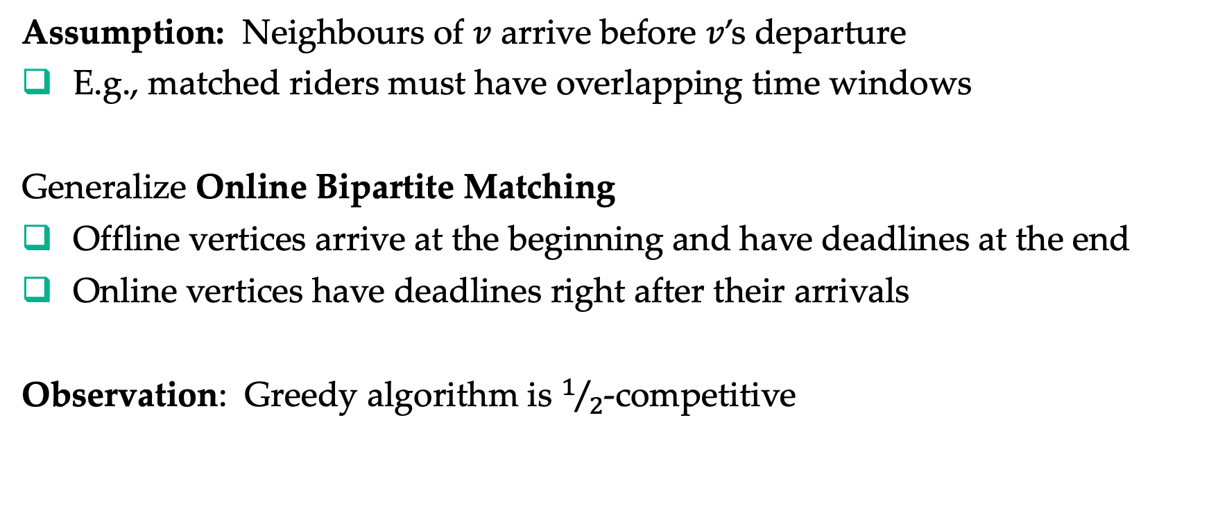
Fully Online Matching / Online Windowed Matching
Huang, Kang, Tang, Wu, Zhang, and Zhu (2018)
Ashlagi, Burq, Dutta, Jaillet, Saberi, and Sholley (2019)
Assumption: Neighbours of $v$ arrive before $v$’s departure
E.g., matched riders must have overlapping time windows
Generalize Online Bipartite Matching
Offline vertices arrive at the beginning and have deadlines at the end
Online vertices have deadlines right after their arrivals
Observation: Greedy algorithm is $1/2$-competitive
Notes:
One-side model is special case.

Slide 31
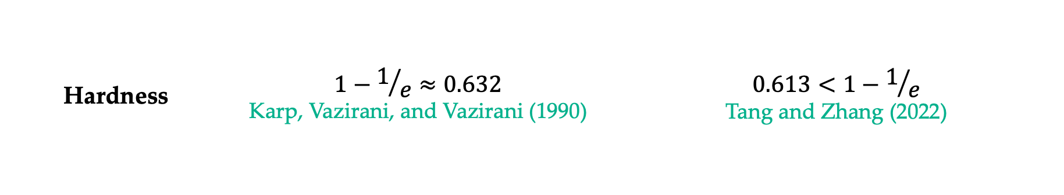
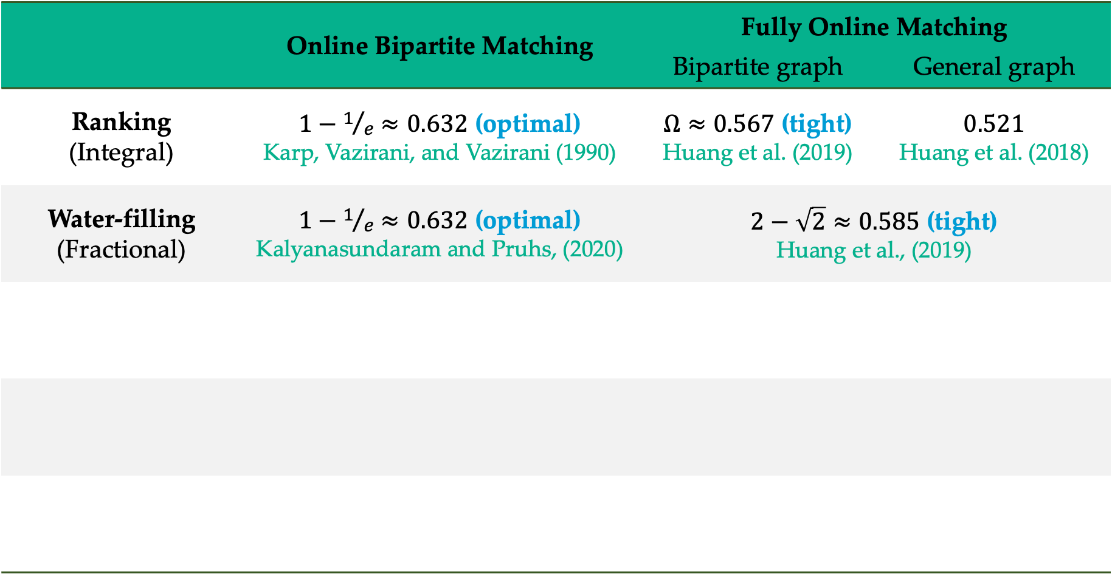
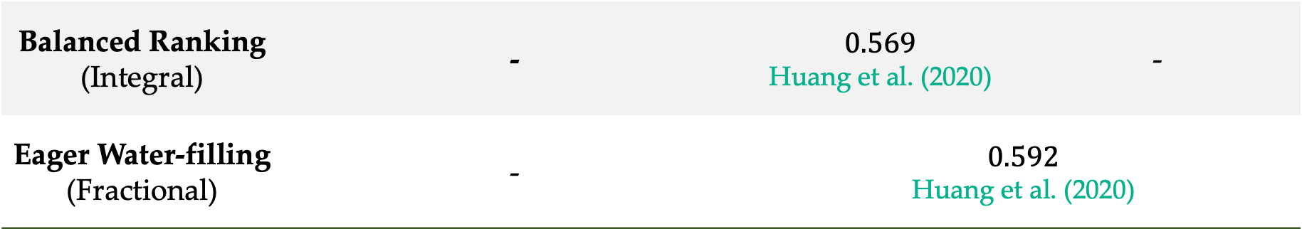
 | Online Bipartite Matching | Fully Online Matching
 |  | Bipartite graph | General graph | General graph
Ranking (Integral) | $1−1/e≈0.632$ (optimal) Karp, Vazirani, and Vazirani (1990) | $Ω≈0.567$ (tight) Huang et al. (2019) | $$0.521$$ [Huang et al., 2018] | $$0.521$$ Huang et al. (2018)
Water-filling (Fractional) | $1−1/e≈0.632$ (optimal) Kalyanasundaram and Pruhs, (2020) | $2−\sqrt{2}≈0.585$ (tight) Huang et al., (2019)
Hardness | $$1−1/e≈0.632$$ $$\text{Karp}\text{, }\text{Vazirani}\text{, }\text{and} \text{Vazirani}\text{ (1990)}$$ | $$0.613<1−1/e$$ Tang and Zhang (2022)
Balanced Ranking (Integral) | - | $$0.569$$ Huang et al. (2020) | -
Eager Water-filling (Fractional) | - | $$0.592$$ Huang et al. (2020)

Slide 32

Ranking in Fully Online Matching
$0.4
$0.25
$0.8
$0.25
Arrival of $v$:
$v$ draws rank/quantile $q_{v}∈[0, 1]$
and sets price $p_{v}= p\left(q_{v}\right)$
Departure of $v$:
$v$ picks best offer
$0.75
$0.65

Slide 33

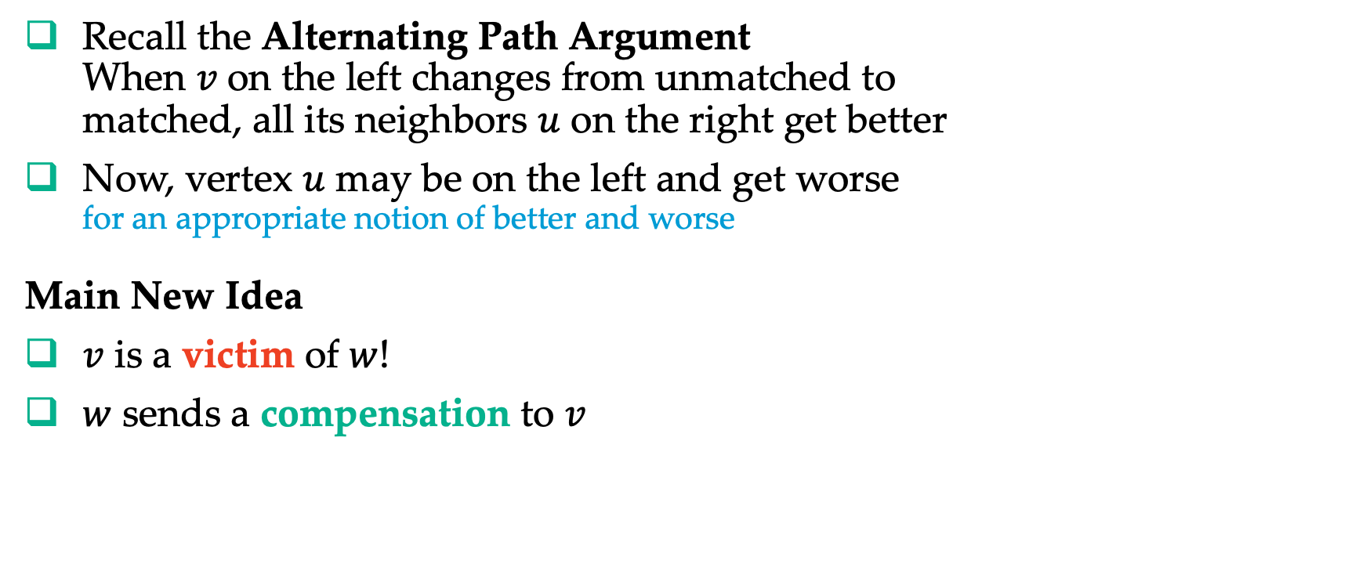



Fully Online Matching on General Graphs
$$v$$
$$w$$
Recall the Alternating Path Argument
When 𝑣 on the left changes from unmatched to
matched, all its neighbors $u$ on the right get better
Now, vertex $u$ may be on the left and get worse
for an appropriate notion of better and worse
Main New Idea
$v$ is a victim of $w$!
$w$ sends a compensation to $v$
$$u$$
…
Tang, Wu, and Zhang (2020) used this idea to get an improved randomized greedy matching algorithm, resolving Mehta’s Open Question 15.

Slide 34
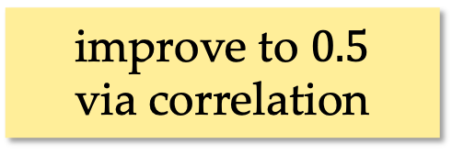
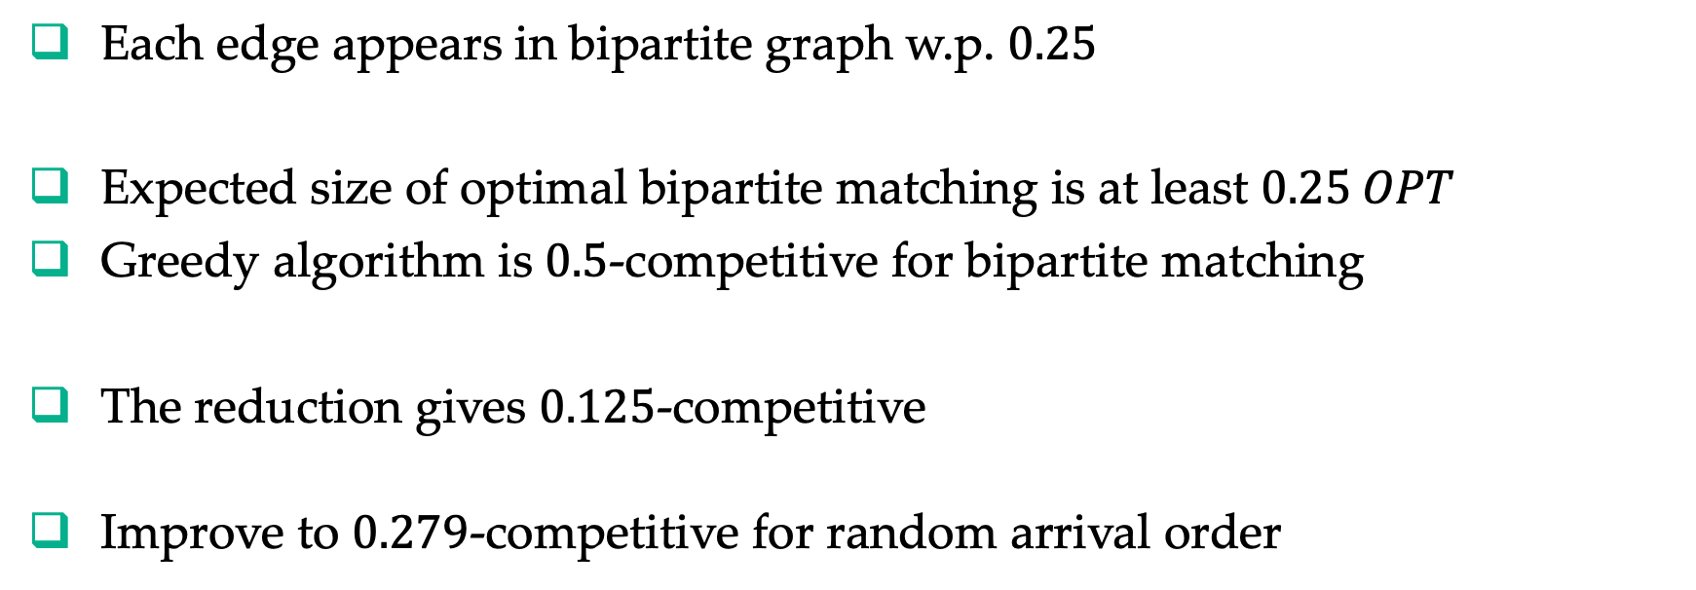
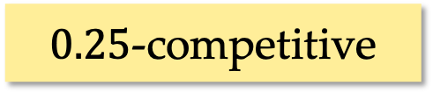
Online Windowed Matching
Ashlagi, Burq, Dutta, Jaillet, Saberi, and Sholley (2019)
Randomly place each vertex on left (seller) or right (buyer)
Keep an edge if earlier vertex on left, and later one on right
improve to $0.5$
via correlation
Each edge appears in bipartite graph w.p. $0.25$
Expected size of optimal bipartite matching is at least $0.25 OPT$
Greedy algorithm is $0.5$-competitive for bipartite matching
The reduction gives $0.125$-competitive
Improve to $0.279$-competitive for random arrival order
$0.25$-competitive

Slide 35
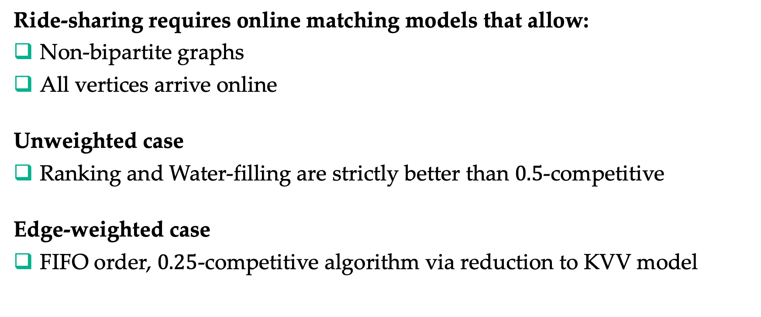
Summary of Fully Online Matching and
Online Windowed Matching
Ride-sharing requires online matching models that allow:
Non-bipartite graphs
All vertices arrive online
Unweighted case
Ranking and Water-filling are strictly better than $0.5$-competitive
Edge-weighted case
FIFO order, $0.25$-competitive algorithm via reduction to KVV model
Fully Online Matching
Huang, Kang, Tang, Wu, Zhang, and Zhu (2018)
Huang, Tao, Tang, Peng, Wu, and Zhang (2019)
Huang, Tang, Wu, and Zhang (2020)
Windowed Online Matching
Ashlagi, Burq, Dutta, Jaillet, Sholley, and Saberi (2019)

Slide 36
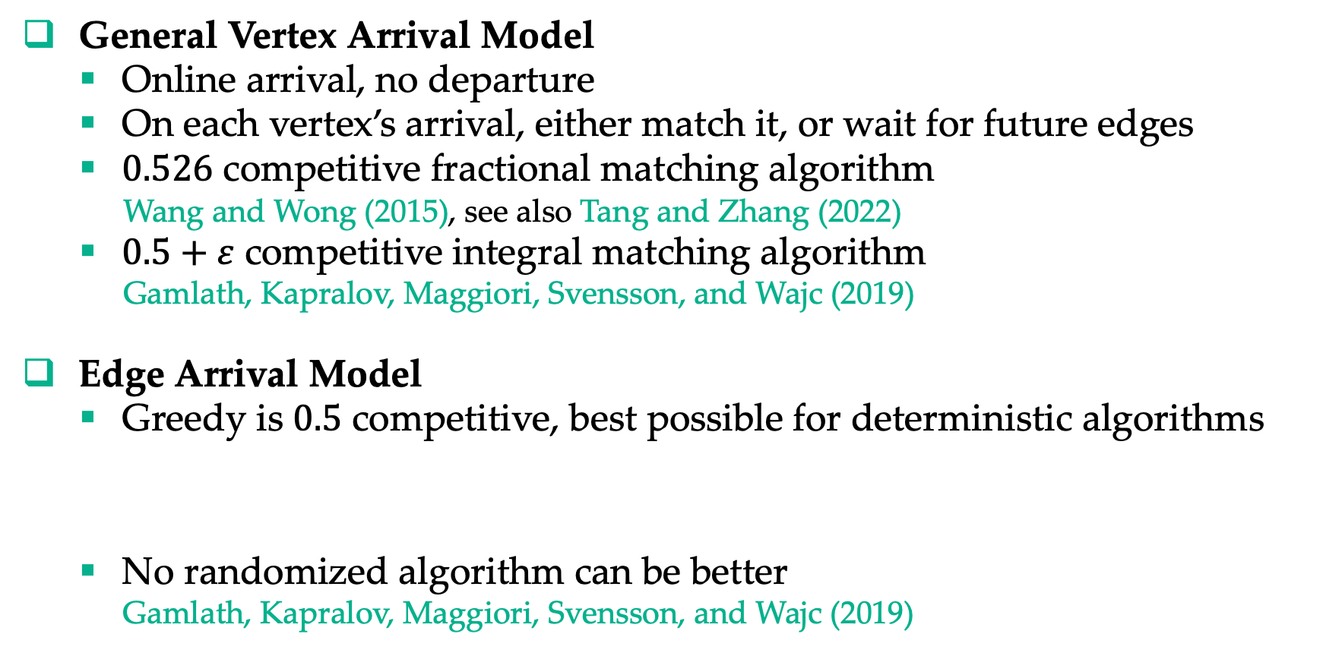
Other Arrival Models
General Vertex Arrival Model
  Online arrival, no departure
  On each vertex’s arrival, either match it, or wait for future edges
  $0.526$ competitive fractional matching algorithm
  Wang and Wong (2015), see also Tang and Zhang (2022)
  $0.5+ε$ competitive integral matching algorithm
  Gamlath, Kapralov, Maggiori, Svensson, and Wajc (2019)
Edge Arrival Model
  Greedy is $0.5$ competitive, best possible for deterministic algorithms
  No randomized algorithm can be better
  Gamlath, Kapralov, Maggiori, Svensson, and Wajc (2019)
Mehta’s Open Problems 17. Can randomization help?

Slide 37
Today’s Agenda
Basics of Online Matching
Online Correlated Selection
General Arrival Models
Other Progress and Outro

Slide 38
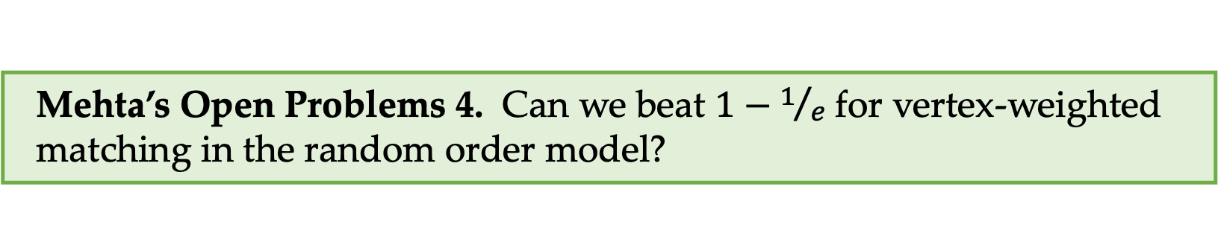
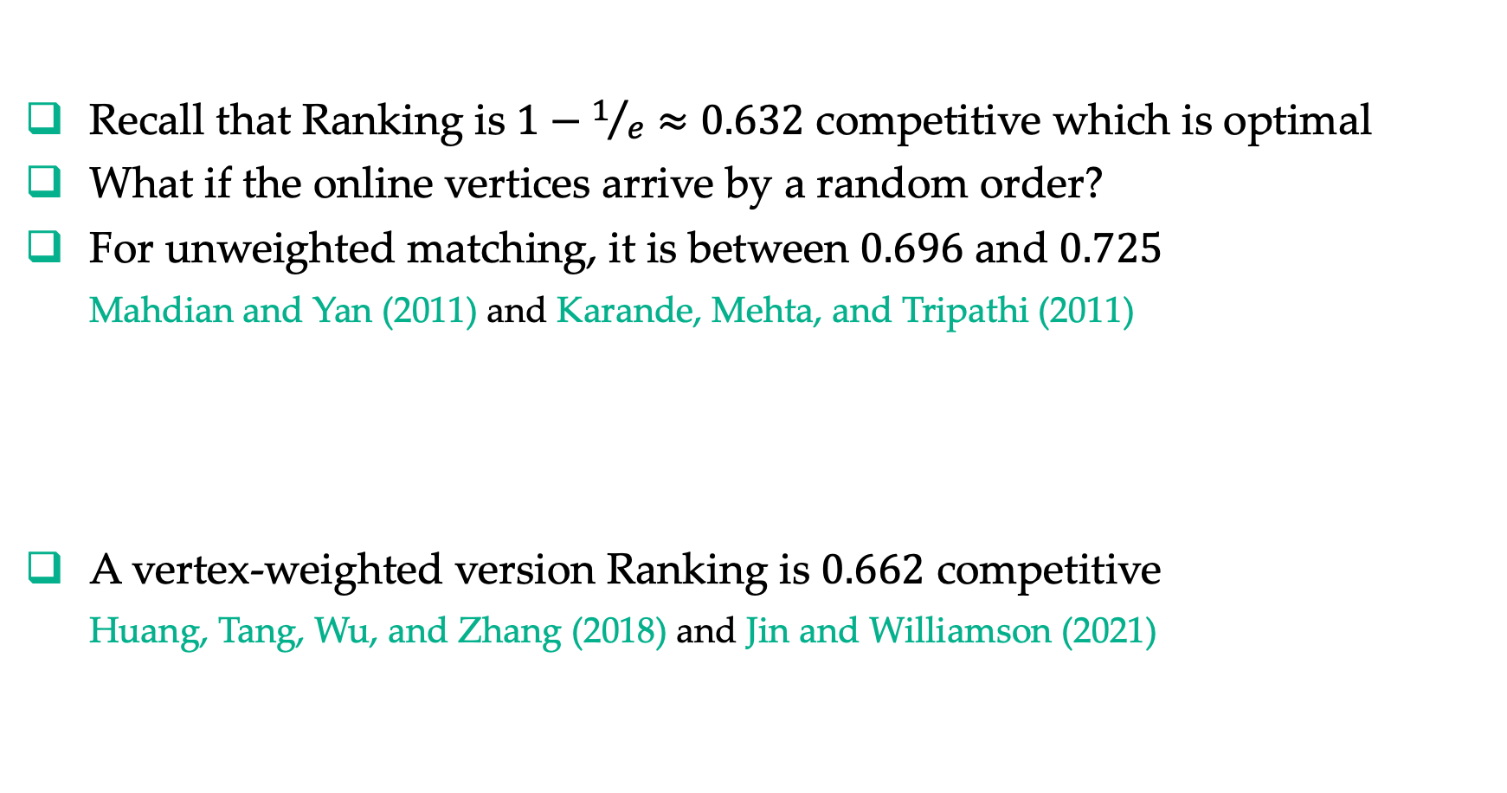
Random Arrival Order Model
Recall that Ranking is $1−1/e≈0.632$ competitive which is optimal
What if the online vertices arrive by a random order?
For unweighted matching, it is between $0.696$ and $0.725$
Mahdian and Yan (2011) and Karande, Mehta, and Tripathi (2011)
A vertex-weighted version Ranking is $0.662$ competitive
Huang, Tang, Wu, and Zhang (2018) and Jin and Williamson (2021)
Mehta’s Open Problems 4. Can we beat $1−1/e$ for vertex-weighted matching in the random order model?

Slide 39
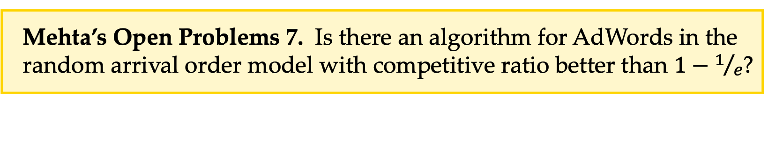
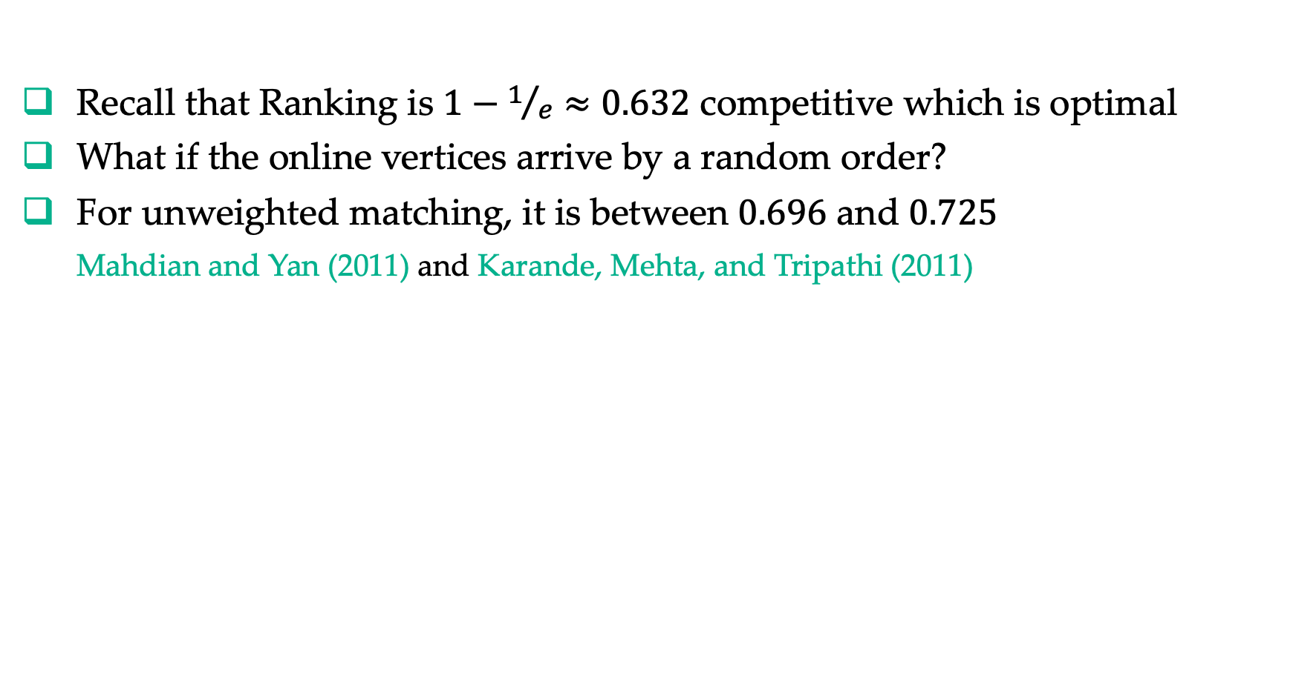
Random Arrival Order Model
Recall that Ranking is $1−1/e≈0.632$ competitive which is optimal
What if the online vertices arrive by a random order?
For unweighted matching, it is between $0.696$ and $0.725$
Mahdian and Yan (2011) and Karande, Mehta, and Tripathi (2011)
Mehta’s Open Problems 1. Close the gap for unweighted matching.
Mehta’s Open Problems 7. Is there an algorithm for AdWords in the random arrival order model with competitive ratio better than $1−1/e$?

Slide 40
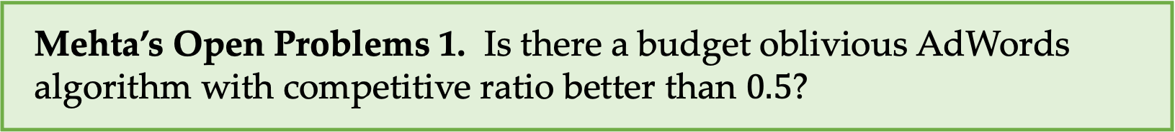
AdWords with Unknown Budget
Mehta’s Open Problems 1. Is there a budget oblivious AdWords algorithm with competitive ratio better than $0.5$?
Practical motivation: Using less information is more robust
Theoretical motivation: Relation to stochastic rewards model
(see Part II by Zhihao)
Udwani (2023) gave a 0.522 competitive algorithm for small bids

Slide 41
Outro
Online matching is still going strong, 30+ years after Karp, Vazirani, and Vazirani (1990), and 10 years after Mehta (2013)
Techniques
  New aspects of the randomized online primal dual framework
  (e.g., victim and compensation, time-dependent prices in random order model)
  Online correlated selection (more broadly, online rounding for matching)
Models
  Ride hailing/sharing General arrival models
  Cloud computing Reusable resources
  Online labor market Online submodular welfare maximization
  Assortment optimization
  Kidney exchange Stochastic models (see Part II)
Thank You! Questions?

